Slide 1

Title here
Write a great subtitle here

Slide 2
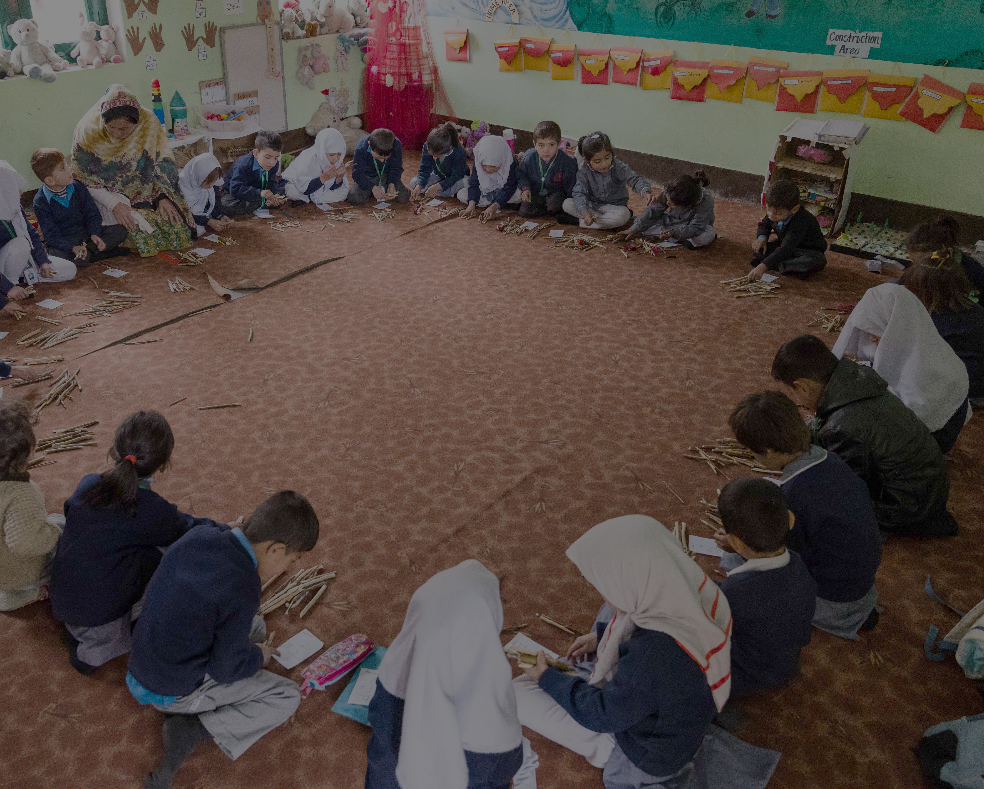
How to Use this Template
Build the visuals for your presentation here.
1
    Match the visual slides to the presentation script slides. Add your presentation notes into the notes section of the slides in this deck.
2
    Use the suggestions for each slide to select images to share. Be sure to delete the suggestions and edit the titles before you finalize your slide deck.
Notes:
Sources

Slide 3

Welcome Message
Suggested time: 1 minute | The slide you present to your audience for The Welcome Message should include pictures of your school and community.

Slide 4
The Challenge
What is the problem that you want to solve?
Suggested time: 1 minute | The slide you present to your audience for The Challenge should include pictures of your school and community.

Slide 5
The Idea
How will you solve the problem?
Suggested time: 1 minute | The slide you present to your audience for The idea should include pictures of your students and your micro-innovation.

Slide 6
Design Process | Empathy
What did you learn from those you interviewed?
Suggested time: 1 minute | The slide you present to your audience for The Design Process – Empathy should include pictures of the specific stakeholder you are focusing on.

Slide 7
Prototyping and Testing
So we created…
and we learned…
Suggested time: 1-2 minutes | The slide you present to your audience for The Design Process – Prototyping and Testing should include pictures of testing your prototypes.

Slide 8
About Your Innovation
How will you implement your innovation?
Suggested time: 1-2 minutes | The slide you present to your audience for About Your Innovation should include pictures of testing your prototypes.

Slide 9
Creating Positive Change
How will you know if your idea is successful?
Suggested time: 1 minute | The slide you present to your audience for Creating Positive Change should include pictures of your students.

Slide 10
Call to Action
What support do you need?
Suggested time: 1 minute | The slide you present to your audience for the Call to Action slide should include pictures of your students.

Slide 11
The Closing
Share your visionary statement about the possibilities you see for your students if you innovation is successful.
Suggested time: 1 minute | The slide you present to your audience for The Closing should include pictures of your school and community.

Slide 13
OPTIONAL TEMPLATE
Write a great subtitle here
A company is an association or collection
of individuals, whether natural persons, legal persons,
or a mixture of both. Company members share a common purpose and unite in order to focus their various talents and organize their collectively available skills or resources to achieve specific, declared goals.
Because companies are legal persons, they also may associate and register themselves as companies – often known as a corporate group. When the company closes
it may need

Slide 14
OPTIONAL TEMPLATE
Write a great subtitle here
A company is an association or collection
of individuals, whether natural persons, legal persons, or a mixture of both. Company members share a common purpose and unite in order to focus their various talents and organize their collectively available skills or resources to achieve specific, declared goals.
Because companies are legal persons, they also may associate and register themselves as companies – often known as a corporate group. When the company closes
it may need

Slide 15
OPTIONAL TEMPLATE
Write a great subtitle here
A company is an association or collection
of individuals, whether natural persons, legal persons,
or a mixture of both. Company members share a common purpose and unite in order to focus their various talents and organize their collectively available skills or resources to achieve specific, declared goals.
Because companies are legal persons, they also may associate and register themselves as companies – often known as a corporate group. When the company closes
it may need

Slide 16
OPTIONAL TEMPLATE
Write a great subtitle here
A company is an association or collection
of individuals, whether natural persons, legal persons,
or a mixture of both. Company members share a common purpose and unite in order to focus their various talents and organize their collectively available skills or resources to achieve specific, declared goals.
Because companies are legal persons, they also may associate and register themselves as companies – often known as a corporate group. When the company closes
it may need

