Slide 1


The Girls With Tools Project.
By JAMILA MAYANJA

Slide 2
THE PROBLEM
Recent data shows that only 53% of girls aged 6-12 are reported to complete the required seven years of primary education, and merely 22.5% of the female Ugandan population as a whole enroll in secondary education. The male-dominated society in Uganda also poses problems for girls who are able to pursue an education mostly in STEM subjects.

Slide 3
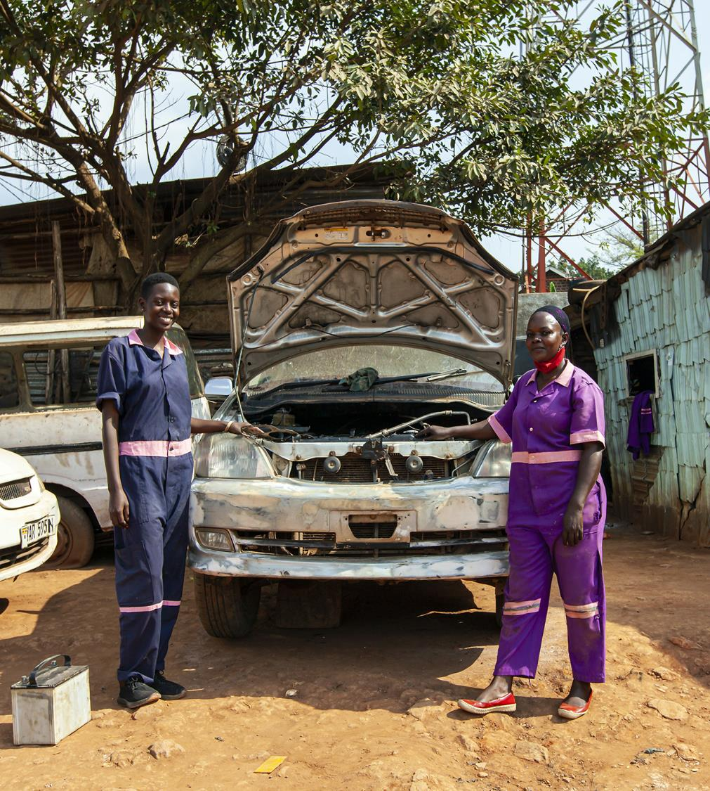
Girls like…
Sharifa – ‘ I was married off at the age of 14 because my parents wanted money to take my brothers to school.’
Hope – ‘After my secondary 4 my single mother wanted me to start learn tailoring skills’

Slide 4
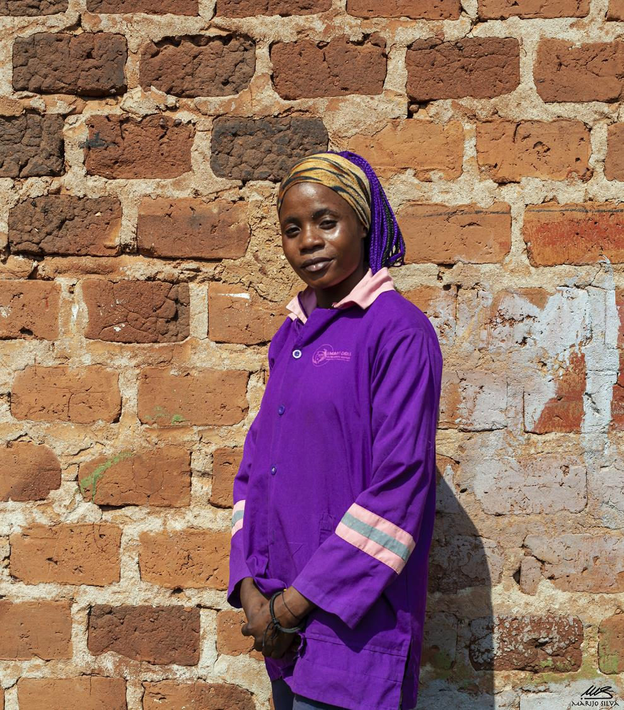
Girls like…
Britiney – ‘ My single mother did not have enough money to keep me in school beyond S.4, She wanted me to work in the saloon with her so that I can attract a potential husband’

Slide 5
THE GIRLS WITH TOOLS
A skilling program training young vulnerable women in the traditional male dominated skills to socially and economically empower vulnerable young women through models of STEM skills development in order to increase their employability and their earning potential.
Our biggest number of girls are skilled in mechanical and electrical engineering

Slide 6
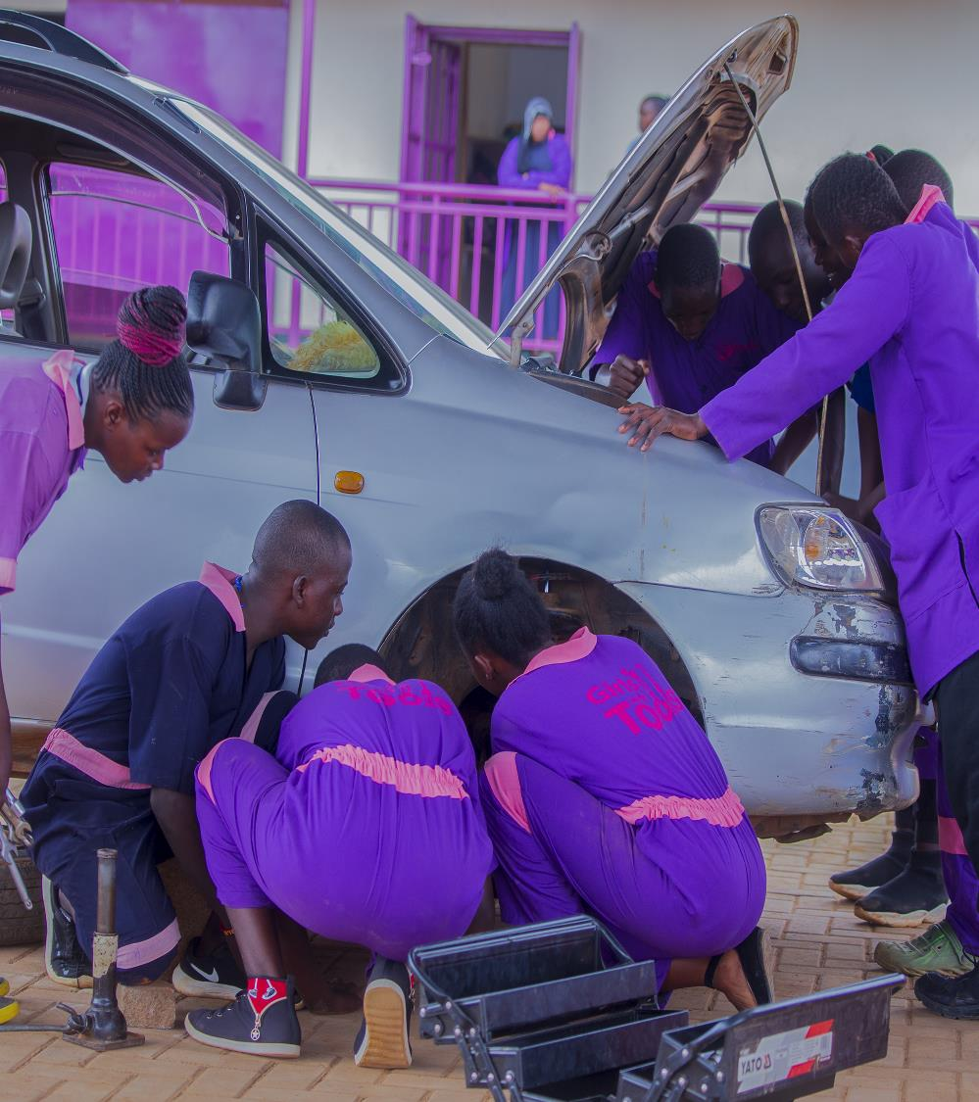
Girls with Tools
A practical Automotive engineering class going on for our 2nd year UBTEB class.

Slide 7
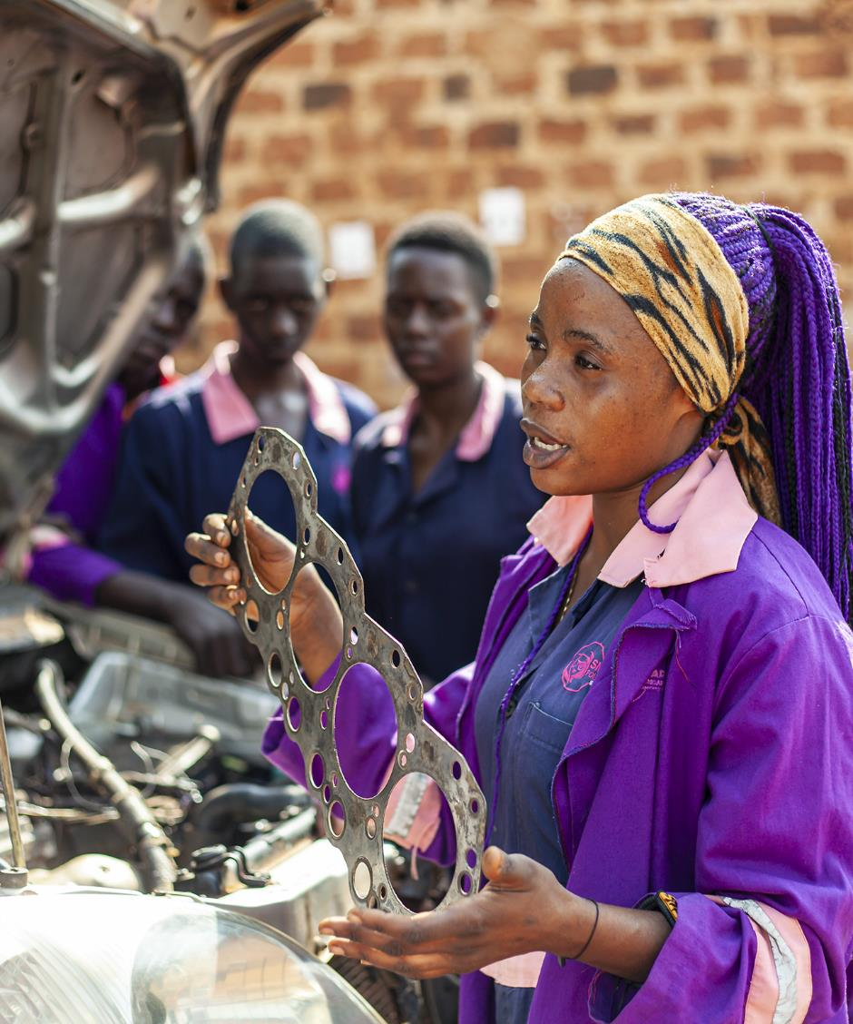
Girls with Tools
‘Britiney explaining to her peers parts found in a car.’

Slide 8
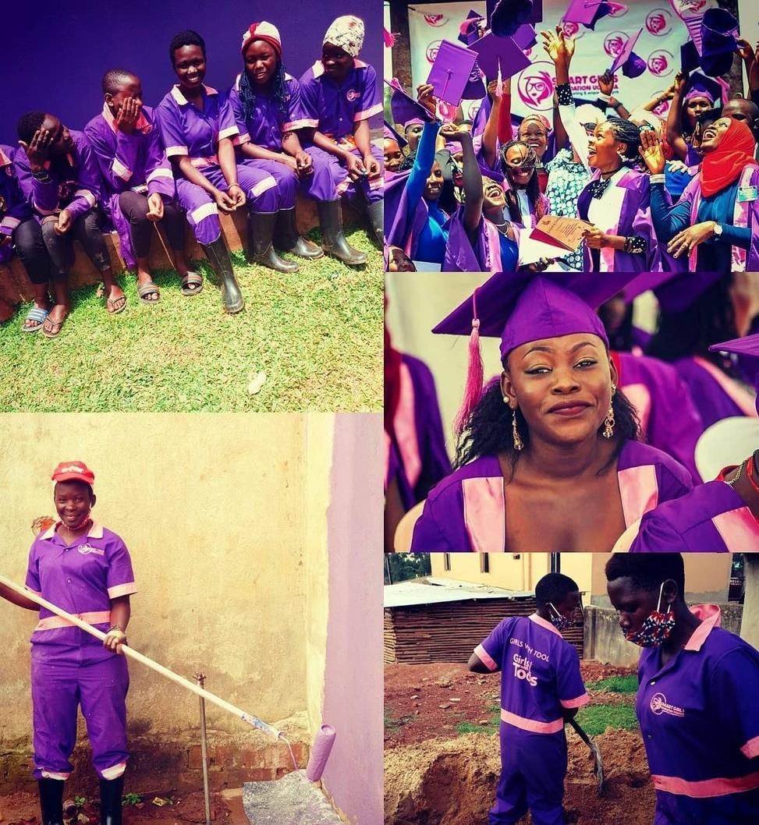
Girls with Tools
- We have them certified and graduated.
- Connected to jobs & host their workshops/businesses.

Slide 9
HCD ASSESSMENT SHOWED ANOTHER PROBLEM…
Despite the success of skilling through the girls with tools, our alumni were not successfully practicing the skills gained in the field because they lacked tools to use while in the workshop.
How might we help our alumni execute jobs in the field

Slide 10
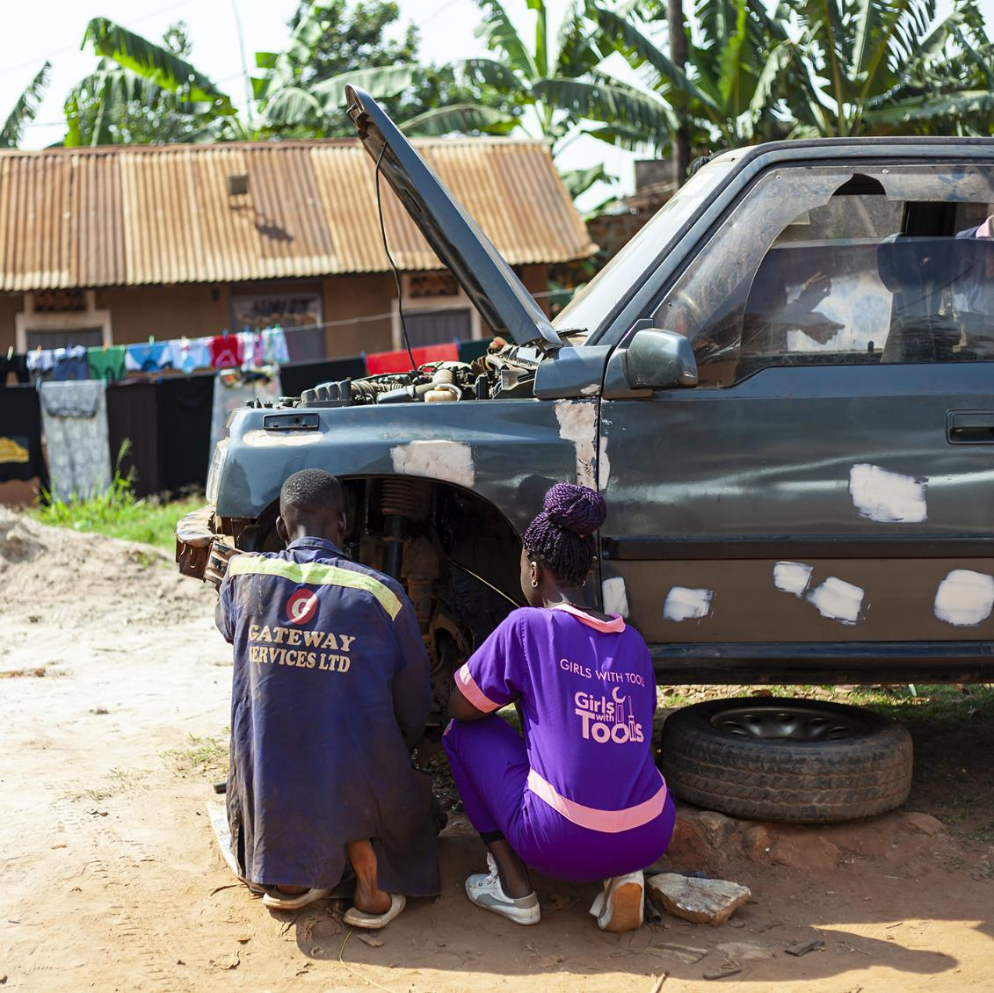
HOW MIGHT WE HAVE ALUMNI ACCESS AFFORDABLE TOOLS IN THE FEILD?

Slide 11
THE HCD SOLUTION
The solution to the above problem is The Tools Library.
Through the FRF resources, Smart girls purchased a set of tools that girls borrow at no cost, use to do the car repair work and return. This has greatly solved the lack of tools.
However, the girls still have some skills gaps which they only discovered on the job. To address this, Smart girls designed a mentorship database that the girls could reach-out to support with skills gaps but also provide advise on how to counter challenges like bullying at work.
Furthermore, Smart girls has secured internship opportunities with DSTV, Mantrac and MTN Uganda to allow the girls practice their skills and get exposed to modern equipment

Slide 12
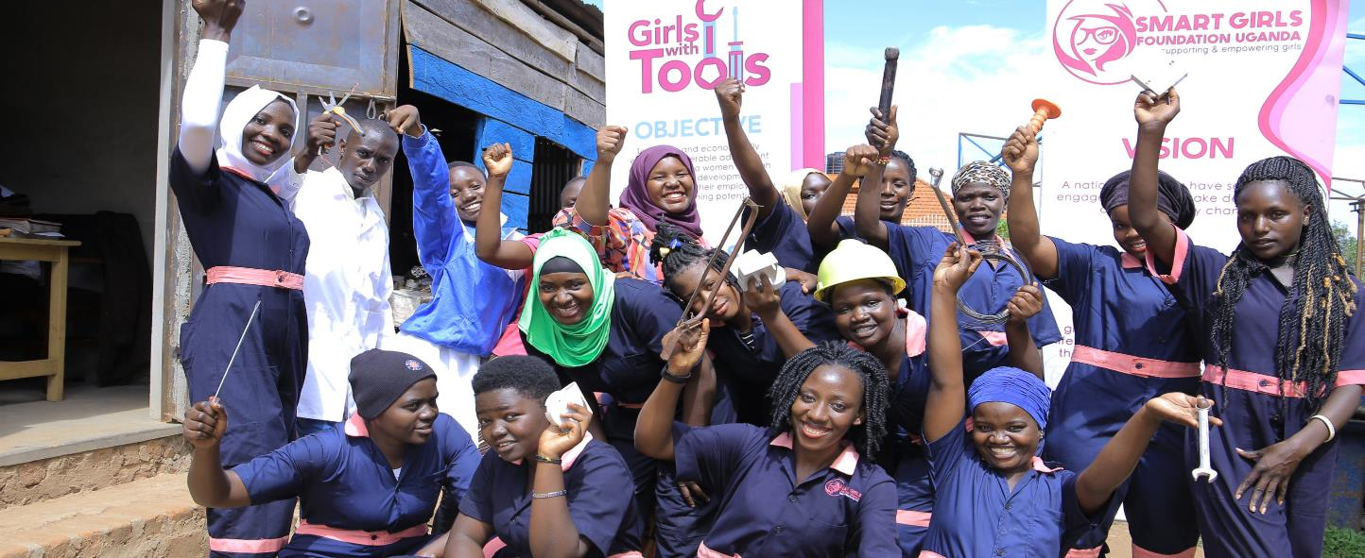
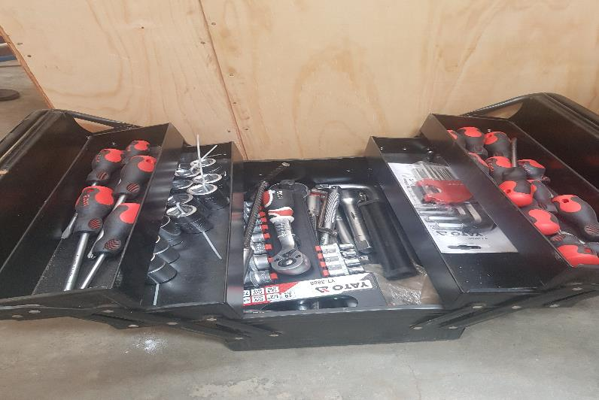
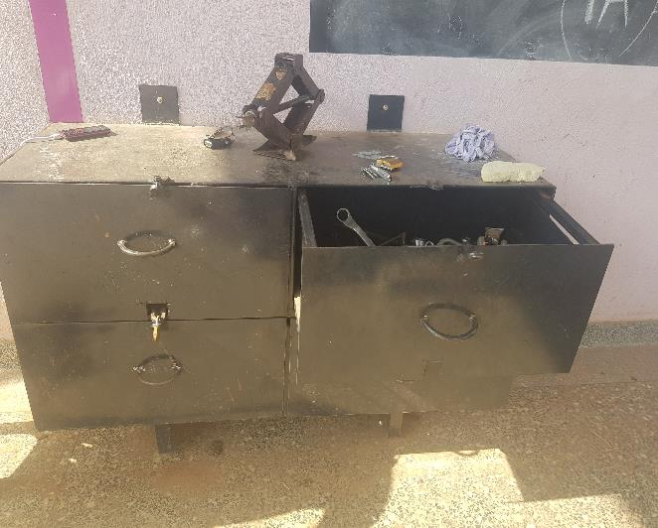

Slide 13
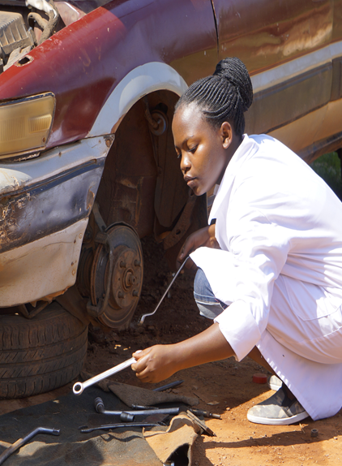
JACKIE USING THE TOOLS FROM THE TOOLS LIBRARY TO FIX A CAR TYRE PROBLEM.

Slide 14
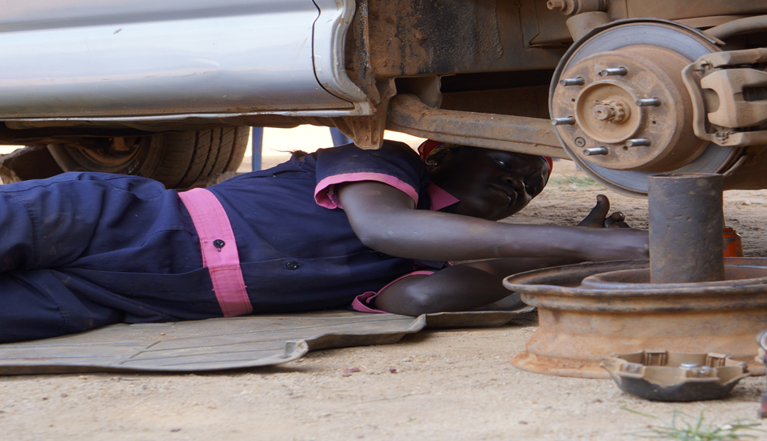
ATIM USING THE TOOLS IN THE FIELD.

Slide 15
WE ASSESSED ANOTHER PROBLEM...
How might we reach girls in remote communities with our girls with tools lessons?

Slide 16
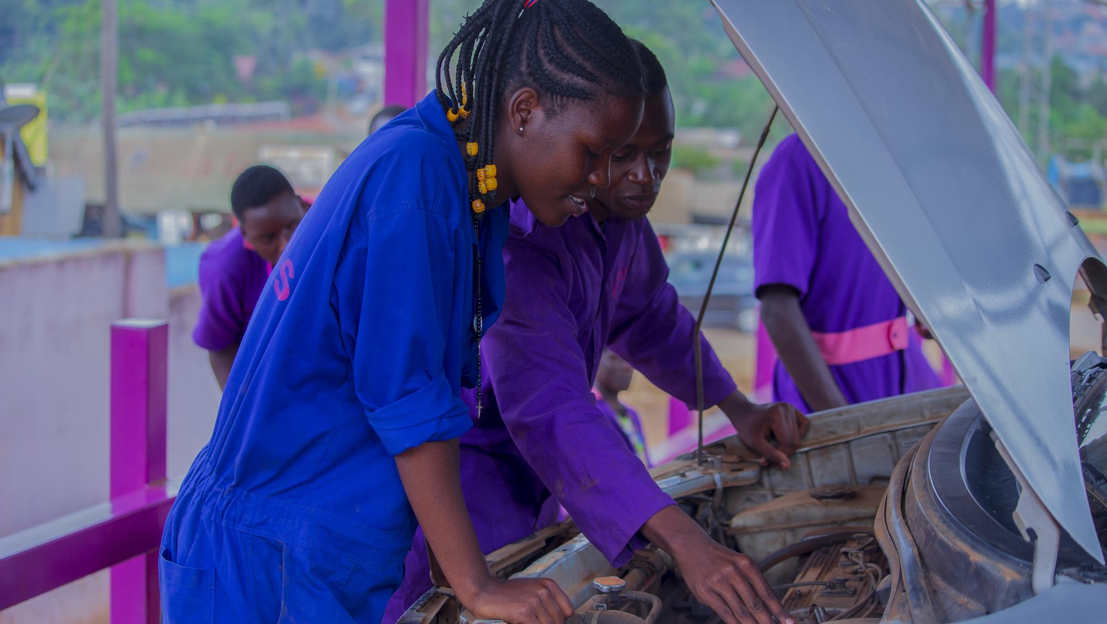

Slide 17
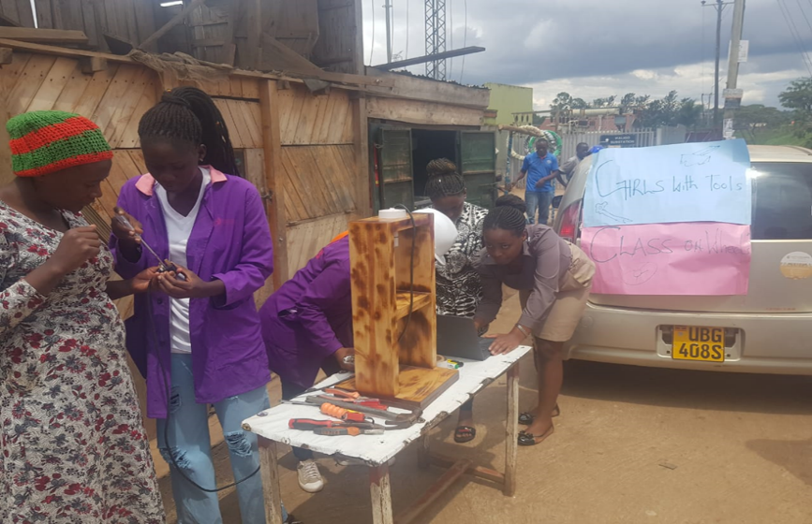
SOLUTION - CLASS ON WHEELS...

Slide 18
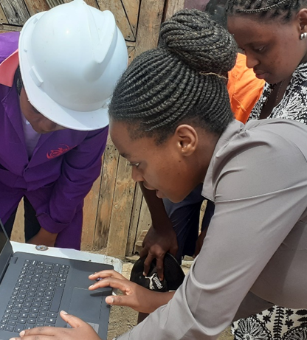
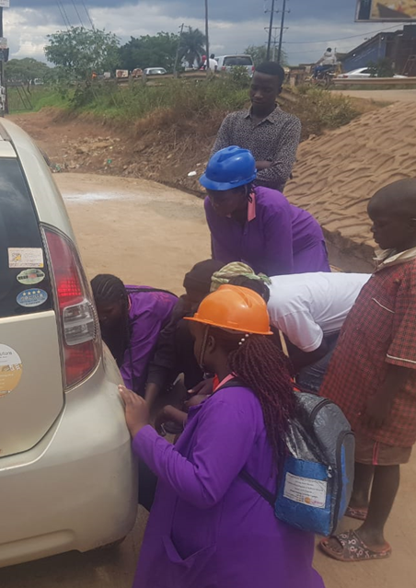

Slide 19
OUR DREAM & CALL TO ACTION…
Looking at the potential of the class of wheels, we can meet the girls where they are and we achieve community by in who now appreciating gender equity within these trades.
We dream of partnerships to make these innovative ideas a mega success and also create a virtual market space to connect more jobs for the girls.
We want to mobile resources to start a girls with tools vocational university. To impact young girls all over the continent in these trades.

Slide 20

Thank You Schools2030, thank you all!

