Slide 1
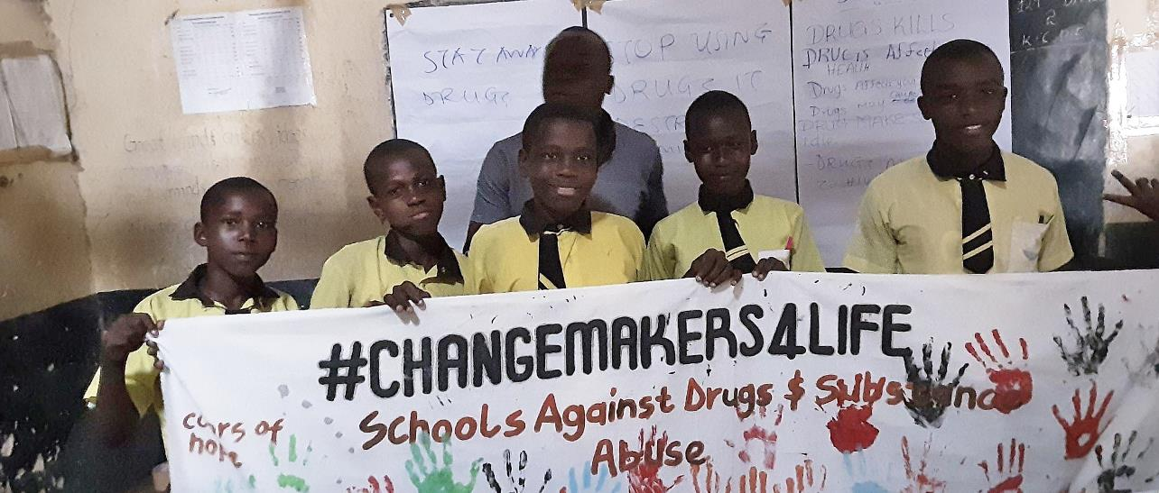


Supporting young people to make healthy life choices
using Schools2030’s Human-Centred Design model
By Alfred Sigo

Slide 2
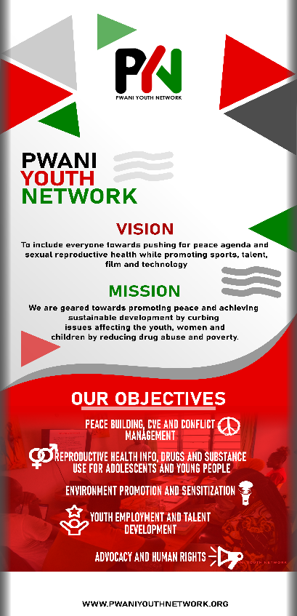
About Pwani
Youth Network
Pwani Youth Network (PYN) is a Community-Based Organization (CBO] Youth network in the Coast of Kenya.
Vision: Kenyan youth progress and prosperity
Mission: Inspiring the dreams of Kenyan youth through positive change
Notes:
How do we get feedback progressively as the session is going one or as they use the toolkit
Tracking process discuissions …

Slide 3
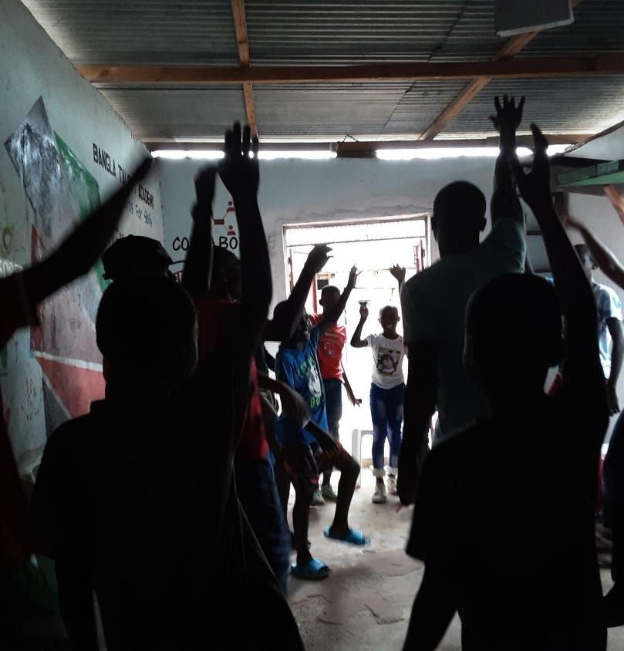



CHANGEMAKER4LIFE
Project

Slide 4
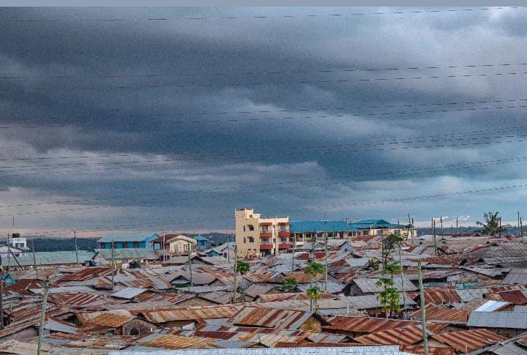



Launch
Bangladesh [slum] is the largest informal settlement in Mombasa, Kenya, and a home to more than 4000 school-going aged young people.
The area has four community schools and one government school.
None of these five schools have a library that can be used by the students.

Slide 5
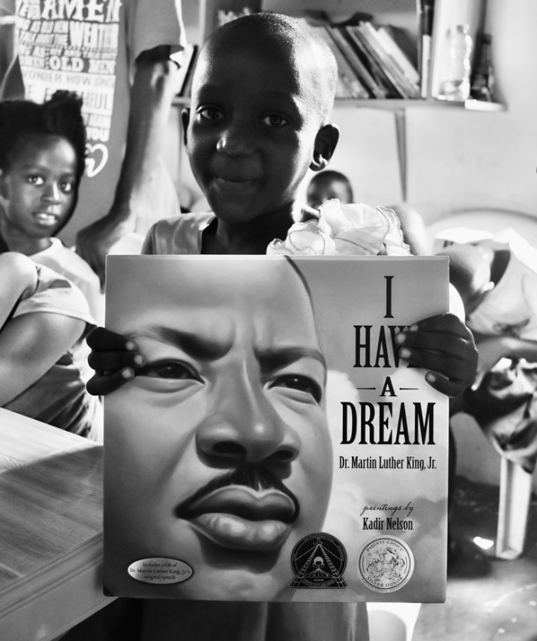
Challenges
1. Inadequate digital skills for our learners
2. Drugs and Substance abuse.
3. Poor parental upbringing.
4. No safe learning spaces in the community
5. The schools do not have culturally responsive books

Slide 6
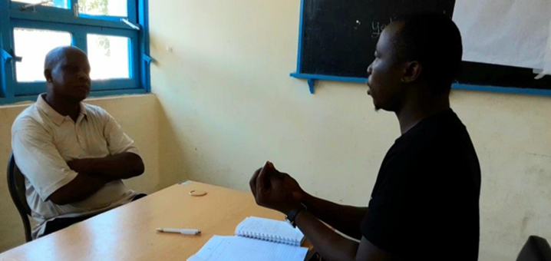
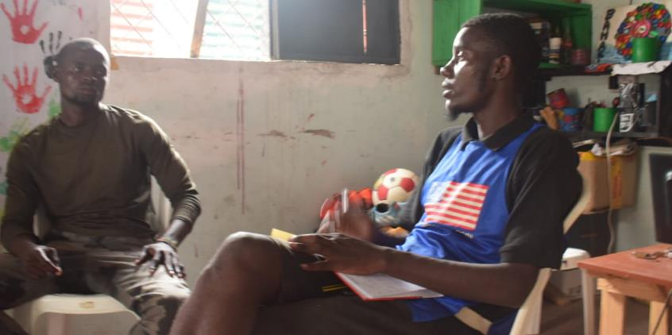
Stakeholders
Mapped
1, Parent to our youth volunteer (Mr Awedhe)
2. A youth (10-24) Fransisca, a resident of Bangladesh Community
3. Religious leader, Pst. Josiah (age 35-44)
4. A teacher at Jerusalem primary school Mr. Fredrick (age 35-44)
5. A community Organizer – Wevyn-Isirika

Slide 7
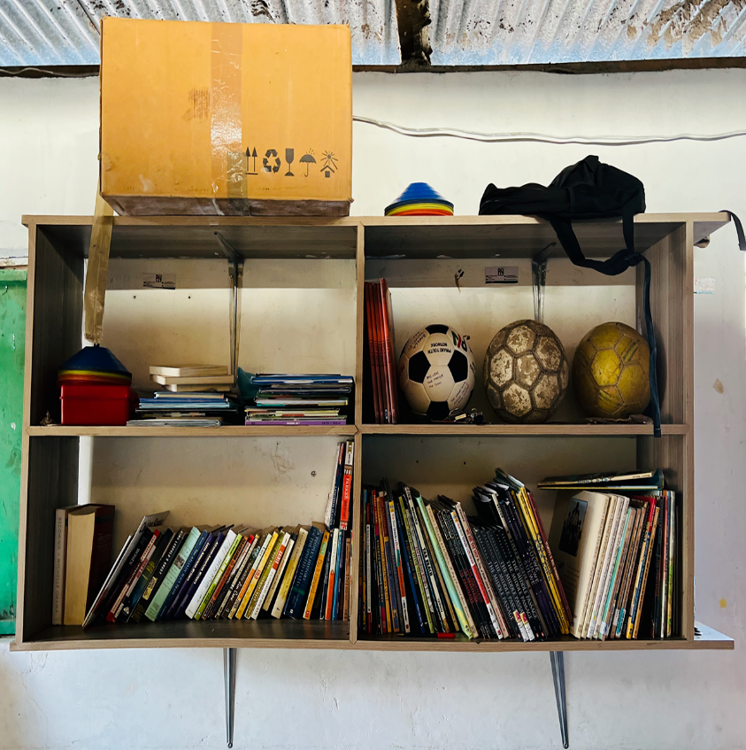
Explore
Teacher Fredrick from Jerusalem school and others says that the leading cause of the low self esteem in his school is inadequate life skills, conflict resolutions mechanisms between children and parents and lastly lack of community safe space for children to engage in as part of the after school program

Slide 8
DEFINE
INFERRED
POV
There are few programs related to life skill after school. We think this is important because without the right information on this matters it will lead to wrong decision making and also the student have low self esteem leading to bad learning outcome.
The learners needed a way to sensitized them on life skill to help them in order for them to make the right decision as they play and learn in the Youths space and hence through the use of art and sports as a way to mobilise them
Parents are having challenges dealing with the children as after school engagement and hence create a safe learning space to learn and play will create a great space for correction decision

Slide 9
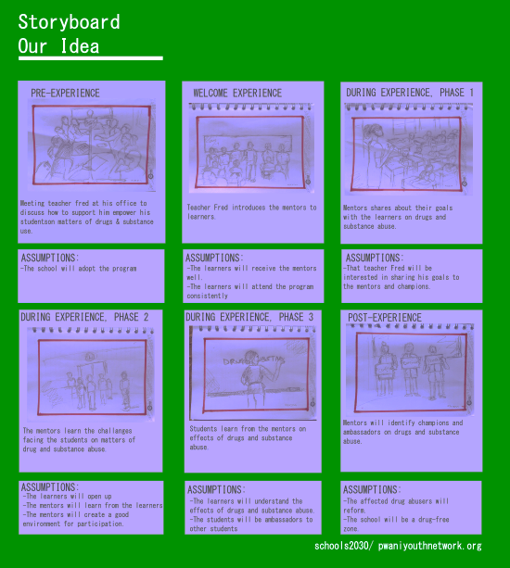
Storyboard
Our Idea

Slide 10
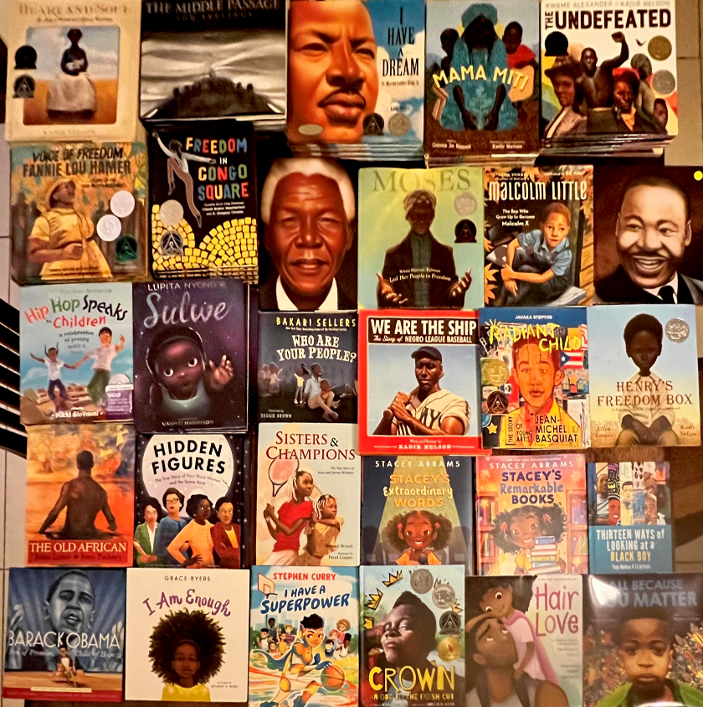
How our POV Connects with HMW
If Fredrick, a teacher from Jerusalem, gets support from the champions and professionals to empower his students, then the challenge he is facing because of low self esteem will be dealt with and the students will get life skills and this will eventually improve their decision-making and taking responsibilities.
If we create a community Micro Library in Bangladesh the children will have an after school engagement through books, art and sports and hence reduce pressure on parents

Slide 11

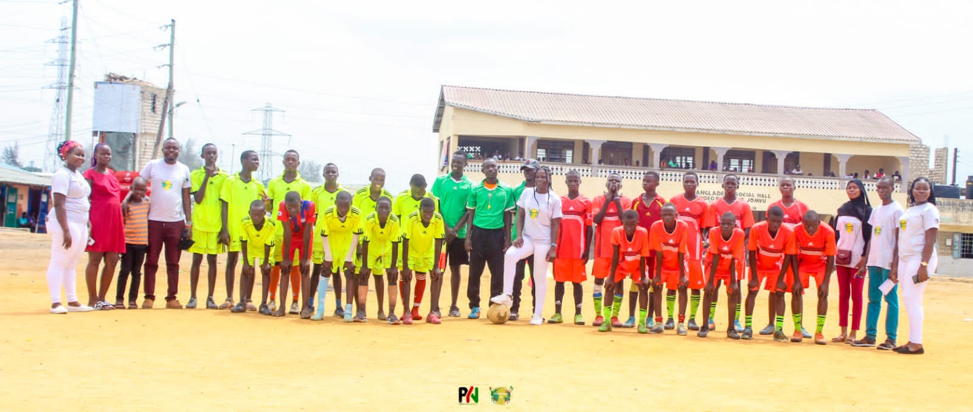
OUR IDEA
​Support Fred as a teacher to empower his learners on life skills by using mentors and professionals in a safe space​. Also leverage on sports, talent showcasing and cultural responsive education through community micro Library.

Slide 12
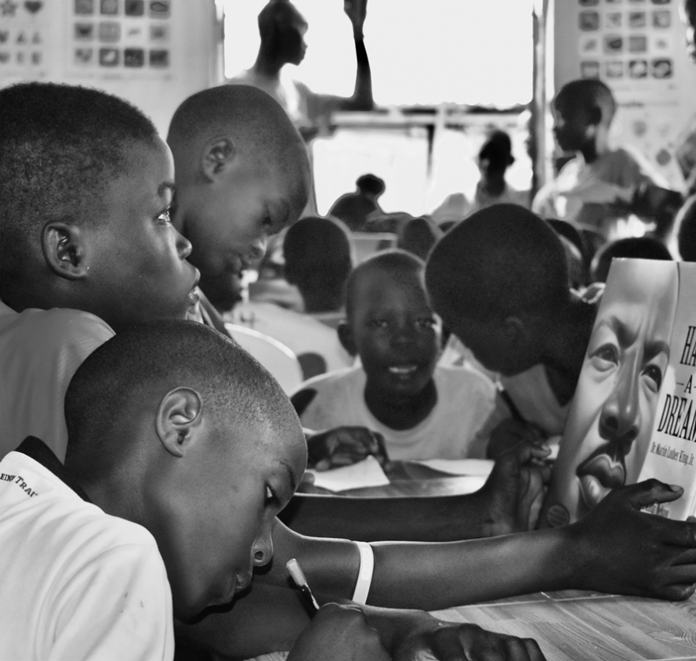
Why we chose
our Idea
We believe that we should have both in school program for life skill through teachers like Fred and after school engagement through our community micro library to engage the kids through cultural responsive learning material, arts and sports so that they will have right information and will be able to make the right decision and engage in play as they learn

Slide 13
EXPECTED IMPACT
By engaging Mr Fred in empowering his students, it will help him bridge the gap on information on the effect of drugs and substance abuse hence creating a conducive environment for learning, and improve academic performance.
By creating a community Micro Library that would integrate learning with skilling in talent development through sports and art then the learner would have a safe space for learning.
By Introducing culturally responsive books and other learning material in the library would help the students with self esteem.
By Collaborating with other Youth Groups and faculties like professor Amina we can help the Children Create picture book that they use and also share with other learners

Slide 14
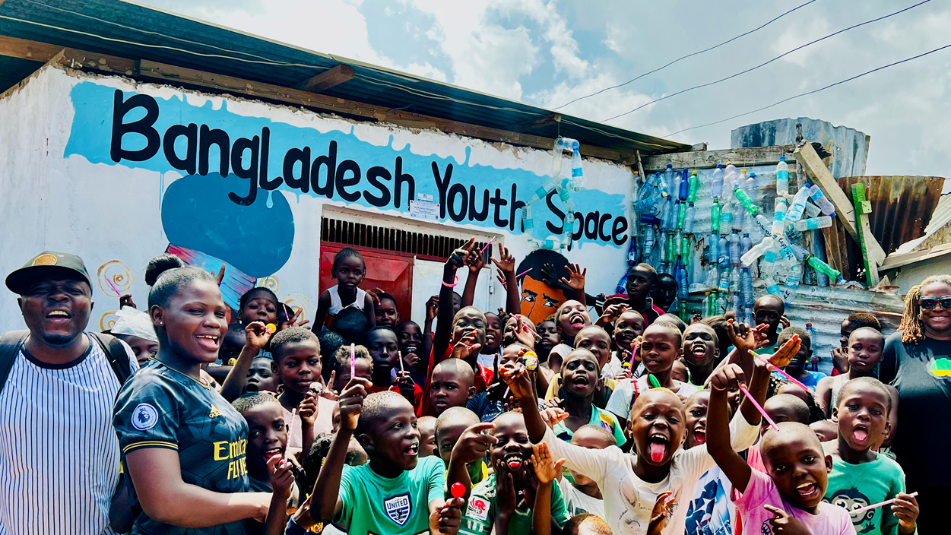
PROTOTYPING STRATEGY

Slide 15
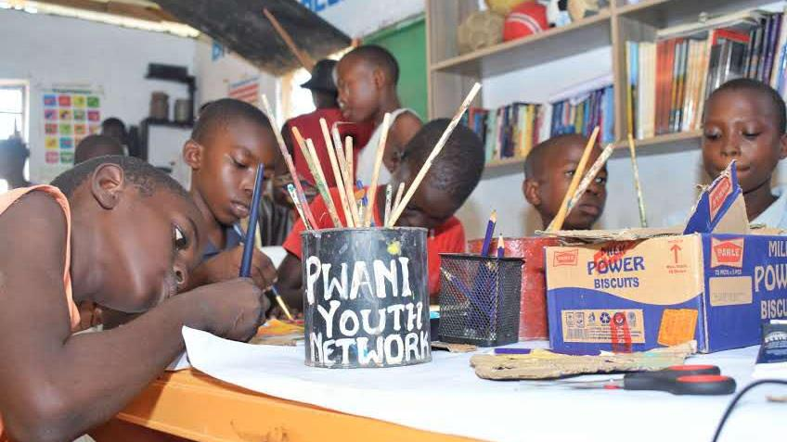

Slide 16
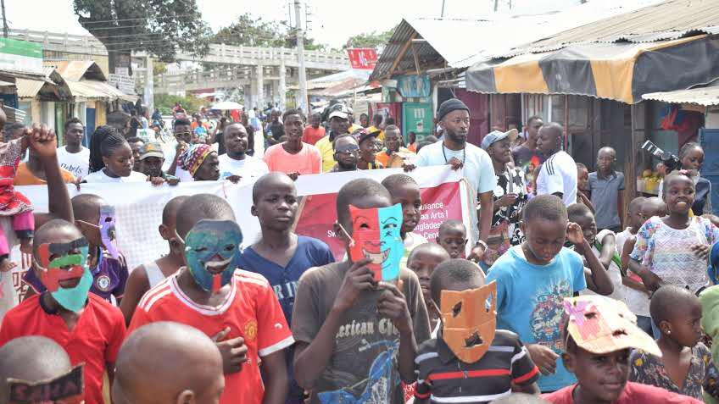

Slide 17
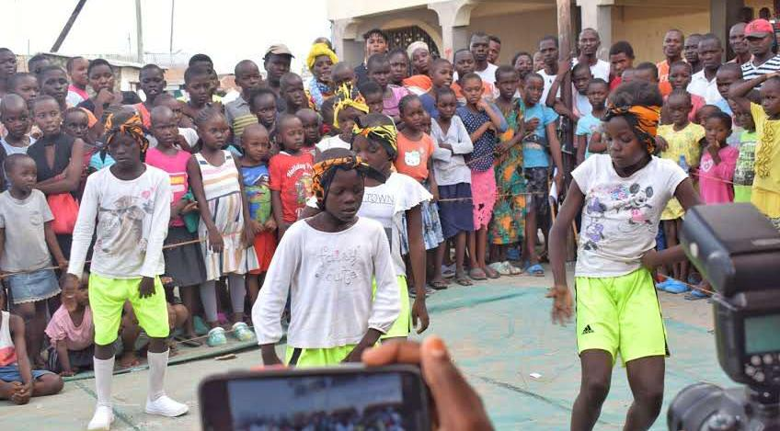

Slide 18
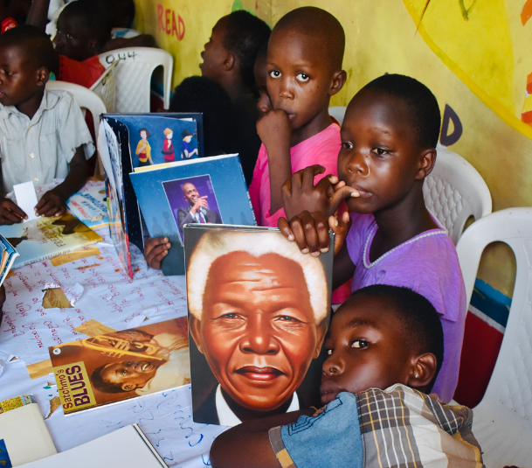
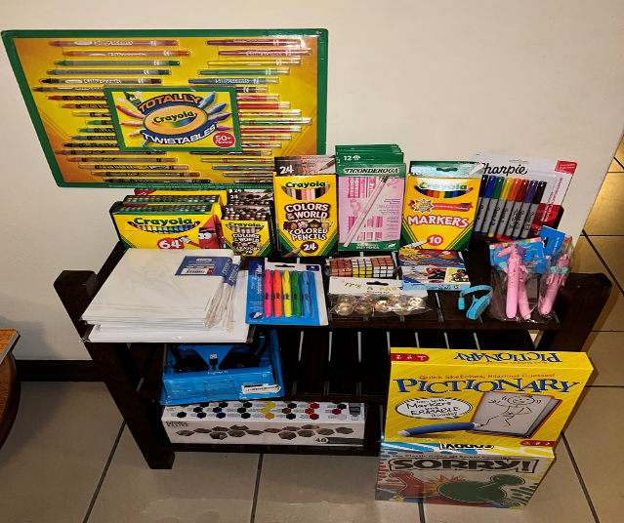
After School Program

Slide 19
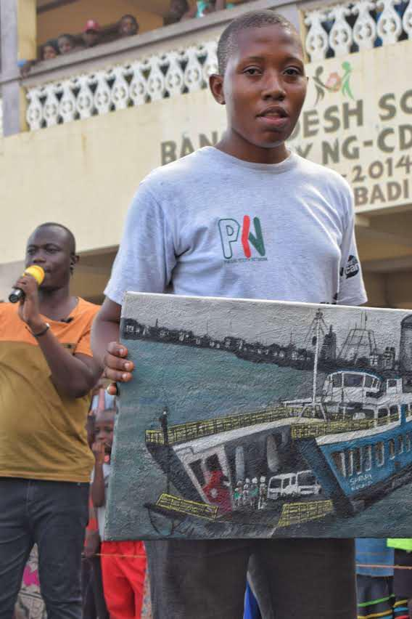
Evidence of Impact
The Micro Library have 137 culturally-responsive books and art supplies, the Pwani Youth Network has become a model library/art/media space in Mombasa, Kenya. And the community [children and adults] attend the facility daily to check out books and to make art.
Trained teacher on how to deliver life skill to learn in school
We have strengthened the reading and art culture in Bangladesh with the use of culturally-responsive texts related to the African Diaspora
We are now developing art/literacy/media/culturally-responsive collaborations for other ages of children from the community
We are creating ideas for children’s books with a focus on local Kenyan history and culture with Swahili/Luo languages
The Community Library if currently serving all the five schools reaching at least 1000 children monthly
Through a partnership with Dr Amina from California state University Faculty the Micro Library have received ethnically diverse toys/dolls/games that represent Black children of the African Diaspora helping them with Self Esteem
Plans are under with way with Dr Amina for Kenyan/Luo/Swahili/English animated education cartoon series for the Children

Slide 20


Closing Reflections
To partner with community members, teachers, and artists in South LA creating cross-cultural partnerships for animated children and young adult programming in Mombasa, Kenya
Developing partnerships and collaborations with LA community in building culturally-responsive art/micro-libraries in Mombasa, Kenya
Pwani Youth Network Partnering with Baldwin Hills Elementary in South Los Angeles Creating Micro-Libraries and a Multilingual Digital Pen Pal Program
Baldwin Hills Elementary will provide new and/or gently used texts in helping to build culturally responsive micro-libraries in Mombasa, Kenya at the Pwani Youth Network
Multilingual Digital Pen Pal Program with Kenyan children sharing Swahili and Luo and South LA children sharing English and Spanish. This multi-language exchange will foster culture, cultural diversity, and academic preparation.

Slide 21
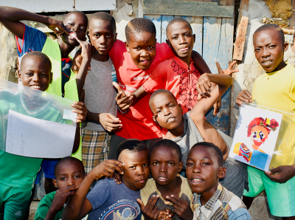
THANK YOU!

Slide 22
