Slide 1
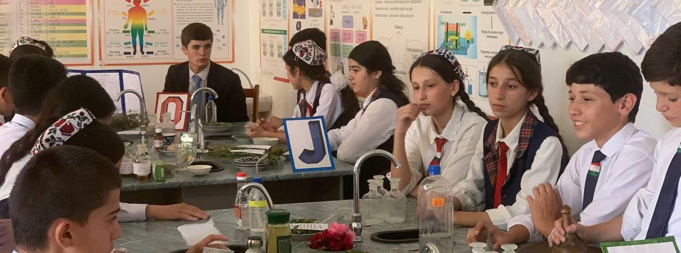

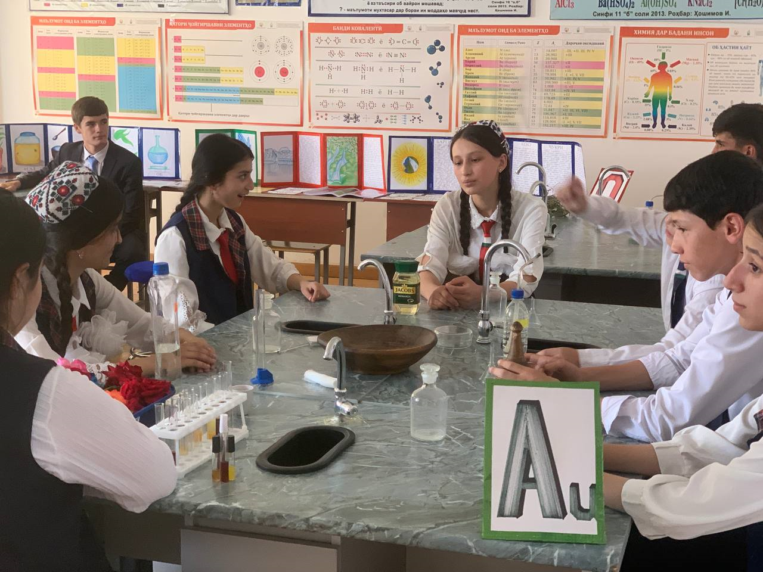
Moving from theory to practice
Chemistry and Biology Club
Tajikistan

Slide 2
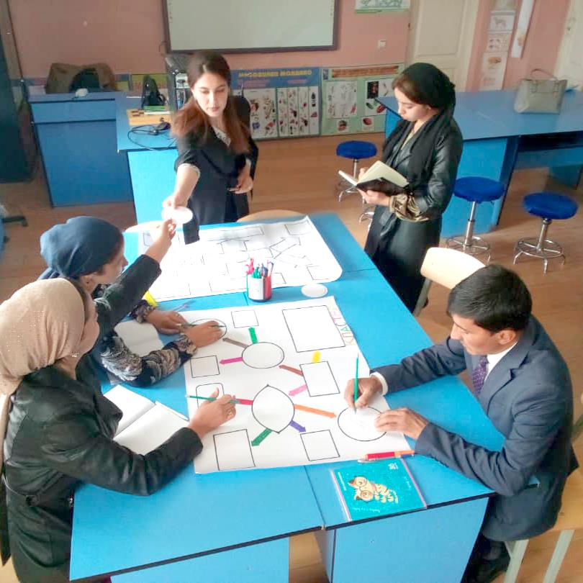
Nazokat Mahmadieva
School#2 Danghara district, Khatlon region, Tajikistan
Teacher of Chemistry & Biology, grade 8-11 students
4 years of teaching experience

Slide 3
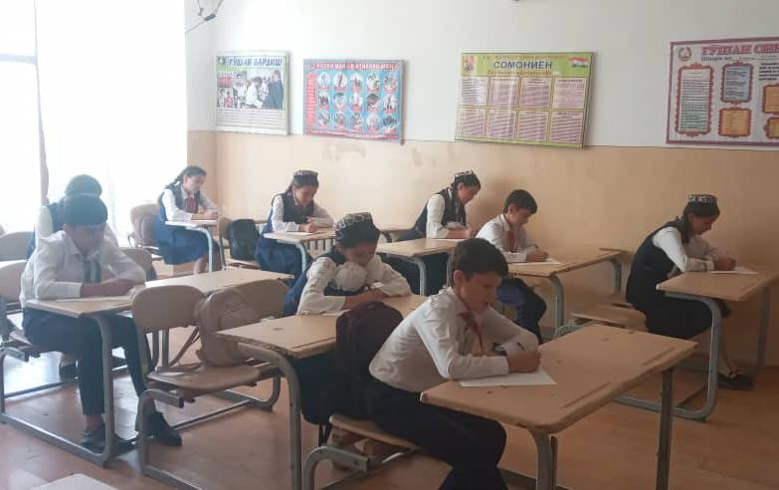
The Challenge
Low engagement and poor performance in science subjects, particularly for less active students and girls
Many students struggle to learn higher grade science lessons in chemistry and biology lessons. Girls and lower-performing students particularly struggle in this subject due to lack of appropriate learning materials and hands-on learning opportunities.
Notes:
Sources

Slide 4
The Idea
Establish Chemistry and Biology Club in school
1
2
3
Conduct practical sessions with low cost and accessible local resources
Help students to improve their competencies on chemistry and biology through experiments
Increase students' motivation and their progress on chemistry and biology subjects
Notes:
Sources

Slide 5
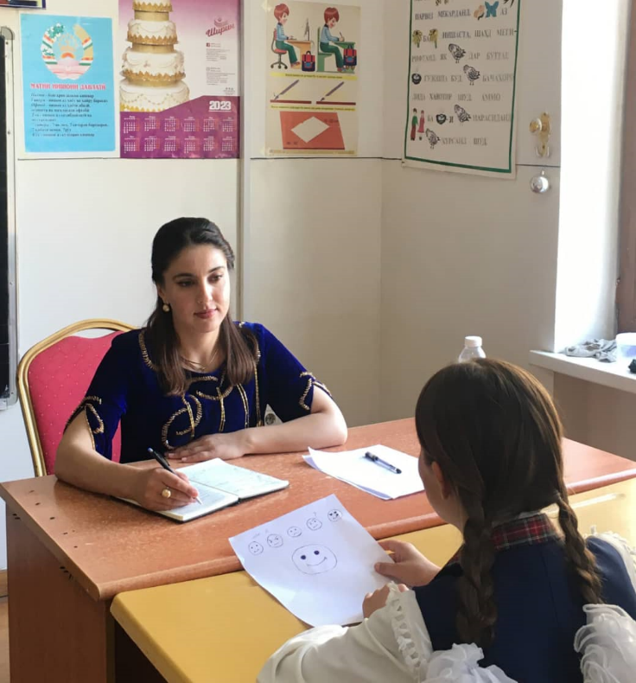
Design Process | Gathering Evidence
Theory without practice not connected to daily life is wasting students precious time in school
We met…
Students during the interviews in design process highlighted that chemistry and biology are very difficult for them to learn, due to information and theory they have to memorize.
We noticed
Surprisingly, some students had willingness to become doctors, nurses, scientist, pharmacists etc.
Our insight…
Every child has so much potential that needs to be supported by any means despite the challenges we face in our teaching environment.
Notes:
Sources

Slide 6
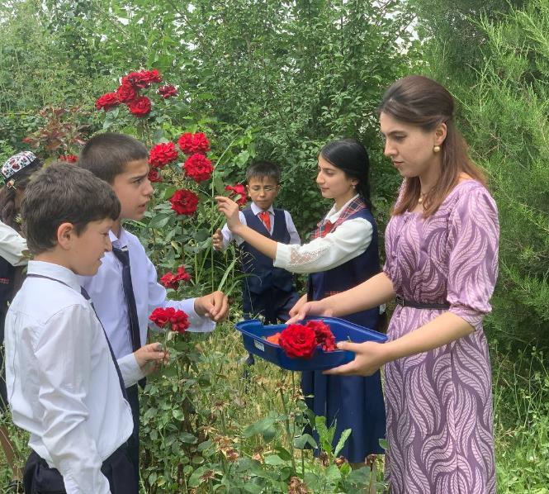
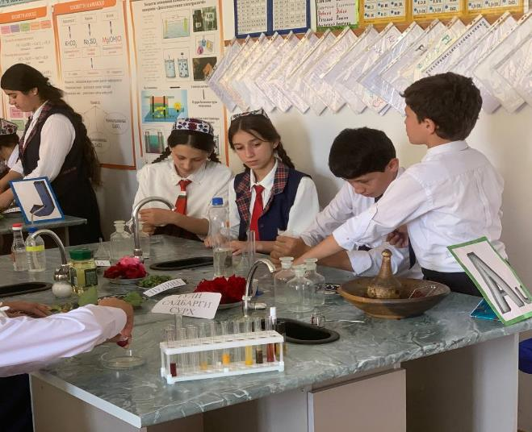
1
Our prototype was conducting small research and experiments on chemical topics related to herbs.
Prototyping
and Testing
Design
Process
I assumed that connecting chemistry and biology to the students’ environment will enhance their motivation to learn these subjects.
By establishing chemistry and biology club I observed that in a short period students desire and engagement in learning process tremendously increased.
2
3
I learnt that chemistry and biology outdoor activities and laboratory experiments could be conducted with local low - cost and available resources.
Notes:
Sources

Slide 7
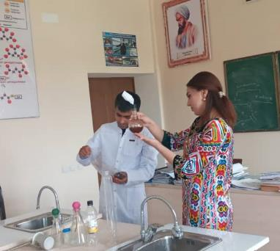
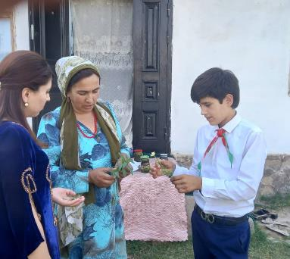
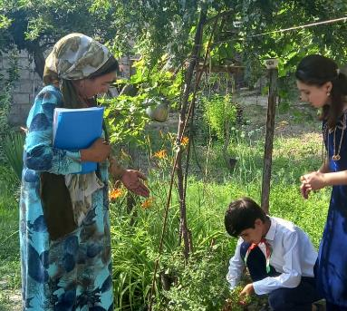
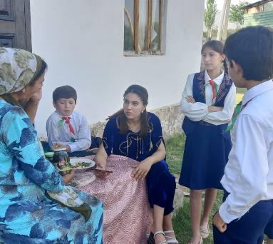
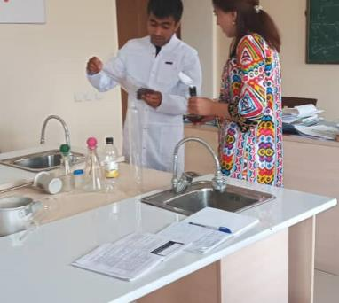
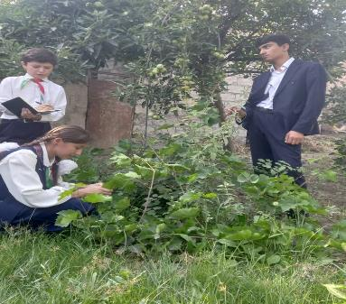
Innovation – Chemistry and Biology Club
Students come together in the club twice a week to conduct research and experiments
Interviews with herb specialists and pharmacist from local community to compile their findings
Based on the findings students in groups and pairs prepare presentations
Students present their findings to their peers and wider school community in different science occasions
Conducted researcher and presentation collected and I am aiming to consolidate them into in a chemistry and biology experiments handbook for grade 9 students

Slide 8
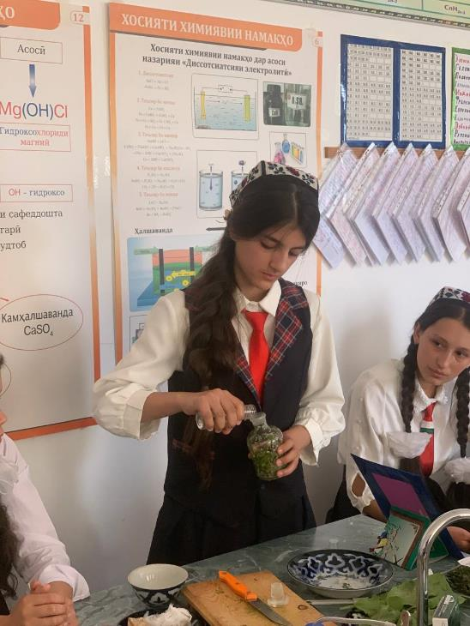
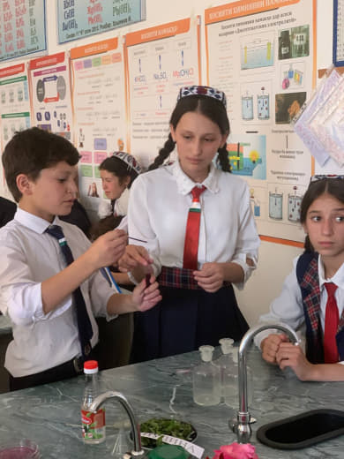
Creating Positive Change
An immediate visible motivation demonstrated by students after the first experiment
All my students in grade 9 attend the club and actively engaged in the research and experiments.
This design could be enriched with more interesting experiments and research to make teaching and learning enjoyable for students.
Methods and resources can be used in class to reinforce daily lessons
Through Schools2030 assessment tools at the beginning and end of academic year I will measure the progress for the long-term period.
Everyday observation and assessment in class will show the progress of my students for the short- term period.
Notes:
Sources

Slide 9
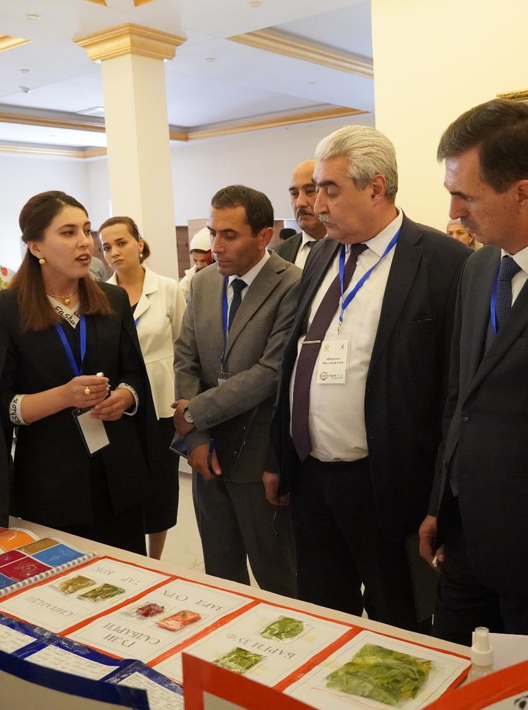
Call to Action
1
All the teachers in my country should have access to HCD trainings therefore HCD approach should be incorporated into in service Teacher Training at National Level.
2
Support teachers to integrate creative and hands-on approaches into their daily lessons, particularly for challenging and theoretical subjects
3
Create a platform to scale up best teaching innovations design through Schools2030 at National and Global levels.
Notes:
Sources

Slide 10
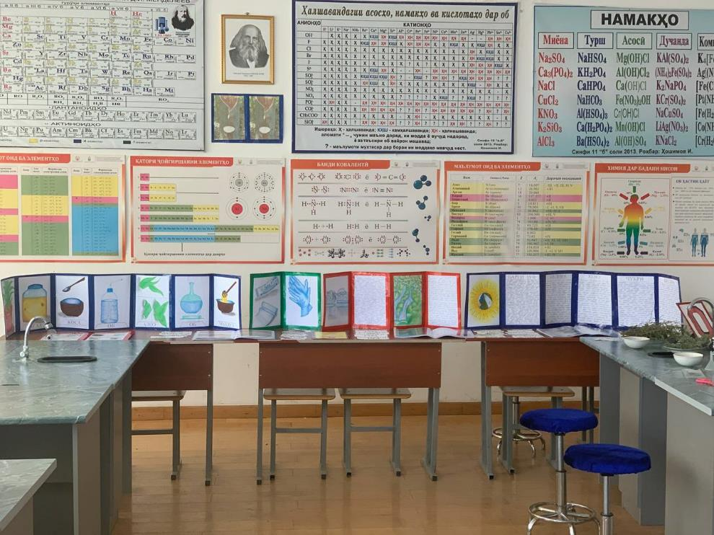
Closing Reflections
The introduction of a chemistry and biology club and experimental-based lessons is at initial stage and I am confident that my designed teaching innovation will bring a positive change in improving the students' competencies
I will continue to improve it and support my colleagues to apply the same approach on their classrooms.
The teaching innovation that I designed would have not happen without Schools 2030 HCD trainings, therefore I would like to thank AKF Tajikistan for the given opportunity.
Notes:
Sources

Slide 11


