Slide 1
Inspiring Change
through our Stories:
Strengthening inclusivity
through differentiated and
inquiry-based learning

Slide 2
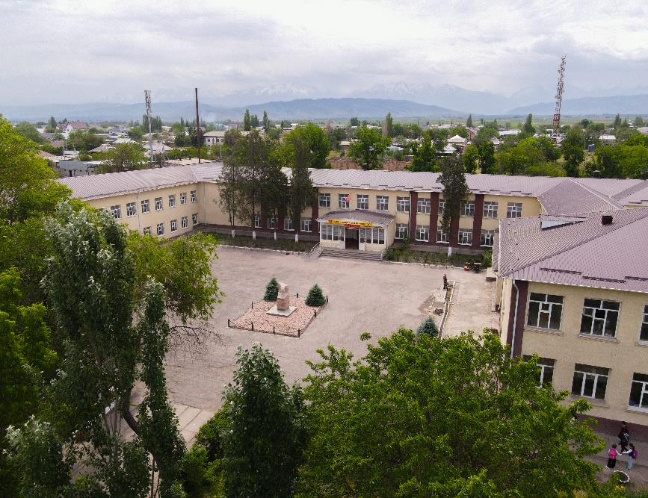
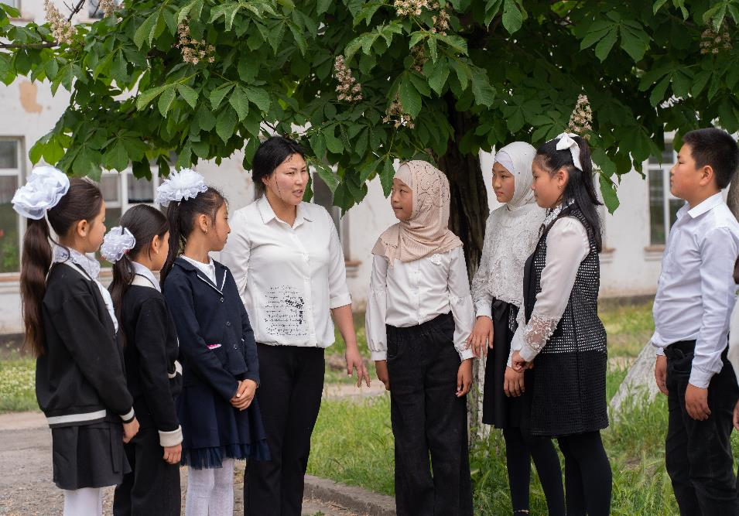
Welcome Message
My name is Aikanysh, and I am a teacher at the Shivaza General Secondary School in Moscow district, Chui oblast, Kyrgyz Republic.

Slide 3
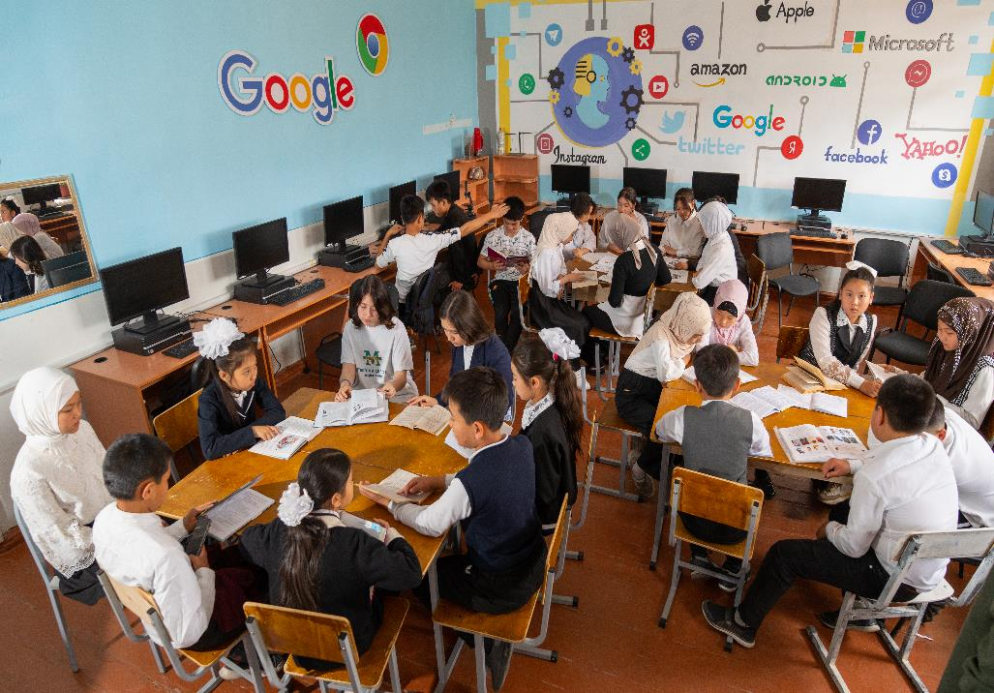
The Challenge
Persistent disparities in academic performance among multicultural
and socio-economically diverse learners
1
Minority ethnic students and internal migrants face language, communication, and cultural challenges that affect their academic performance. Limited Russian and Kyrgyz proficiency hinders comprehension and expression.
Limited parental education and language barriers hamper academic progress and well-being of minority ethnic students lacking a strong home support system.
Student learning opportunities vary based on family living conditions, parental education, religious beliefs, and family values.
2

Slide 4

Context Framework
History of the Problem?
Academic performance disparities among our students are caused by cultural and linguistic differences, biased expectations, limited resources, and inadequate home support.
Who are the students?
Children of 10 and 15 age cohorts.
What is the community like?
Village of Aleksandrovka in Chui oblast is home to various ethnic groups, including Kyrgyz (15%), Russians (2%), Dungans (70%), Uzbeks (2%), Kurds (1.4%), Uighurs (1.1%), and others. The village experiences significant internal migration from the southern regions. The primary source of income for the residents is agriculture.
Notes:
This school provides education for students coming from diverse ethnic and socio-economic backgrounds, emphasizing the heightened significance of fostering inclusivity, equity, and pluralism in the field of education.
The population of Aleksandrovka village is diverse and includes different ethnic groups. The Dungan community is the largest ethnic group, representing 70% of the village's population, kyrgyzs – 15 % etc.
The village has a high rate of internal migration, and according to the national statistic committee report Chui Oblast is the destination with the highest influx of people from other regions
In the presentation, it would be good to mention "why internal migration from the southern regions is challenging" and mention that the internal immigrants from the south tend to have lower level of Russian, in general.

Slide 5
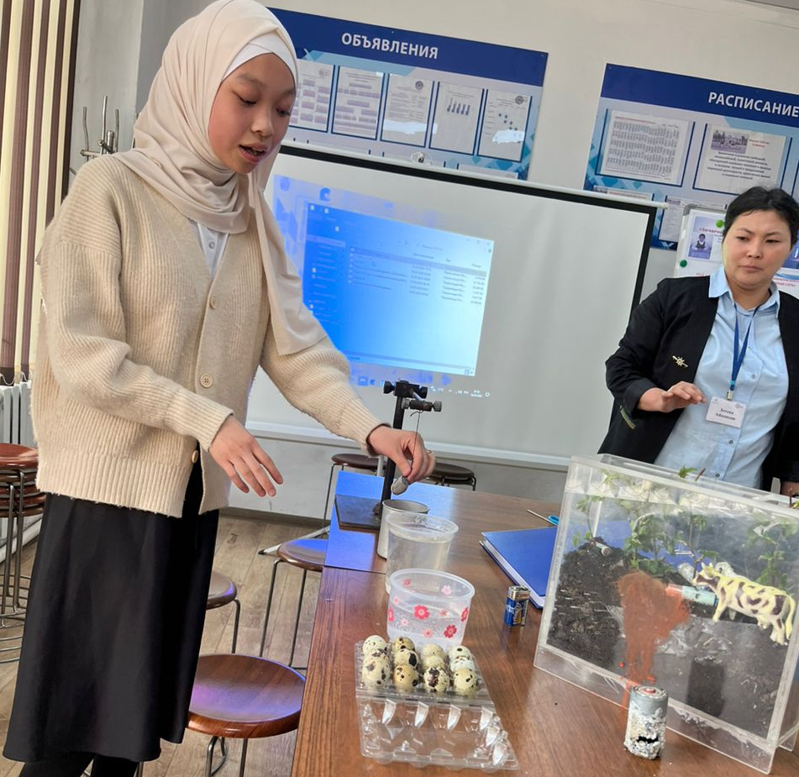
The Solution
“Curiosity minds”
IDEA
Creating inclusive and pluralistic learning environment to address persistent disparities in literacy and critical thinking among multicultural and socioeconomically diverse learners.
Our team has developed an extracurricular programme that specifically caters to our students’ learning needs via differentiated and inquiry-based learning.
To mitigate academic disparities by establishing a pluralistic and inclusive learning environment that cultivates a sense of value, respect, and inclusion for students from diverse backgrounds and varying abilities.
METHOD
GOAL

Slide 6
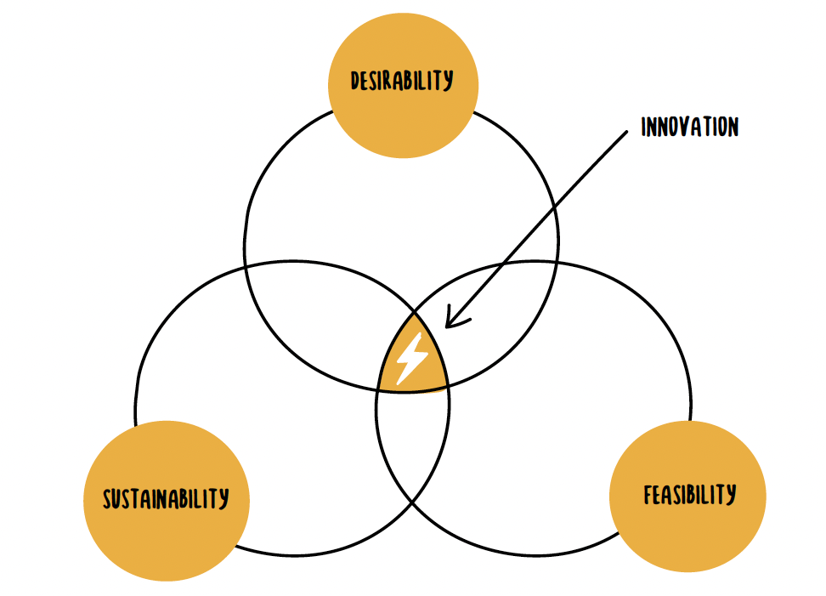
DESIRABILITY
INNOVATION
The solution's focus on diversity, inclusivity, and equity fosters academic success among diverse students, bridging achievement gaps through improved literacy and critical thinking.
The flexible teaching methods and adaptable programme design enable the solution to evolve and respond to students’ learning needs and abilities, ensuring its long-term sustainability.
Student-driven-promotes
active student involvement;
Differentiated and inquiry learning approach addresses the unique needs, strengths, and learning differences of students; Low-cost-affordable and accessible resources
SUSTAINABILITY
FEASIBILITY
Notes:
Desirability: Inquiry-based learning can also be effective in promoting inclusivity and diversity in the classroom. By allowing students to explore topics that are relevant to their own experiences and backgrounds, inquiry-based learning can help create a more inclusive and supportive learning environment. This approach can also help students develop empathy and understanding for others, as they are encouraged to listen to different perspectives and ideas. Sustainability: Emphasizing inclusivity and respect for diverse perspectives across socio-cultural backgrounds can greatly enhance the potential for successful application of solutions in other communities. By promoting an environment that values and respects differences, solutions developed in one community can be adapted and implemented in other communities without encountering cultural resistance or misunderstandings. Inclusive and respectful solutions can also attract support and participation from a diverse range of stakeholders, increasing the chances of success and sustainability of the solution. Ultimately, an inclusive and respectful approach can help to bridge divides, build trust and facilitate communication across different cultural backgrounds and socioeconomic statuses, leading to better outcomes for all involved.

Slide 7
Design Process | Gathering Evidence
What did we learn from those we interviewed?
1
2
3
We noticed/saw/heard…
Students struggle to extract, analyze, and form their own opinions based on information from different sources.
Students often prefer to socialize and form groups with peers of the same ethnicity.
Parental involvement in their children's learning activities is minimal.
Our insight…
There is a need for support in developing critical thinking skills and literacy
Promoting diversity and fostering interactions among students of diverse ethnic backgrounds is crucial and can be achieved through inquiry-based and differentiated activities.
Encouraging parental engagement is essential
We met…
students and their parents from various ethnicities and diverse socio-economic backgrounds

Slide 8

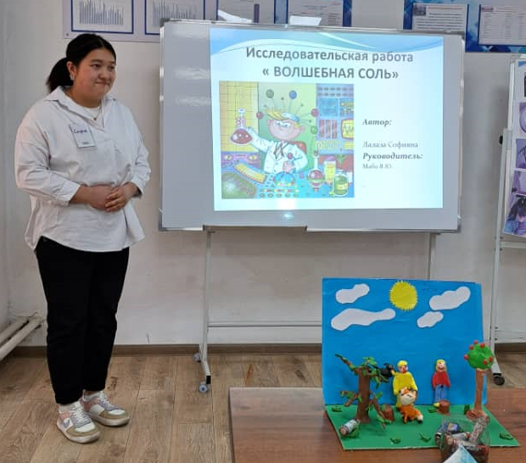
Prototyping and Testing
Prototype: Extracurricular Programme Outline
Topic Selection: Aligning with Students' Learning Needs and Abilities
Formulating Hypotheses
Gathering Information on the Chosen Topic
Conducting Experiments
Analyzing Data
Presenting Findings
1
Design Process
2
Assumptions to test: Differentiated and Inquiry-based learning
improves students' critical thinking skills
promotes deeper understanding and retention of concepts
encourages active collaboration among students from diverse ethnic backgrounds
promotes parental involvement in inquiry-based activities
3
Learning from testing: Differentiated and Inquiry-based learning
has a positive impact on enhancing students' ability to ask questions, analyze information, and draw conclusions
supports students in developing a thorough comprehension of concepts
fosters a collaborative environment for students and supportive home-school connection
Notes:
Sources

Slide 9
About Our Solution
1.
Idea
2. Resources
3. Timeline
Finalize the extracurricular program for inquiry-based and differentiated learning, along with its timeline.
Conduct inception meetings with parents and students to explain the program's objectives.
Implementation: encourage students to collaborate in groups and prepare study and/or research projects on topics of their choice that interest them.
Arrange presentations for students to showcase the results of their research and other study projects.
Computer with the internet connection
Books, encyclopaedias, journals, research articles and the internet sources
Low-cost resources to conduct experiments
Phase 1 (Month 1):
Develop the program, including creating detailed lesson plans and identifying the necessary resources.
Phase 2 (Month 2):
Establish effective communication channels with students and parents, ensuring clear and consistent information flow.
Phase 3 (Months 3-5):
Launch and implement the extracurricular program, putting the developed plans into action.
Regularly monitor the progress of the program and make any necessary adjustments to ensure its success.
Notes:
Sources

Slide 10
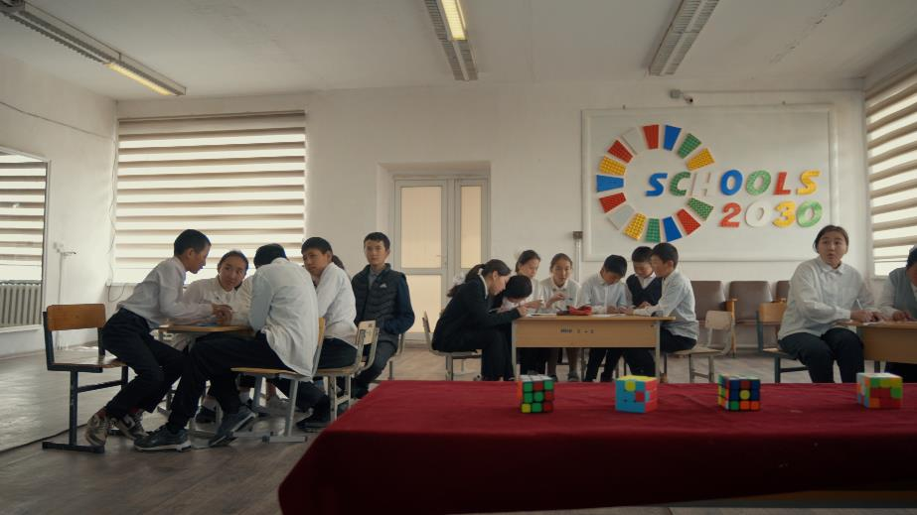
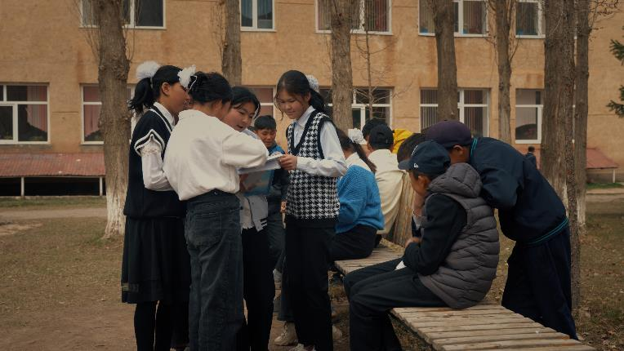
1
Gauging Success
What is the potential impact in the short-term?
Students have developed skills in questioning, critical evaluation, and effective information analysis. They have also learned to value diverse viewpoints and appreciate different cultures, fostering inclusivity and a friendly environment. Increased parental and family engagement has enhanced the overall educational experience. Our students’ critical thinking skills and literacy have improved.
In the long-term?
We will be able to cultivate an inclusive school culture that values and respects diversity, leading to enhanced interactions among students of varying ethnicities.
2
Notes:
Inquiry-based learning can have several potential impacts among students from diverse cultural and socio-economic backgrounds in the short-term, such as enhancing their critical thinking and problem-solving skills, promoting active engagement in the learning process, improving their academic performance, and fostering a sense of curiosity and love for learning. It can also help students develop better communication and collaboration skills through working on projects and conducting research together. Furthermore, inquiry-based learning can promote respect for diverse perspectives and backgrounds, which can lead to better cultural understanding and social cohesion among students. In the long-term, inquiry-based learning has the potential to significantly impact students from diverse cultural and socio-economic backgrounds. By fostering critical thinking, collaboration, and problem-solving skills, students are better prepared to tackle complex real-world issues. Additionally, the exposure to diverse perspectives and experiences can lead to increased empathy, understanding, and respect for others, ultimately promoting greater social cohesion and a more harmonious society. Furthermore, the skills and attitudes developed through inquiry-based learning can serve students well beyond their academic years, preparing them for lifelong learning and success in their personal and professional lives. There are several steps that can be taken to gauge the success of inquiry-based learning, including:
Collecting data on student performance: This can include assessments, tests, and grades on specific topics related to the inquiry-based learning approach.
Observing student behavior: Teachers can observe how students interact with each other, their level of engagement, and their willingness to participate in collaborative work.
Feedback from students and parents: Students and their parents can provide feedback on their experience with inquiry-based learning and the impact it has had on their academic and personal growth.
Comparison with traditional teaching methods: Compare the success of inquiry-based learning with traditional teaching methods and their impact on academic achievement.

Slide 11
Call to Action: Support needed
Call to Action #1
Policy advocacy
Promote policy advocacy efforts at the local, regional, or national level to support comprehensive initiatives targeted at addressing academic disparities among multicultural and socioeconomically diverse learners.
Call to Action #2
Teacher professional development
Offer training and workshops for teachers and educators to develop cultural competence, inclusive teaching strategies, and techniques for addressing academic disparities.
Call to Action #3
Community of practice
Creating a community of practice to promote experience exchange, collaborative learning, professional growth, and effective implementation of inquiry-based and differentiated learning practices.
Notes:
Sources

Slide 12
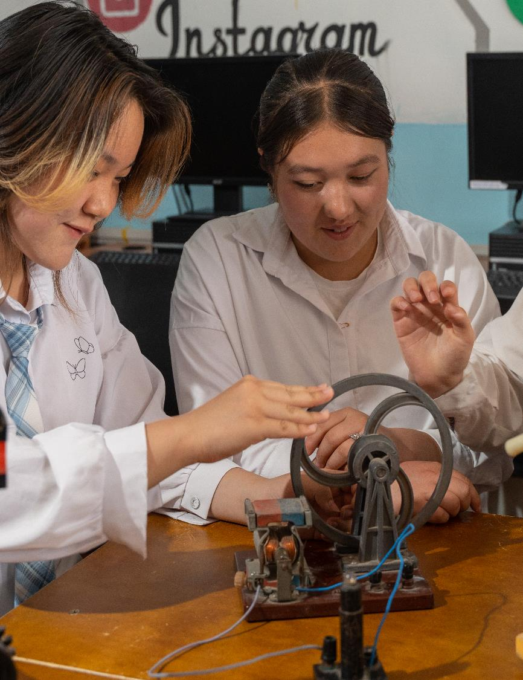
Closing reflections
What is possible for your school if your innovation succeeds?
Enhanced academic performance and achievements
Strengthened family and community involvement
Cultivated a positive diverse school culture and fostered strong relationships between students, parents, and the school
What is possible for your students if your innovation succeeds?
Enhanced literacy and critical thinking skills
Improved communication and collaboration abilities
Cultivation of pluralism and creation of an inclusive learning community

Slide 13


