Slide 1
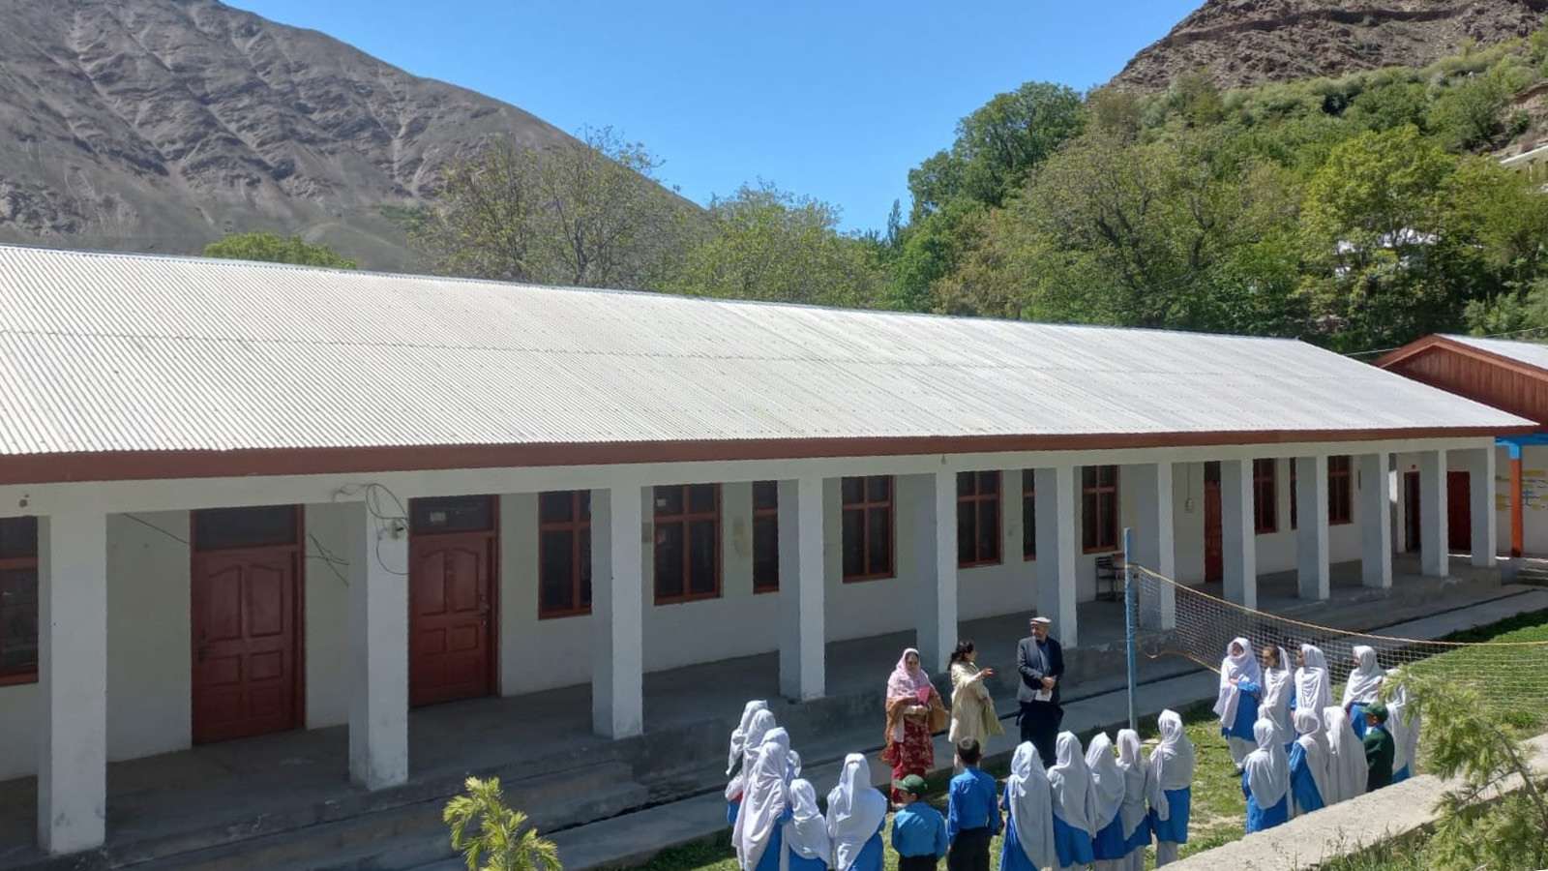

Empowering Girls to Lead
Shazia Bibi
Government Girls’ High School, Murdan, Chitral, Pakistan

Slide 2
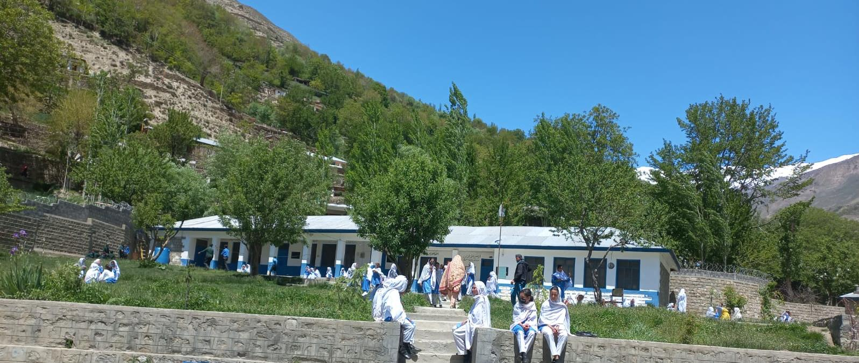
Welcome to GGHS Murdan, Chitral, Pakistan
Government Girls’ High School, Murdan, is located in Garamchashma Chitral, Pakistan.
Established in 2003; Enrollment: 113 students and 8 teachers.

Slide 3
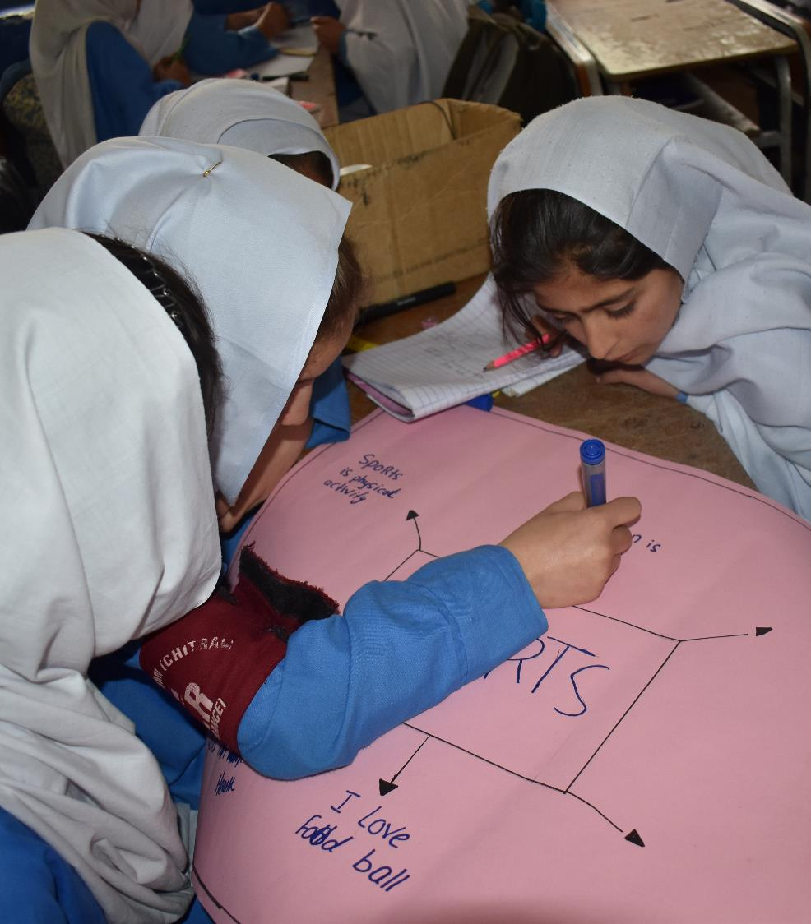
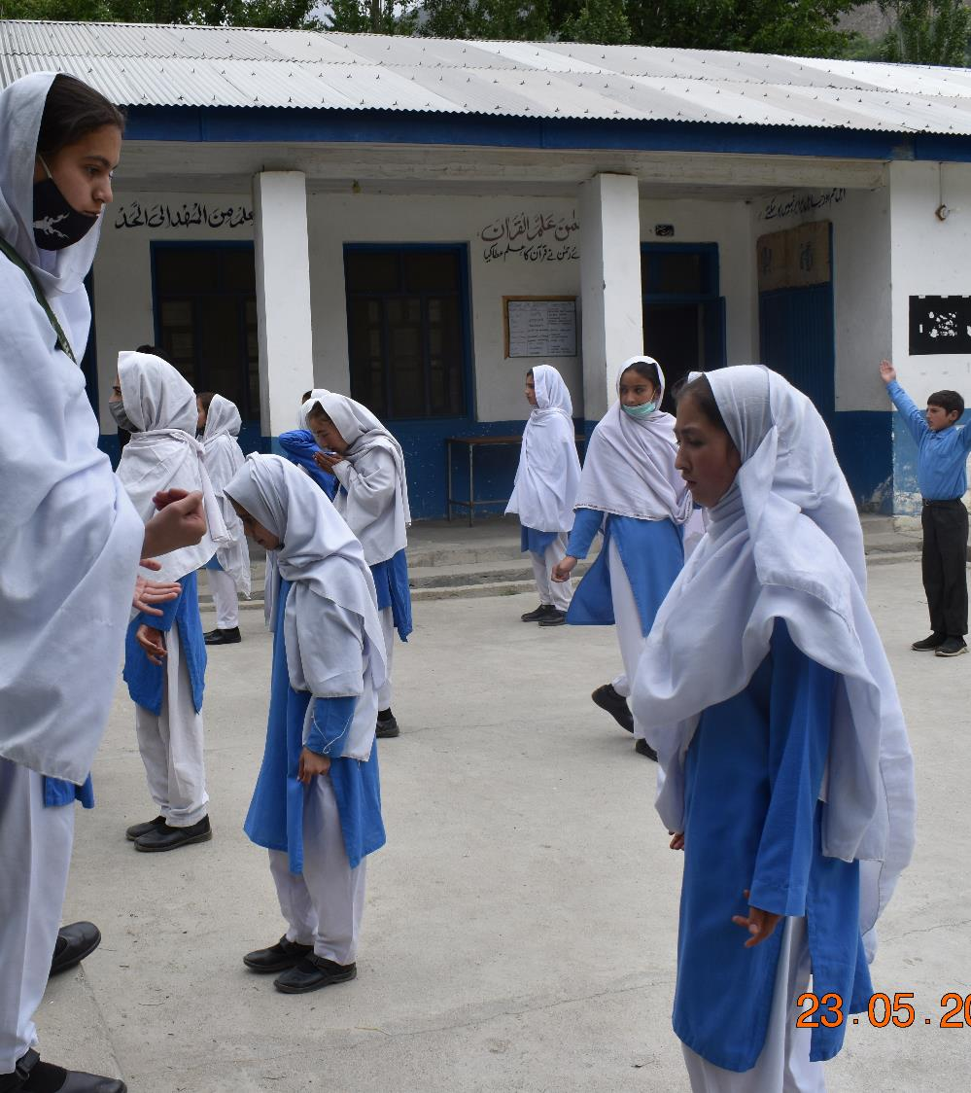
EMPOWERING GIRLS TO LEAD

Slide 4
Students of Grade 9 (Age 14) were hesitant
to take on responsibilities while performing
individual and group tasks.
How did I identify the problem?
The Challenge
.
Personal observation
Rapid Assessment
Notes:
Sources

Slide 5
Domains selected for Pakistan
Country | Secondary School Cohort Learning Domains
Pakistan | Literacy Numeracy Digital literacy Leadership Respect for diversity & the environment

Slide 6
Analysis of Leadership Domain (secondary cohort)
Areas | Agreed | Disagreed
Ability to manage yourself | 20% | 80%
Ability to solve problems | 30% | 70%
Ability to influence others | 0 | 100%
Ability to work in a group and establish good relationships | 20% | 80%

Slide 7
Understanding/exploring the Problem
Girls’ Perspectives/Mindset
"We do not think that girls have to lead because our decision do not matter.”
Parents’ Perspectives/Mindset
"Girls cannot lead because they cannot think the way boys do. Moreover, they need someone to accompany them.”
Notes:
Sources

Slide 8

Prototyping -1
Class teachers were assigned task to delegate
responsibilities among the children, particularly girls.
Design Process
Not Sustainable
Feasible to some extent
Not desirable
Therefore, this prototype was not used.
Notes:
Sources

Slide 9
Prototyping -2
Introduction of House System
Assumption
Introducing a house system with a mentor may encourage girls to take responsibilities.
Activities
Self-reflection
Group Reflection
Identify Mentor
Role distribution
Result of Prototype 2
The girls showed
interest in taking up
responsibilities.
Notes:
Sources

Slide 10
Concept Map for Implementation
Challenge
Solution
EMPOWERING GIRLS TO LEAD
Headmistress
House teacher
Head girl
House captain
CR
House teacher
Head girl
House captain
CR
Teaching staff
Discipline
Unity
HOUSES
House teacher
House captain
CR
Tolerance
House teacher
House captain
CR
Generosity

Slide 11
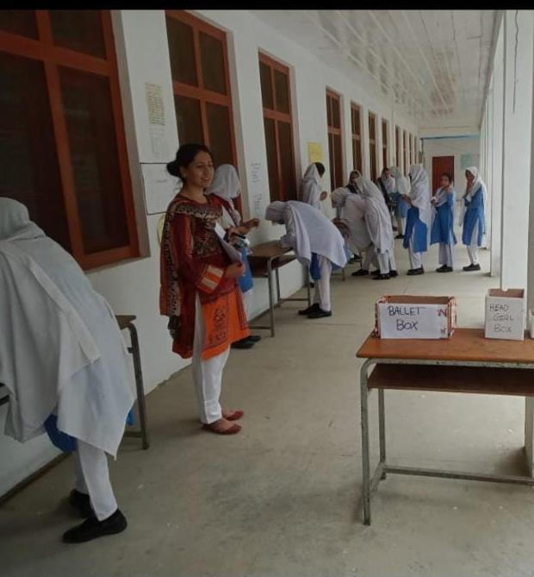
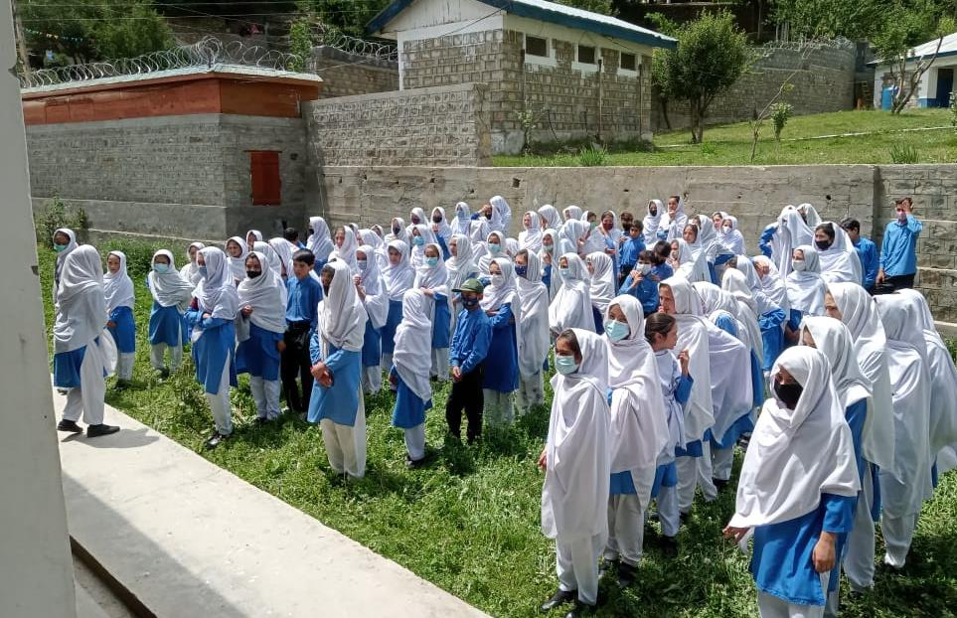
Election Day Activities
Election day under the supervision
of a teacher
The elected student thanks to her fellows for costing vote for her

Slide 12
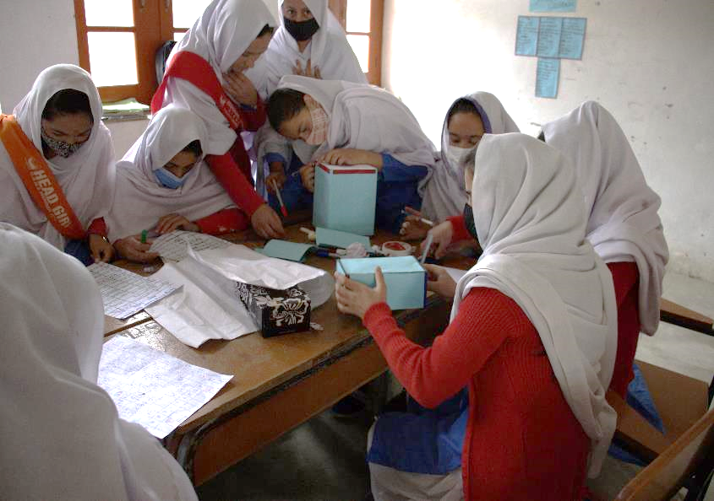
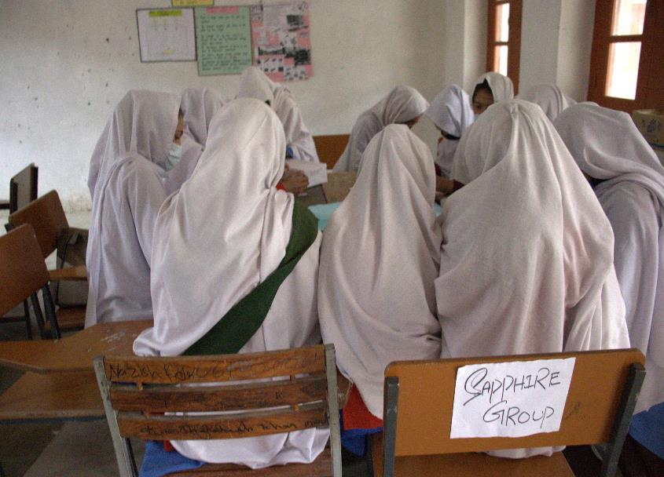
House Corner Development Activity
Students are busy developing their respective House Corners

Slide 13
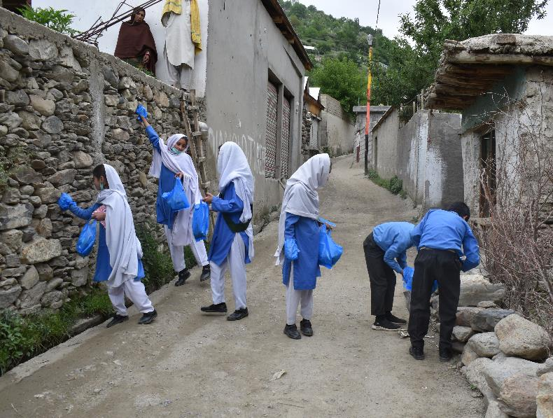
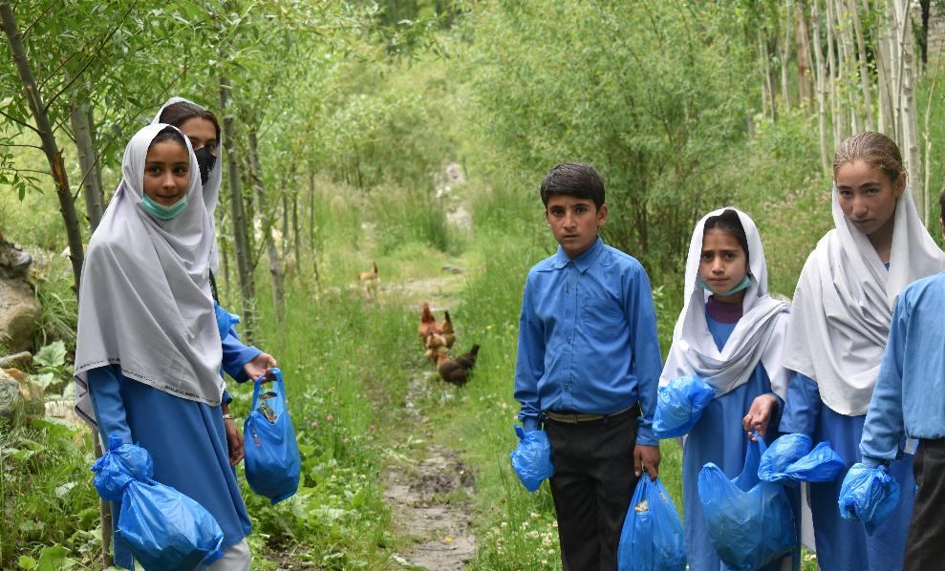
Civic Responsibility: Leading the Show
The students have decided to launch a campaign in the community to care about the environment

Slide 14
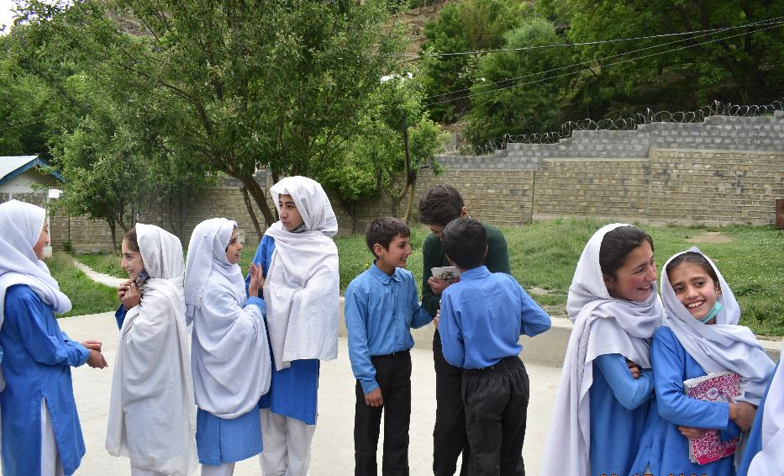
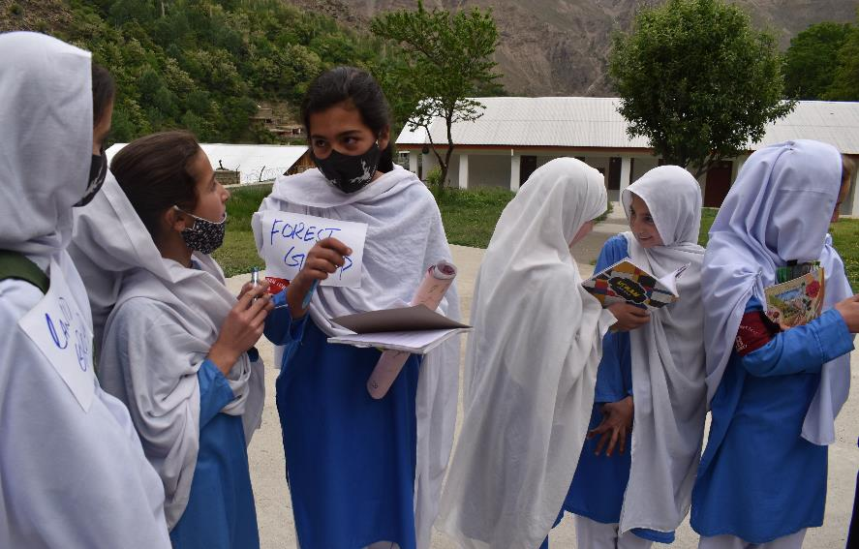
Post Field Work Reflection

Slide 15
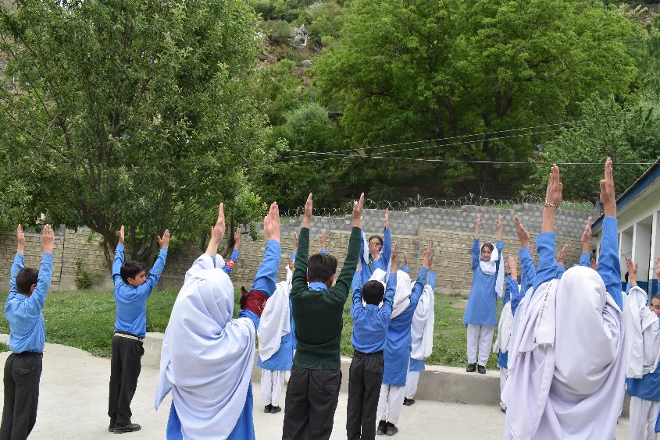
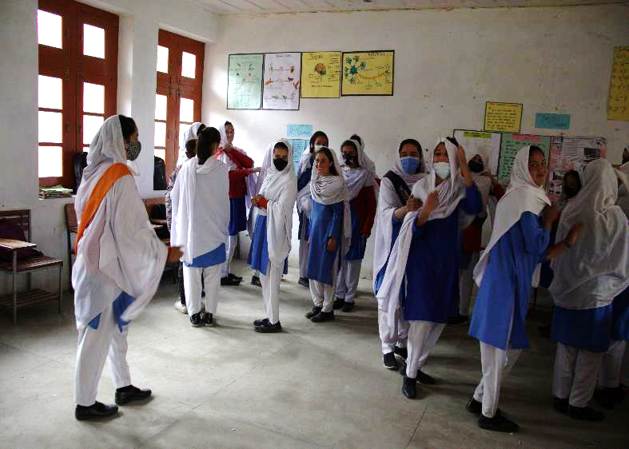
Girls Leading Activities

Slide 16
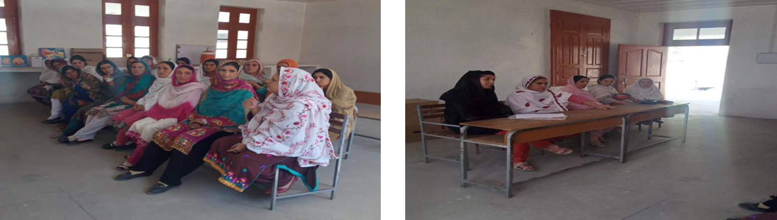
Awareness Session with Mothers

Slide 17
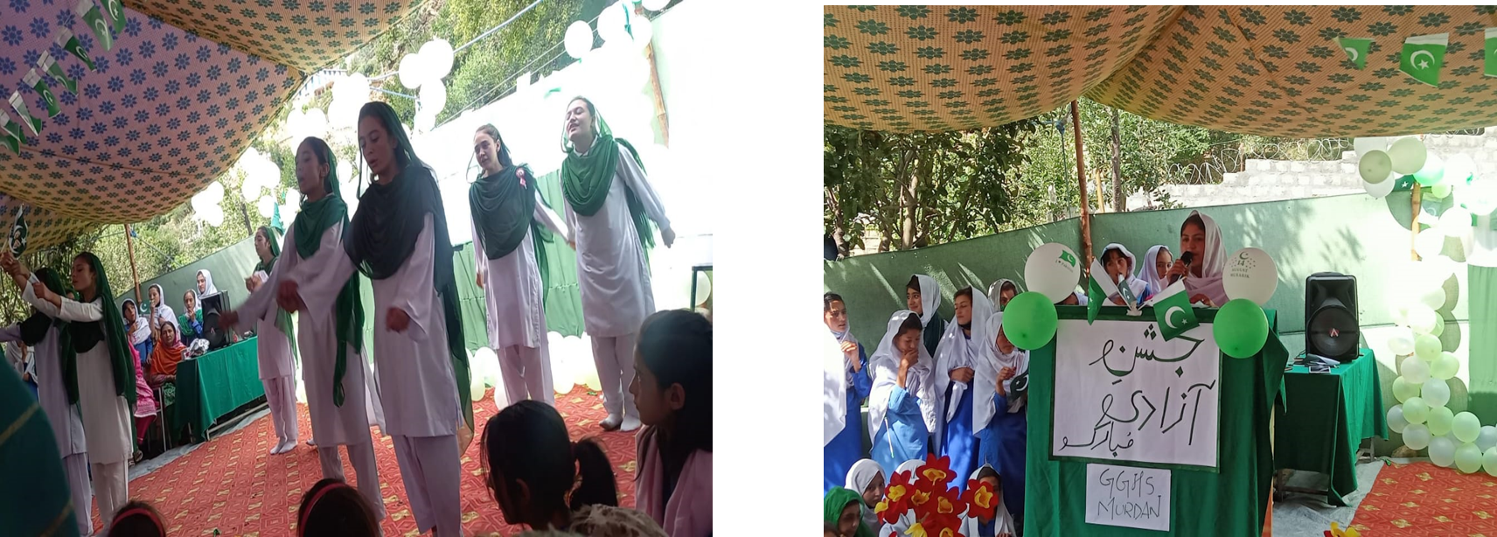
Outcomes
Girls led a school event
Notes:
Sources

Slide 18
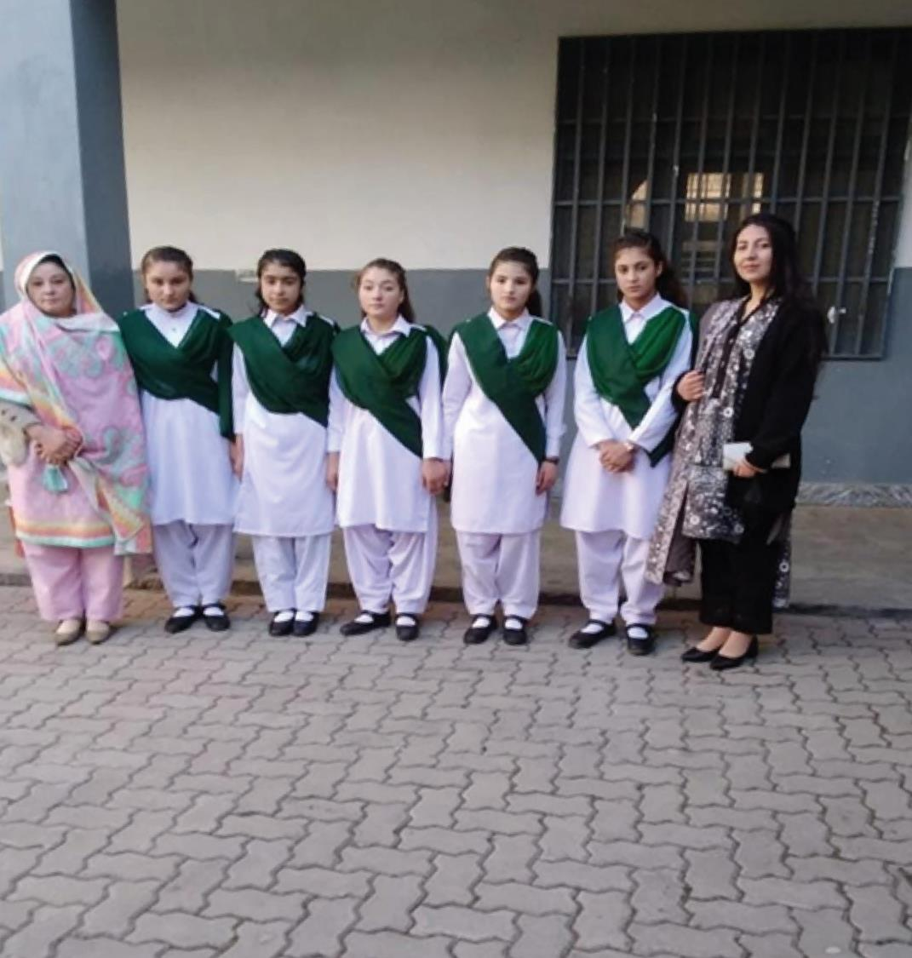
Additional Skills Practiced
Communication
Collaboration
Literacy
Respect for diversity
Self-management
Creativity
Motivation

Slide 19
Support
Education Department
Community
Merit based scholarship
Monitoring (Assessment and feedback)
Principal support
Teacher support
Parental involvement
Resource sharing
Notes:
Sources

Slide 20
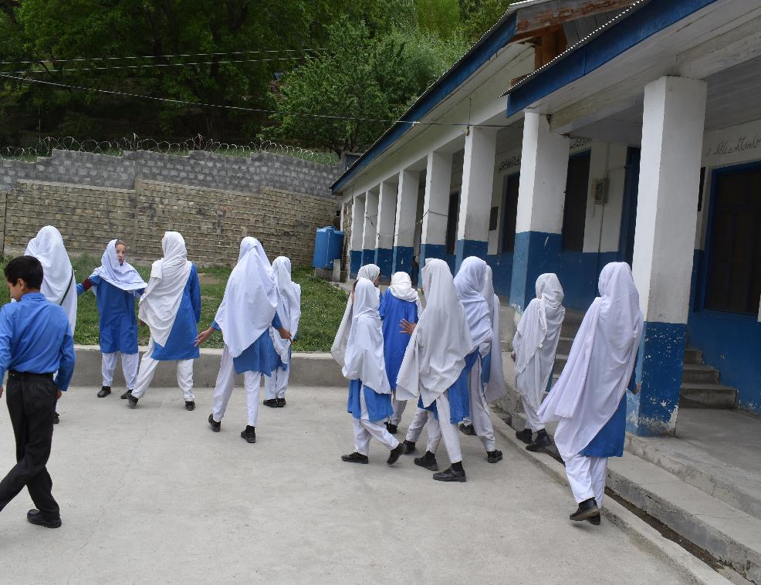
Girls Looking towards the Future
.
The success of our innovation will elevate our school to new heights of excellence, innovation and community impact.
We will become a catalyst for positive change in education, inspiring other institutions to embrace innovation and reimagine the possibilities of teaching and learning.
Our students will become the leaders', innovators and compassionate contributors that our society needs to make a lasting impact on their community and the world at large.
Notes:
Sources

Slide 21
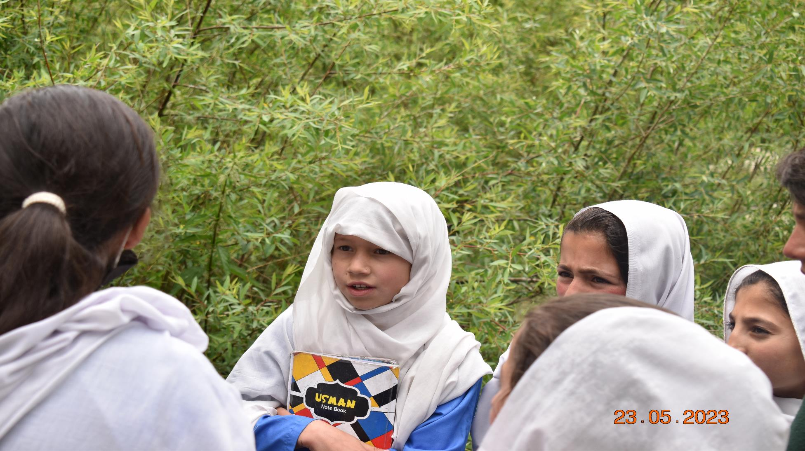
Thank You

