Slide 1


INDIA
Improving Literacy and Creative Expression for
Marginalized Learners
Supporting Multilingualism in the Classroom

Slide 2
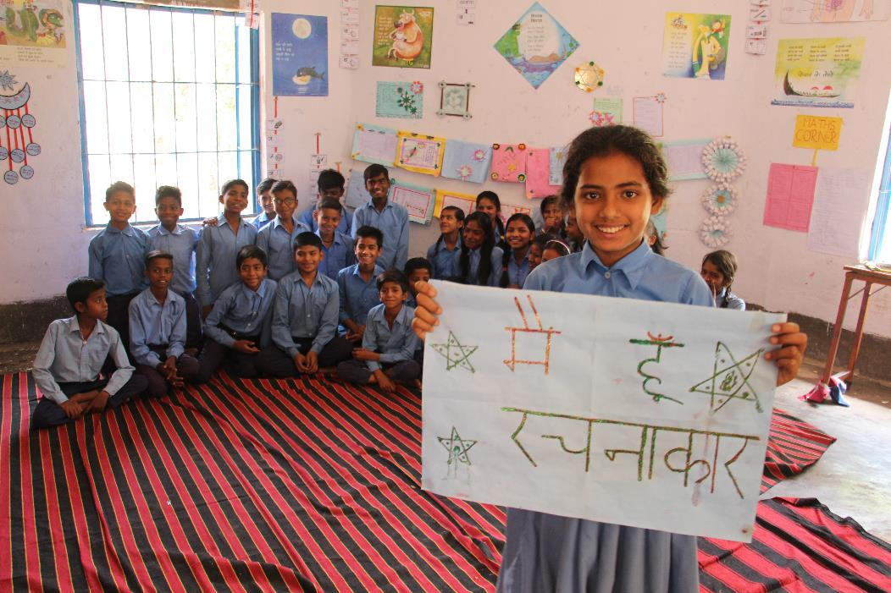
Welcome Message
My name is Abhishek Kumar, and I am a teacher at the Basic School, Bakhari, Muzaffarpur district, Bihar, India

Slide 3
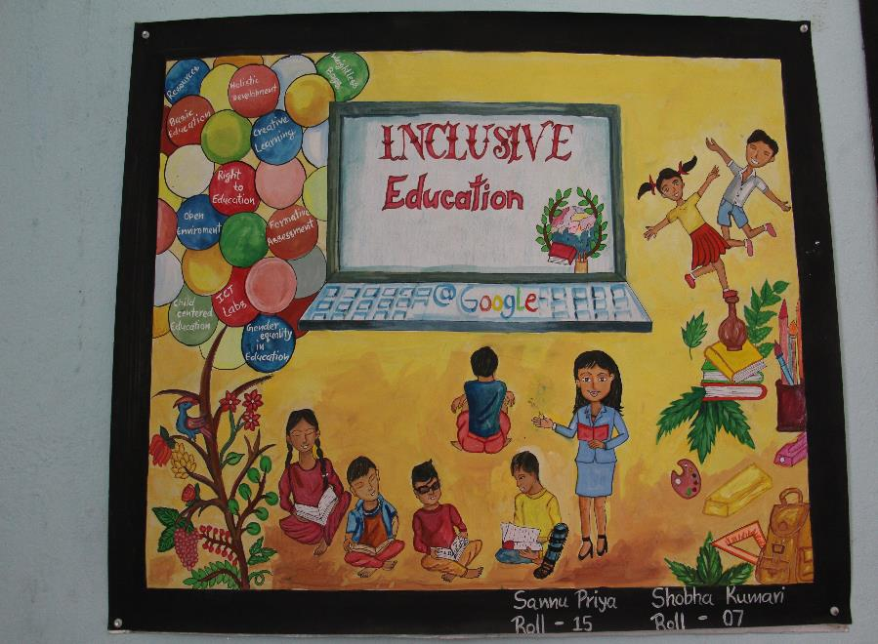
The Challenge
Nearly 50% of students in primary classes encounter moderate difficulties in learning,
especially during the initial months, due to the disparity between their native language
and the language used in school
1
    Students from diverse language backgrounds encounter various language, communication, and cultural challenges that impact their daily performance in school
    Children’s literature is predominantly available in Hindi or English, with limited options in regional languages
    Schools currently lack suitable opportunities to incorporate students' home languages into various curricular activities
2
3

Slide 4
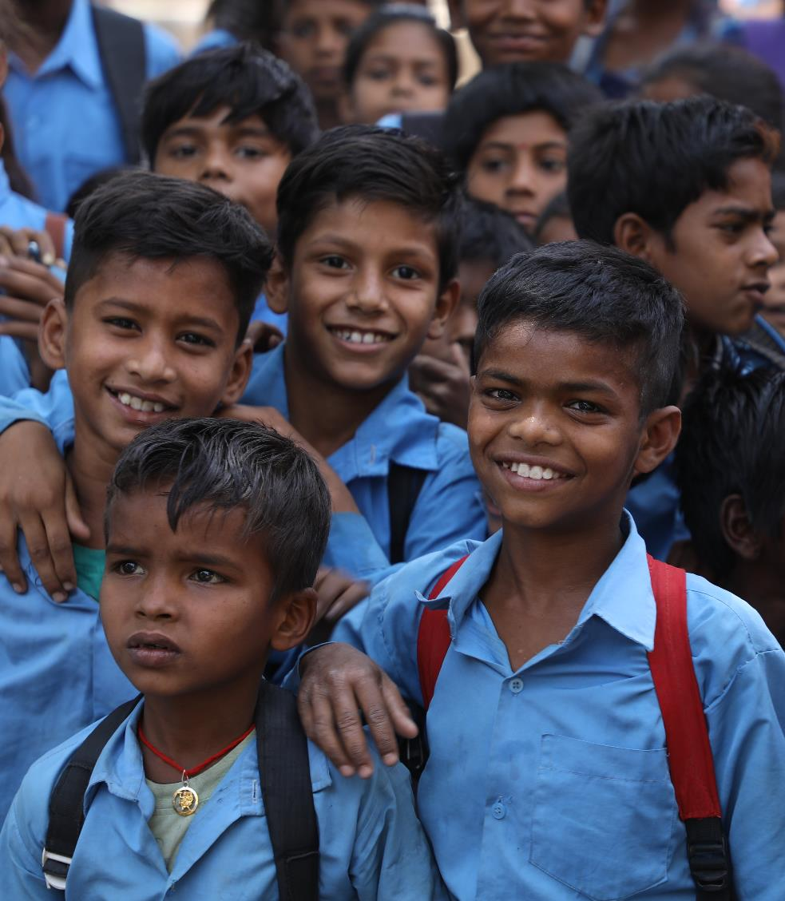
Context Framework
History of the Problem
The difference in languages between the school and home environments, emphasis on standard language, limited space for home language in curricular activities, and a significant scarcity of print materials in local languages collectively impede students' understanding of the curriculum
Who are the students?
Children of 6 to 10 age cohorts.
What is the community like?
Bakhari is a medium-sized village with a diverse linguistic landscape comprising Hindi, Urdu, Maithili, Vajjika, and Bhojpuri speakers. The overall literacy rate stands at around 46%, while female literacy remains low at approximately 18%. About 34% of the population constitutes the working class, and there has been a significant rise in migration from the village to other states.
Notes:
This school provides education for students coming from diverse ethnic and socio-economic backgrounds, emphasizing the heightened significance of fostering inclusivity, equity, and pluralism in the field of education.
The population of Aleksandrovka village is diverse and includes different ethnic groups. The Dungan community is the largest ethnic group, representing 70% of the village's population, kyrgyzs – 15 % etc.
The village has a high rate of internal migration, and according to the national statistic committee report Chui Oblast is the destination with the highest influx of people from other regions
In the presentation, it would be good to mention "why internal migration from the southern regions is challenging" and mention that the internal immigrants from the south tend to have lower level of Russian, in general.

Slide 5
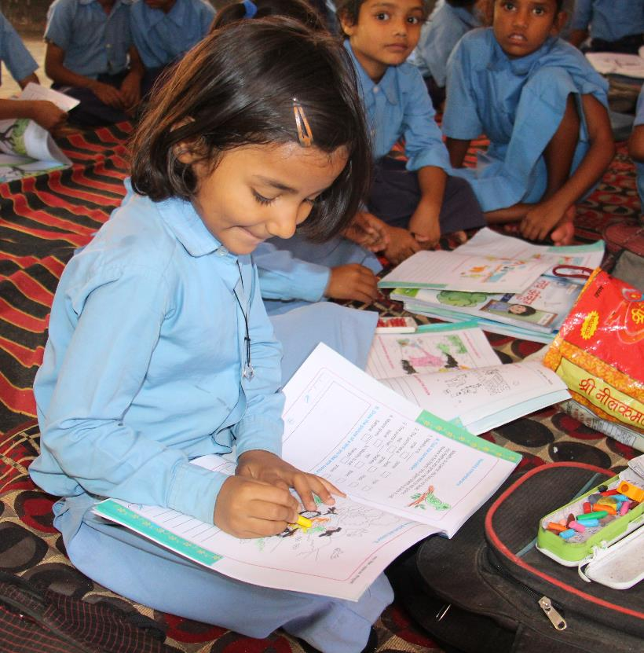
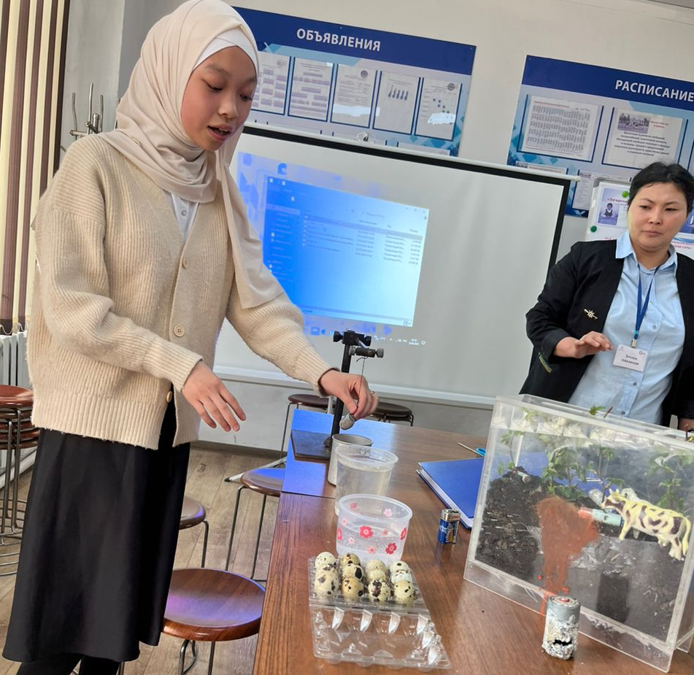
The Idea
How will we solve the problem?
Establishing a multilingual learning environment that integrates students' home languages within the curriculum aids in improving their understanding of the subjects and facilitates a smooth transition to the standard languages (Hindi and English).
To foster language inclusion and learning, initiatives like collecting folktales, children creating books, and introducing a local language children's newspaper can be implemented. Incorporating home languages into the medium of instruction also supports students' educational growth
To address the learning challenges arising from language differences between school and home, and to mitigate academic disparities, it is essential to establish a multilingual environment
IDEA
METHOD
GOAL

Slide 6
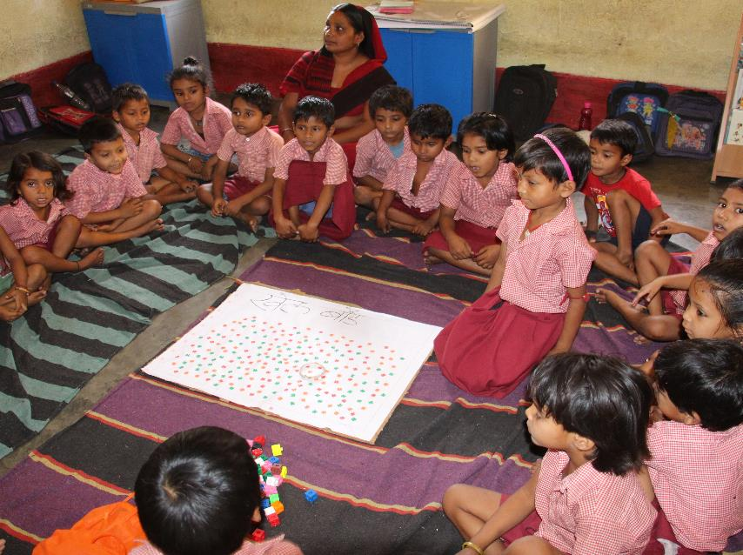
Design Process | Gathering evidence
What did we learn from assessments and interviews?
1
Assessment
Difference of language as well as focus on standard language hinders overall learning, expression, meaning-making, and understanding of concepts and generate a sense of exclusion.
2
Language and Socio-cultural Profiling of Students
The home languages of students are Vajjika, Maithili, and Bhojpuri. Hindi and English are almost missing in the community life of the students. Students get hardly any academic support from their parents due to their high level of illiteracy. However, among the parents, English/Hindi carries an aspirational value and are preferred as a medium of instruction.
3
Non-availability of Multilingual Teaching-Learning Material
Surprisingly, no teaching-learning material is available in Vajjika, Maithili, Bhojpuri, and other languages. The dominance of English and Hindi in Children’s Literature.

Slide 7
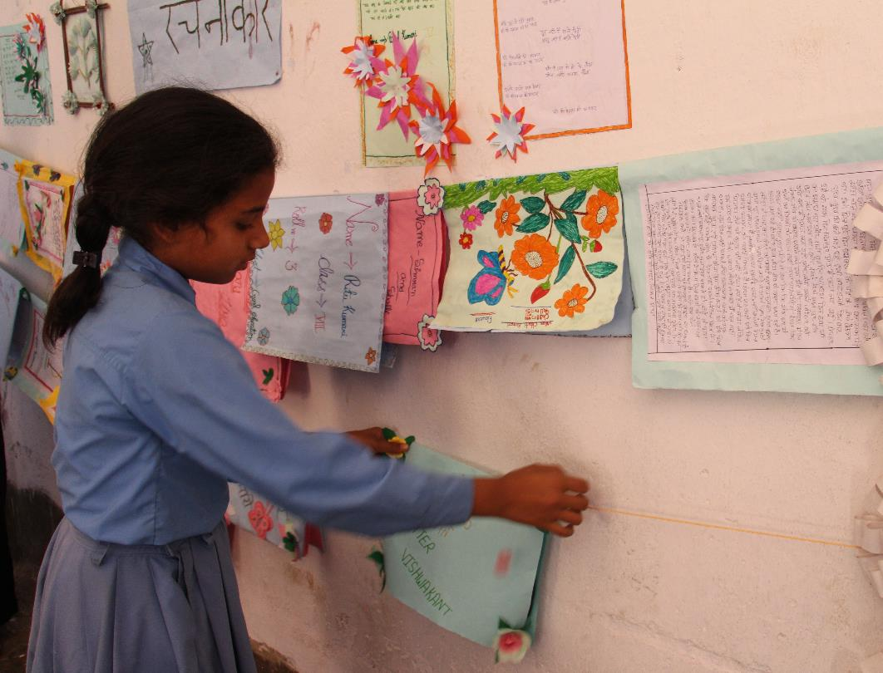
Prototyping
and Testing
Library corner and providing age-appropriate Children’s Literature
School-community collaboration: collecting folklores, storytelling
Multilingual TLM: Small Books, Simple Dictionaries, Monthly News Paper
Creating space for Home Language in Medium of Instruction
Design
Process
Notes:
Sources

Slide 8
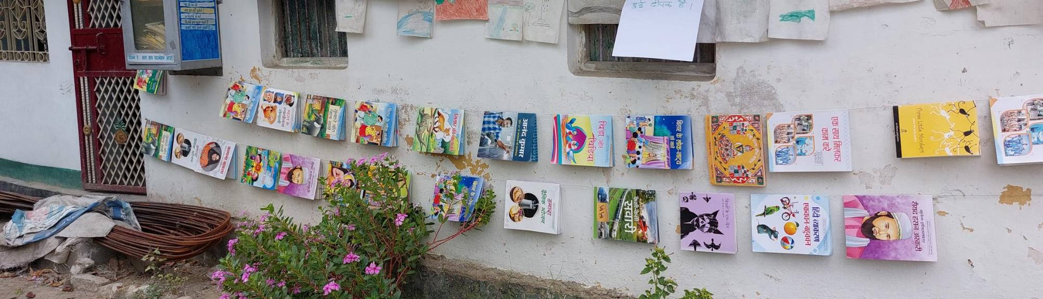
About Our Innovation
Phase 1: Print-Rich Environment
Established a library corner and oriented students to spend their free time there in the company of others. Displaying their works, encouraging them to do various activities viz. making stories, expressing their thoughts in their home language, drawing.
Notes:
Sources

Slide 9
About Our Innovation
Phase 2: local language resource creation
We have implemented activities focusing on children's home languages, including:
    a monthly newspaper featuring articles written in their native tongues
    a program for translating stories into their home language
    adaptations of popular stories into local languages
    These initiatives promote language expression, literacy development, and cultural appreciation within our diverse student community. By celebrating linguistic diversity, we aim to create an inclusive environment that supports the overall growth and well-being of our students.
Moving ahead we will be:
creating a simple dictionary to document vocabulary in different home languages
collecting folklores from various cultures
converting them into small books for students to read and share
These initiatives aim to further preserve and promote linguistic and cultural diversity while fostering language learning and storytelling among our students.
Notes:
Sources

Slide 10
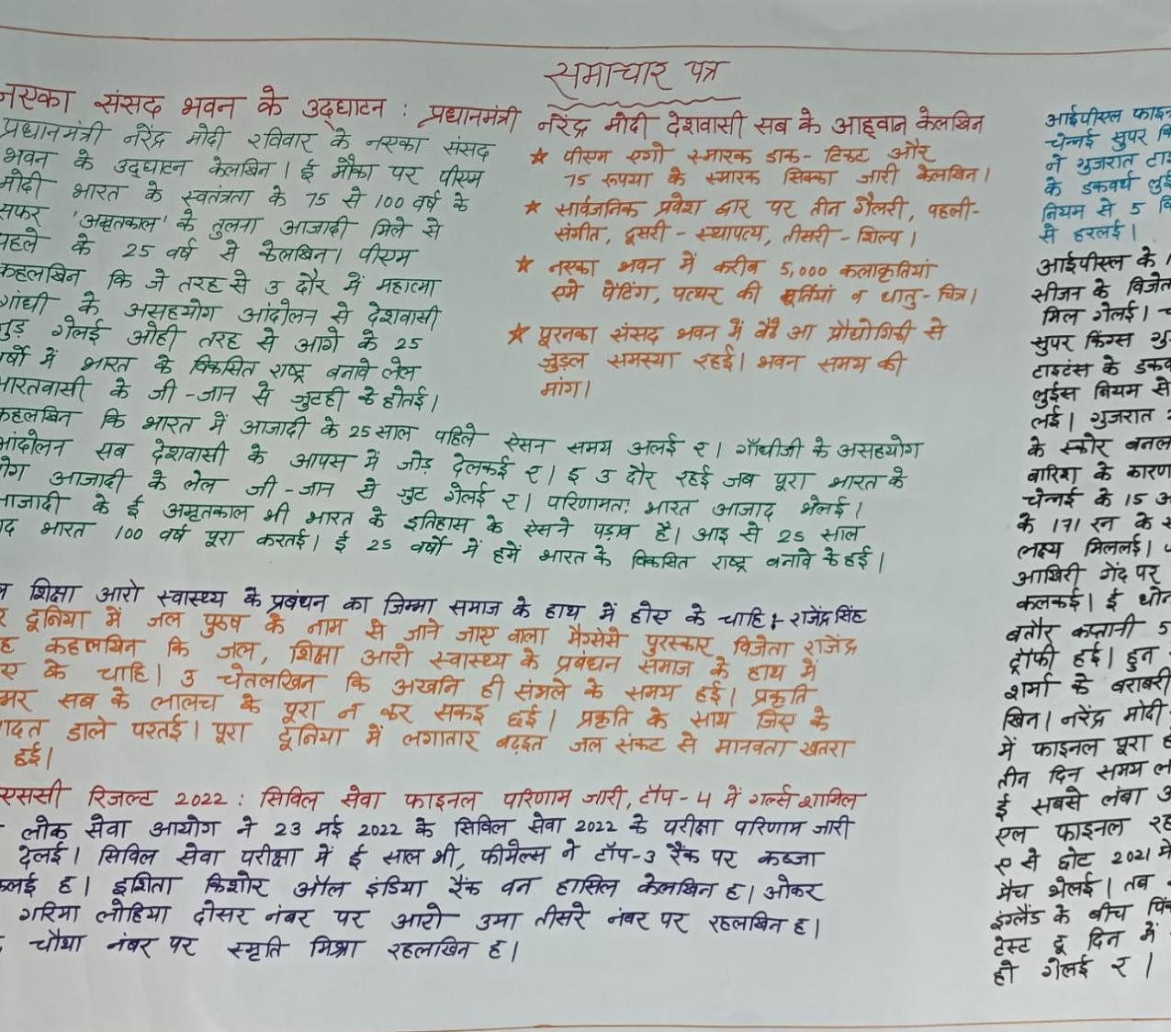
About Our
Innovation
Monthly Newspaper in Vajjika Language
Notes:
Sources

Slide 11
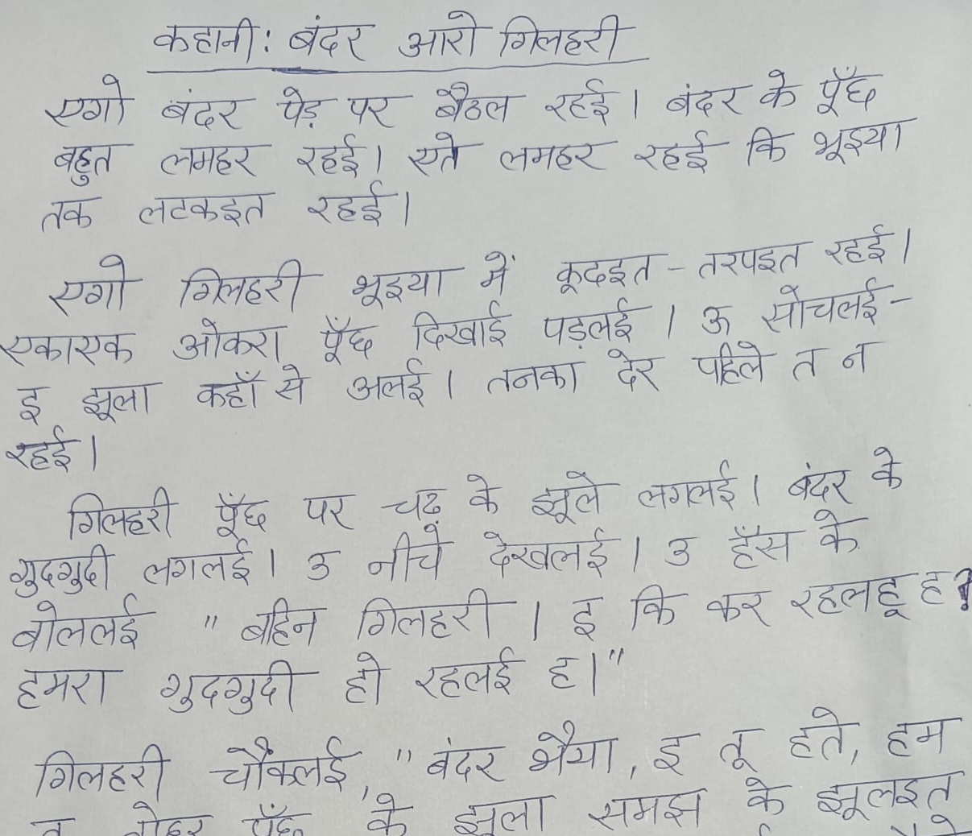
About Our
Innovation
Translating and adapting the stories in English and Hindi into Vajjika and other home languages of the students
Notes:
Sources

Slide 12
Creating Positive Change
How will know if our idea is successful?
We have developed customized assessment tools to evaluate holistic learning outcomes, encompassing cognitive, social, emotional, and physical aspects. Through assessment, we aim to provide insights that will inform educators and policymakers in creating targeted and impactful learning experiences for these cohorts
We continuously evaluate the impact of students' participation and interest in various activities, as well as their attendance and retention rates. This evaluation is carried out through regular feedback from students and documentation by our Learning Partner. By gathering and analyzing this information, we aim to understand and improve the overall engagement and commitment of students in their learning journey
Notes:
Sources

Slide 13
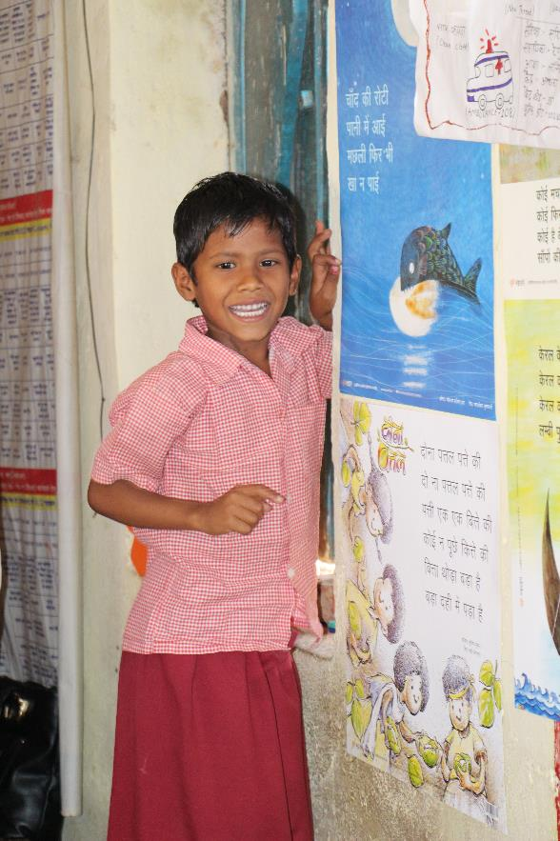
Call to Action
Call to Action
2
1
Literature and Teaching-learning Material in Home Languages
Translating and adapting children's literature from Hindi and English into the home language enhances language diversity and inclusivity. It allows children to access stories that reflect their cultural background, fostering a love for reading. Additionally, collecting folklore preserves cultural heritage and promotes a sense of identity among young readers.
Fostering a common understanding and cooperation among other teachers within the school
Embracing linguistic diversity requires a collaborative approach where teachers recognize and value the benefits of multilingualism, fostering an inclusive environment that celebrates and supports various languages and cultures.
Notes:
Sources

Slide 14
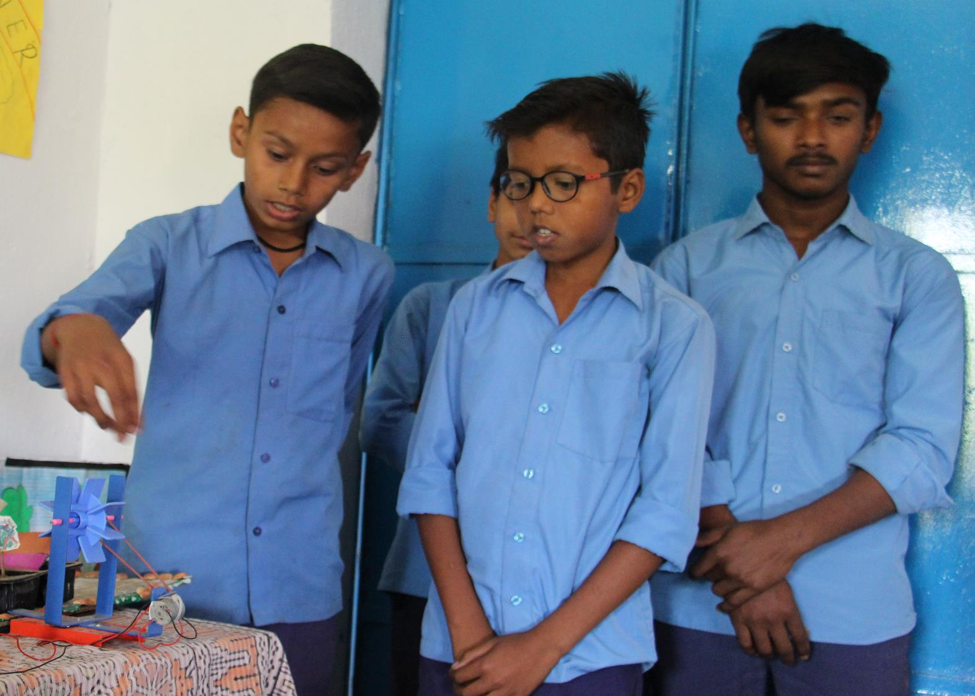
Closing remarks
Enhancing curricular understanding fosters appreciation for languages and cultures, creating a more inclusive learning environment. By incorporating linguistic diversity, students develop empathy and a broader worldview
Creating an inclusive learning environment ensures that students feel welcomed and included. By embracing diversity and fostering a sense of belonging, students can thrive and engage fully in their educational journey
Developing teaching and learning materials in children's home languages enhances their educational experience, supporting language development and cultural pride. This initiative promotes improved educational outcomes for students by providing resources that align with their linguistic backgrounds.

