Slide 1
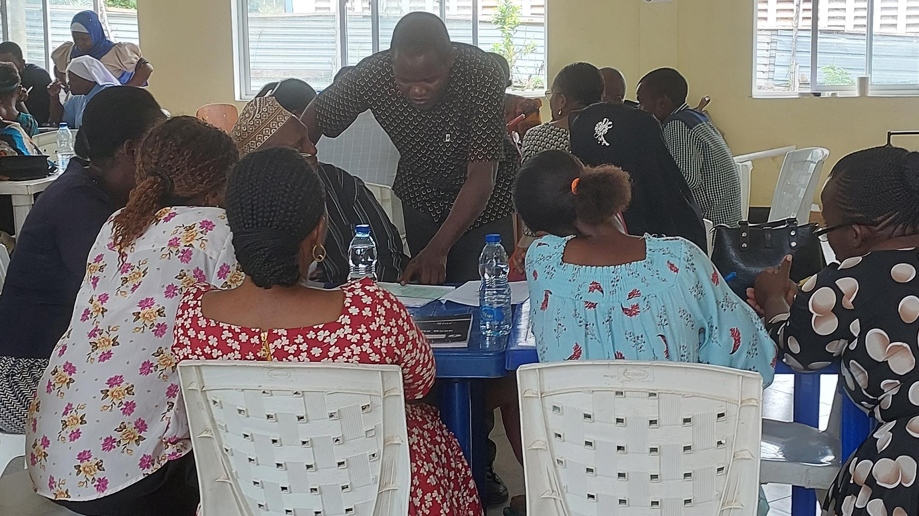
Mbande Primary School
Name: Mwajuma Mlezi
PARENTAL ENGAGEMENT

Slide 2
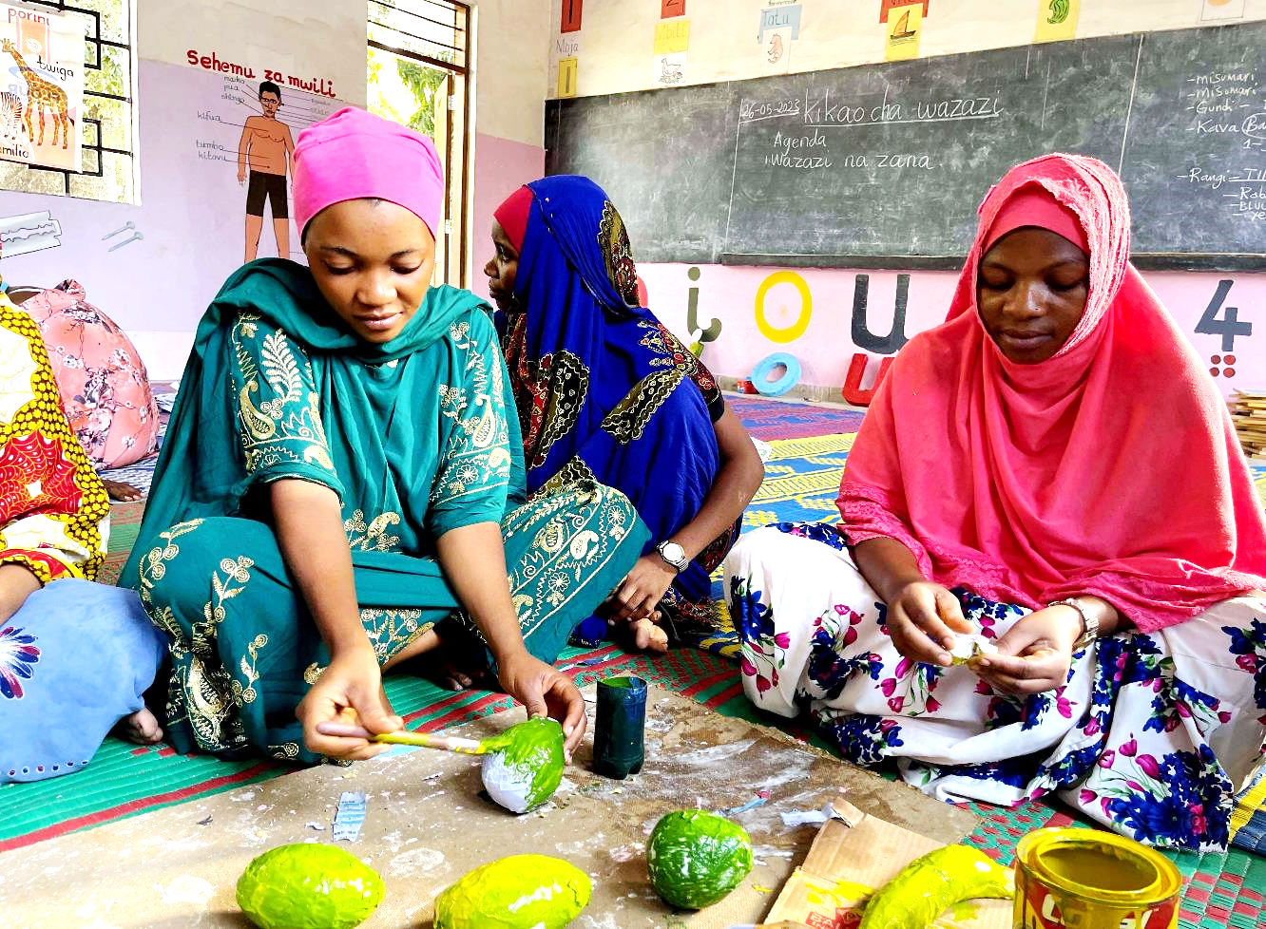
PARENTAL ENGAGEMENT AND MATERIALS
Notes:
My name is Mwajuma Mlezi
Pre-primary teacher at Mbande school, from Dar es Salaam Tanzania

Slide 3
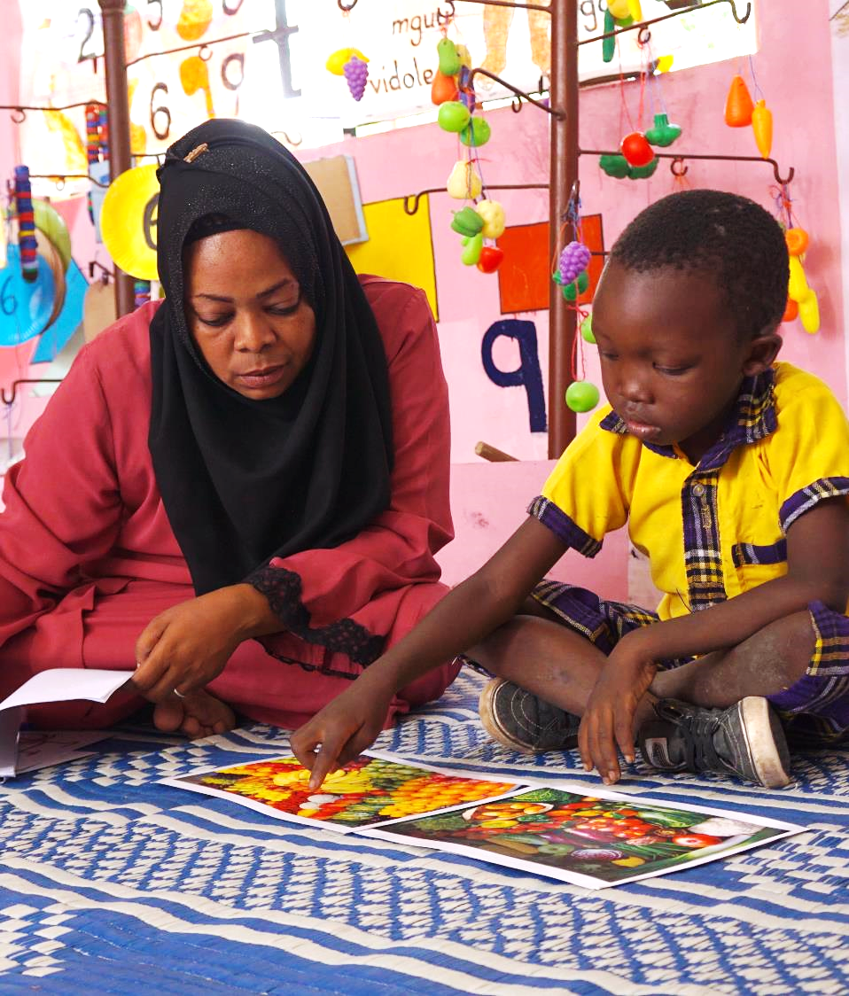
The Challenge
We assessed holistic learning outcomes and the teaching and learning environment
We identified that the teaching and learning environment wasn’t good enough. It doesn’t have the best quality T/L materials. Children didn't acquire basic learning skills more easily.
1
Parents were not engaging in supporting children’s learning. They didn’t prioritise preprimary education. Also, attendance was low. Here is a current enrolment: 154; M63, F91.
.
2
Notes:
The problem that the teacher solve

Slide 4
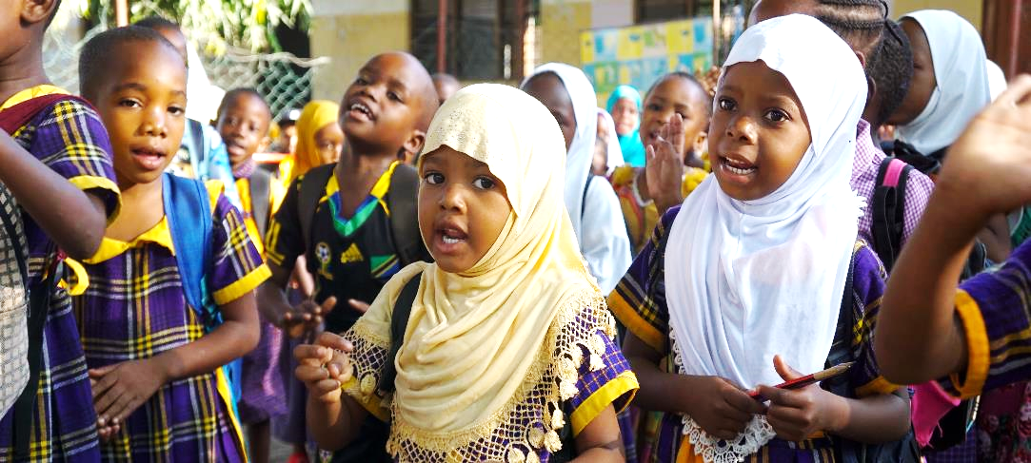
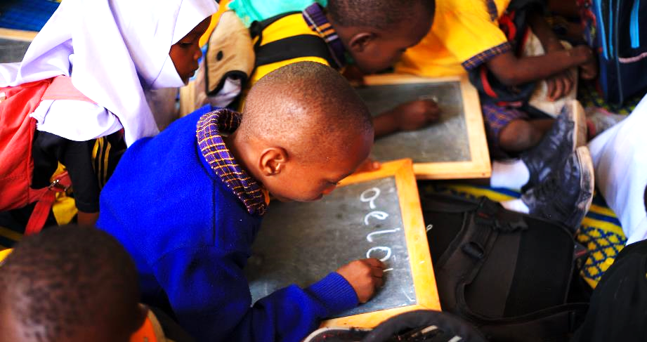
C
The Idea
How we solved this problem?
1
2
3
Parental engagement in the development of T/L materials
We achieve the idea through parents meetings, giving them reports on children’s progress, sensitising them through info letters, and igniting their enthusiasm to participate in school development activities, such as bringing resources and engaging in the fabrication of the teaching and learning materials, contributing and manage the feeding program, ensuring children’s safety and security.
This idea has helped all children learn through play, be creative, acquire 3R skills, increased collaboration among themselves, and self-expression.
Notes:
Our idea, Parental engagement in the development of teaching and learning materials to improve the learning environment

Slide 5
Design Process
1
2
3
We assessed learners and conducted interviews.
We conducted assessments on holistic learning outcomes using IDELA and learning environments (BEQI), where students and teachers participated.
Parents who participated in the interview explained their participation status and confirmed that their participation in school- related activities was generally poor.
We noticed
We identified that the teaching and learning environment wasn’t good enough. It doesn’t have the best quality T/L materials.
Children didn’t acquire basic learning skills more easily.
Our insight
These challenges and the way they hinder children’s learning. We confirmed the importance of improving the environment so that it can support learning processes.
Notes:
International Development and Early Learning Assessment(IDELA), Brief Early Childhood Quality Inventory(BEQI).
We worked together in our design team

Slide 6
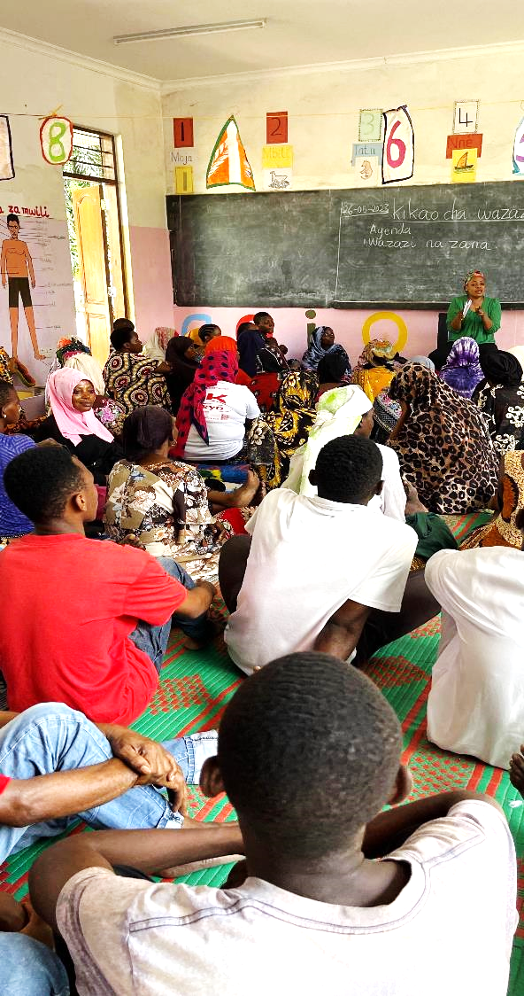
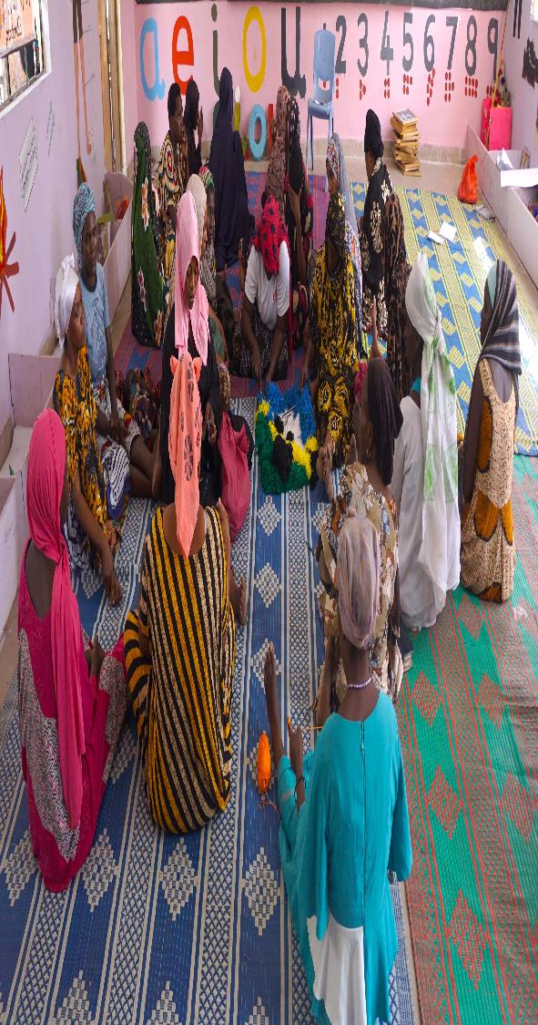
Design Process
Parental engagement and materials
We prepared parents’ invitation cards which clearly stated the purpose.
Through the meetings, we explained the teacher’s efforts in developing teaching and learning materials and their importance.
We agreed to meet once a month
Collect locally available resources to fabricate teaching and learning materials
Organise materials development sessions
Active participation for parents, both men and women
To have enough teaching and learning materials
Children to learn happily
Improved learning environment stimulates children’s creativity
1
What prototype did you create?
2
What assumptions were you testing in your prototypes?
3
What did you learn from testing your prototype?
How has your idea evolved?
When parents are involved, they participate actively
Parents have a great ability to develop quality materials and contribute to school development
Parents are the core agent in children learning
Quality and adequate teaching materials stimulate children’s learning

Slide 7
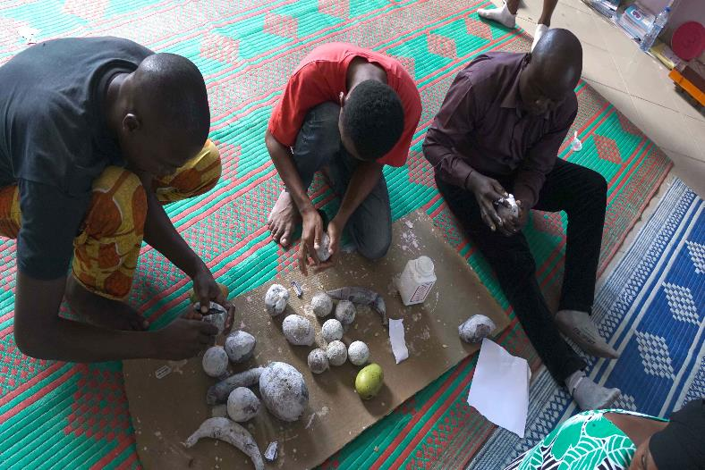
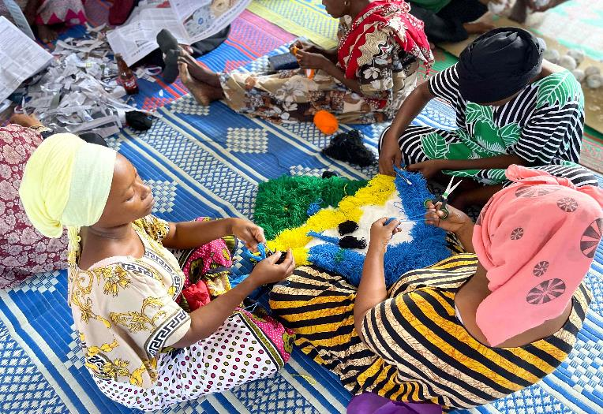
About the Innovation: Implementation
1
2
3
Key activities
Parent meetings
Resources mobilisation
Materials development
Teaching using available materials
Resources: locally available resources to fabricate T/L materials, contribute to the feeding program and purchase stationeries to develop materials
Timetable | Event | Time
Once a month | Meeting and materials development | Afternoon
Notes:
Meeting and continued materials development sessions, Photos: some parents in materials development sessions

Slide 8
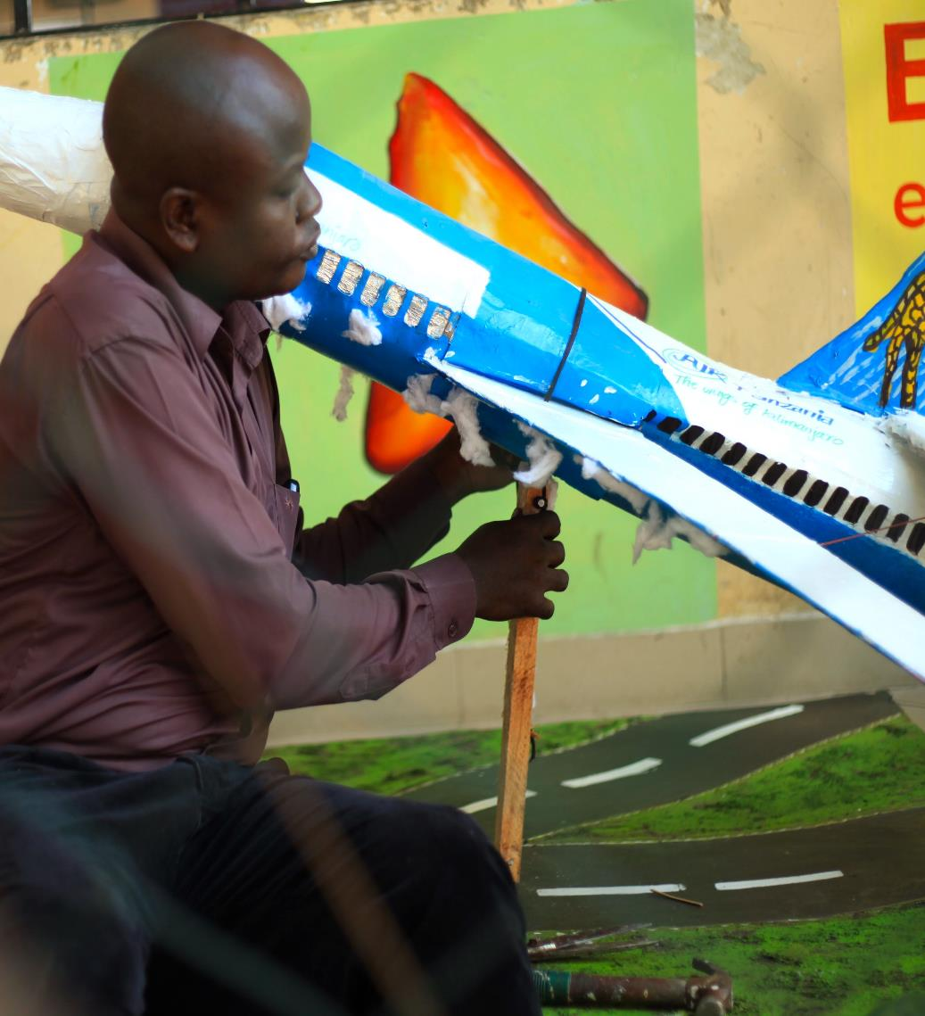
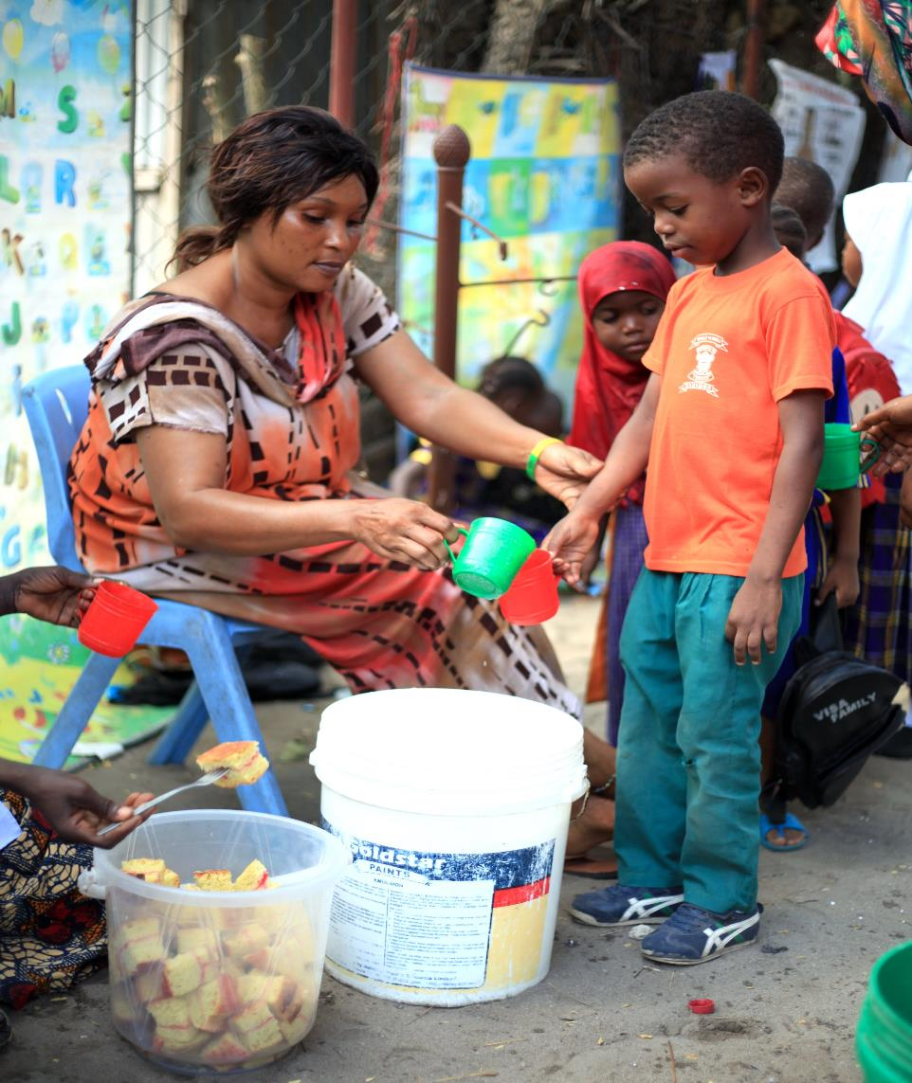
Notes:
Parental engagement, parents volunteering in developing materials and support in managing the feeding program

Slide 9
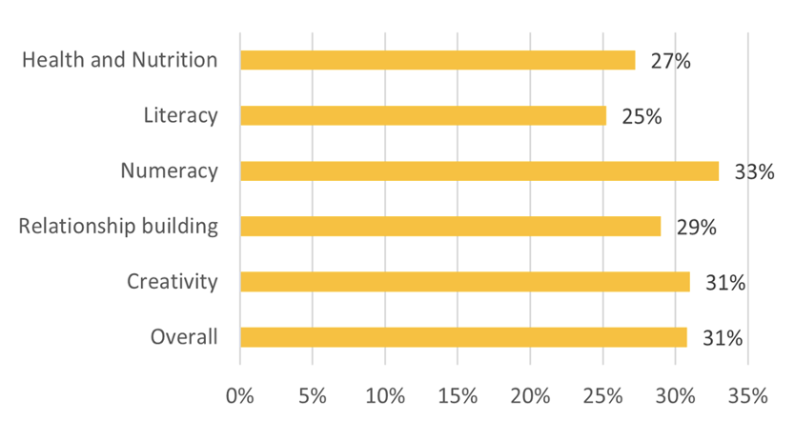
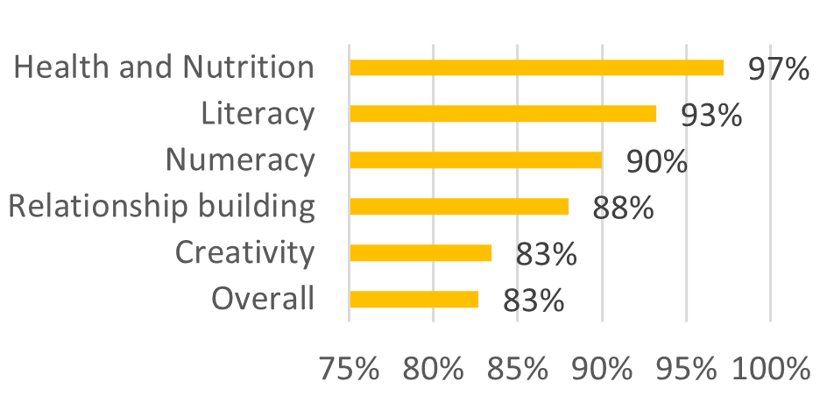
Positive Change
Learning Outcomes start of academic year
Observed impacts: Short term positive changes
The participation of parents has improved; data show that about 95 parents have participated in materials development sessions at least 6 times
Learning environment is friendly, improved with quality and enough materials
Learning is through play and collaboration
Children mastered 3Rs skills quickly
Increased creativity, children develop their own learning materials.
Children’s memory improved
Attendance has increased from 70 to 95 per cent
I believe next year, all the children will transition to standard one
Learning Outcomes end of academic year
Notes:
Assessment shows good progress as recently conducted

Slide 10
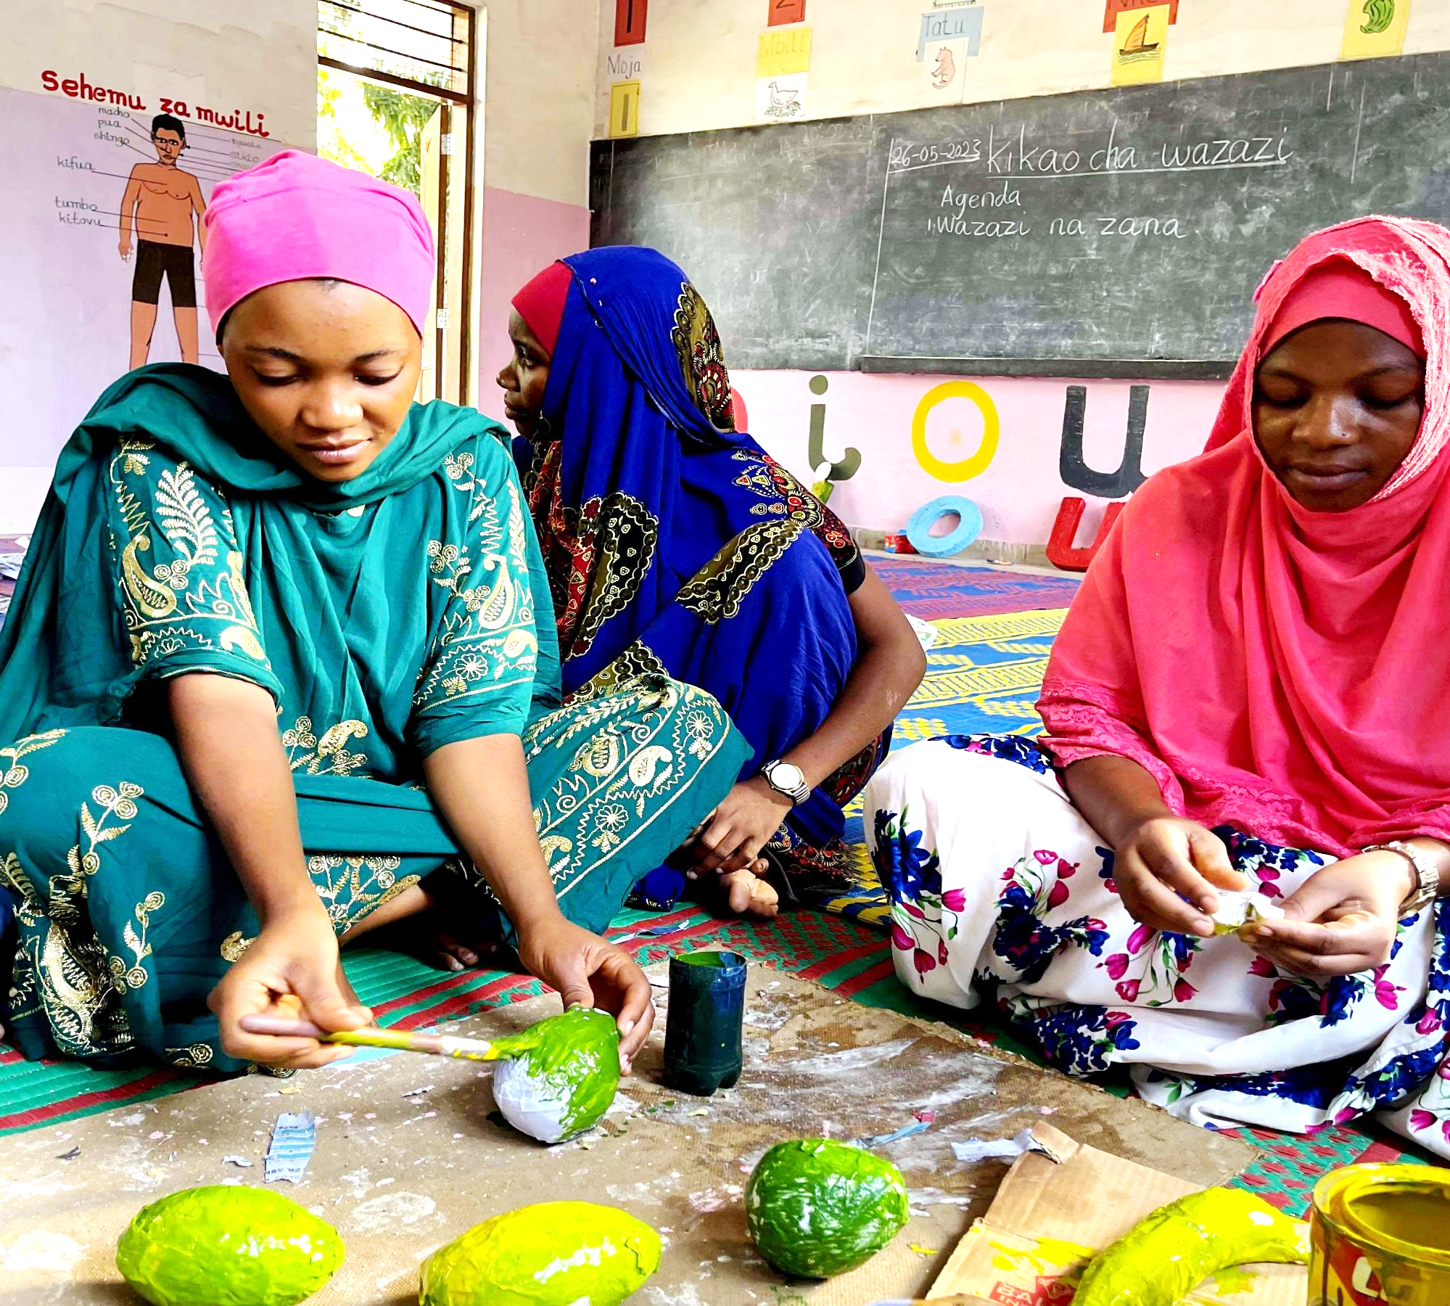
Call to Action
3
1
2
ENGAGE PARENTS
I call upon other teachers in all preschools to involve parents in the general school’s development, including the fabrication of teaching and learning materials. Parents are very helpful, and when they are involved, they participate actively.
ADDING MORE TRAINING
Stakeholders to train teachers on how to fabricate quality teaching and learning materials from locally available resources so they can involve parents.
TO EMPOWER TEACHERS WITH ASSESSMENT SKILLS
Schools2030 project should ensure that they equip teachers with the skills to prepare assessment tools, particularly those assessing soft skills and manage the exercise by themselves.
SCALE UP THE PROJECT TO OTHER SCHOOLS
I call upon stakeholders to continue supporting schools so other teachers can use Human Centered Design, to design, be creative in addressing challenges they face.
Notes:
Call to Action

Slide 11
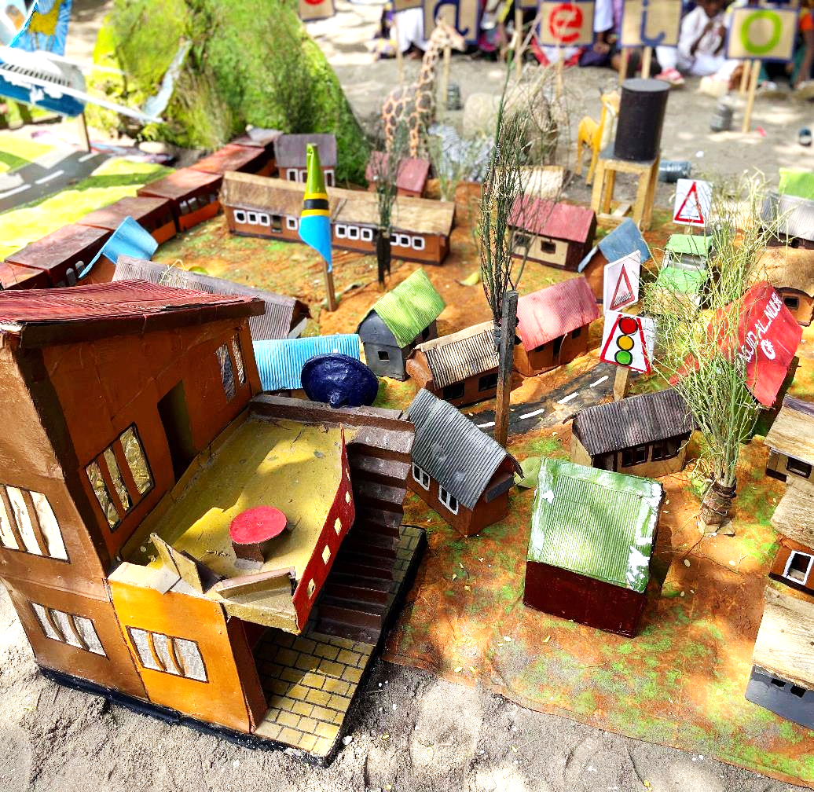
Closing Reflections
The Schools2030 project helps us a lot; we have become creative teachers, we implement our innovation, and it gives us the productivity to make work easier.
We get to engage other teachers from nearby schools who come to our school to learn and replicate what we do.
I believe that if I continue implementing this innovation and others designed in 2021 and 2022, I will be able to strengthen children’s learning processes, support children who do not have the 3R skills and improve attendance by 100%.
It will also help children to be creative, be able to express themselves and build good relationships with each other.
Notes:
Photo: model of my street created by parents, that teachers use to teach different topics including environment, traffic road signs etc

