Slide 1
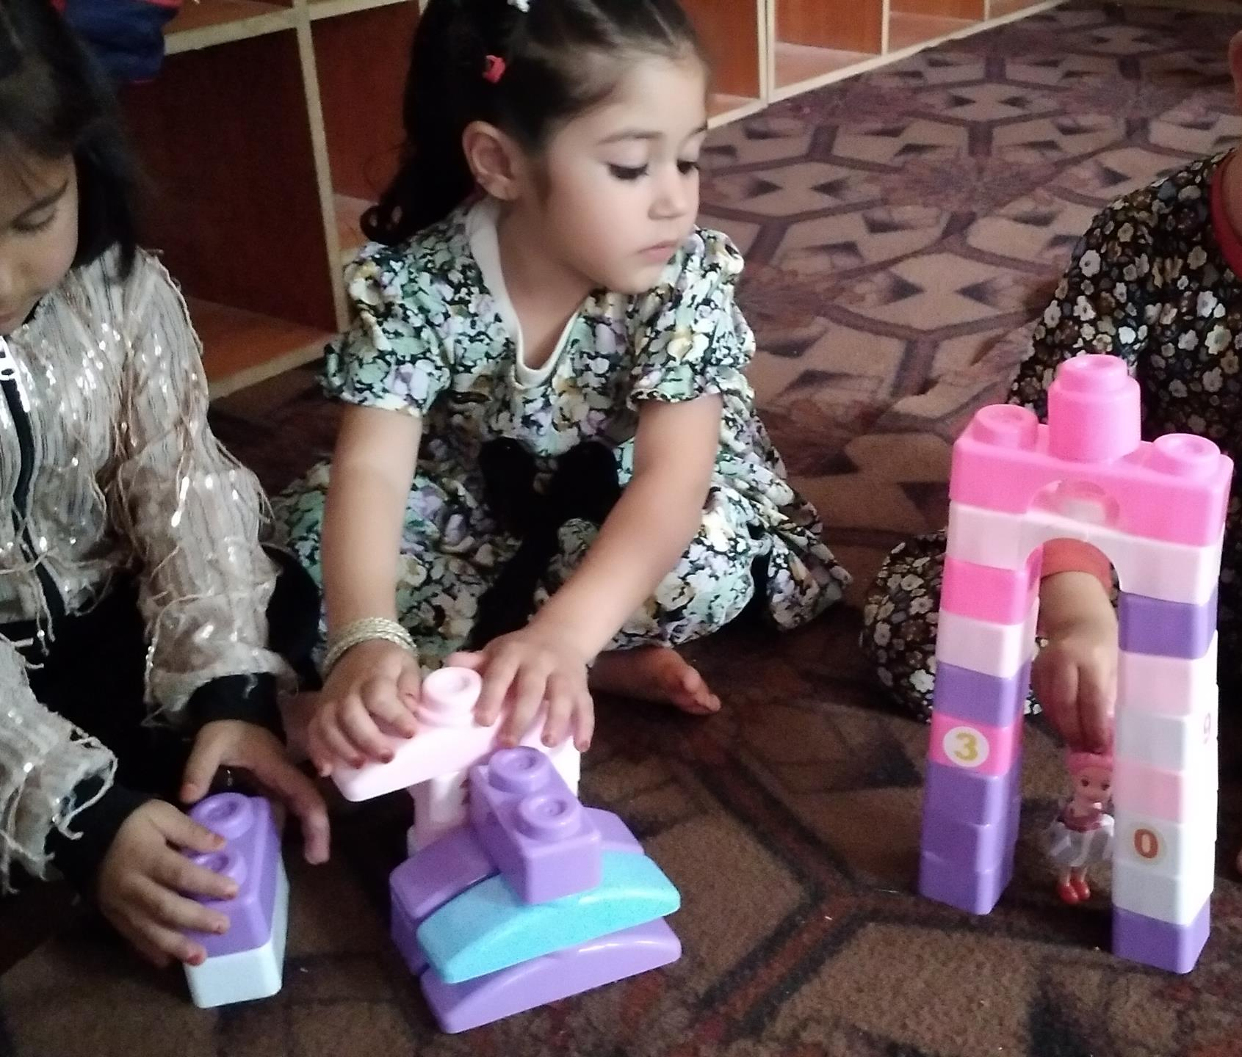


Learning Through Play – ECD in Afghanistan
Presented by: Jan Ali Entezar
June 5, 2023

Slide 2
Welcome!
Outline of today’s showcase
Jan Ali Entezar, National Manager –Education Implementation, AKF- Afghanistan
Presenting On behalf of Shakila and Qurban Begum, ECD teachers in Karte Khurasan high school in Baghlan Province, Afghanistan
Introduction
Showcase on Learning Through Play
Closing remarks

Slide 3




The Challenge: Low Student
Learning Outcomes in literacy, numeracy, health and nutrition, art, cooperation and creativity
Lack of qualified teachers
Social norms
Lack of public awareness about ECD
Limited mobility outside of community
Poor Parent-child interaction
Lack of understanding about the importance of play
Not trained on holistic and innovative teaching and learning approaches/ student centered teaching methodologies;
Lack of ECD teachers
Poorly equipped facilities
Policy and Strategy
Poorly equipped ECD classrooms
Lack of availability of play and learning materials at home and communities
Lack of specific curriculum, policy and strategy for ECD
Lack of policy makers awareness about ECD

Slide 4
Evidence of Challenge
Review of assessment evidence
Interview with Parents
The evaluation of the student’s knowledge in ECD (Early Childhood Development) showed 69 % in literacy(Reading and writing) subject, 34% in numeracy subject, 44% in cooperation, 70% in art and culture, 47% in health & nutrition and 7% in creativity.
There is not any playing space or playground for children, and because of that, the children have no interest in participating in ECD class".
Interviews with School heads
Interviews with teachers
School heads shared feedback on the biggest challenges that the teachers are not familiar with holistic, and students centered teaching methodologies, and as a result, the students face challenges in achieving their goals.
ECD teachers need the most support/short- and long-term trainings on holistic and students centered teaching methodologies. lack of teaching & learning materials.

Slide 5
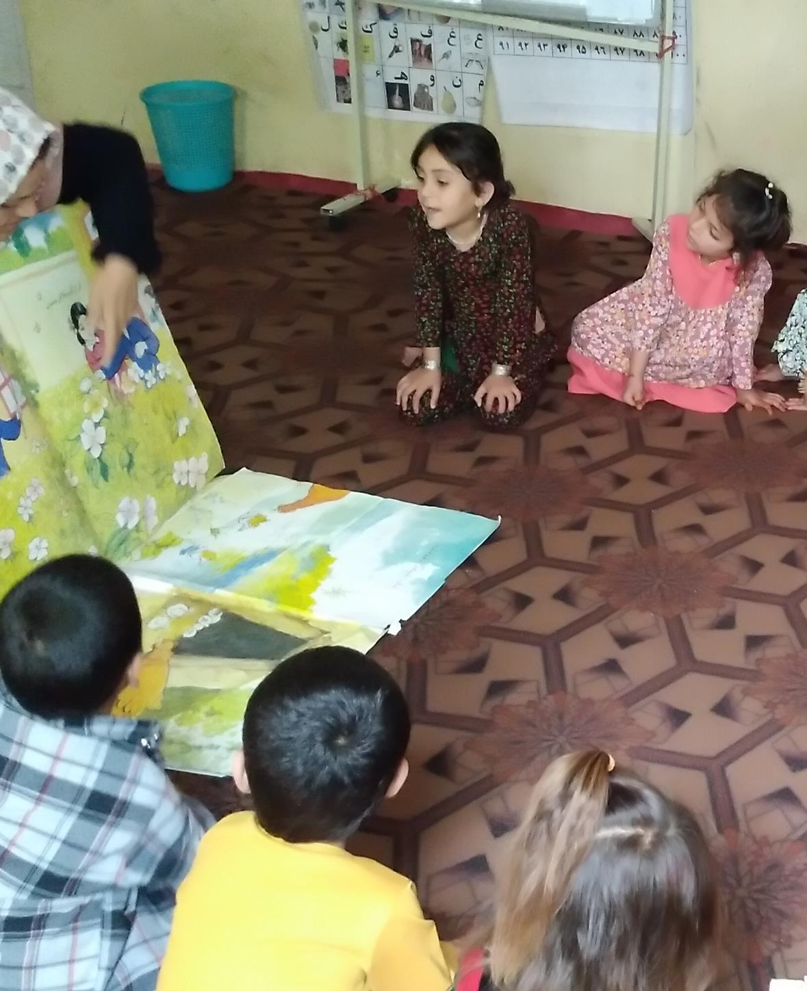
The Idea
How will we solve the problem?
1. Idea: To work with each student and provide the play and games environment for the students to improve the student learning outcomes.
2. Teachers receive training on the HCD process
3. To assess the students and use the data in the HCD process
4. To implement the HCD process in the ECD class

Slide 6
Design Process | Empathy
What did we learn from those we interviewed?
2
1
3
We noticed/ saw/heard…
There is not any playing space or
playground for children,
which affects children’s interest in participating in ECD class. ECD teachers need the support on holistic and students centered teaching and learning approaches. lack of teaching & learning materials in the ECD class.
Our insight…
Providing the play activities/environment for the ECD students will improve the students' learning outcomes
We met…
Teachers, school
leads, parents, and students

Slide 7

Prototyping and Testing
So, we created… and we learned…
Prototyping: 1. Provide the contents and topics of the training for the teachers and get their opinions. 2. Provision of teaching materials for prototype testing. 3. Equipping one of the classes in the school to hold a prototype testing session. 4. Preparation for two days of prototype testing, that in the first day AKF master trainer did some activities for teachers, and after that, the teachers practiced the activities in the class.
1
Design
Process
Assumptions:
1. The teacher is interested and actively participating in the training.
2. The teacher is interested to understand new teaching methods and activities.
3. The teacher learned new ECD activities.
4. The students’ participation in the class increased.
5. The student learns the lesson through play/games.
6. The learning outcomes of the students increased.
2
3
Learned: The testing prototype showed that all the students were active during activities, and the students were at the center of the activities and learned with each other to improve their literacy, numeracy, and non-academic skills. The activities were like play/games, and the implementation of the activities was as entertainment. The teachers said that implementing these activities would solve the learning problems.

Slide 8
About Innovation
How we implemented our innovation
1
2
3
Key activities
First letter collection game, Line puzzle game, Story telling, Teaching the alphabet to children by reading poetry, Play with Shapes, Make Shape Pictures, Play with Numbers, Happy games, and Cartoon drawing.
Resources
Stationery for students, class kit, doctor set, kitchen set, story books, math kit, flash disk, LCD for showing the alphabet melody videos for academic parts, stipend for the teachers.
Timeline
3 hours per day, 6 days a week, 3 Months.

Slide 9
Creating Positive Change
How will we know if our idea is successful?
Assessment table Shows the positive change in learning outcomes
Subject | Baseline | End Line | Progress
Reading & Writing | 69% | 84% | 15%
Numeracy | 34% | 85% | 51%
Cooperation | 44% | 85% | 41%
Art & Culture | 70% | 96% | 26%
Health & Nutrition | 47% | 99% | 52%
Creativity | 7% | 99% | 92%

Slide 10
Call to Action
What support do we need?
1
2
3
Qualified Teachers to implement holistic and innovative teaching and learning approaches
Schools Leads/Principals and Teachers Heads to support the teachers and provide opportunities
Parents and Community to support the schools and motivate the students

Slide 11
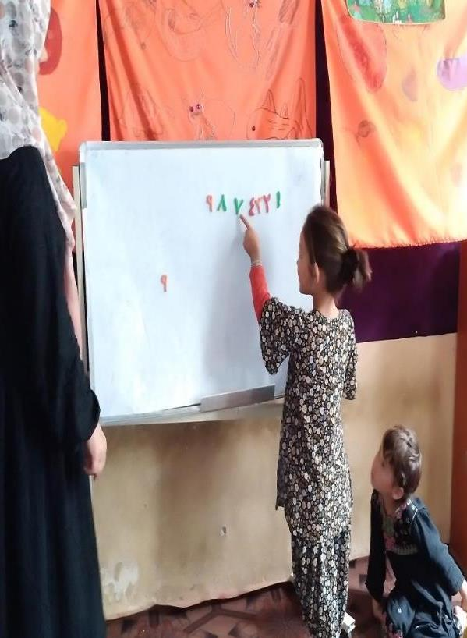
Closing Remarks
To share the results/progress with other teachers at the schools
To iterate and implement the successful innovation next academic year
Improved quality and relevance of teaching and improved students learning outcomes (knowledge, value, attitudes, skills).
Community and school support for ECD

Slide 12
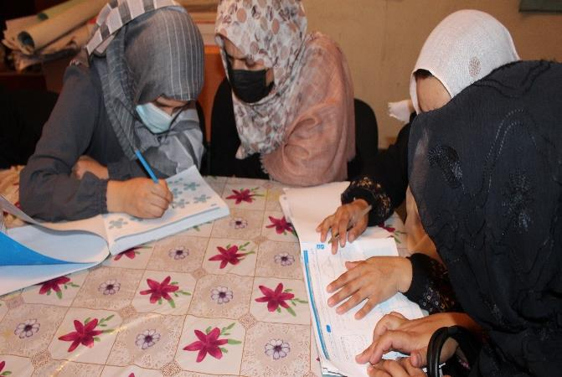
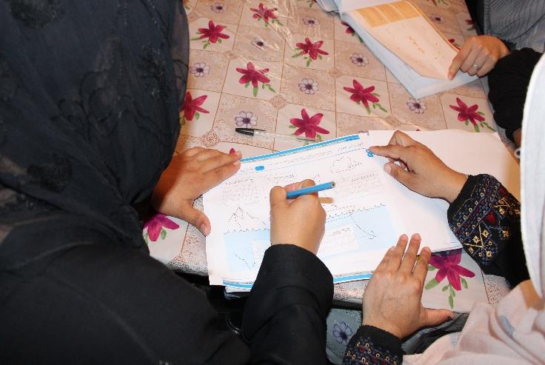
Photos
The design team is completing the launch phase to launch the challenge in the Karte Khurasan ECD center

Slide 13
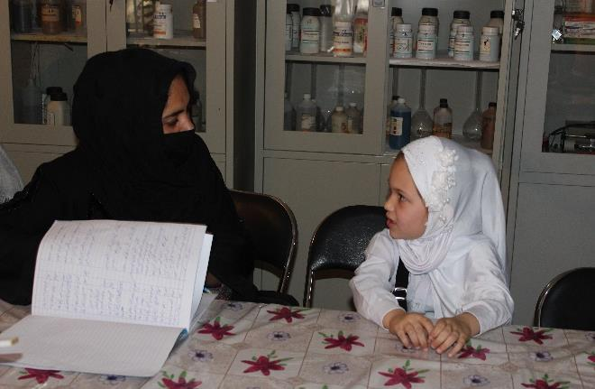
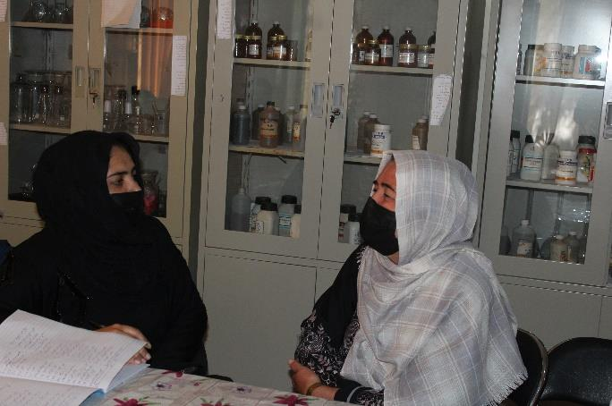
Shogufa Design team members interviewing parents and students to explore the challenge or problem.

Slide 14
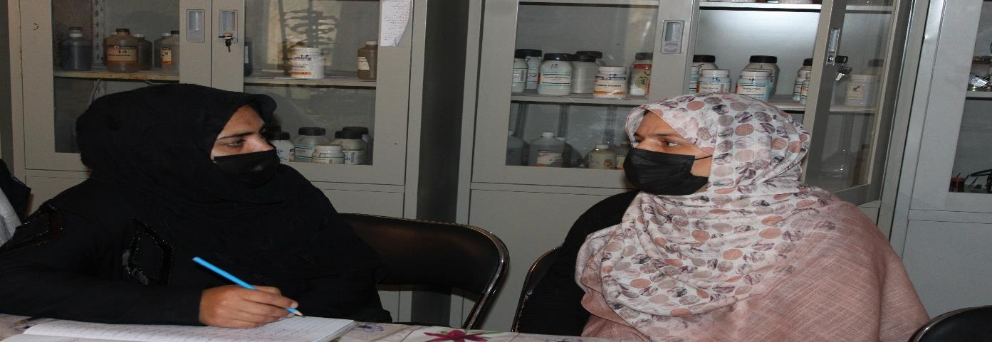
Shogufa, Design team member is interviewing the teacher of the class to explore the challenge or problem.

Slide 15
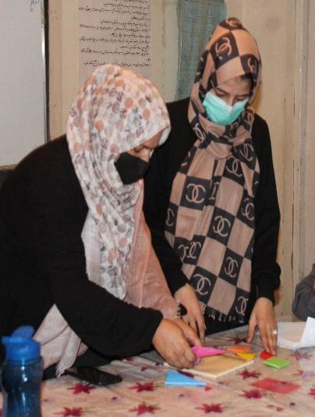
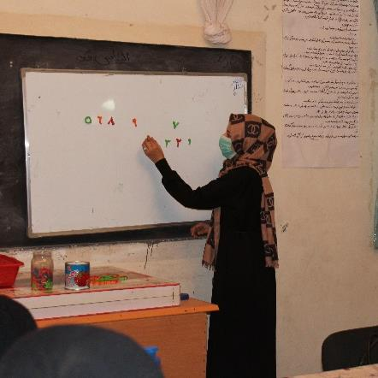
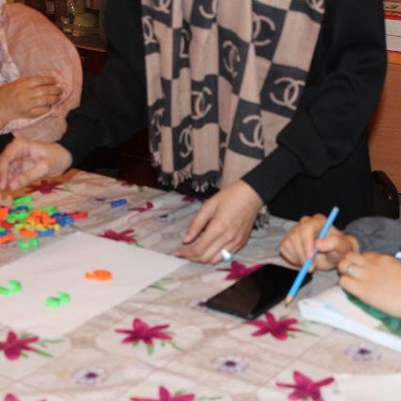
First day of test prototype:
Design Team is testing the prototype with the AKF Master trainer (Implementation of several ECD teaching activities with using of teaching materials in the classroom for teachers, as an example).

Slide 16
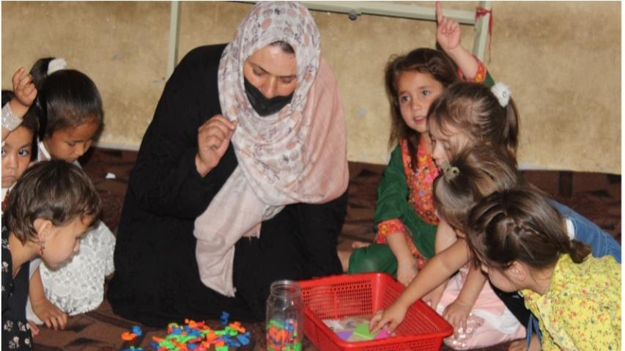
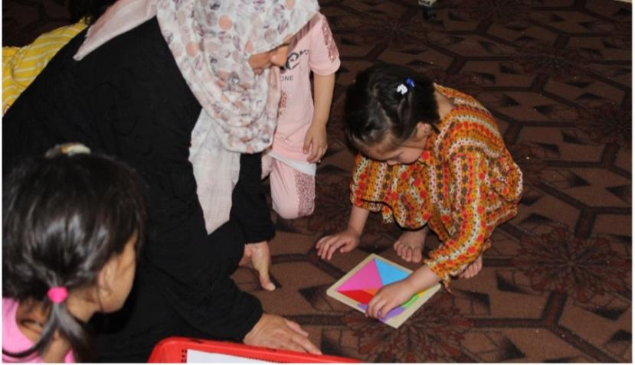
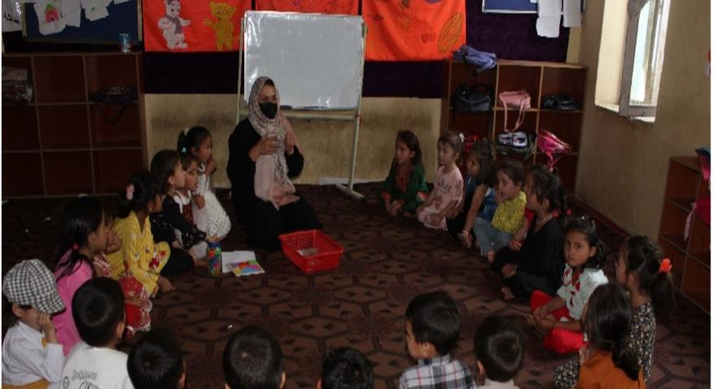
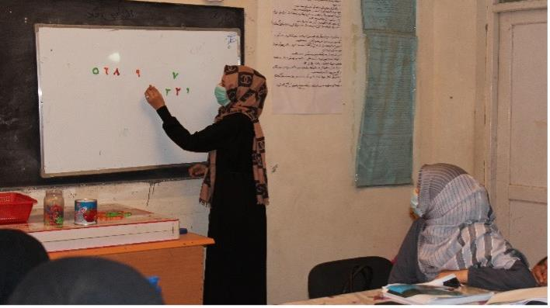
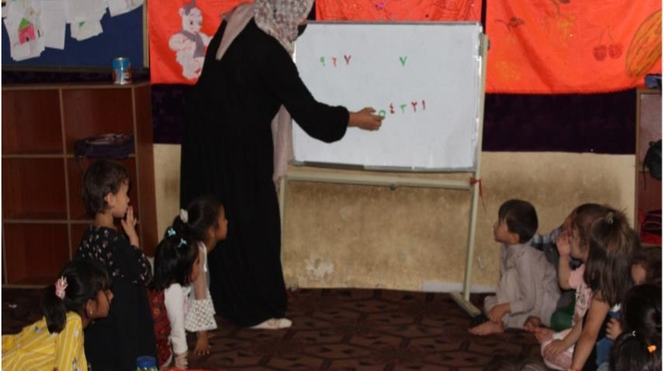
On the second day of the prototype test: The teacher practiced the activities, and the design team tested the determined assumptions in the Kharte Khurasan ECD center.

