Slide 1


GERAS aprender ao ar livre
‘outdoor learning’
Rogério Pereira, School Cluster Algueirão

Slide 2
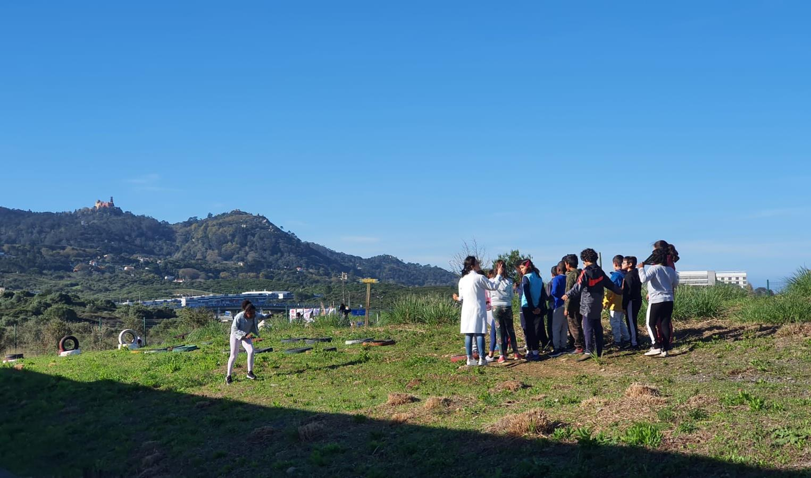

Agrupamento de Escolas do Algueirão
School Cluster of Algueirão
Urban school
1600 students
265 kindergarten children

Slide 3
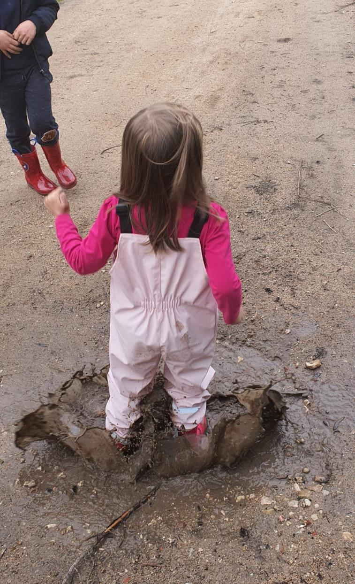
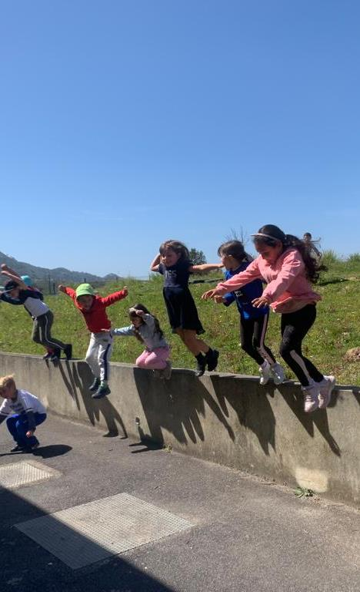
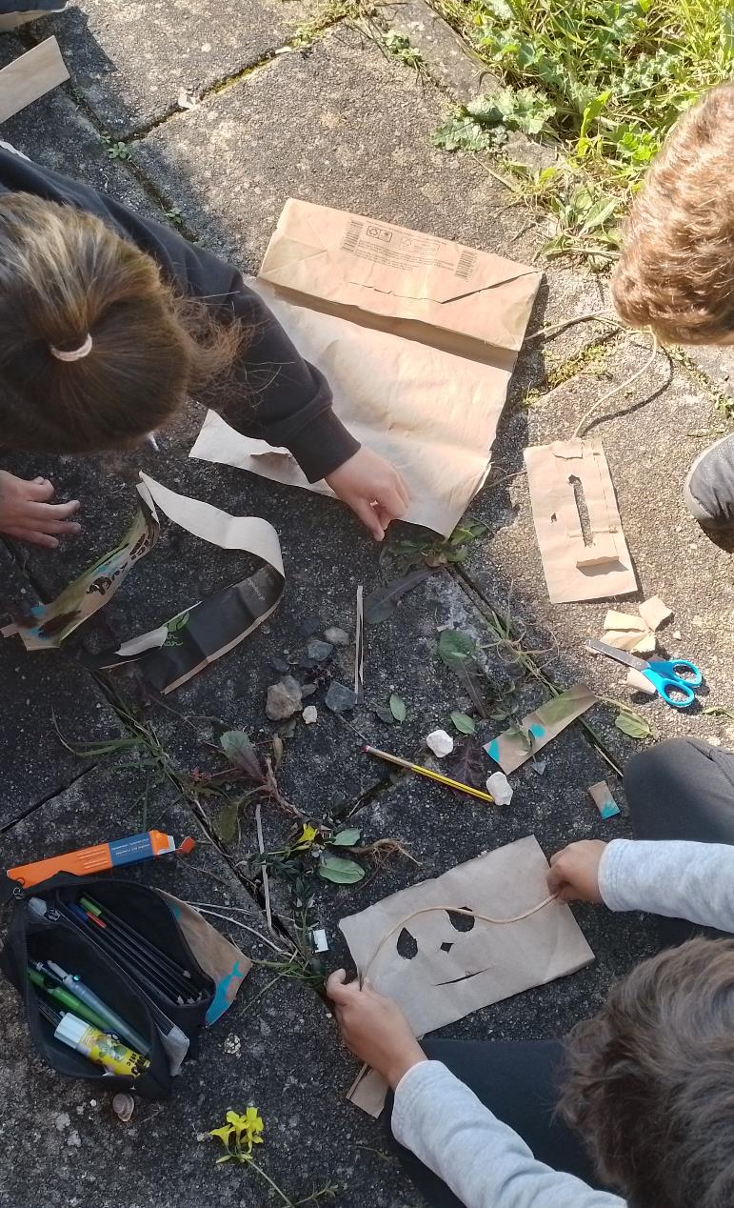
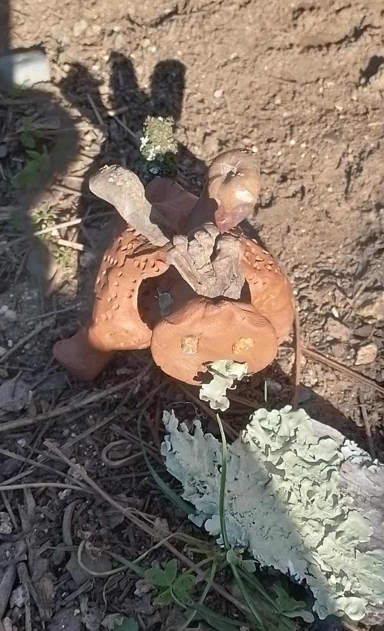
How to enhance creativity?
Students have little contact with nature. With pandemic this problem has worsened
The taste for school is lost;
Students lose creativity.

Slide 4
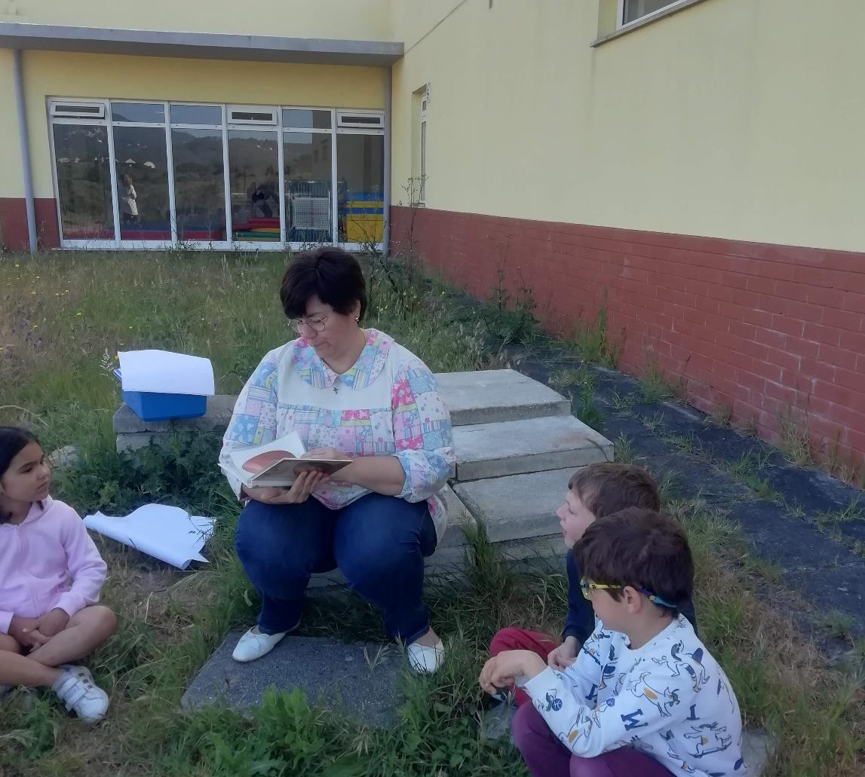
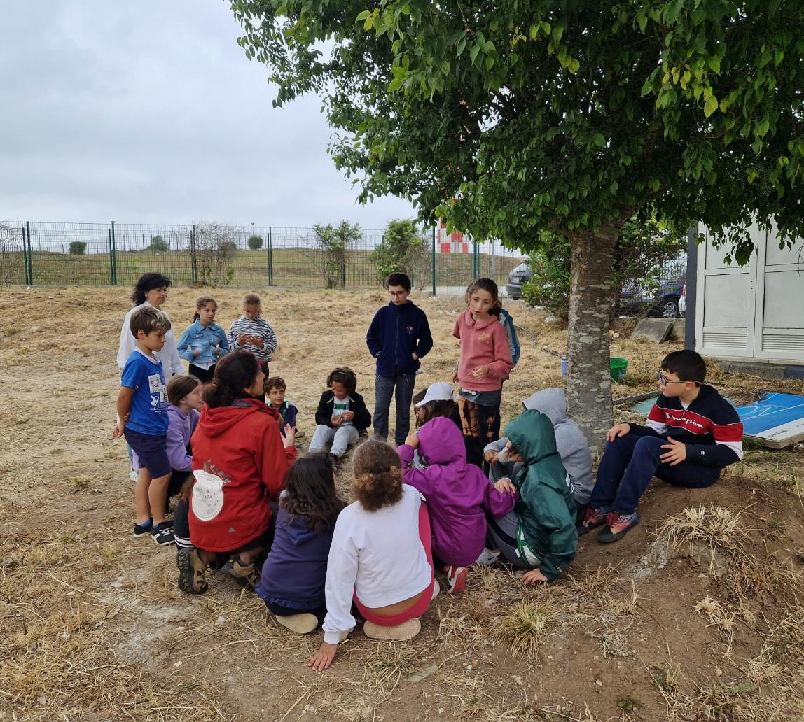
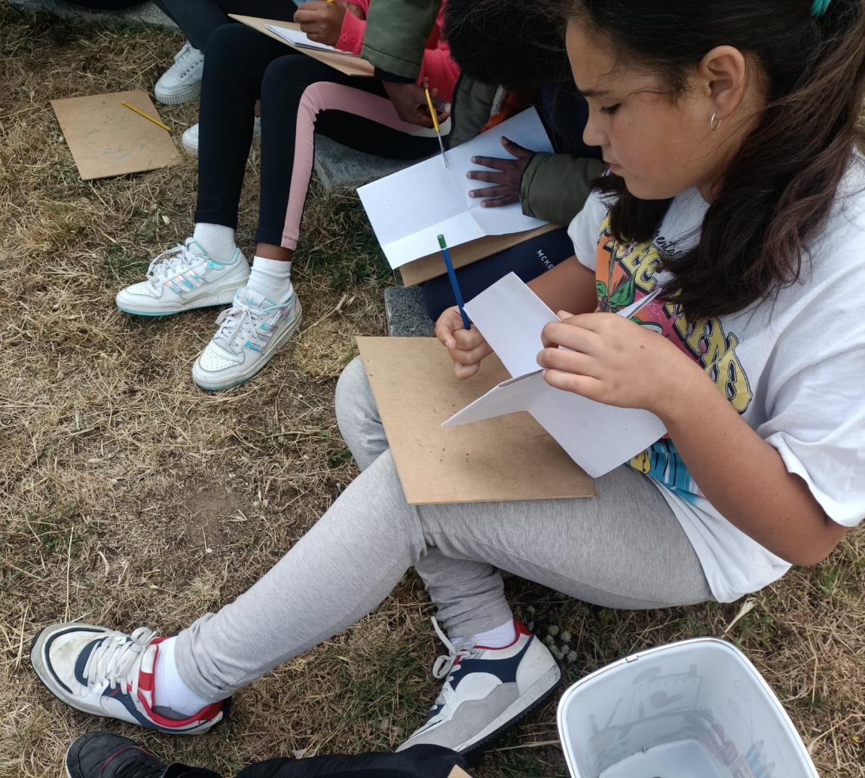
Creating an outdoor learning space
Students in kindergarten and fourth grade visited the site to develop design ideas for the outdoor space

Slide 5
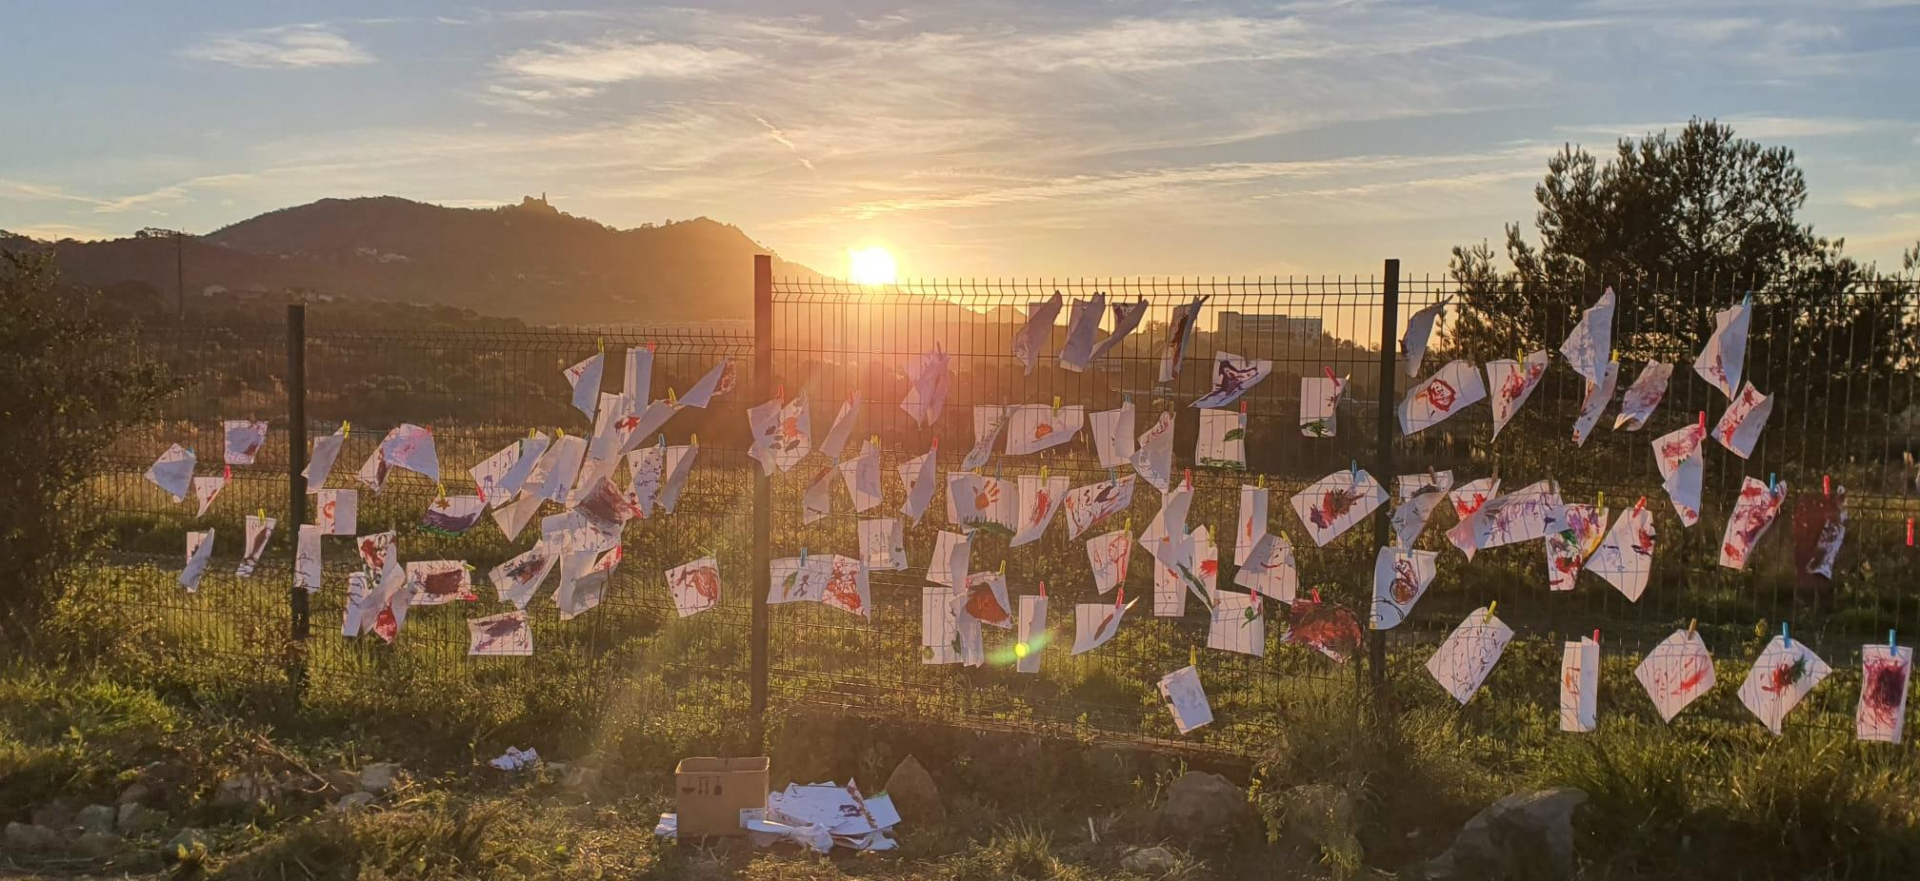
Sharing our design process
Children from 5 to 15 worked collaboratively to develop their ideas.
Parents, teachers and students recount this experience with enthusiasm

Slide 6
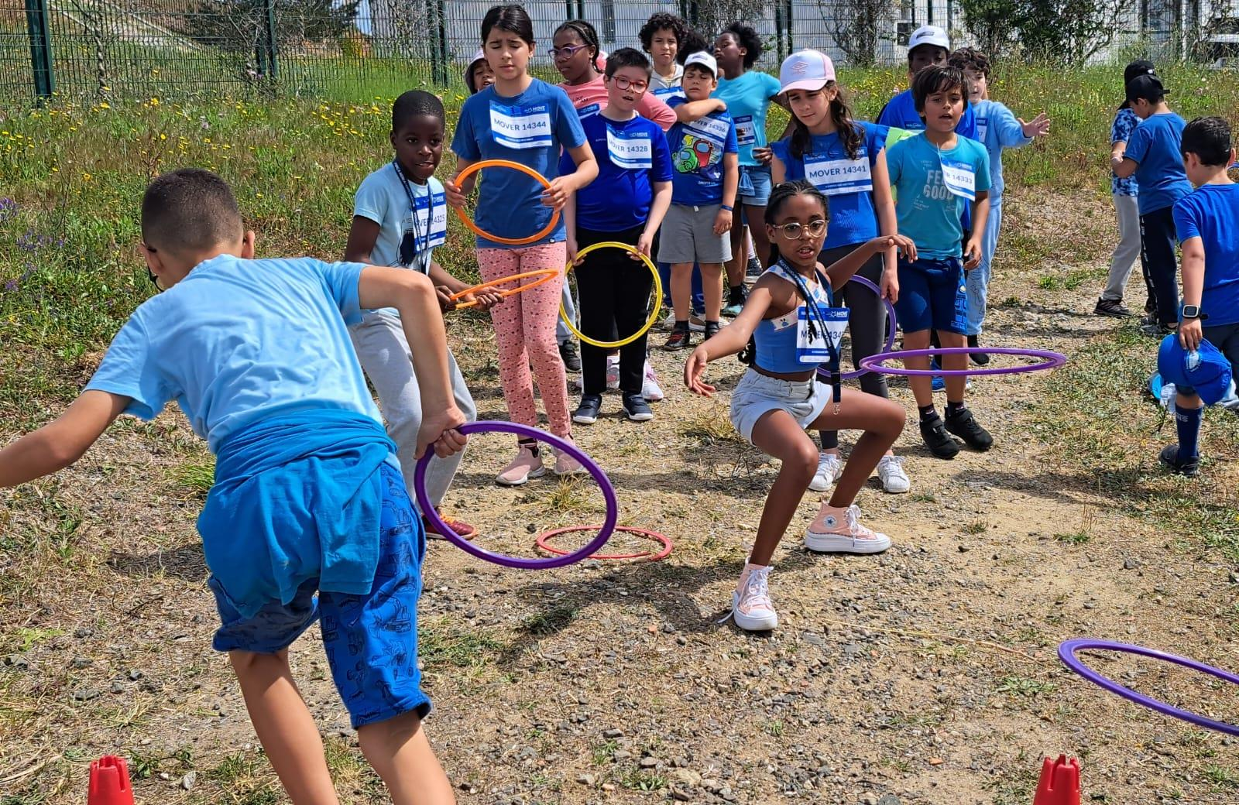
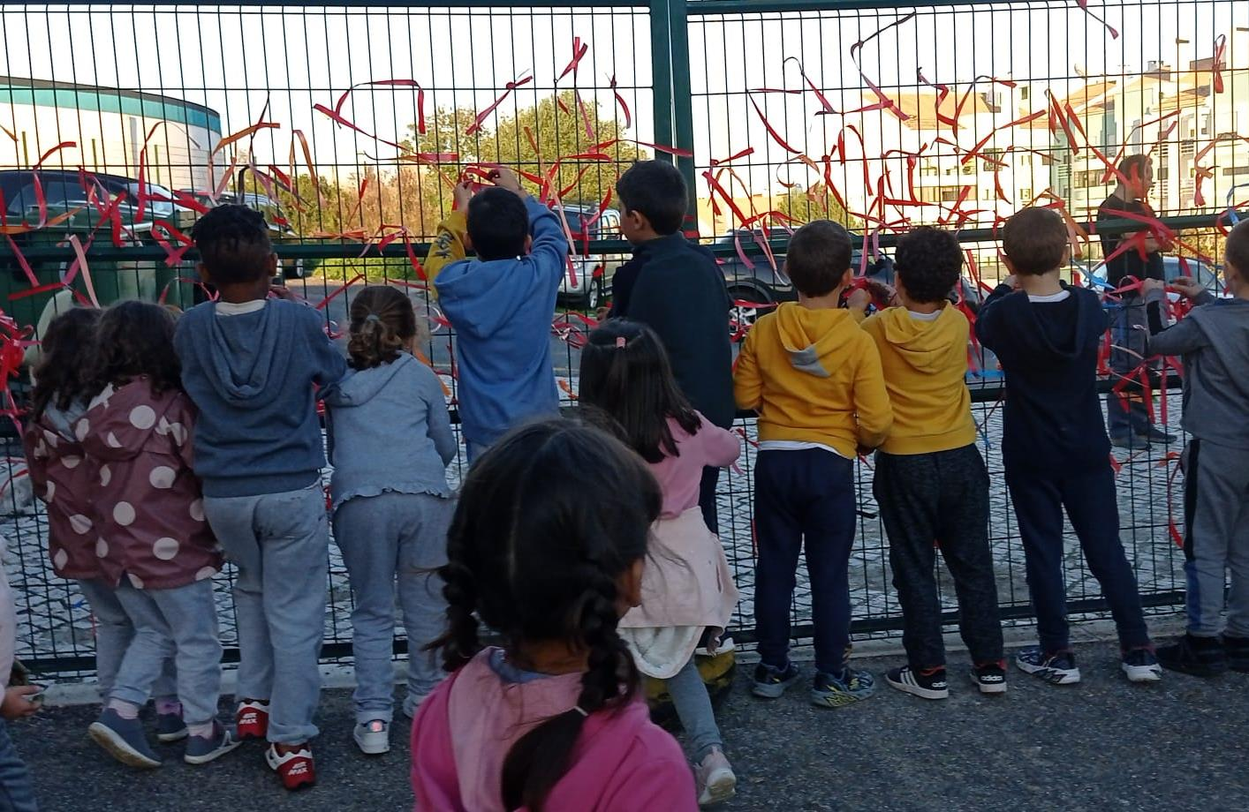
The test
“ It was astratospherically cool”
Teachers and students thought, acted, experienced, took risks, had fun and learned

Slide 7
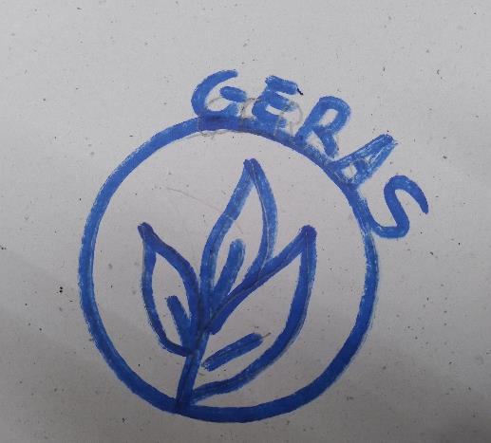
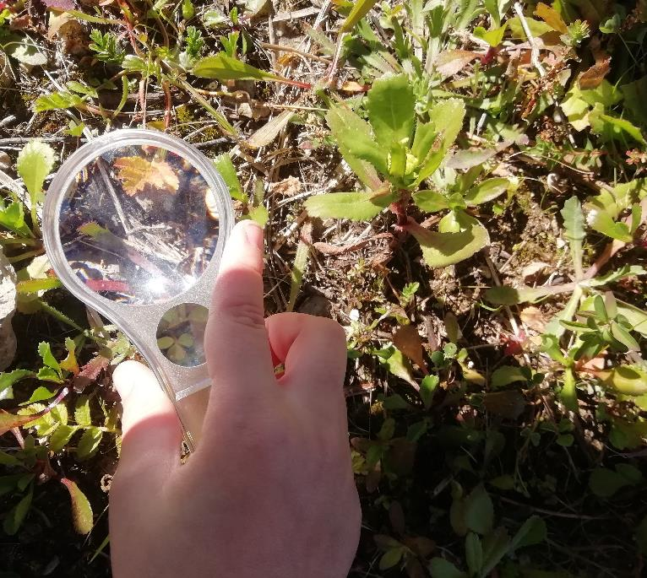
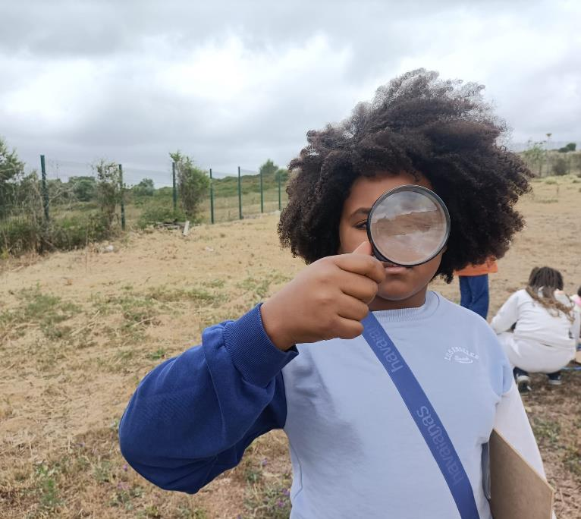
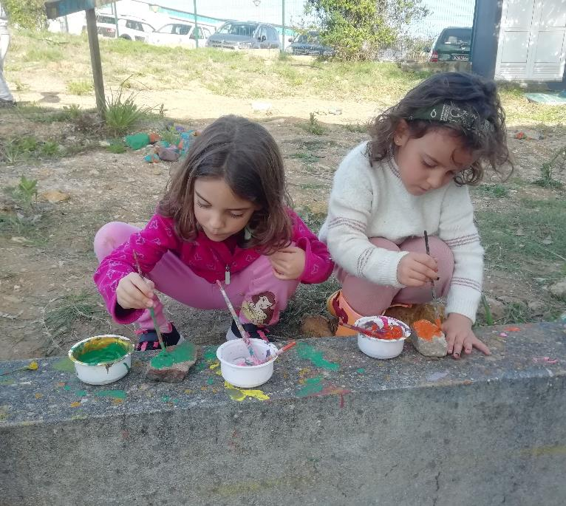
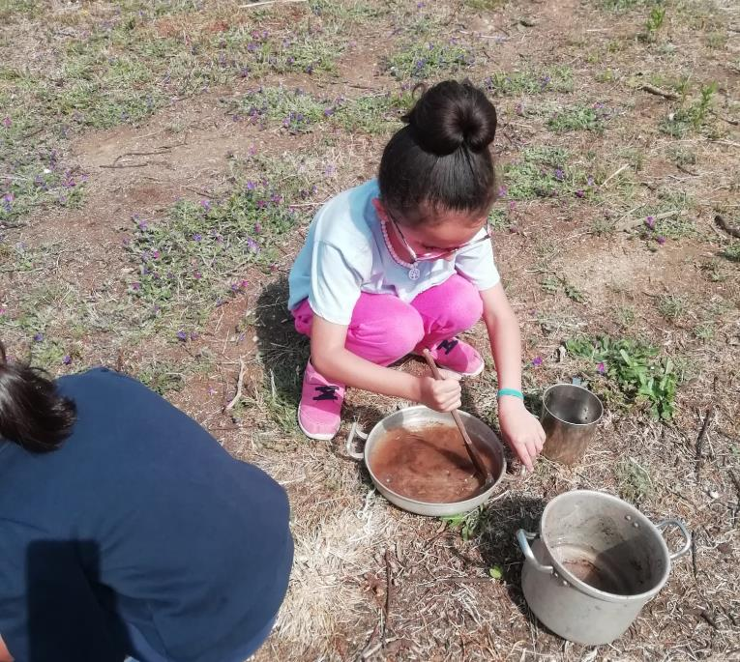
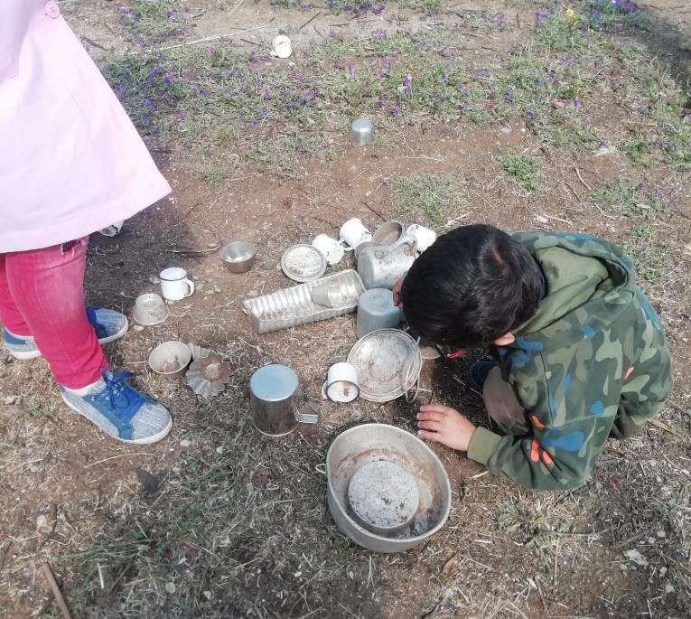
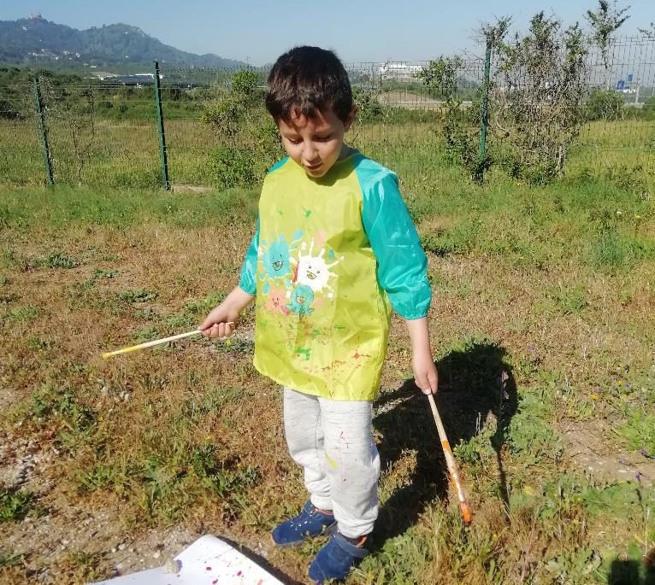
GERAS – outdoor learning
GERAS Logo made by 15 year old students
From the toponymy Algueirão
of Arabic origin, Al-geirãn, which means hole or cave
Geirãn became GERAS where ideas are born and ways of approaching learning are generated

Slide 8
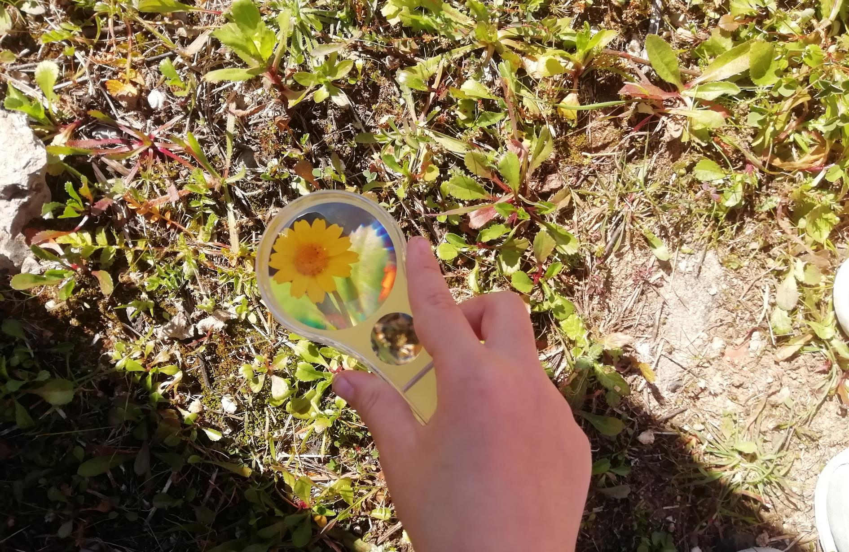
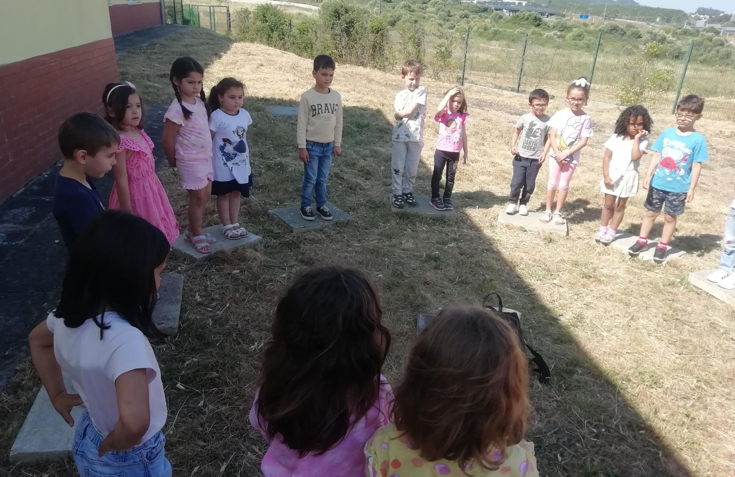
GERAS – outdoor learning
Variety of outdoor activities
Regularly visit the outdoor space
Explore the five senses

Slide 9
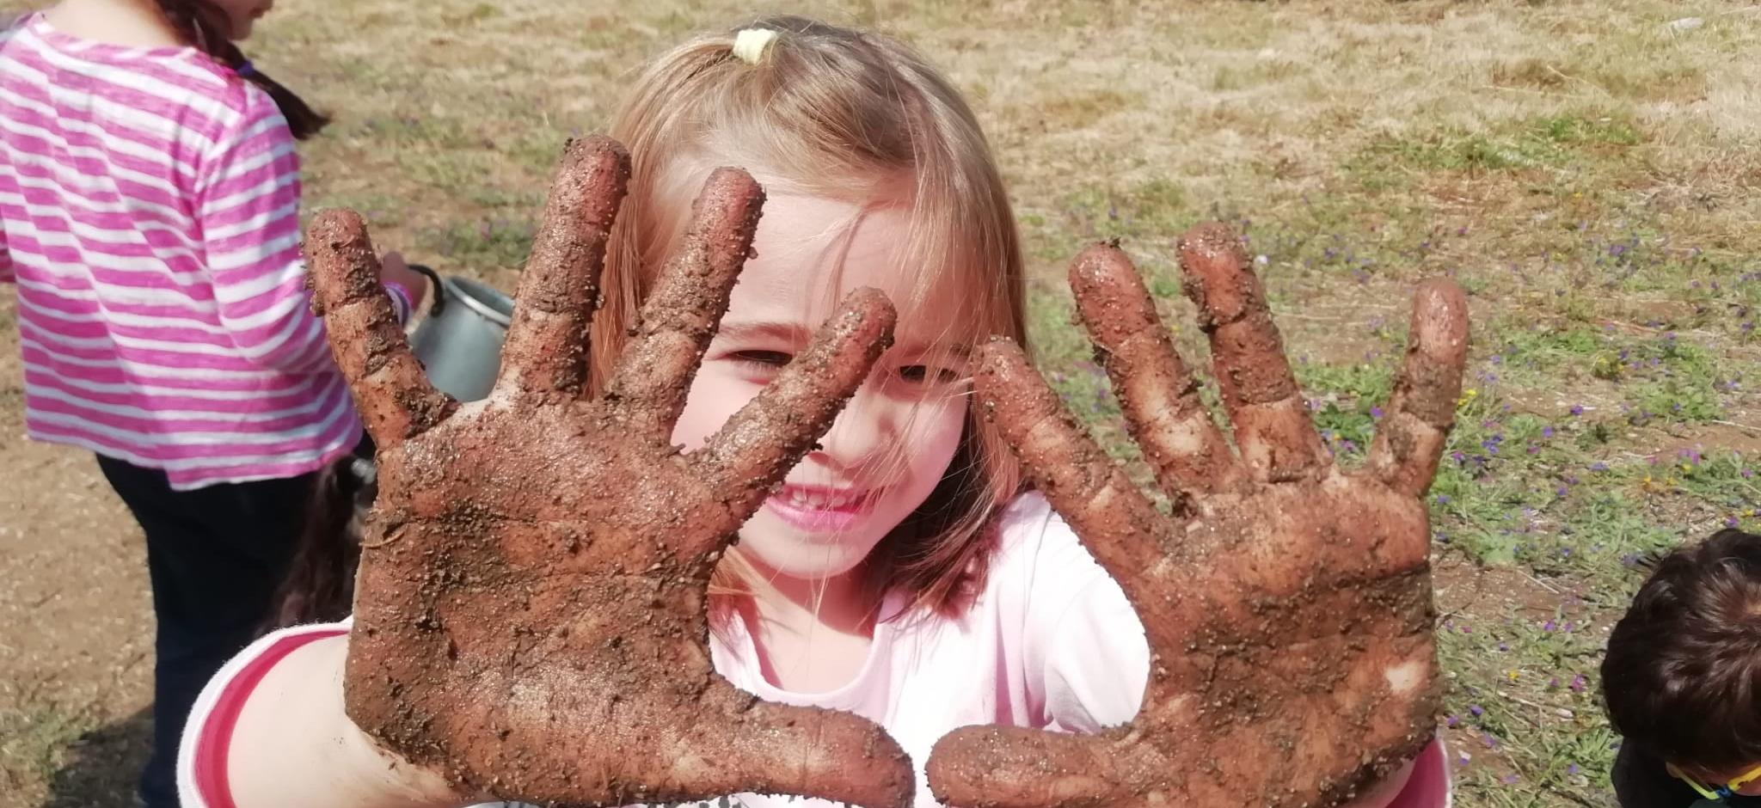
GERAS – outdoor learning
Collaboration through messy play
create more challenging spaces
The kids tell what they did with more details, they say that the joy of the kids is contagious.

Slide 10
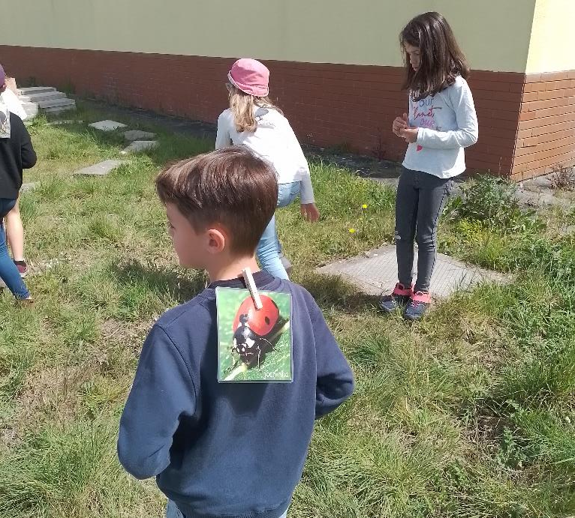
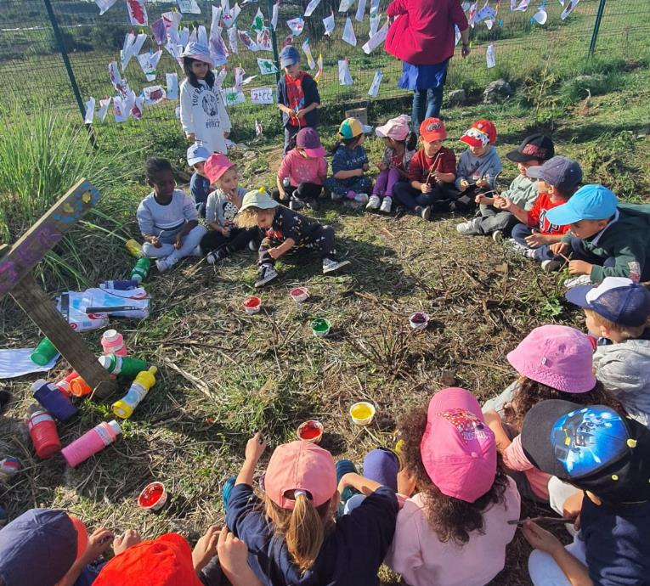
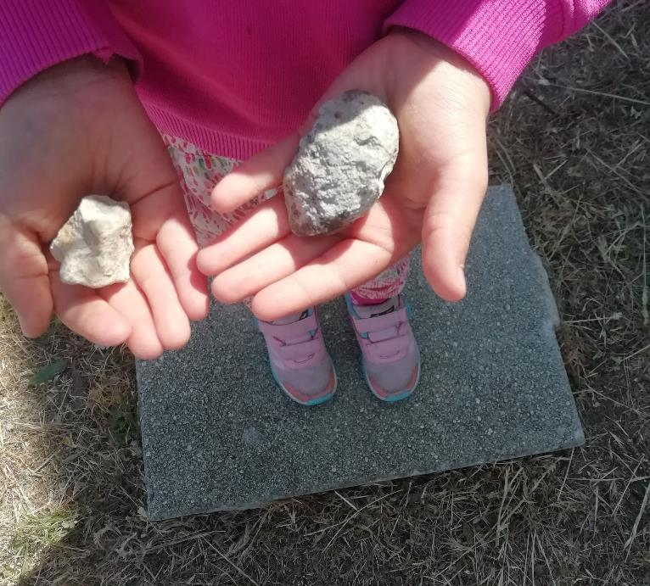
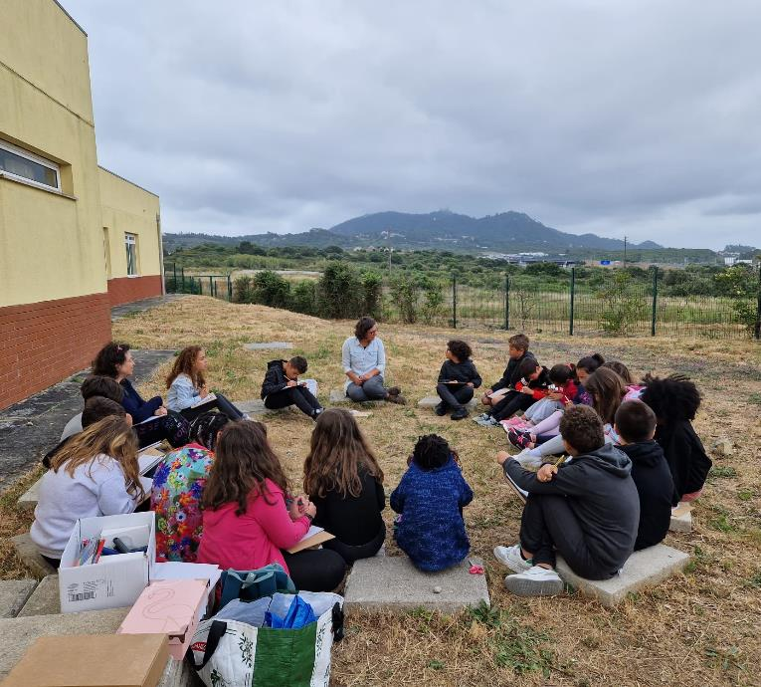
GERAS – grows with everyone and for everyone
What have we done?
Thinking outside of the box
Children feel freer
Discovery happens
Skills are consolidated

Slide 11
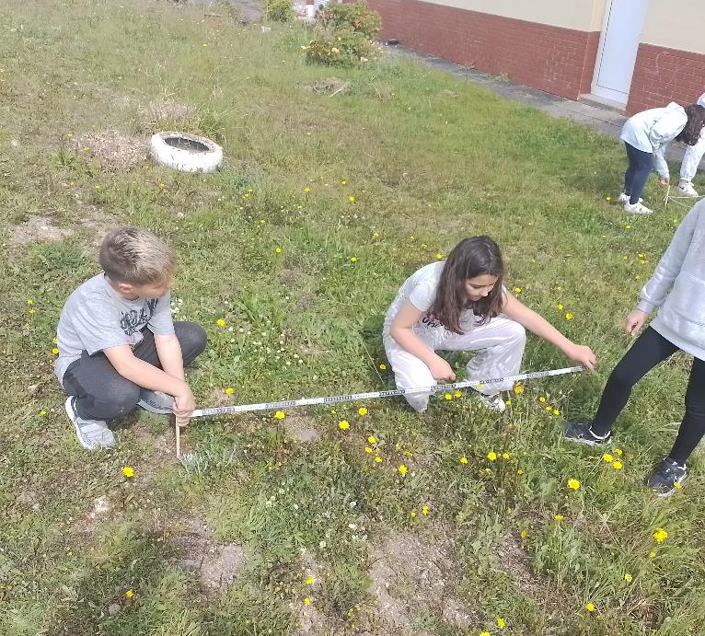
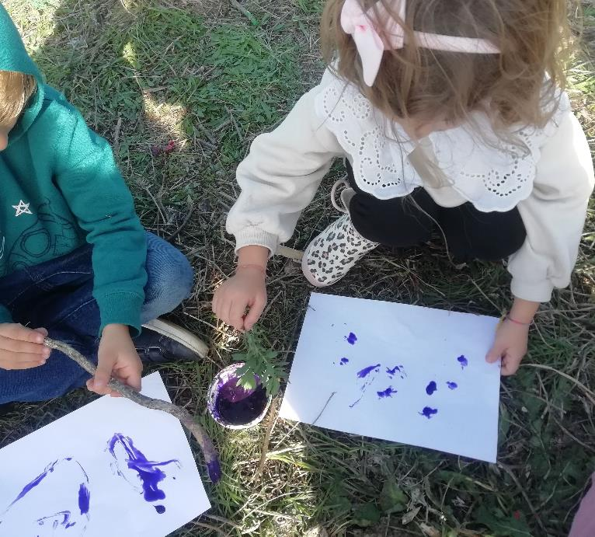
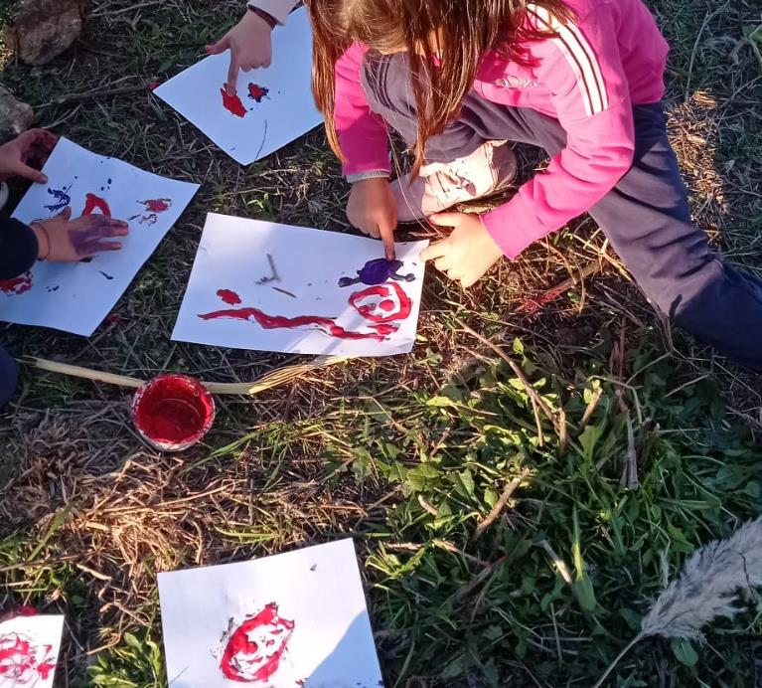
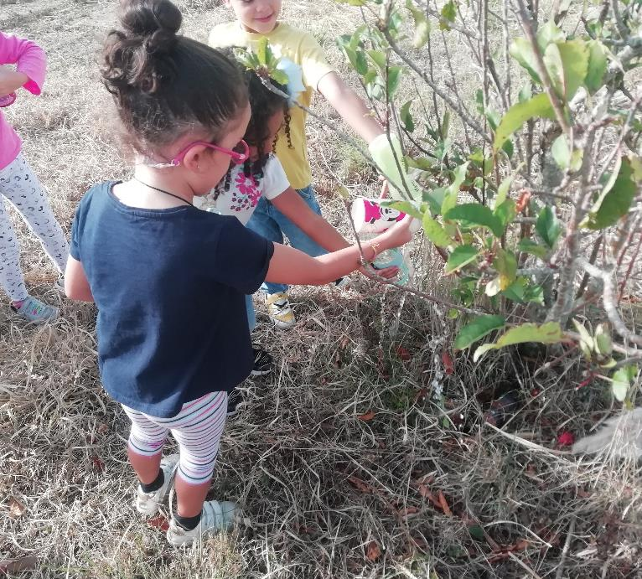
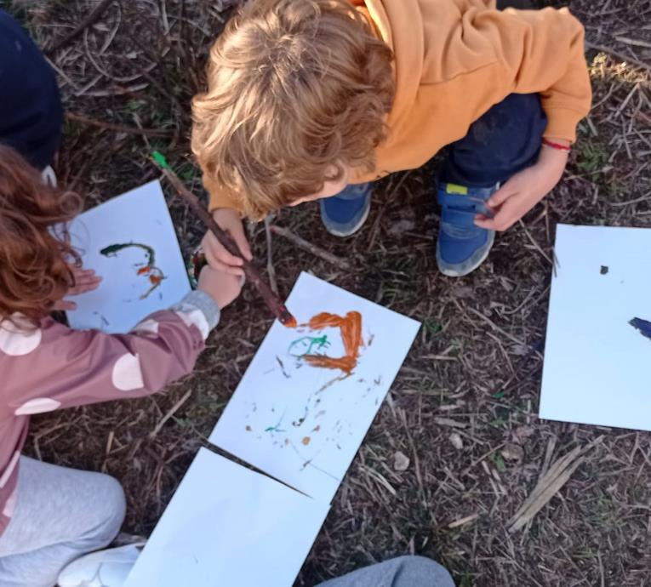
GERAS – grows with everyone and for everyone
Next steps
Share experience &
knowledge with others
Motivate more adults and children to work GERAS
Growing partnership with municipality and other partners

Slide 12
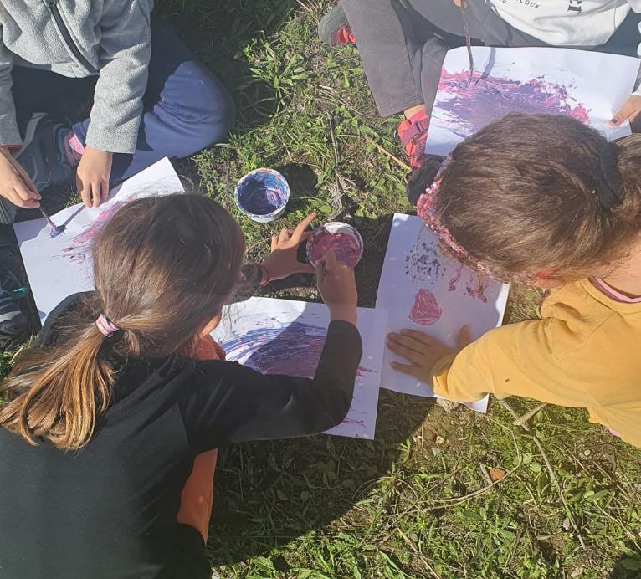
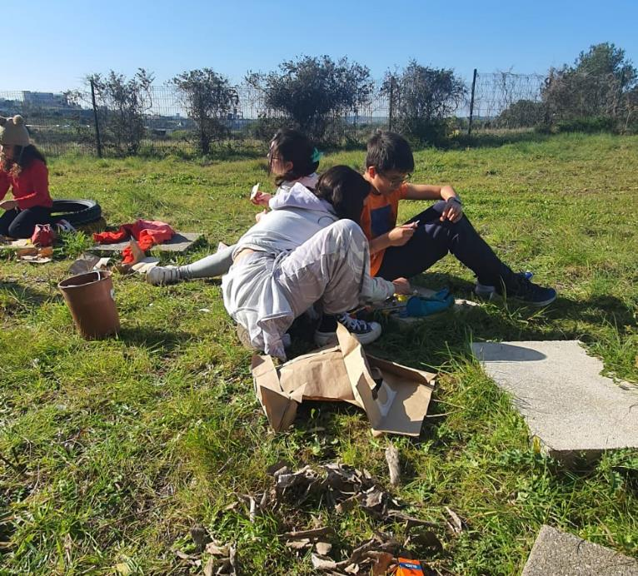
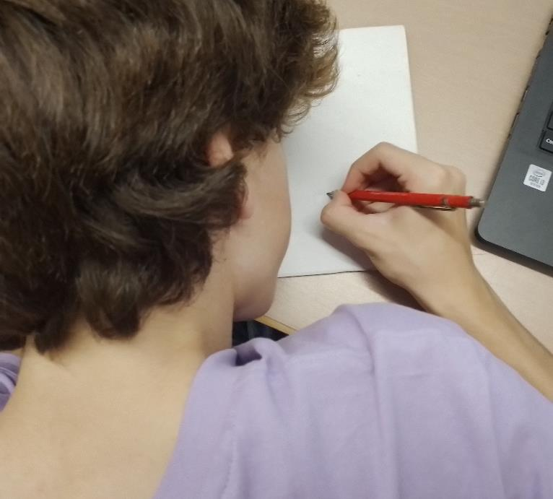

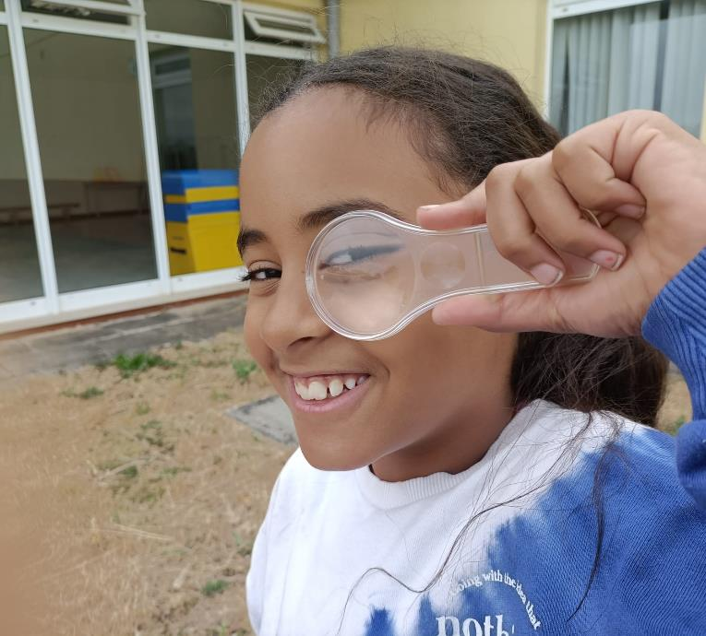
GERAS – grows with everyone and for everyone
Next steps
Make the solution more inclusive
and equitable
5 years
10 years
Transform learning with a happy and healthy activity
15 years

