Slide 1





SCHOOLS 2030 HUMAN-CENTERED DESIGN TOOLKIT
Facilitator’s guide
Developed by

Slide 3

SCHOOLS 2030 HUMAN-CENTERED DESIGN TOOLKIT
FACILITATOR’S GUIDE
• FACILITATING A HUMAN-CENTERED CHALLENGE
PREPARING TO COACH A DESIGN CHALLENGE
Your Role in the Design Challenge
Working with a School Leader
Working with Educators
Selecting and Empowering Design Teams
Mindsets of Design
Holistic Learning Outcomes
Using the Educator Toolkit
As an Aga Khan Foundation human-centered design facilitator and coach, you are about to guide school teams on a design challenge.
This process will help them to explore the existing barriers that prevent students from achieving the holistic learning outcomes identified in the Schools2030 initiative. By coaching school teams to put aside their assumptions, listen to stakeholders closely,
and work collaboratively as a team, you will help them uncover root causes to challenges facing their school community and will guide them to generate creative solutions to solve those challenges.
As a facilitator and coach, you have a special role to play in guiding school teams through the design challenge. An excellent facilitator and coach will serve as a guide, a resource, a critical friend and a champion. We wrote this guide to help you to reflect and prepare for engaging with school leaders and design teams.
For this design challenge, there are ten phases. Each phase has different tools or activities that design teams will need to complete in order to move to the next phase. The Educator Toolkit will serve as the design teams’ guide to this process. Each step of the design challenge is supported with a tool in the toolkit. Throughout the toolkit, at the beginning of each phase there is an introduction page with context and goals for the phase as well as summaries of the tools. At the end of each phase there is a tool to help design teams summarize their work.
There are also tools to help the design teams evaluate whether they are ready to move on to the next phase of the process and to reflect on what they have learned thus far.
These materials have been developed to be used by Schools Leaders and educators but they can be adapted to any context facing human-centered challenges.
See to the right for the topics covered in this guide. Use this guide to prepare to launch the design teams.
MAKING A PLAN
The Core Tenets of
a Human-Centered Design Challenge
Mapping out teams’ design challenges
Potential Program Models
LAUNCHING THE DESIGN CHALLENGE
Preparing to Launch
Working with an Equity Lens
SUPPORTING DESIGN TEAMS THROUGH EACH PHASE
Supporting Your Design Teams
Tips and Coaching Advice for each Phase of the Toolkit
COMPLETING THE DESIGN CHALLENGE
Selecting the Idea to Pitch
Regional Pitch Night & Celebration
Transitioning from the Design Challenge to Implementation
IMPLEMENTATION CHECKLIST & PLANNING TOOLS

Slide 4
SCHOOLS 2030 HUMAN-CENTERED DESIGN TOOLKIT
FACILITATOR’S GUIDE
1
PREPARING TO COACH
A DESIGN CHALLENGE
SCHOOLS 2030 HUMAN-CENTERED DESIGN TOOLKIT
Your Role in the Design Challenge
As a facilitator and coach, you will help School Leaders and their design teams progress through the design challenge. It is your job to make a plan for how to check in with design teams. Your check-ins will serve as an opportunity to hold teams accountable to the process, to answer questions, to provide support and to offer feedback about their design work.
In cases where teams are convening, you will help organize those convenings. In cases where teams are not convening, we recommend that you check in more frequently with design teams to ensure progress.
Building Your Internal Team
Below are descriptions of potential roles and responsibilities for teams implementing the Schools 2030 HCD process. These are just suggestions -- please feel free to adapt them and/or disregard them as you see fit.
Each of these roles does not correlate to one single person; one person may take on more than one role. Many of these roles may be the responsibilities of the National Coordinator with support from the larger team.
Some of the roles included (external) are optional. If your country team is interested in leveraging community support, you are encouraged to recruit for these roles as well.

Slide 5
SCHOOLS 2030 HUMAN-CENTERED DESIGN TOOLKIT
Global Design Advisors
(Internal, Global Team)
Support the Project Manager in designing and producing the Schools2030 Journey E-Portfolio
Creates process phases, tools, training materials
Guides and advises Facilitators and Project Managers
Monitoring & Evaluation Manager
Capture stories from the Design Teams of their process and impact
Provide technical support to the Project Manager in liaising with external Monitoring & Evaluation partners
Guarantee implementation of the Monitoring & Evaluation plan and/or system designed by the Monitoring
& Evaluation external partner
and provide support to schools
Oversee and provide support to schools on data collection through PROMISE3
Provide support / lead any other data collection processes as defined by the Monitoring & Evaluation external partner
Team Leader (Internal, Country Team)
Oversees learning journey with Facilitator (if different person)
Oversees team progress with the Program Manager (if different person)
Oversees communications plan with the Communications Manager (if different person)
Oversees the Monitoring & Evaluation Manager (if different person)
Connects with the Global Design Advisors
Facilitator (Internal, Country Team)
Prepares training and project materials
Leads trainings
Oversees learning journey
Provides design critiques
Organizational Coaches (Internal, Country Team)
Internal leaders who advise teams and provide feedback and critique
Organization Coaches are not required -- they may be additional members of your team who are working with Design Teams
Project Manager (Internal, Country Team)
Coordinates experience for all participants
Manages project work to ensure that teams are meeting benchmarks
Critical friend to the Design Team participants
Designs and produces the S2030 Journey E-Portfolio
Liaises with external Monitoring & Evaluation partners
Community Coaches (External)
Community leaders who advise teams and provide feedback and critique
These Community Coaches might have skills or expertise in one or more
of the following areas:
Human-Centered Design
Visual or Graphic Design
Architecture, Manufacturing or Coding
Entrepreneurship & Social Impact
Business Pitches & Storytelling
Educational Policy
Program Development & Implementation
Communications Manager (Internal, Country Team)
Support M&E in capturing stories from the Design Teams of their process and impact
Design and produce communication materials throughout the project following S2030 Communication guidelines

Slide 6
SCHOOLS 2030 HUMAN-CENTERED DESIGN TOOLKIT
FACILITATOR’S GUIDE
• PREPARING TO COACH A DESIGN CHALLENGE
Working with Education Officials
As the leader of this initiative, you are likely going to have to communicate the value and potential of the human-centered design process to education officials in the community. Through the resources listed on page 6 (and in the electronic appendix) and your own experiences with human-centered design, develop a presentation that explains the process and the potential of the process to unlock innovation and positive change in communities.
Here are some helpful talking points to help you build your presentation:
Human-Centered Design is an internationally-recognized innovation process.
HCD is leveraged by corporations, governments, founcations and NGOs to create more culturally-relevant and effective solutions to some of the most complex problems.
Through investment in the HCD process, the solutions that are generated, tested and implemented will have a higher success rate and are more likely to create the
outcomes you are seeking.
Design teams are particularly successful when using the HCD process to tackle problems that involve human motivations and behaviors; the process is well-suited to take on seemingly intractable problems through gaining new perspectives on the issue at hand.
Working with School Leaders
As a facilitator, you will be working directly with a School Leader to help her or him initiate a design challenge on their campus, select and form design teams and guide the teams to progress through the phases of the design challenge.
We recommend scheduling a meeting with the School Leader (or a cohort of School Leaders) as a kick-off to this project. Use the School Leader Guide to help them identify the steps they
need to complete and the considerations they need to make before, during and after the design challenge.
In terms of working with School Leaders, be aware that they might express nervousness with the innovation and change process. Coach School Leaders to allow their design teams to continue their exploratory design work in order for their ideas to fully develop. Be aware of the power and influence that School Leaders have, especially for certain educators (new teachers or people with less status) or in hierarchal cultural contexts.
Working with Educators
Your role as a facilitator and coach is to help empower educators to do the work required
in a design challenge. Encourage and support them, both with logistical challenges (arranging
interviews, finding time to complete tasks or convene as a group) as well as any nervousness
they might have with completing each tool in the different phases of the design challenge.
Help hold design teams accountable through check-ins and convenings and serve as a “critical friend” or someone who pushes the team to improve through supportive and honest feedback.
This Facilitator’s Guide has coaching tips for each phase of the design challenge as well as specific tips for each tool in the Educator Toolkit. Use this to guide your coaching and the feedback you
give to design teams throughout their design challenge.

Slide 7


SCHOOLS 2030 HUMAN-CENTERED DESIGN TOOLKIT
AGA KHAN FOUNDATION
IMPLEMENTATION PLAN
ENGAGEMENT | PARTICIPANTS | RESOURCE | PROCESS
1 Train the Trainer Workshop | PROFESSIONAL AKF STAFF DESIGNERS | EDUCATOR FACILITATOR’S SCHOOL LEADER’S TOOLKIT GUIDE GUIDE | AKF Staﬀ will gain familiarity with the human-centered design process. AKF Staﬀ will gain familiarity with the Educator Toolkit, Facilitator’s Guide & School Leader’s Guide. AKF Staﬀ will determine the design challenge model that is most appropriate for their region & will make a plan for implementation.
2 School Leader Planning Meeting | AKF STAFF SCHOOL LEADER | FACILITATOR’S SCHOOL LEADER’S GUIDE GUIDE | AKF Staﬀ will work with School Leaders to review the Design Challenge model, calendar the workshops/meetings and select participants for the design team(s).
3 Design Challenge Kick-Oﬀ Meeting | ^{SCHOOL} EDUCATOR AKF STAFF ^{LEADER} optional | SCHOOL LEADER’S GUIDE | The School Leader will call a meeting (AKF staﬀ may or may not attend) of all the design team participants to kick oﬀ the design challenge. The School Leader will review the goals of the design challenge, as well as the resources provided and the calendar and expectations for commitment to the process.
4 Design Challenge | _{EDUCATOR} ADDITIONAL STAKEHOLDERS (STUDENTS, FAMILIES) SCHOOL AKF STAFF LEADER | EDUCATOR FACILITATOR’S SCHOOL LEADER’S TOOLKIT GUIDE GUIDE | Design teams will convene, depending on the model, to complete the workshop tasks. Design teams will complete ﬁeldwork independently. School Leaders may or may not be a part of the design team. School Leaders will help design teams with logistics and will oﬀer feedback at the end of every phase of the design challenge. AKF Staﬀ will coach design teams through using each of the tools and completing the work of each phase of the design challenge. This coaching may happen in person or virtually.
5 Regional Pitch Night & Celebration | _{EDUCATOR} ADDITIONAL STAKEHOLDERS (STUDENTS, FAMILIES) | FACILITATOR’S SCHOOL LEADER’S GUIDE GUIDE | AKF Staﬀ will work with School Leaders to plan the Regional Pitch Night & Celebration, an opportunity for regional schools to share with their communities and each other the results of their design challenge. There will be an opportunity at this event to seek funding as well as determine if diﬀerent schools want to team up to implement a single idea.
 | SCHOOL AKF STAFF LEADER
Selecting and Empowering Design Teams
Ideally, there will be one or two design team(s) per school.
Each design team will ideally have four to six participants.
Design team(s) should be made of up educators who teach in the same grade level or similar grade levels.
If you are creating regional cohorts, we recommend no more than five schools in a cohort.
Educator teams should have a diversity of backgrounds (women, men, grew up in the community, grew up elsewhere, new teacher, experienced teacher, etc.)
Using the School Leaders’ Guide, work with School Leaders to identify which educators are best suited for participating on a design team. Ask the School Leader to think about individuals who are able and willing to engage in projects that require extra effort. Together, think about
educators who are open to new ideas, excited to try new things, good at listening, and who value other people’s perspectives.

Slide 8
SCHOOLS 2030 HUMAN-CENTERED DESIGN TOOLKIT
FACILITATOR’S GUIDE
Mindsets of Design
In design projects, we find that it is helpful to have a variety of backgrounds and perspectives
on a design team in order to push the team to question assumptions and challenge the status quo.
Below are some of the mindsets that are helpful to have when engaging in a design challenge. Use these mindsets as a way to help School Leaders identify educators to serve on their design team(s).
Work together to understand the context
Look carefully to understand potential problems and opportunities
Stay optimistic that you can solve the problem
Hold back on solving the problem until the time is right
Get inspired by people – active listening is a source of creative inspiration
Put aside biases and assumptions about what you think the problem is – listen to the stakeholder.
Seek new perspectives on old problems
See opportunities in constraints
Get comfortable with navigating contradictory information
Many ideas lead to good ideas
Defer judgment and criticism of ideas until the time is right
Idea generation is not the time for evaluating ideas
Brainstorming is a collaborative team activity
Allow yourself to think of wild ideas
Prototype early and often in order to learn about your idea
Start small to make big changes
Show don’t tell
Many cycles of prototyping are necessary to develop an idea
Feedback is a gift to improve your ideas

Slide 9
SCHOOLS 2030 HUMAN-CENTERED DESIGN TOOLKIT
Additional Resources
Before School Leaders launch their design teams, we recommend that everyone involved in the design challenge (education officials, school leaders, educators) read the following articles about human-centered design in educational settings. Check our electronic appendix of articles we have curated to find these articles and more.
Introduction to Human-Centered Design
Design Thinking Comes of Age
Design Thinking at the LA County Department of Public Social Services (video)
How to Build Your Creative Confidence (video)
Extreme by Design (video)
Human-Centered Design in Education
Thinking and Acting Like a Designer: How design thinking supports innovation in K12 education
Ways Design Can Help Educators Create Change
How Design Thinking Supports Innovation in K-12 Education
Recasting Teachers and Students as Designers
Applying Design Thinking in 4 Different Ways in Schools
Can Design Thinking Help Schools Find New Solutions to Old Problems?
Holistic Learning Outcomes
The goal of this design challenge is for design teams to work to improve the holistic learning outcomes of students in their schools. Below is a comprehensive list of the holistic learning outcomes that have been identified by the Schools2030 initiative.
Before you begin work with your design teams, you will work with a local group of education leaders to determine which of the holistic learning outcomes your country will focus on. Literacy and numeracy are required; your team will select an additional three that you and your larger group agree are most appropriate for your country based on alignment with the goals of the government and local values, beliefs, needs and interests.
The school-based design teams’ work will be focused on the holistic learning outcomes a country-level team will select. The design teams will then further narrow their focus based on the data they get from both the assessment process and the PROMISE app. Review the holistic learning outcomes with the design teams at the beginning of the project as well and throughout their design work to keep them at the center of their efforts.
Below are the list of holistic learning outcomes and their simplified definitions. You will find tools in the following pages to help guide your decision-making process around narrowing to three additional holistic learning outcomes.

Slide 10
SCHOOLS 2030 HUMAN-CENTERED DESIGN TOOLKIT
FACILITATOR’S GUIDE
Designing the Conversation
As you prepare to host this discussion, think of which stakeholders you want to invite to the table
-- government officials, local education leaders and experts, community members, others? As you are launching the conversation, be sure to share the goals of the conversation and emphasize that you will be working through a structure process to make these decisions. This work is very ambiguous -- there are many definitions for these terms and many ways to prioritize them.
Hopefully, the strucure will support you to have a productive conversation and help the group
you convene to make your decisions in an efficient and productive way.
Core Academic Proficiencies
The level of competence in an academic area that a student needs to achieve in order to lead a successful, productive and fulfilling life.
• Literacy: Learners have the ability to engage with others verbally in order to communicate meaning. Learners have the ability to engage with written language to understand and make meaning. Learners have the ability to engage in the production of written language in order to communicate meaning.
• Numeracy & Mathematics: Learners have the ability to use numbers to communicate ideas, analyze information and solve problems. Learners have the ability to understand, appreciate and apply concepts related to shapes and space, patterns and data.
Applied Academic Proficiencies
The level of competence in bringing together multiple complex academic areas that a student needs to achieve in order to lead a successful, productive and fulfilling life.
• Science: Learners have the ability to pursue knowledge and understanding of the natural and social world following a systematic methodology based on evidence. Learners have the ability to apply their knowledge and understanding of the natural and social world, in order to produce new knowledge.
• Health and nutrition: Learners have the ability to pursue knowledge and understanding of the systems that work together to create health and well-being for humans. Learners have the ability to act on that information to create a healthy lifestyle.
• Humanities: Learners have the ability to pursue knowledge and understanding of how human beings express their values and their cultures following a systematic methodology based on critical analysis. Learners have the ability to apply their knowledge and understanding of the humanities, in order to produce new knowledge.
• Arts and culture: Learners have the ability to pursue knowledge, understanding and competency in utilizing tools related to communication and expression. Learners have the ability to analyze and appreciate pieces of art and forms of cultural expression. Learners have the ability to apply their knowledge and understanding of arts and culture, in order to produce new knowledge and self-expression.
• Digital literacy, technology and media: Learners have the ability to pursue knowledge, understanding and competency in utilizing the most appropriate tools related to communication, computation and expression. Learners have the ability to analyze sources of information and determine if they are trustworthy and appropriate.

Slide 11
SCHOOLS 2030 HUMAN-CENTERED DESIGN TOOLKIT
Being Our Best (the individual learner)
The cognitive, social and emotional skills needed in order to lead a successful, productive and fulfilling life.
• Self-awareness: Learners develop the ability to self-reflect on their thoughts: recognizing their beliefs, biases, and feelings and gaining an understanding of their behaviours. Learners practice self-regulation alongside self-awareness, bringing about mindful awareness to thoughts and actions. Learners reflect upon their various identities, build greater self-esteem, motivation, and confidence to bring about positive personal changes in behaviour.
• Self-efficacy: Learners have an accurate assessment and belief in their ability to accomplish a goal. Learners have the ability to take action to accomplish that goal and to ask for help when needed.
• Self-regulation: Learners have the ability to regulate their emotions and behaviors. Learners have the ability to modulate their emotions and behaviors based on the context they are in.
• Resilience: Learners demonstrate the ability to cope with failure and mistakes, persevere, and take creative risks.
• Taking responsibility: Learners take ownership of their actions and the repercussions of actions, choices, and decisions. Learners reflect on and critically evaluate their choices and actions from an ethical perspective, with the ability to evaluate their ethical stance and make decisions based on respect for others.
• Ethical decision-making: Learners have the ability to evaluate options based on a predetermined set of values-based considerations and choose the option most aligned to that set of values. Learners demonstrate respect for themselves, others and the environment.
• Creativity: Learners have the ability to leverage one’s imagination, critical thinking, and problem-solving skills in order to create something that did not previously exist.
• Critical thinking: Learners reflect critically on learning experiences, processes and their own ideas, values and beliefs. Learners identify and ask significant questions, including those related to norms, values, meanings, and limitations.

Slide 12
SCHOOLS 2030 HUMAN-CENTERED DESIGN TOOLKIT
FACILITATOR’S GUIDE
Working with Others (our class/school)
The cognitive, social and emotional skills needed in order to successfully work with others
in the community to improve circumstances for everyone.
• Communication: Learners have the ability to translate an idea into a format that helps others to understand the intention and meaning of the idea.
• Collaboration: Learners work together with others who hold different perspectives, exercising flexibility and willingness to be helpful in making necessary compromises to accomplish a common goal. Learners demonstrate shared responsibility for collaborative work and value the individual contributions made by each team member.
• Open mindedness: Learners demonstrate respect and appreciation for the ideas, perspectives and values of others. Learners acknowledge their own prejudice
with a willingness to continually learn from others.
• Empathy: Learners listen to others and try to experience what others may feel. Learners relate to others with deep understanding and care about the well-being of their friends, families, communities, and the planet.
• Relationship building: Learners develop integrity, honesty, and consistency to build trust and demonstrate trustworthiness in interactions. Learners build trust by sharing themselves and seeking to understand others as individuals. Learners develop and sustain meaningful relationships with people different from themselves.
• Reconciling Tensions: Learners think in an integrated way that avoids premature conclusions and recognises interconnections between diverse views. Learners develop skills in handling tensions, dilemmas and trade-offs with others from a different background. Learners work towards balancing competing interests and perspectives of others to manage conflict in a respectful manner. Learners are aware of the tensions within themselves and seek to understand and resolve tensions.
• Leadership: Learners have the ability to understand one’s role and act on the opportunity to influence and guide a group of people to act ethically and work collaboratively toward achieving a common goal.

Slide 13
SCHOOLS 2030 HUMAN-CENTERED DESIGN TOOLKIT
Improving Our World (our community/our world)
The cognitive, social and emotional skills needed in order to contribute to a healthy, equitable society that reflects a wide variety of beliefs and identities.
• Problem-solving: Learners analyse and solve problems with consideration of diverse viewpoints and ethical implications to make sound decisions. Learners connect their ethics and values to their thinking and decision-making processes.
• Civic engagement: Learners have the understanding of decision-making structures in a society. Learners have the ability to understand one’s role and act on the opportunity to participate in one’s community in order to improve life for everyone.
• Entrepreneurship: Learners have the ability to understand the challenges facing different communities and the opportunities to improve their circumstances. Learners have the ability to understand one’s role and act on the opportunity to create market-driven value for others. Learners have the ability to design and implement value-added initiatives and overcome and learn from challenges and setbacks.
• Respect for Diversity: Learners’ commitment and everyday actions demonstrate respect for and positive engagement with diversity and difference, including working constructively with people different from themselves. Learners understand that pluralism is an ethic of respect for diversity and that it is a process not a product, and one that is challenging. As such, it requires continuous effort at multiple scales and levels across society.
• Respect for the Environment: Learners understand their impact on the natural world, show concern for environmental issues and take action to protect natural resources for a sustainable future. Learners have a sense of responsibility and actively participate in protecting and resolving environmental problems.

Slide 14
SCHOOLS 2030 HUMAN-CENTERED DESIGN TOOLKIT
FACILITATOR’S GUIDE
Starting the Conversation
Before you begin using the tools, begin the process with a conversation establishing the group’s defintions of the criteria we will be using to proritize the holistic learning outcomes.
1 Define what a quality education that supports students to be successful in life might look like? How are students growing? What are they able to do when they graduate? What are their academic skills? What are their social emotional skills? What does it look like for a student to lead a successful life?
2 Define some of the cultural values related to learning in your community. What is the purpose of learning? What is the purpose of an education? Are they the same or different?
3 Define some of the priorities your country’s government has articulated related to education. According to the government, what is the purpose of learning? What is the purpose of an education? Are they the same or different? According to the government what should children focus on in school?

Slide 15
SCHOOLS 2030 HUMAN-CENTERED DESIGN TOOLKIT
Beginning to Prioritize
The first step in this process is to prioritize the learning outcomes within each of the categories. This will help you begin to see where you align and prepare you to begin to narrow to the three holistic learning outcomes you will select. For each specturm, place the numbers on the line corresponding to the criteria. At least half of the holistic learning outcomes need to be to
the left of the center line.
Required: Literacy Numeracy & Mathematics
Science
Health and nutrition
Humanities
Arts and culture
Digital literacy, technology and media
Self-awareness
Self-efficacy
Self-control
Resilience
Taking responsibility
Ethical decision-making
Creativity
Critical thinking
Communication
Collaboration
Open mindedness
Empathy
Relationship building
Reconciling Tensions
Leadership
Problem-solving
Civic engagement
Entrepreneurship
Respect for Diversity
Respect for the Environment
Applied Academic Proficiencies (1-5)
Least Critical to Students’ Success and Wellbeing in Life
Most Critical to Students’ Success and Wellbeing in Life
Being Our Best (6-13) (the individual learner)
Least Critical to Students’ Success and Wellbeing in Life
Most Critical to Students’ Success and Wellbeing in Life
Working with Others (14-20) (our class/school)
Least Critical to Students’ Success and Wellbeing in Life
Most Critical to Students’ Success and Wellbeing in Life
Improving Our World (21-25) (our community/our world)
Least Critical to Students’ Success and Wellbeing in Life
Most Critical to Students’ Success and Wellbeing in Life

Slide 16
SCHOOLS 2030 HUMAN-CENTERED DESIGN TOOLKIT
FACILITATOR’S GUIDE
Selecting the Holistic Learning Outcomes Based on Cultural Relevance
Use the following tools to assess the holistic learning outcomes based on your local context. Begin with the prioritization activity on the previous page. Combine each of the spectums on the x-axis
and then assess how they relate to the cultural values of your community.
Required: Literacy Numeracy & Mathematics
Science
Health and nutrition
Humanities
Arts and culture
Digital literacy, technology and media
Self-awareness
Self-efficacy
Self-control
Resilience
Taking responsibility
Ethical decision-making
Creativity
Critical thinking
Communication
Collaboration
Open mindedness
Empathy
Relationship building
Reconciling Tensions
Leadership+
Problem-solving
Civic engagement
Entrepreneurship
Respect for Diversity
Respect for the Environment
Use this framework to assess the holistic learning outcomes above by placing the numbers above on the graph.
More Culturally-Relevant
A
B
Least Critical to Students’ Success and Wellbeing in Life
Most Critical to Students’ Success and Wellbeing in Life
C
D
Less Culturally-Relevant

Slide 17
SCHOOLS 2030 HUMAN-CENTERED DESIGN TOOLKIT
Selecting the Holistic Learning Outcomes Based on Government Priorities
Use the following tools to assess the holistic learning outcomes based on your local context. Begin with the prioritization activity on the previous page. Combine each of the spectums on the x-axis
and then assess how they relate to the cultural values of your community.
Required: Literacy Numeracy & Mathematics
Science
Health and nutrition
Humanities
Arts and culture
Digital literacy, technology and media
Self-awareness
Self-efficacy
Self-control
Resilience
Taking responsibility
Ethical decision-making
Creativity
Critical thinking
Communication
Collaboration
Open mindedness
Empathy
Relationship building
Reconciling Tensions
Leadership+
Problem-solving
Civic engagement
Entrepreneurship
Respect for Diversity
Respect for the Environment
Use this framework to assess the holistic learning outcomes above by placing the numbers above on the graph.
More Aligned to Government’s Goals
A
B
Least Critical
to Students’ Success and Wellbeing in Life
Most Critical to Students’ Success and Wellbeing in Life
C
D
Less Aligned to Government’s Goals

Slide 18

SCHOOLS 2030 HUMAN-CENTERED DESIGN TOOLKIT
FACILITATOR’S GUIDE
Selecting the Holistic Learning Outcomes: Beginning to Narrow
Review the two frameworks you just completed and place the numbers from each framework into
the corresponding rings (including duplicated numbers). Next, select the top three numbers (those numbers closest to the center of the circle -- if there are duplicate numbers, give those numbers extra priority). If there are more than three different numbers in the “B” circle, discuss which ones you want to eliminate. If you need to look to the “D” ring, follow the same process.
B
D A C

Slide 19
SCHOOLS 2030 HUMAN-CENTERED DESIGN TOOLKIT
Final Priorization
The last step in this process is to prioritize the learning outcomes that you have narrowed through this process. Your goal for this exercise is the select the three holistic learning outcomes your country will focus on. For each specturm, place the numbers on the line corresponding to the
criteria. Only three of the holistic learning outcomes can be to the right of the center line.
If there are three holistic learning outcomes on the right side of the Ring B spectrum, those will be the three you have selected. If there are less than three, have a discussion as a group about which holistic learning outcomes on the right side of the Ring D spectrum you will also select.
Required: Literacy Numeracy & Mathematics
Science
Health and nutrition
Humanities
Arts and culture
Digital literacy, technology and media
Self-awareness
Self-efficacy
Self-control
Resilience
Taking responsibility
Ethical decision-making
Creativity
Critical thinking
Communication
Collaboration
Open mindedness
Empathy
Relationship building
Reconciling Tensions
Leadership+
Problem-solving
Civic engagement
Entrepreneurship
Respect for Diversity
Respect for the Environment
Ring B
Least Critical to Students’ Success and Wellbeing in Life
Most Critical to Students’ Success and Wellbeing in Life
Ring D
Least Critical to Students’ Success and Wellbeing in Life
Most Critical to Students’ Success and Wellbeing in Life

Slide 20
SCHOOLS 2030 HUMAN-CENTERED DESIGN TOOLKIT
FACILITATOR’S GUIDE
Reflecting on the Holistic Learning Outcomes – Age 5
Take a few minutes to discuss as a group how you might describe the holistic learning outcomes you selected. Develop summary statements for each holistic learning outcome.
1 Define one of the holistic learning outcome you selected in 2-3 sentences.
2 Define one of the holistic learning outcome you selected in 2-3 sentences.
3 Define one of the holistic learning outcome you selected in 2-3 sentences.

Slide 21
SCHOOLS 2030 HUMAN-CENTERED DESIGN TOOLKIT
FACILITATOR’S GUIDE
Reflecting on the Holistic Learning Outcomes – Age 10
Take a few minutes to discuss as a group how you might describe the holistic learning outcomes you selected. Develop summary statements for each holistic learning outcome.
1 Define one of the holistic learning outcome you selected in 2-3 sentences.
2 Define one of the holistic learning outcome you selected in 2-3 sentences.
3 Define one of the holistic learning outcome you selected in 2-3 sentences.

Slide 22
SCHOOLS 2030 HUMAN-CENTERED DESIGN TOOLKIT
FACILITATOR’S GUIDE
Reflecting on the Holistic Learning Outcomes – Age 15
Take a few minutes to discuss as a group how you might describe the holistic learning outcomes you selected. Develop summary statements for each holistic learning outcome.
1 Define one of the holistic learning outcome you selected in 2-3 sentences.
2 Define one of the holistic learning outcome you selected in 2-3 sentences.
3 Define one of the holistic learning outcome you selected in 2-3 sentences.

Slide 23
SCHOOLS 2030 HUMAN-CENTERED DESIGN TOOLKIT
Describing the Holistic Learning Outcomes – Age 5
As a team, brainstorm all of the observable behaviors that you would see in students improved
in this holistic learning outcome.
Holistic Learning Outcome:
Literacy
Observable behavior:
Example: Students are reading books during their free time.
Observable behavior:
Example: Students are discussing books they are reading.
Observable behavior:
Observable behavior:
Observable behavior:
Observable behavior:
Is there an assessment that currently exists that would measure these behaviors? If so, what is it? If not, what ideas do you have for how to assess this holistic learning outcome based on the observable behaviors you brainstormed above?

Slide 24
SCHOOLS 2030 HUMAN-CENTERED DESIGN TOOLKIT
Describing the Holistic Learning Outcomes – Age 10
As a team, brainstorm all of the observable behaviors that you would see in students improved
in this holistic learning outcome.
Holistic Learning Outcome:
Literacy
Observable behavior:
Example: Students are reading books during their free time.
Observable behavior:
Example: Students are discussing books they are reading.
Observable behavior:
Observable behavior:
Observable behavior:
Observable behavior:
Is there an assessment that currently exists that would measure these behaviors? If so, what is it? If not, what ideas do you have for how to assess this holistic learning outcome based on the observable behaviors you brainstormed above?

Slide 25
SCHOOLS 2030 HUMAN-CENTERED DESIGN TOOLKIT
Describing the Holistic Learning Outcomes – Age 15
As a team, brainstorm all of the observable behaviors that you would see in students improved
in this holistic learning outcome.
Holistic Learning Outcome:
Literacy
Observable behavior:
Example: Students are reading books during their free time.
Observable behavior:
Example: Students are discussing books they are reading.
Observable behavior:
Observable behavior:
Observable behavior:
Observable behavior:
Is there an assessment that currently exists that would measure these behaviors? If so, what is it? If not, what ideas do you have for how to assess this holistic learning outcome based on the observable behaviors you brainstormed above?

Slide 26
SCHOOLS 2030 HUMAN-CENTERED DESIGN TOOLKIT
FACILITATOR’S GUIDE
Describing the Holistic Learning Outcomes – Age 5
As a team, brainstorm all of the observable behaviors that you would see in students improved
in this holistic learning outcome.
Holistic Learning Outcome:
Numeracy & Mathematics
Observable behavior:
Example: Students are reading books during their free time.
Observable behavior:
Example: Students are discussing
books they are reading.
Observable behavior:
Observable behavior:
Observable behavior:
Observable behavior:
Is there an assessment that currently exists that would measure these behaviors? If so, what is it? If not, what ideas do you have for how to assess this holistic learning outcome based on the observable behaviors you brainstormed above?

Slide 27
SCHOOLS 2030 HUMAN-CENTERED DESIGN TOOLKIT
FACILITATOR’S GUIDE
Describing the Holistic Learning Outcomes – Age 10
As a team, brainstorm all of the observable behaviors that you would see in students improved
in this holistic learning outcome.
Holistic Learning Outcome:
Numeracy & Mathematics
Observable behavior:
Example: Students are reading books during their free time.
Observable behavior:
Example: Students are discussing
books they are reading.
Observable behavior:
Observable behavior:
Observable behavior:
Observable behavior:
Is there an assessment that currently exists that would measure these behaviors? If so, what is it? If not, what ideas do you have for how to assess this holistic learning outcome based on the observable behaviors you brainstormed above?

Slide 28
SCHOOLS 2030 HUMAN-CENTERED DESIGN TOOLKIT
FACILITATOR’S GUIDE
Describing the Holistic Learning Outcomes – Age 15
As a team, brainstorm all of the observable behaviors that you would see in students improved
in this holistic learning outcome.
Holistic Learning Outcome:
Numeracy & Mathematics
Observable behavior:
Example: Students are reading books during their free time.
Observable behavior:
Example: Students are discussing
books they are reading.
Observable behavior:
Observable behavior:
Observable behavior:
Observable behavior:
Is there an assessment that currently exists that would measure these behaviors? If so, what is it? If not, what ideas do you have for how to assess this holistic learning outcome based on the observable behaviors you brainstormed above?

Slide 29
SCHOOLS 2030 HUMAN-CENTERED DESIGN TOOLKIT
Defining Holistic Learning Outcomes – Age 5
As a team, brainstorm all of the observable behaviors that you would see in students improved
in this holistic learning outcome.
Holistic Learning Outcome:
Observable behavior:
Example: Students notice mathematical concepts in thier lives and discuss them in class.
Observable behavior:
Example: Students use numbers to express an idea to a classmate.
Observable behavior:
Observable behavior:
Observable behavior:
Observable behavior:
Is there an assessment that currently exists that would measure these behaviors? If so, what is it? If not, what ideas do you have for how to assess this holistic learning outcome based on the observable behaviors you brainstormed above?

Slide 30
SCHOOLS 2030 HUMAN-CENTERED DESIGN TOOLKIT
FACILITATOR’S GUIDE
Defining Holistic Learning Outcomes – Age 5
As a team, brainstorm all of the observable behaviors that you would see in students improved
in this holistic learning outcome.
Holistic Learning Outcome:
Observable behavior:
Observable behavior:
Observable behavior:
Observable behavior:
Observable behavior:
Observable behavior:
Is there an assessment that currently exists that would measure these behaviors? If so, what is it? If not, what ideas do you have for how to assess this holistic learning outcome based on the observable behaviors you brainstormed above?

Slide 31
SCHOOLS 2030 HUMAN-CENTERED DESIGN TOOLKIT
Defining Holistic Learning Outcomes – Age 5
As a team, brainstorm all of the observable behaviors that you would see in students improved
in this holistic learning outcome.
Holistic Learning Outcome:
Observable behavior:
Observable behavior:
Observable behavior:
Observable behavior:
Observable behavior:
Observable behavior:
Is there an assessment that currently exists that would measure these behaviors? If so, what is it? If not, what ideas do you have for how to assess this holistic learning outcome based on the observable behaviors you brainstormed above?

Slide 32
SCHOOLS 2030 HUMAN-CENTERED DESIGN TOOLKIT
Defining Holistic Learning Outcomes – Age 10
As a team, brainstorm all of the observable behaviors that you would see in students improved
in this holistic learning outcome.
Holistic Learning Outcome:
Observable behavior:
Example: Students notice mathematical concepts in thier lives and discuss them in class.
Observable behavior:
Example: Students use numbers to express an idea to a classmate.
Observable behavior:
Observable behavior:
Observable behavior:
Observable behavior:
Is there an assessment that currently exists that would measure these behaviors? If so, what is it? If not, what ideas do you have for how to assess this holistic learning outcome based on the observable behaviors you brainstormed above?

Slide 33
SCHOOLS 2030 HUMAN-CENTERED DESIGN TOOLKIT
FACILITATOR’S GUIDE
Defining Holistic Learning Outcomes – Age 10
As a team, brainstorm all of the observable behaviors that you would see in students improved
in this holistic learning outcome.
Holistic Learning Outcome:
Observable behavior:
Observable behavior:
Observable behavior:
Observable behavior:
Observable behavior:
Observable behavior:
Is there an assessment that currently exists that would measure these behaviors? If so, what is it? If not, what ideas do you have for how to assess this holistic learning outcome based on the observable behaviors you brainstormed above?

Slide 34
SCHOOLS 2030 HUMAN-CENTERED DESIGN TOOLKIT
Defining Holistic Learning Outcomes – Age 10
As a team, brainstorm all of the observable behaviors that you would see in students improved
in this holistic learning outcome.
Holistic Learning Outcome:
Observable behavior:
Observable behavior:
Observable behavior:
Observable behavior:
Observable behavior:
Observable behavior:
Is there an assessment that currently exists that would measure these behaviors? If so, what is it? If not, what ideas do you have for how to assess this holistic learning outcome based on the observable behaviors you brainstormed above?

Slide 35
SCHOOLS 2030 HUMAN-CENTERED DESIGN TOOLKIT
Defining Holistic Learning Outcomes – Age 15
As a team, brainstorm all of the observable behaviors that you would see in students improved
in this holistic learning outcome.
Holistic Learning Outcome:
Observable behavior:
Example: Students notice mathematical concepts in thier lives and discuss them in class.
Observable behavior:
Example: Students use numbers to express an idea to a classmate.
Observable behavior:
Observable behavior:
Observable behavior:
Observable behavior:
Is there an assessment that currently exists that would measure these behaviors? If so, what is it? If not, what ideas do you have for how to assess this holistic learning outcome based on the observable behaviors you brainstormed above?

Slide 36
SCHOOLS 2030 HUMAN-CENTERED DESIGN TOOLKIT
FACILITATOR’S GUIDE
Defining Holistic Learning Outcomes – Age 15
As a team, brainstorm all of the observable behaviors that you would see in students improved
in this holistic learning outcome.
Holistic Learning Outcome:
Observable behavior:
Observable behavior:
Observable behavior:
Observable behavior:
Observable behavior:
Observable behavior:
Is there an assessment that currently exists that would measure these behaviors? If so, what is it? If not, what ideas do you have for how to assess this holistic learning outcome based on the observable behaviors you brainstormed above?

Slide 37
SCHOOLS 2030 HUMAN-CENTERED DESIGN TOOLKIT
Defining Holistic Learning Outcomes – Age 15
As a team, brainstorm all of the observable behaviors that you would see in students improved
in this holistic learning outcome.
Holistic Learning Outcome:
Observable behavior:
Observable behavior:
Observable behavior:
Observable behavior:
Observable behavior:
Observable behavior:
Is there an assessment that currently exists that would measure these behaviors? If so, what is it? If not, what ideas do you have for how to assess this holistic learning outcome based on the observable behaviors you brainstormed above?

Slide 38
SCHOOLS 2030 HUMAN-CENTERED DESIGN TOOLKIT
FACILITATOR’S GUIDE
Selecting and Empowering Design Teams
Ideally, there will be one or two design team(s) per school.
Each design team will ideally have four to six participants.
Design team(s) should be made of up educators who teach in the same grade level or similar grade levels.
If you are creating regional cohorts, we recommend no more than five schools in a cohort.
Educator teams should have a diversity of backgrounds (women, men, grew up
in the community, grew up elsewhere, new teacher, experienced teacher, etc.)
Using the School Leaders’ Guide, work with School Leaders to identify which educators are best suited for participating on a design team. Ask the School Leader to think about individuals who are able and willing to engage in projects that require extra effort. Together, think about
educators who are open to new ideas, excited to try new things, good at listening, and who value other people’s perspectives.
Using the Educator Toolkit
The Educator Toolkit is designed to guide your design teams through every step of the design challenge. The design teams will work through each phase of the design challenge, step-by-step. There are ten phases to this design process, and it’s unproductive to skip a step or jump ahead in
the process.
The Educator Toolkit has ten sections, one per phase, as well as an Introduction and Conclusion. Each section has the same structure. The section starts with an Introduction page which defines the goals and objectives of the phase and introduces all the tools the design teams will be completing in this phase. The next pages are the tools that the design team will need to complete, in order, to finish the work of the phase. At the end of the section, there are three pages designed to help the design team capture their work, evaluate it and transition to the next phase.
The following pages have previews of each of the kinds of pages found in every section of the Educator Toolkit.
When in doubt, refer back to the Educator Toolkit for context and clarification.
Printing the Toolkit or Using a Digital Version?
As human-centered designers we like to work as a team with physical documents rather
than individually on a computer. Writing on the paper worksheets is helpful because the design team will need to get out of the classroom, and away from their normal ways of working. The paper toolkit
is easy to take into the field and later show your work to the rest of the team. If your region is able to print the toolkit and distribute it to educators we recommend doing so.
If not, we have created a digital version. Educators will be able to see the tools on their computer screen and capture notes on the digital version. We recommend teams refer to the tools but take notes on paper before transferring them into the computer. This encourages everyone on the team
to stay focused and engaged in the work. If the team uses the digital version we recommend saving
a backup copy of the file after each phase of the design process to have an archive of the work.

Slide 39
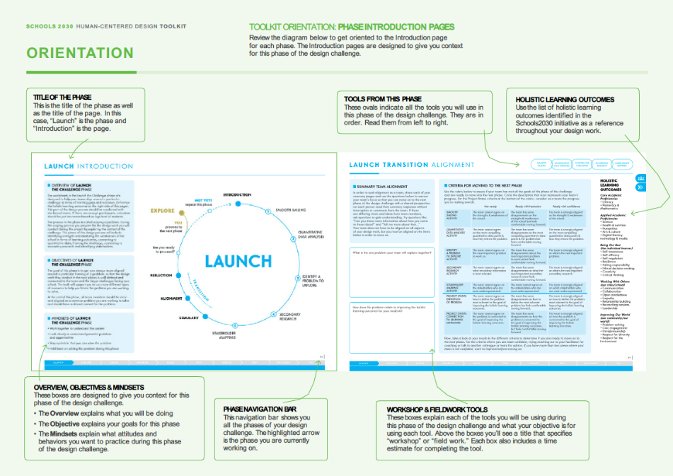
SCHOOLS 2030 HUMAN-CENTERED DESIGN TOOLKIT
• INTRODUCTION PAGE
The Introduction page includes a navigation bar for the entire process as well as visuals
for all of the tools in this section. The holistic learning outcomes are included as a reference
for teams.
The Introduction page includes a description of the phase of the design challenge
as well as the objectives of the phase and the mindsets needed to complete this phase.
The Introduction page also gives a brief description of each tool – what it is and
why design teams are completing it, as well as the estimated time needed to complete the tool.
As a coach, ensure that every member of the design team is familiar with the introduction of each section before they begin the work of that phase. If you have the opportunity, talk through the mindsets needed for this phase with the design teams.

Slide 40
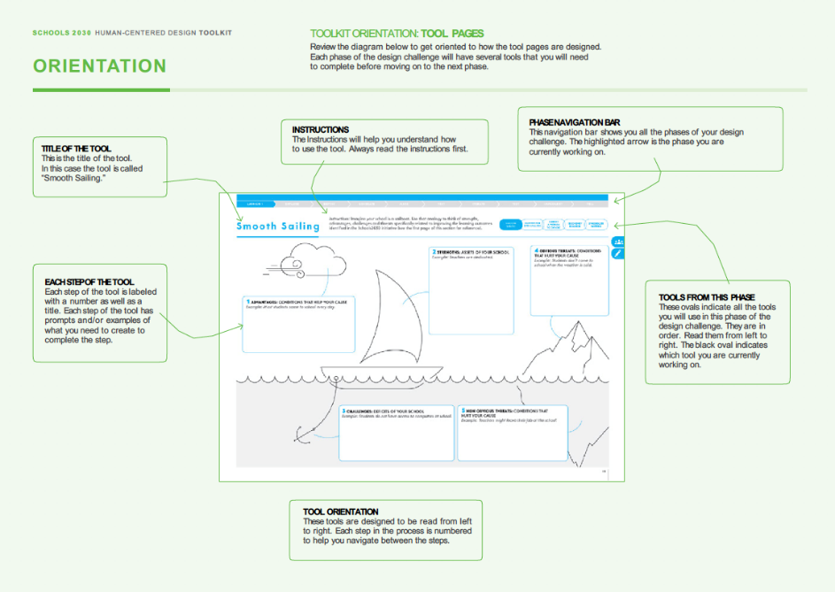
SCHOOLS 2030 HUMAN-CENTERED DESIGN TOOLKIT
FACILITATOR’S GUIDE
• TOOL PAGES
The Tool pages are where the work of the phase is completed. Encourage teams to
work through each tool in order and take notes and answer the prompts on every page.
If design teams are working from a digital version, encourage them to take notes
by hand as a team and then have one person transfer them into their digital toolkit.
Tool pages include a navigation bar for the entire process at the top of the page. Underneath the navigation bar is a visual guide for all of the tools in this section,
with the current tool highlighted.

Slide 41
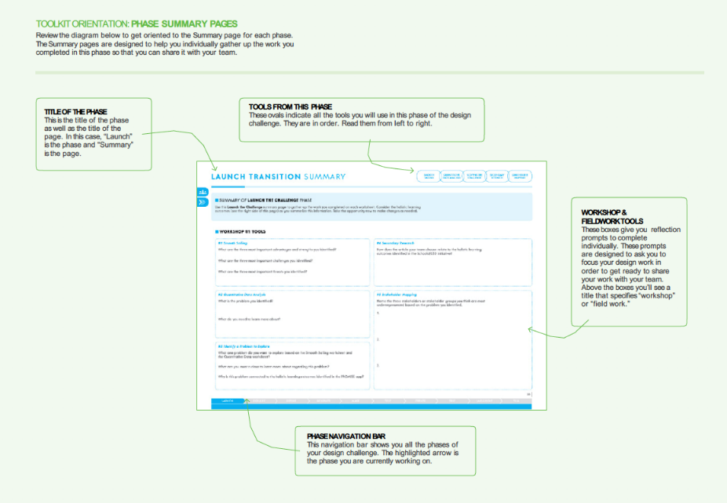
SCHOOLS 2030 HUMAN-CENTERED DESIGN TOOLKIT
• SUMMARY PAGE
The Summary page includes a navigation bar for the entire process as well as visuals for all
of the tools in this section. The holistic learning outcomes are included as a reference for teams.
The Summary page is designed for individuals to review all the design work they have completed
in this phase and summarize the most important information from each tool in one place.
Individuals will then use the Summary page to share their thinking with the rest of their team,
so that they can complete the process of aligning as a group.

Slide 42
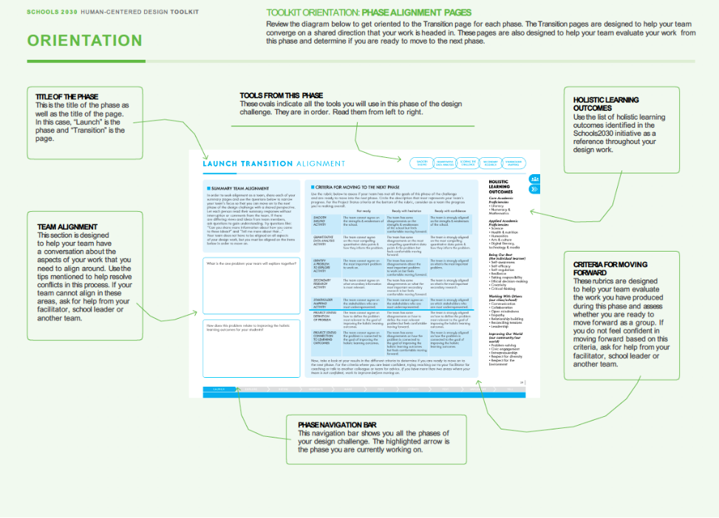
SCHOOLS 2030 HUMAN-CENTERED DESIGN TOOLKIT
FACILITATOR’S GUIDE
• ALIGNMENT PAGE
The Alignment page includes a navigation bar for the entire process as well as visuals for all of the tools in this section. The holistic learning outcomes are included as a reference for teams.
The Alignment page asks teams to align around a single set of ideas and then evaluate those ideas using the rubric provided.
The Alignment page is designed to help teams align and move forward, confident in their collective design work. If the team is not aligned or not confident, now is a good time as a coach to intervene and support the team to make changes to improve their work and get aligned.

Slide 43
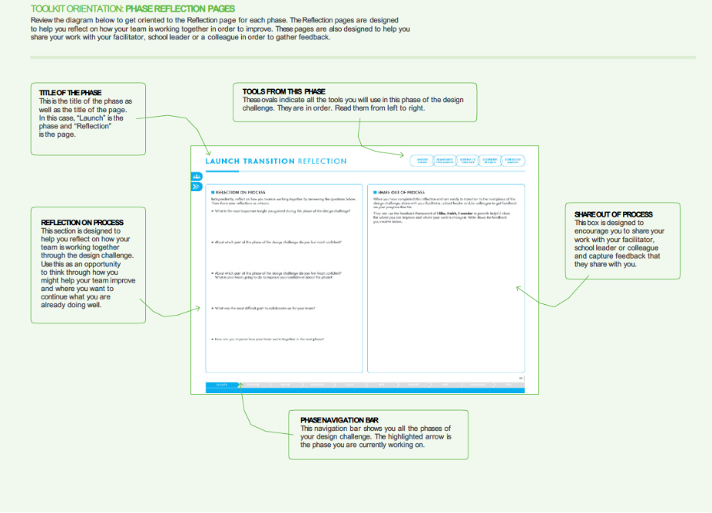
SCHOOLS 2030 HUMAN-CENTERED DESIGN TOOLKIT
• REFLECTION PAGE
The Reflection page includes a navigation bar for the entire process as well as visuals for all
of the tools in this section. The holistic learning outcomes are included as a reference for teams.
The Reflection page is designed to help individuals and design teams reflect on their work thus
far and make adjustments as needed.
There is also a space for design teams to gather feedback from others outside the team (the School Leader, you their coach, other colleagues, etc.). This is a good opportunity to provide coaching and feedback to help the design teams stay on track.

Slide 44
SCHOOLS 2030 HUMAN-CENTERED DESIGN TOOLKIT
FACILITATOR’S GUIDE
2
MAKING A PLAN
SCHOOLS 2030 HUMAN-CENTERED DESIGN TOOLKIT
The Core Tenets of a Human-Centered Design Challenge
The foundation of human-centered design is a first-hand understanding of the human needs and behaviors related to the problem you are solving, followed by decision-making that is based on that understanding.
To preserve the integrity of the human-centered design process, we are requesting that you commit to the following components of your design challenge:
Engaging with stakeholders in one-on-one interviews to deeply understand their perspectives, needs and motivations.
Working collaboratively as a team when possible.
Generating many ideas before selecting one to move forward.
Trying an idea in a small-scale prototype in order to test your assumptions before committing to implementing the idea.
If you and your design team are able to fully commit to all of those steps, you will be maximizing
the innovation potential of conducting a design challenge. If you skip any of those steps, you will be compromising the potential to create a truly student-centered solution that helps to increase students’ holistic learning outcomes.
Mapping Out Your Teams’ Design Challenges
We understand that every region has different constraints in terms of their educators’ ability to be away from their classrooms, their ability to travel to other campuses and the budget to cover those expenses.
Please work with your team to choose between the four options explained in the following pages
to determine which model is most appropriate for your region (or create your own!).

Slide 45

SCHOOLS 2030 HUMAN-CENTERED DESIGN TOOLKIT
Process Feedback
Once you have determined which model your country is going to implement, identify when you will ask participants to complete the mid-program survey. There is also an end of program survey as well. You can find a template for both surveys in the online resources.
• OPTION 1: REGIONAL TEAMS - 4 WORKSHOPS
Option 1: Regional Teams
Four workshops with regional schools. Individual fieldwork to be completed between workshops.
Pros:
Educators get a chance to share ideas and collaborate with other local schools. This diversity of perspectives enriches the design process.
Educators get to maximize their opportunities to work through the design challenge together and to receive coaching support.
Cons:
The logistics and budget required to get regional groups together.
This model requires several days away from school.
Who Should Consider This Model:
If you live in a region where schools can gather with relative ease, this model may prove to be beneficial. If it is possible for educators to be away from their classrooms for the day, this model may prove to be beneficial.
SCHOOLS 2030
JORNADA DO PARTICIPANTE
Opção 1 e 2
1 | 2 | 3 | 4 | 5 | 6 | 7 | 8 | 9 | 10
LANÇAR O DESAFIO | EXPLORAR | DEFINIR O | GERAR | PRODUZIR | TESTAR O | ITERAR | TESTAR OUTROS | PREPARAR PARA | CONTAR À SUA
DE DESIGN | O PROBLEMA | PROBLEMA | SOLUÇÕES | O PROTÓTIPO | PROTÓTIPO |  | PROTÓTIPOS | IMPLEMENTAR | COMUNIDADE
Workshop 1: | Workshop 1: | Workshop 2: | Workshop 2: | Workshop 2: | Workshop 2: | Workshop 3: | Workshop 3: | Workshop 4: | Workshop 4:
+ Navegação tranquila | + Preparação para | + Observações e palpites | + Preparação | + Combinar ideias | + Testar um protótipo | + Combinar ideias | + Testar um protótipo | + Reﬁnar a sua ideia | + Storytelling
+ Análise dos dados | a entrevista | + Ponto de vista | para a sessão | + Constituir | Trabalho de campo B: | + Constituir os | Trabalho de campo C: | + Planear o projeto | / Narrativa
quantitativos | Trabalho de campo A: | + Como poderemos | de brainstorming | os blocos chave | + Reﬂexão sobre | blocos chave | + Reﬂexão sobre |  | + Apresentação
11 NOITE DA APRESENTAÇÃO REGIONAL E CELEBRAÇÃO
+ Identiﬁcar o problema a explorar
+ Pesquisa secundária
+ Mapeamento das partes Interessadas
+ Questões para a entrevista
+ Técnicas adicionais de entrevista
+ Notas da entrevista e reﬂexões
+ Observação e mapeamento da jornada
+ Preparação para
a observação - opcional
+ Notas de Observação e Reﬂexão - opcional
(How Might We)
+ Brainstorm individual
+ Brainstorm em grupo
+ Seleção de ideias
+ Fazer um guião da ideia
+ Conceber um protótipo
+ Dicas para conceber e testar um protótipo
os testes feitos ao protótipo
+ Grelha de reﬂexão
+ O que aprendeu?
+ Fazer um guião da ideia
+ Conceber um protótipo
os testes feitos ao protótipo
+ Grelha de reﬂexão
+ O que aprendeu?
/ pitching ﬁnal
FACILITADORES/FORMADORES
+ Avaliação de ideias
+ Avaliar protótipos para passar às fases seguintes
+ E agora?
+ Avaliação de ideias
EQUIPA DA AKF
EQUIPA DA AKF
EQUIPA DA AKF
EQUIPA DA AKF
EQUIPA DA AKF
EQUIPA DA AKF
EQUIPA DA AKF
EQUIPA DA AKF
EQUIPA DA AKF
EQUIPA DA AKF
PARTICIPANTES
LÍDER EDUCADOR ESCOLAR
LÍDER EDUCADOR ESCOLAR
LÍDER EDUCADOR ESCOLAR
LÍDER EDUCADOR ESCOLAR
LÍDER EDUCADOR ESCOLAR
LÍDER EDUCADOR ESCOLAR
LÍDER EDUCADOR ESCOLAR
LÍDER EDUCADOR ESCOLAR
LÍDER EDUCADOR ESCOLAR
LÍDER EDUCADOR ESCOLAR
PARTES INTERESSADAS ADICIONAIS (ALUNOS, FAMÍLIAS)
PARTES INTERESSADAS ADICIONAIS
(ALUNOS, FAMÍLIAS)
ALUNO
ALUNO
WORKSHOP PRESENCIAL
TRABALHO DE CAMPO INDIVIDUAL
TRABALHO DE CAMPO INDIVIDUAL
TRABALHO DE CAMPO INDIVIDUAL
TRABALHO DE CAMPO INDIVIDUAL
TRABALHO DE CAMPO INDIVIDUAL
TRABALHO DE CAMPO INDIVIDUAL
Workshop 1
Workshop 2
Workshop 3
Workshop 4

Slide 46
SCHOOLS 2030 HUMAN-CENTERED DESIGN TOOLKIT
FACILITATOR’S GUIDE
Workshop 1 - Working as a School-Based Team 5 - 7 hours total
This workshop ideally will take place near the end of the first month of school. This workshop should be conducted in school-based groups, so that team(s) can focus on their own school context.
2.5 - 3.75 hours for Launch activities #1 Smooth Sailing
#2 Quantitative Data Analysis #3 Identify a Problem to Explore #4 Secondary Research
#5 Stakeholder Mapping
1 hour for Launch reflection
1.25 hours for Explore activities #1 Preparing to Interview
Fieldwork A - Individual Work 6 - 7 hours total + 1 day, optional
Ideally, educators would have two to four weeks to conduct their design research.
They can arrange their design research fieldwork independently, but may need some assistance if they are going to pursue a site visit at another school.
2.75 - 3.5 hours for Interviews/Observation #2 Interview Questions
#3 Additional Interview Techniques #4 Interview Notes & Reflection
#5 Observation & Journey Mapping
Optional Shadow -- optional
  30 minutes to prepare #6 Preparing to Shadow
  All day shadow
  30 minutes to reflect
#7 Shadow Notes & Reflection

Slide 47
SCHOOLS 2030 HUMAN-CENTERED DESIGN TOOLKIT
Workshop 2 - Working in Regional Teams 8.5 - 12.25 hours total
This workshop ideally will take place four to six weeks after the first workshop.
The first part of the workshop (Explore and Define) can be conducted with teams from multiple schools working together. The second part of the workshop (Generate) is an opportunity to co-design with other stakeholder groups , such as students and families.
If a school team is going to engage other stakeholder groups from their school,
we recommend that they do not collaborate with teams from other schools. If they
do not engage other stakeholders, collaborating with teams from other schools
in the region is an option.
.5 - 1 hour for Explore reflection
1.75 - 2.5 hours for Define activities #1 Observations & Guesses
#2 Point of View
#3 How Might We Questions
.5 - 1 hour for Define reflection
1.75 - 2 hours for Generate activities (option to bring in parents/students)
#1 Prepare to Brainstorm
#2 Solo Brainstorm
#3 Group Brainstorm
#4 Idea Selection
.5 - 1 hour for Generate reflection
2.5 - 3.25 hours for Make activities #1 Combine Ideas
#2 Building Blocks
#3 Storyboard Your Idea #4 Design a Prototype
#5 Tips for Designing and Testing a Prototype
.5 - 1 hour for Make reflection
.5 hours for Test activities #1 Testing a Prototype
Fieldwork B - Individual work 2 - 5 hours total
Ideally, educators would have two to four weeks to complete the testing of their prototypes. They can arrange this work independently and on their own timeline.
1 - 2 hours for testing prototypes
1.5 - 2.25 hours for testing reflection
#2 Testing a Prototype Reflection
#3 Reflection Grid

Slide 48
SCHOOLS 2030 HUMAN-CENTERED DESIGN TOOLKIT
FACILITATOR’S GUIDE
Workshop 3 - Working in Regional Teams 7.5 - 12 hours total
Ideally, this workshop would be conducted as one experience. This workshop should take place four to six weeks after the last workshop. This workshop can be conducted with teams from multiple schools working together.
1.5 - 2.5 hours for Test activities #4 What Did You Learn?
#5 Idea Evaluation
#6 Evaluating Prototypes to Get to Next Steps #7 What’s Next?
.5 - 1 hour for Test reflection
2 - 3 hours for Iterate activities #1 Combine Reflection & Ideas #2 Building to Iterate
#3 Storyboard Your Iteration #4 Design Another Prototype
.5 - 1 hour for Iterate reflection
.5 hours for Test Another Prototype activities #1 Test a Prototype
Fieldwork C - Individual work 2 - 5 hours total
Ideally, educators would have two to four weeks to complete the testing of their prototypes. They can arrange this work independently and on their own timeline.
There is also an opportunity during this phase of the project for schools to choose to add additional rounds of testing prototypes and analyzing the results in order to iterate on their ideas.
1 - 2 hours for testing prototypes
1.5 - 2.25 hours for testing reflection #2 Testing a Prototype Reflection
#3 Reflection Grid

Slide 49
SCHOOLS 2030 HUMAN-CENTERED DESIGN TOOLKIT
Workshop 4 - Working as a School-Based Team 7.75 - 9.25 hours total
This workshop ideally will take place four to six weeks after the last workshop. This workshop should be conducted in school-based groups, so that teams can focus on their own school context.
This may be a moment when teams want to consolidate and focus on a smaller number of promising ideas. If that is the case, the team who originally designed the idea should share the idea with the new team members. From there, they will work together to iterate and create multiple prototypes to test the single idea.
.5 - .75 hours for Test Another Prototype activities #4 What Did You Learn?
#5 Idea Evaluation
1 hour for Test Another Prototype reflection
2.25 - 3 hours for Implement activities #1 Refine Your Idea
#2 Project Planning
1 hour for Implement reflection
1 - 1.5 hours for Tell activities #1 Storytelling
#2 Pitching
1 hour for Tell reflection
1 hour for Design Challenge wrap-up and reflection
Regional Pitch Night & Celebration
This event would ideally take place four to six weeks after the last workshop.
This is an opportunity for schools to come together, learn from each other and share ideas. This is also an opportunity for schools to work together to steward the funding they receive and ensure that implementation of their ideas is having the desired impact. If schools choose to partner, they can work together in preparing to implement an idea and then meet periodically to share what they are learning and how they might improve on the process of implementing their idea.

Slide 50

SCHOOLS 2030 HUMAN-CENTERED DESIGN TOOLKIT
FACILITATOR’S GUIDE
• MAKING A PLAN: OPTION 2
Option 2: School-Based Team(s) – 4 Workshops
Four workshops with school-based team(s).
Individual fieldwork to be completed between workshops.
Pros:
Educators get a chance to share ideas and collaborate with their colleagues.
Educators get to maximize their opportunities to work through the design challenge together and to receive coaching support.
Cons:
This model requires several days where the educators are not in the classroom.
Who Should Consider This Model:
If you live in a region where schools cannot gather with ease, this model may prove
to be beneficial.
If it is possible for educators to be away from their classrooms for the day, this model may prove to be beneficial.
SCHOOLS 2030
JORNADA DO PARTICIPANTE
Opção 1 e 2
1 | 2 | 3 | 4 | 5 | 6 | 7 | 8 | 9 | 10
LANÇAR O DESAFIO | EXPLORAR | DEFINIR O | GERAR | PRODUZIR | TESTAR O | ITERAR | TESTAR OUTROS | PREPARAR PARA | CONTAR À SUA
DE DESIGN | O PROBLEMA | PROBLEMA | SOLUÇÕES | O PROTÓTIPO | PROTÓTIPO |  | PROTÓTIPOS | IMPLEMENTAR | COMUNIDADE
Workshop 1: | Workshop 1: | Workshop 2: | Workshop 2: | Workshop 2: | Workshop 2: | Workshop 3: | Workshop 3: | Workshop 4: | Workshop 4:
+ Navegação tranquila | + Preparação para | + Observações e palpites | + Preparação | + Combinar ideias | + Testar um protótipo | + Combinar ideias | + Testar um protótipo | + Reﬁnar a sua ideia | + Storytelling
+ Análise dos dados | a entrevista | + Ponto de vista | para a sessão | + Constituir | Trabalho de campo B: | + Constituir os | Trabalho de campo C: | + Planear o projeto | / Narrativa
quantitativos | Trabalho de campo A: | + Como poderemos | de brainstorming | os blocos chave | + Reﬂexão sobre | blocos chave | + Reﬂexão sobre |  | + Apresentação
11 NOITE DA APRESENTAÇÃO REGIONAL E CELEBRAÇÃO
+ Identiﬁcar o problema a explorar
+ Pesquisa secundária
+ Mapeamento das partes Interessadas
+ Questões para a entrevista
+ Técnicas adicionais de entrevista
+ Notas da entrevista e reﬂexões
+ Observação e mapeamento da jornada
+ Preparação para
a observação - opcional
+ Notas de Observação e Reﬂexão - opcional
(How Might We)
+ Brainstorm individual
+ Brainstorm em grupo
+ Seleção de ideias
+ Fazer um guião da ideia
+ Conceber um protótipo
+ Dicas para conceber e testar um protótipo
os testes feitos ao protótipo
+ Grelha de reﬂexão
+ Fazer um guião da ideia
+ Conceber um protótipo
os testes feitos ao protótipo
+ Grelha de reﬂexão
/ pitching ﬁnal
FACILITADORES/FORMADORES
+ O que aprendeu?
+ Avaliação de ideias
+ Avaliar protótipos para passar às fases seguintes
+ E agora?
+ O que aprendeu?
+ Avaliação de ideias
EQUIPA DA AKF
EQUIPA DA AKF
EQUIPA DA AKF
EQUIPA DA AKF
EQUIPA DA AKF
EQUIPA DA AKF
EQUIPA DA AKF
EQUIPA DA AKF
EQUIPA DA AKF
EQUIPA DA AKF
PARTICIPANTES
LÍDER EDUCADOR ESCOLAR
LÍDER EDUCADOR ESCOLAR
LÍDER EDUCADOR ESCOLAR
LÍDER EDUCADOR ESCOLAR
LÍDER EDUCADOR ESCOLAR
LÍDER EDUCADOR ESCOLAR
LÍDER EDUCADOR ESCOLAR
LÍDER EDUCADOR ESCOLAR
LÍDER EDUCADOR ESCOLAR
LÍDER EDUCADOR ESCOLAR
PARTES INTERESSADAS ADICIONAIS (ALUNOS, FAMÍLIAS)
PARTES INTERESSADAS ADICIONAIS
(ALUNOS, FAMÍLIAS)
ALUNO
ALUNO
WORKSHOP PRESENCIAL
TRABALHO DE CAMPO INDIVIDUAL
TRABALHO DE CAMPO INDIVIDUAL
TRABALHO DE CAMPO INDIVIDUAL
TRABALHO DE CAMPO INDIVIDUAL
TRABALHO DE CAMPO INDIVIDUAL
TRABALHO DE CAMPO INDIVIDUAL
Workshop 1
Workshop 2
Workshop 3
Workshop 4

Slide 51
SCHOOLS 2030 HUMAN-CENTERED DESIGN TOOLKIT
• OPTION 2: SCHOOL-BASED TEAMS - 4 WORKSHOPS
Workshop 1 5 - 7 hours total
This workshop ideally will take place near the end of the first month of school.
2.5 - 3.75 hours for Launch activities #1 Smooth Sailing
#2 Quantitative Data Analysis
#3 Identify a Problem to Explore #4 Secondary Research
#5 Stakeholder Mapping
1 hour for Launch reflection
1.25 hours for Explore activities #1 Preparing to Interview
Fieldwork A
6 - 7 hours total + 1 day, optional
Ideally, educators would have two to four weeks to conduct their design research.
They can arrange their design research fieldwork independently, but may need some assistance if they are going to pursue a site visit at another school.
2.75 - 3.5 hours for Interviews/Observation #2 Interview Questions
#3 Additional Interview Techniques #4 Interview Notes & Reflection
#5 Observation & Journey Mapping
Optional Shadow
  30 minutes to prepare
#6 Preparing to Shadow -- optional
  All-day shadow
  30 minutes to reflect
#7 Shadow Notes & Reflection -- optional

Slide 52
SCHOOLS 2030 HUMAN-CENTERED DESIGN TOOLKIT
FACILITATOR’S GUIDE
Workshop 2 8.5 - 12.25 hours total
This workshop ideally will take place four to six weeks after the first workshop.
The second part of the workshop is an opportunity to co-design with other stakeholder groups such as parents and students.
.5 - 1 hour for Explore reflection
1.75 - 2.5 hours for Define activities #1 Observations & Guesses
#2 Point of View
#3 How Might We Questions
.5 - 1 hour for Define reflection
1.75 - 2 hours for Generate activities (option to bring in parents/students)
#1 Prepare to Brainstorm
#2 Solo Brainstorm
#3 Group Brainstorm
#4 Idea Selection
.5 - 1 hour for Generate reflection
2.5 - 3.25 hours for Make activities #1 Combine Ideas
#2 Building Blocks
#3 Storyboard Your Idea #4 Design a Prototype
#5 Tips for Designing and Testing a Prototype
.5 - 1 hour for Make reflection
.5 hours for Test activities #1 Test a Prototype
Fieldwork B - Individual work 2 - 5 hours total
Ideally, educators would have two to four weeks to complete the testing of their prototypes. They can arrange this work independently and on their own timeline.
1 - 2 hours for testing prototypes
1.5 - 2.25 hours for testing reflection #2 Testing a Prototype Reflection
#3 Reflection Grid

Slide 53
SCHOOLS 2030 HUMAN-CENTERED DESIGN TOOLKIT
Workshop 3 7.5 - 12 hours total
Ideally, this workshop would be conducted as one experience.
This workshop should take place four to six weeks after the last workshop.
This may be a moment when teams want to consolidate and focus on a smaller number
of promising ideas. If that is the case, the team who originally designed the idea should share the idea with the new team members. From there, they will work together to iterate and create multiple prototypes to test the single idea.
1.5 - 2.5 hours for Test activities #4 What Did You Learn?
#5 Idea Evaluation
#6 Evaluating Prototypes to Get to Next Steps #7 What’s Next?
.5 - 1 hour for Test reflection
2 - 3 hours for Iterate activities #1 Combine Reflection & Ideas #2 Building to Iterate
#3 Storyboard Your Iteration #4 Design Another Prototype
.5 - 1 hour for Iterate reflection
.5 hours for Test Another Prototype activities #1 Test a Prototype
Fieldwork C 2 - 5 hours total
Ideally, educators would have two to four weeks to complete the testing of their prototypes. They can arrange this work independently and on their own timeline. There is also an opportunity during this phase of the project for schools to choose
to add additional rounds of testing prototypes and analyzing the results in order to iterate on their ideas.
1 - 2 hours for testing prototypes
1.5 - 2.25 hours for testing reflection #2 Testing a Prototype Reflection
#3 Reflection Grid

Slide 54
SCHOOLS 2030 HUMAN-CENTERED DESIGN TOOLKIT
FACILITATOR’S GUIDE
Workshop 4 - Working as a School-Based Team 7.75 - 9.25 hours total
This workshop ideally will take place four to six weeks after the last workshop. This workshop should be conducted in school-based groups, so that teams can focus on their own school context.
.5 - .75 hours for Test Another Prototype activities #4 What Did You Learn?
#5 Idea Evaluation
1 hour for Test Another Prototype reflection
2.25 - 3 hours for Implement activities #1 Refine Your Idea
#2 Project Planning
1 hour for Implement reflection
1 - 1.5 hours for Tell activities #1 Storytelling
#2 Pitching
1 hour for Tell reflection
1 hour for Design Challenge wrap-up and reflection
Regional Pitch Night & Celebration
This event would ideally take place four to six weeks after the last workshop.
This is an opportunity for schools to come together, learn from each other and share ideas. This is also an opportunity for schools to work together to steward the funding they receive and ensure that implementation of their ideas is having the desired impact. If schools choose to partner, they can work together in preparing to implement an idea and then meet periodically to share what they are learning and how they might improve on the process of implementing their idea.

Slide 55
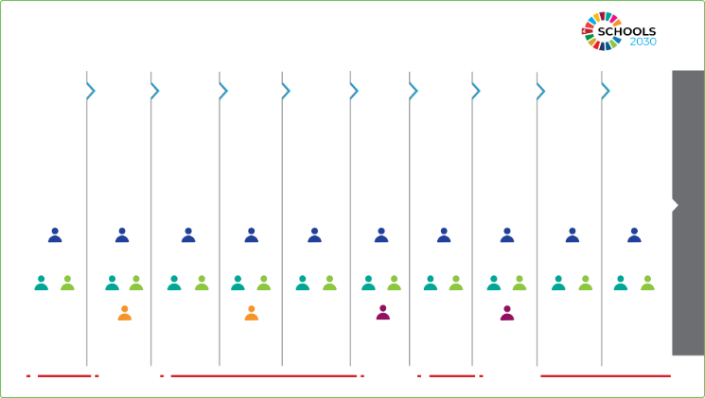
SCHOOLS 2030 HUMAN-CENTERED DESIGN TOOLKIT
• MAKING A PLAN: OPTION 3 - 20 MEETINGS
Option 3: School-Based Teams - 20 Meetings
Twenty before- or after-school meetings working in school-based teams. Four phases
of individual fieldwork to be completed between workshops as stated below. This model takes the elements of the four workshops (in Option 1 & 2) and divides the engagement time
and work across twenty shorter meetings.
There are more activities in a phase than a design team can complete in a short meeting (approximately 90 minutes). So multiple meetings are clustered into this model to help outline your work plan. For example, the Launch Phase will take approximately two meetings, and by the end of the Meetings 1 & 2 your design team will have, ideally, completed #5 Stakeholder Mapping.
Pros:
Educators get a chance to share ideas and collaborate with their colleagues.
The process is broken into manageable chunks that can be completed over time.
Educators do not have to commit to meetings that take them away from class.
Cons:
This model does not maximize opportunities for coaching.
This model spreads the work over time limiting the potential for the process to gain and maintain momentum.
This model requires a commitment to meeting before or after school for twenty meetings.
Who Should Consider This Model:
If you live in a region where schools cannot gather with ease, this model may prove to be beneficial. If it is not possible for educators to be away from their classrooms for the day,
this model may prove to be beneficial.
SCHOOLS 2030
JORNADA DO PARTICIPANTE
Opção 1 e 2
1 | 2 | 3 | 4 | 5 | 6 | 7 | 8 | 9 | 10
LANÇAR O DESAFIO | EXPLORAR | DEFINIR O | GERAR | PRODUZIR | TESTAR O | ITERAR | TESTAR OUTROS | PREPARAR PARA | CONTAR À SUA
DE DESIGN | O PROBLEMA | PROBLEMA | SOLUÇÕES | O PROTÓTIPO | PROTÓTIPO |  | PROTÓTIPOS | IMPLEMENTAR | COMUNIDADE
Workshop 1: | Workshop 1: | Workshop 2: | Workshop 2: | Workshop 2: | Workshop 2: | Workshop 3: | Workshop 3: | Workshop 4: | Workshop 4:
+ Navegação tranquila | + Preparação para | + Observações e palpites | + Preparação | + Combinar ideias | + Testar um protótipo | + Combinar ideias | + Testar um protótipo | + Reﬁnar a sua ideia | + Storytelling
+ Análise dos dados | a entrevista | + Ponto de vista | para a sessão | + Constituir | Trabalho de campo B: | + Constituir os | Trabalho de campo C: | + Planear o projeto | / Narrativa
11 NOITE DA APRESENTAÇÃO REGIONAL E CELEBRAÇÃO
quantitativos
+ Identiﬁcar o problema a explorar
+ Pesquisa secundária
+ Mapeamento das partes Interessadas
Trabalho de campo A:
+ Questões para a entrevista
+ Técnicas adicionais de entrevista
+ Notas da entrevista e reﬂexões
+ Observação e mapeamento da jornada
+ Preparação para
a observação - opcional
+ Notas de Observação e Reﬂexão - opcional
+ Como poderemos (How Might We)
de brainstorming
+ Brainstorm individual
+ Brainstorm em grupo
+ Seleção de ideias
os blocos chave
+ Fazer um guião da ideia
+ Conceber um protótipo
+ Dicas para conceber e testar um protótipo
+ Reﬂexão sobre os testes feitos ao protótipo
blocos chave
+ Fazer um guião da ideia
+ Conceber um protótipo
+ Reﬂexão sobre os testes feitos ao protótipo
+ Apresentação
/ pitching ﬁnal
FACILITADORES/FORMADORES
+ Grelha de reﬂexão
+ O que aprendeu?
+ Avaliação de ideias
+ Avaliar protótipos para passar às fases seguintes
+ E agora?
+ Grelha de reﬂexão
+ O que aprendeu?
+ Avaliação de ideias
EQUIPA DA AKF
EQUIPA DA AKF
EQUIPA DA AKF
EQUIPA DA AKF
EQUIPA DA AKF
EQUIPA DA AKF
EQUIPA DA AKF
EQUIPA DA AKF
EQUIPA DA AKF
EQUIPA DA AKF
PARTICIPANTES
LÍDER EDUCADOR ESCOLAR
LÍDER EDUCADOR ESCOLAR
LÍDER EDUCADOR ESCOLAR
LÍDER EDUCADOR ESCOLAR
LÍDER EDUCADOR ESCOLAR
LÍDER EDUCADOR ESCOLAR
LÍDER EDUCADOR ESCOLAR
LÍDER EDUCADOR ESCOLAR
LÍDER EDUCADOR ESCOLAR
LÍDER EDUCADOR ESCOLAR
PARTES INTERESSADAS ADICIONAIS (ALUNOS, FAMÍLIAS)
PARTES INTERESSADAS ADICIONAIS
(ALUNOS, FAMÍLIAS)
ALUNO
ALUNO
WORKSHOP PRESENCIAL
TRABALHO DE CAMPO INDIVIDUAL
TRABALHO DE CAMPO INDIVIDUAL
TRABALHO DE CAMPO INDIVIDUAL
TRABALHO DE CAMPO INDIVIDUAL
TRABALHO DE CAMPO INDIVIDUAL
TRABALHO DE CAMPO INDIVIDUAL
Reuniões 1-3
Reuniões 4-10
Reuniões 11-15
Reuniões 16-20

Slide 56
SCHOOLS 2030 HUMAN-CENTERED DESIGN TOOLKIT
FACILITATOR’S GUIDE
• OPTION 3: SCHOOL-BASED TEAMS - 20 MEETINGS
Meetings 1 & 2
These meetings ideally will take place near the end of the first month of school.
2.5 - 3.75 hours for Launch activities #1 Smooth Sailing
#2 Quantitative Data Analysis
#3 Identify a Problem to Explore #4 Secondary Research
#5 Stakeholder Mapping
Meeting 3
These meetings ideally will take place near the end of the first month of school.
1 hour for Launch reflection
1.25 hours for Explore activities #1 Preparing to Interview
Fieldwork A
6 - 7 hours total + 1 day, optional
Ideally, educators would have two to four weeks to conduct their design research.
They can arrange their design research fieldwork independently, but may need some assistance if they are going to pursue a site visit at another school.
2.75 - 3.5 hours for Interviews/Observation #2 Interview Questions
#3 Additional Interview Techniques #4 Interview Notes & Reflection
#5 Observation & Journey Mapping
Optional Shadow
  30 minutes to prepare
#6 Preparing to Shadow – optional
  All day shadow
  30 minutes to reflect
#7 Shadow Notes & Reflection – optional

Slide 57
SCHOOLS 2030 HUMAN-CENTERED DESIGN TOOLKIT
Meetings 4 & 5
These meetings ideally will take place four to six weeks after the first meeting.
1 hour for Explore reflection
1.75 - 2.5 hours for Define activities #1 Observations & Guesses
#2 Point of View
#3 How Might We Questions
1 hour for Define reflection
Meetings 6 & 7
These meetings ideally will take place four to six weeks after the first meeting.
There is an opportunity to bring students and/or families to assist with the brainstorming process during one of these meetings.
1.75 - 2 hours for Generate activities #1 Prepare to Brainstorm
#2 Solo Brainstorm
#3 Group Brainstorm
#4 Idea Selection
Meetings 8, 9 & 10
These meetings ideally will take place four to six weeks after the first meeting.
.5 - 1 hour for Generate reflection
2.5 - 3.25 hours for Make activities #1 Combine Ideas
#2 Building Blocks
#3 Storyboard Your Idea #4 Design a Prototype
#5 Tips for Designing and Testing a Prototype
.5 - 1 hour for Make reflection
.5 hours for Test activities #1 Test a Prototype

Slide 58
SCHOOLS 2030 HUMAN-CENTERED DESIGN TOOLKIT
FACILITATOR’S GUIDE
Fieldwork B 2 - 5 hours
Ideally, educators would have two to four weeks to complete the testing of their prototypes.
They can arrange this work independently and on their own timeline.
1 - 2 hours for testing prototypes
1.5 - 2.25 hours for testing reflection #2 Testing a Prototype Reflection
#3 Reflection Grid
Meetings 11 & 12
These meetings ideally will take place six to eight weeks after the first meeting.
1.5 - 2.5 hours for Test activities #4 What Did You Learn?
#5 Idea Evaluation
#6 Evaluating Prototypes to Get to Next Steps #7 What’s Next?
.5 - 1 hour for Test reflection
Meetings 13, 14 & 15
These meetings ideally will take place six to eight weeks after the first meeting.
This may be a moment when teams want to consolidate and focus on a smaller number of promising ideas. If that is the case, the team who originally designed the idea should share the idea with the new team members. From there, they will work together to iterate and create multiple prototypes to test the single idea.
2 - 3 hours for Iterate activities #1 Combine Reflections & Ideas #2 Building to Iterate
#3 Storyboard Your Iteration #4 Design Another Prototype
.5 - 1 hour for Iterate reflection
.5 hours for Test Another Prototype activities #1 Test a Prototype
Fieldwork C 2 - 5 hours
Ideally, educators would have two to four weeks to complete the testing of their prototypes.
They can arrange this work independently and on their own timeline.
1 - 2 hours for testing prototypes
1.5 - 2.25 hours for testing reflection #2 Testing a Prototype Reflection #3 Reflection Grid

Slide 59
SCHOOLS 2030 HUMAN-CENTERED DESIGN TOOLKIT
Meeting 16
These meetings ideally will take place eight to ten weeks after the first meeting.
.5 - .75 hours for Test Another Prototype activities #4 What Did You Learn?
#5 Idea Evaluation
1 hour for Test Another Prototype reflection
Meetings 17 & 18
These meetings ideally will take place eight to ten weeks after the first meeting.
2.25 - 3 hours for Implement activities #1 Refine Your Idea
#2 Project Planning
1 hour for Implement reflection
Meeting 19
These meetings ideally will take place eight to ten weeks after the first meeting.
1 - 1.5 hours for Tell activities #1 Storytelling
#2 Pitching
1 hour for Tell reflection
Meeting 20
These meetings ideally will take place eight to ten weeks after the first meeting.
1 hour for Design Challenge wrap-up and reflection
Regional Pitch Night & Celebration
This event would ideally take place ten to twelve weeks after the first meeting.
This is an opportunity for schools to come together, learn from each other and share ideas. This is also an opportunity for schools to work together to steward the funding they receive and ensure that implementation of their ideas is having the desired impact. If schools choose to partner, they can work together in preparing to implement an idea and then meet periodically to share what they are learning and how they might improve on the process of implementing their idea.

Slide 60
SCHOOLS 2030 HUMAN-CENTERED DESIGN TOOLKIT
FACILITATOR’S GUIDE
• MAKING A PLAN: OPTION 4 - SOLO OR PARTNERED WORK
Option 4: Solo or Partnered Work
Solo or partnered work except one meeting to conduct “Generate” activities. Educators
will work individually or with their School Leader to complete all the activities of the toolkit (except for the Generate phase) – including fieldwork. All tools, including those designated as workshop tools and fieldwork tools, to be completed according to individual schedules.
Pros:
Educators do not have to commit to meetings that take them away from class.
Educators can schedule their work on the design challenge as they see fit.
Cons:
Educators do not get a chance to share ideas and collaborate with other local schools or colleagues.
This model does not maximize opportunities for coaching.
This model does not create accountability to a team or the deadline
of a workshop to motivate educators to continue the work.
Additional Guidance for Option 4:
This option should only be picked if you’re the only member of a school with two or fewer participants. If you have multiple people at your school participating in the School 2030 Initiative and the Design Challenge, use another option for your Design Challenge Model.
Who Should Consider This Model:
If you live in a region where schools cannot gather with ease, this model may prove to be beneficial. If it is not possible for educators to be away from their classrooms for the day, this model may prove to be beneficial. If you have a small number of educators
or educators who cannot find time to meet, this model may prove to be beneficial.
  Working individually for an entire design challenge means you will want
  to incorporate some other structures for support and accountability.
  Who might you ask to support you?
  You might set up a weekly or monthly call with other designers or leaders
  of the Schools2030 Initiatives to share, ask questions, and learn more.
  You might want to establish who you will call if you need help, support, or guidance.
“Generate” workshop
There is an opportunity to bring students and/or families to assist with the brainstorming process during this meeting.
  1.75 - 2 hours for Generate activities
  1 hour for Generate reflection

Slide 61
SCHOOLS 2030 HUMAN-CENTERED DESIGN TOOLKIT
3
LAUNCHING THE
DESIGN CHALLENGE
SCHOOLS 2030 HUMAN-CENTERED DESIGN TOOLKIT
Preparing to Launch
After you have identified the design challenge model your region is going to use, work with School Leaders to identify their design teams (see the School Leader’s Guide for more information). From there, work with the School Leaders to review the calendar of workshops and meetings, talk about a framework for checking on progress and giving feedback,
as well as the materials needed (Educator’s Toolkit, printing, etc.).
Working with an Equity Lens
When making changes to a school’s structure and culture, it is important to keep in mind all of the stakeholders, including those who are typically underrepresented. We have embedded an equity lens into the Educator Toolkit to help design teams keep those who are typically underrepresented in the forefront of the decision-making process.
Coach School Leaders to gather their design team(s) together to share the expectations of their participation. Ensure that School Leaders ask for a commitment to the entire process and explain the supports that you will put in place for them.
Please see below for our definitions of equity and inequity.
Equity: An approach where every person, regardless of who they are, is given what she or he needs in order to survive and thrive.
Inequity: A circumstance in which some people get more resources than others; those with less do not have what they need to survive and thrive.
Work with School Leaders to review the tools
in the Launch phase of the toolkit to help them gather together the information their design team(s) will need into order to complete this phase. Ask School Leaders to plan to participate with the design team(s) during this part of the first workshop in order to help guide them through these steps.
How might you coach your School Leaders and design teams to leverage their design challenges to overcome inequities at their schools and ensure that everyone has what she or he needs to survive and thrive?

Slide 62
SCHOOLS 2030 HUMAN-CENTERED DESIGN TOOLKIT
FACILITATOR’S GUIDE
4
SUPPORTING DESIGN TEAMS THROUGH EACH PHASE
SCHOOLS 2030 HUMAN-CENTERED DESIGN TOOLKIT
Supporting Your Design Teams
Remember to continue supporting your design teams as they progress through the design challenge.
Work with the School Leader to ensure that they have what they need (space, time off, coverage of duties and/or classroom) to complete their design work.
Remind teams to make sure that every voice on their team is being heard.
Some teams might struggle to keep up the momentum. Remind teams to keep moving forward. Encourage them to stick to the estimated times for each tool.
If teams finish a phase quickly, encourage them to go back and review their work. Encourage them to deepen their work.
Tips and Coaching Advice for each Phase of the Toolkit
Use the next section of the Facilitator’s Guide as a reference for when you are coaching School Leaders and design teams. Each phase of the design challenge has overall coaching tips for the phase. Each tool in the toolkit also has tips for coaching teams to get the most out of using the tool.

Slide 63
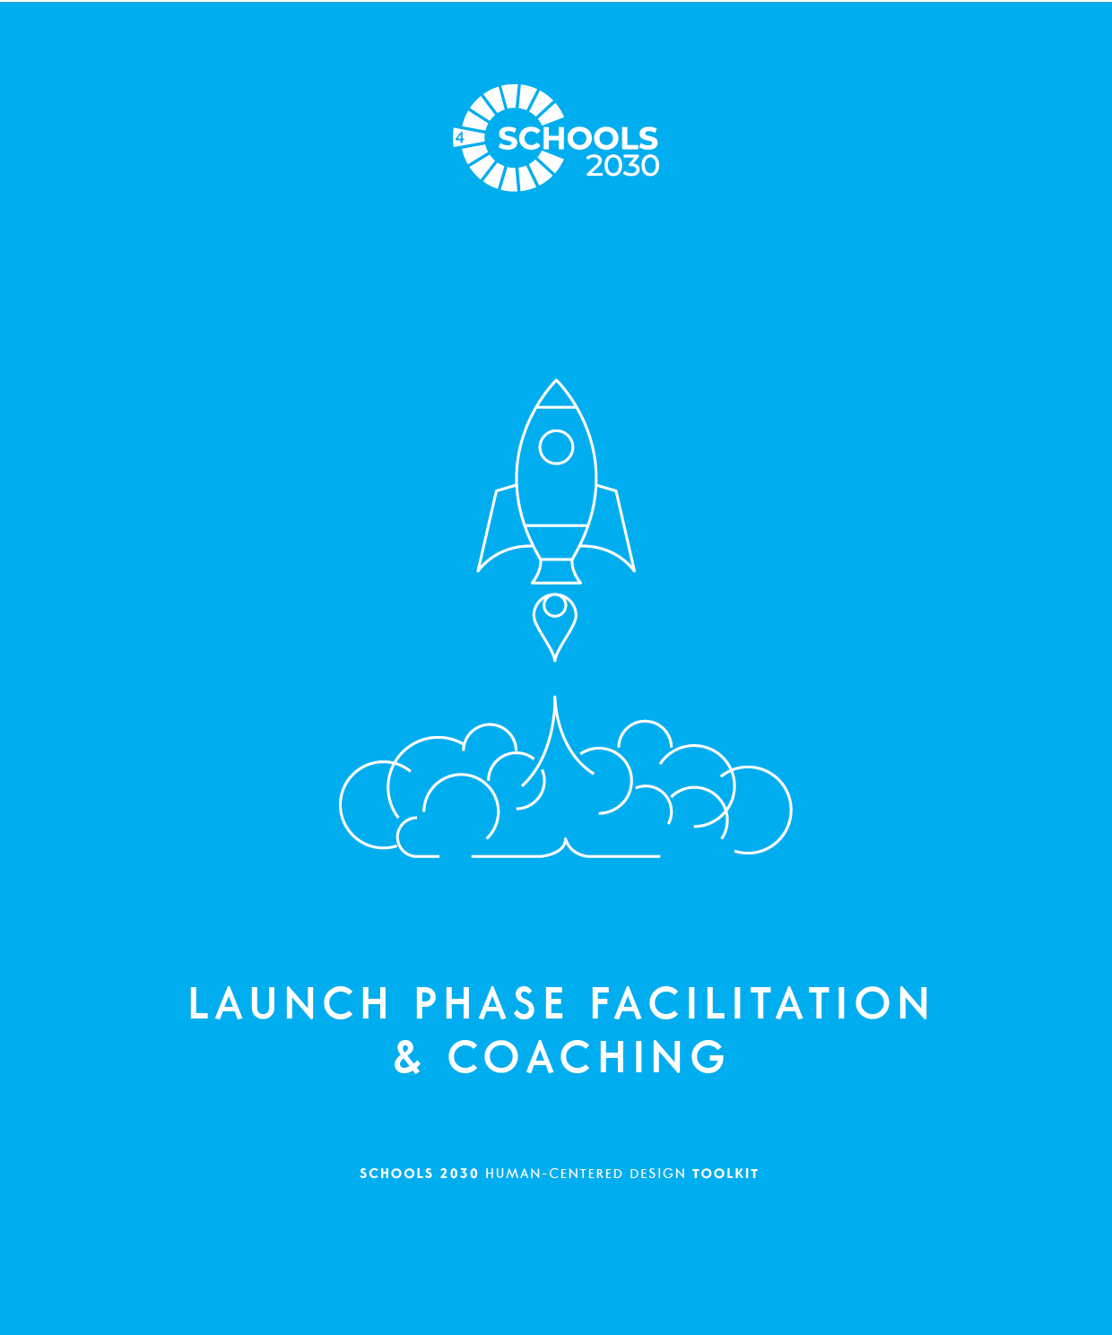
SCHOOLS 2030 HUMAN-CENTERED DESIGN TOOLKIT

Slide 64
SCHOOLS 2030 HUMAN-CENTERED DESIGN TOOLKIT
LAUNCH PHASE FACILITATION & COACHING
FROM THE EDUCATOR TOOLKIT
• OVERVIEW OF LAUNCH THE CHALLENGE PHASE
The handouts in the Launch the Challenge phase
are designed to help your team align around a particular challenge in terms of learning gaps and outcomes (reference the holistic learning outcomes on the right side of this page). This part of the design process should be conducted with site-based teams. If there are enough participants, educators should be put into teams based on age level of students.
The process in this phase is called scoping a problem. During the scoping process you prepare for the design work you will conduct during this project by exploring the context of the challenge. This phase of the design process will include: identifying strengths and analyzing the weaknesses of the school in terms of learning outcomes, connecting to quantitative data, framing the challenge, connecting to secondary research
and identifying stakeholders.
COACHING FOR SUCCESS:
The Launch the Challenge phase has many tools that allow individual members of the team to read, reflect, and consider the obstacles and constraints
that affect the larger context of the issues at their school. This is an important part of any design challenge because it establishes a critical understanding of what you are trying to solve.
A successful completion of this phase will mean the design team has alignment about the problem and how it relates to the holistic learning outcomes. The design team will expand their understanding of the challenge in a future phase.
Allow this initial phase of the design challenge to be about embracing the process and pushing past any discomfort that might come from working in a new way.
• OBJECTIVES OF LAUNCH THE CHALLENGE PHASE
The goal of this phase is to get your design team aligned around a particular framing of a problem, so that the design work they conduct in the next phases is well-defined and connected to the team and the larger challenges facing your school.
The tools will support you to use many different types of resources to help you frame the problem you are working to solve.
At the end of this phase, all team members should be clear and aligned on a common problem you are working to solve and should have a shared context for the problem.
COACHING TO AVOID COMMON MISTAKES:
A common mistake in this phase of the design challenge
is that the team feels that they need to know the solution to the problem to move on. The team doesn’t need to have an answer to select a problem. In fact, NOT having a solution in mind is the ideal type of problem to solve.
Help design teams avoid picking problems that are not human-centered in the focus. You can ask, “Who does that problem most affect?” or “Can we focus on one specific stakeholder for that problem?”
Help the design teams avoid problems that are not connected to a challenge that might improve the holistic learning outcomes at the school.
COACHING FOR MINDSETS:
Although many of the worksheets for the Launch the Challenge are completed individually, reinforce the mindset of working together throughout this phase. This will help to build a successful foundation of collaboration on the design team.
Remember that design teams do not have to have all the answers right now. The team is just collecting information to guide the work. Help teams stay optimistic that the process will reveal the challenge and guide their work.
Help teams embrace the design process, and avoid trying to solve the problem right away, even if they think they have a great idea!
Ask participants to pick one mindset that they are going to focus on during this phase of the process.
• MINDSETS OF LAUNCH THE CHALLENGE PHASE
Work together to understand the context
Look closely to understand potential problems and opportunities
Stay optimistic that you can solve the problem
Hold back on solving the problem during this phase
52
LAUNCH
EXPLORE
DEFINE
GENERATE
MAKE

Slide 65
SCHOOLS 2030 HUMAN-CENTERED DESIGN TOOLKIT
LAUNCH PHASE FACILITATION & COACHING
CREATIVE EXERCISES:
Blind Contour Drawing
Goal:
This exercise is designed to help participants let go of their pursuit of perfection. Because of the constraints of the activity, they are not able to create a perfect drawing of their partner. This allows them to embrace the process and appreciate the beauty in the imperfect.
Instructions:
Turn to a partner and look them in the eyes. Draw a portrait of them using a Sharpie Marker. You cannot look at the page
or pull your pen from the page until you are finished. When everyone is finished have each partner share their drawing.
The artist should put the name of the person they drew at the bottom of the page. Hang up the drawings in the space.
Online Adaptation:
Turn on the Gallery View in Zoom. Find a random person who you are going to draw. When the facilitator says begin, draw
a portrait of that person using a Sharpie Marker. You cannot look at the page or pull your pen from the page until you
are finished. The artist should put the name of the person they drew at the bottom of the page. Ask everyone to share their drawings on their screen using their camera.
Debrief Questions:
What was it like to draw in this way?
What were your expectations for what you might produce?
How did doing this activity make you feel?
What did you learn about yourself in doing this activity?
What are some positive lessons to takeaway from this activity?
Team Building Reflection
Goal:
This exercise is designed to help participants get to know with their teammates and share a little about themselves.
This team-building will help the team to work together more effectively.
Instructions:
Create time during the workshop to have teams connect with each other and answer the following questions:
What are your personal strengths?
What should your teammates know about you? The way you prefer to work?
What is your team name? What animal could represent your team? Why?
LEARN MORE ABOUT THIS PHASE:
To learn more about this phase, check our electronic appendix of articles we have curated.
Human-Centered, Systems-Minded Design
53
LAUNCH
EXPLORE
DEFINE
GENERATE
MAKE

Slide 66
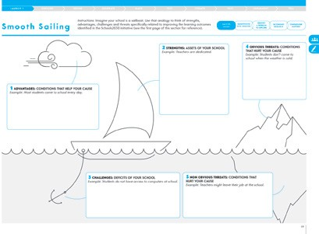
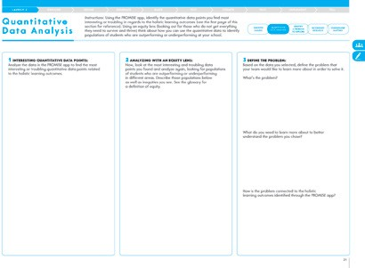
SCHOOLS 2030 HUMAN-CENTERED DESIGN TOOLKIT
#1 Smooth Sailing 30-45 minutes
WHAT IS THIS TOOL?
The Smooth Sailing handout helps your team identify your school’s strengths and weaknesses.
WHAT IS YOUR GOAL?
When you have completed this tool, your team should be aligned around potential problems and opportunities.
TOOL TIPS:
PAGE 19 • HUMAN-CENTERED DESIGN TOOLKIT
It may be easier for teams to generate advantages and strengths than disadvantages and challenges. Reassure teams that the goal is to identify and understand the challenges and disadvantages so they can address them through their design challenge.
Encourage teams to come up with at least three ideas per box.
If teams are struggling to generate any ideas, set aside the tool and begin with just a conversation about the best things about the school.
#2 Quantitative Data Analysis 30-45 minutes
WHAT IS THIS TOOL?
The Quantitative Data Analysis handout helps your team use quantitative data to identify problems and the groups most affected by those problems.
WHAT IS YOUR GOAL?
When you have completed this tool, your team should be aligned around potential problems as well as those stakeholders who are most affected by this problem.
PAGE 21 • HUMAN-CENTERED DESIGN TOOLKIT
TOOL TIPS:
Ask the School Leader to help facilitate this activity by orienting the design team to the quantitative data from the PROMISE app.
If design teams are not able to aggregate data by demographics, ask them to use their intuition to identify groups of students more impacted by the data point.
If teams are struggling to define the problem, ask them
to think about all the factors causing the data point they identified. From there, work to identify what is causing these factors and how they might be addressed.
54
TEST
ITERATE
TEST
IMPLEMENT
TELL

Slide 67
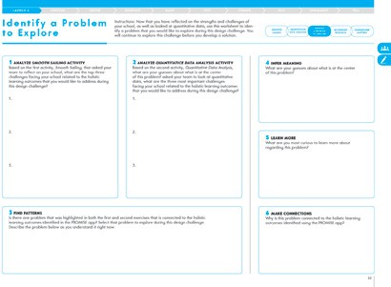
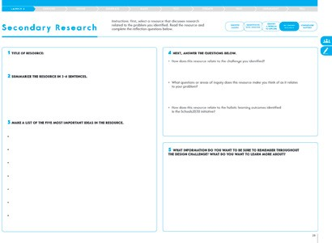
SCHOOLS 2030 HUMAN-CENTERED DESIGN TOOLKIT
LAUNCH PHASE FACILITATION & COACHING
#3 Identify a Problem to Explore
WHAT IS THIS TOOL?
30-45 minutes
The Identify a Problem to Explore handout helps your team bring together both their reflections and analysis of data to identify a problem to solve.
WHAT IS YOUR GOAL?
When you have completed this tool, your team should be aligned around potential problems and opportunities to address during your design work.
PAGE 23 • HUMAN-CENTERED DESIGN TOOLKIT
TOOL TIPS:
Remind design teams to use the first two tools to complete the first two boxes of this tool.
If there is not a problem that emerges from both sets of data, ask the design team to reflect and think if they can identify one problem that shows up both in their reflection and the quantitative data.
If the design team cannot think of one problem that shows up in both sets of data, ask them to select a problem identified through the quantitative data.
#4 Secondary Research
WHAT IS THIS TOOL?
30-45 minutes
The Secondary Research handout helps your team review research and examples of solutions that address problems similar to the problem you are working to solve.
WHAT IS YOUR GOAL?
When you have completed this tool, your team should
be inspired by proven examples and solutions that address the problem they have identified.
PAGE 25 • HUMAN-CENTERED DESIGN TOOLKIT
TOOL TIPS:
Ask design teams to look at outside resources to understand what research and educational thought leaders have shared about this idea.
Design teams can utilize the materials provided by the Schools 2030 initiative or they can search for their own.
55
LAUNCH
EXPLORE
DEFINE
GENERATE
MAKE

Slide 68
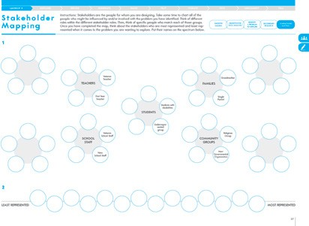
SCHOOLS 2030 HUMAN-CENTERED DESIGN TOOLKIT
#5 Stakeholder Mapping
WHAT IS THIS TOOL?
30-45 minutes
The Stakeholder Mapping handout helps your team identify the different stakeholder groups that relate to the problem as well as any voices that are underrepresented.
WHAT IS YOUR GOAL?
When you have completed this tool, your team should be aligned around potential stakeholders to engage in the next phase of the process.
PAGE 27 • HUMAN-CENTERED DESIGN TOOLKIT
TOOL TIPS:
If design teams are struggling to get started,
ask them to begin by thinking about the different types of stakeholders (students, families, teachers, etc.).
If they are still struggling, ask them to think of specific people from each of those groups.
If design teams are struggling to identify the least represented, ask the group to think about those with whom they frequently interact and those with whom they do not.
56
TEST
ITERATE
TEST
IMPLEMENT
TELL

Slide 69
SCHOOLS 2030 HUMAN-CENTERED DESIGN TOOLKIT
LAUNCH TRANSITION FACILITATION & COACHING
FROM THE EDUCATOR TOOLKIT
COACHING FOR ALIGNMENT:
To successfully wrap up this phase of the design challenge, the team must answer the alignment questions with specific and clear ideas.
n TEAM ALIGNMENT
In order to seek alignment as a team, share each
of your summary pages and use the questions below to narrow your team’s focus so that you can move on to the next phase of the design challenge
with a shared perspective.
Let each person read their summary responses without interruption or comments from the team. If there are differing views and ideas from team members, ask questions to gain understanding.
Try questions like: “Can you share more information about how you came to these ideas?”
and “Tell me more about that...”
Your team does not have to be aligned on all aspects of your design work, but you must be aligned on the items below in order to move on.
In the Launch the Challenge phase, the team will develop many ideas about problems, challenges, opportunities, and issues at the school. This can be difficult to face honestly, but as a facilitator you want to help the team to feel comfortable sharing those ideas.
It is common that there will be disagreement, and the role as facilitator will be to allow each person to share without being interrupted. Alignment should not be an argument. There are no winners in alignment. It is about collaboration, compromise, and understanding of the whole group.
Avoid letting the decision about the problem become about one person’s idea, and keep the conversation focused on the group’s ideas and information.
What is the one problem your team will explore together?
COACHING FOR QUALITY:
A common mistake in this phase of the design challenge is that the team feels that they need to know the solution to the problem to move on. The team doesn’t need to have an answer to select a problem. In fact, NOT having a solution in mind is the ideal type of problem to solve.
Help design teams avoid picking problems that are not human-centered in the focus. You can ask, “Who does that problem most affect?” or “Can we focus on one specific stakeholder for that problem?”
Help the design teams avoid problems that are not connected to a challenge that might improve the holistic learning outcomes at the school.
How does this problem relate to improving
the holistic learning outcomes for your students?
57
LAUNCH
EXPLORE
DEFINE
GENERATE
MAKE

Slide 70
SCHOOLS 2030 HUMAN-CENTERED DESIGN TOOLKIT
CRITERIA FOR IMPROVING PROCESS WORK:
Use the rubric below to assess how your team is doing in terms of your process work and the mindsets of Human-Centered Design. Circle the description that most represents your team’s progress.
Partial Demonstration
Proficient Demonstration
Sophisticated Demonstration
Work together to un- derstand the context | The team is not working together to understand the context; they are continuing to refer to assumptions they have about the problem. | The team is struggling to work together to understand the context; they are using some secondary research but are mostly relying on assumptions they have about the situation. | The team has worked together to conduct thorough secondary research; they can speak knowledgably about the context of the problem they are working to solve.
Look closely to understand potential problems and opportunities | The team is struggling to look closely to understand the problem; they have not conducted in-depth secondary research. | The team has worked to look closely at the problem but their understanding is still superficial. | The team has worked hard to look closely at the problem; they have conducted horough secondary research; they can speak knowledgably about the context of the problem they are working to solve.
Stay optimistic that you can solve the problem | The teams is not optimistic about solving the problem in new and novel ways; there is a lack of positive energy on the team. | The team is struggling to stay optimistic about solving the problem in new and novel ways; positive energy on the team comes and goes. | The team is working hard to help each other stay optimistic about solving the problem in new and novel ways; there is a lot of positive energy on the team.
Hold back on solving the problem during this phase | The team already has a solution in mind based on their assumptions about the problem and the stakeholders they are serving. | The team is struggling to hold back on solving the problem and are working to remind each other. | The team is actively holding back on coming up with solutions; when they do have an idea they write it down and put is aside for later.
58
TEST
ITERATE
TEST
IMPLEMENT
TELL

Slide 71
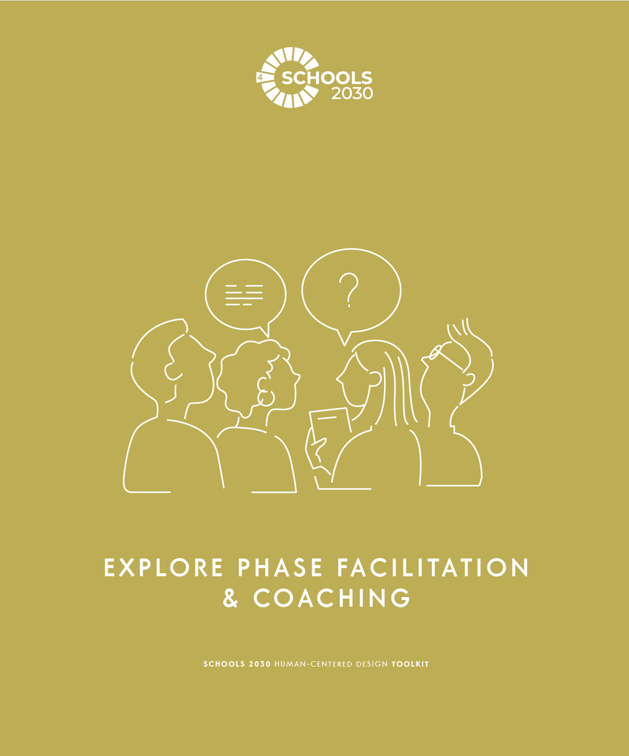
SCHOOLS 2030 HUMAN-CENTERED DESIGN TOOLKIT
59

Slide 72
SCHOOLS 2030 HUMAN-CENTERED DESIGN TOOLKIT
EXPLORE PHASE FACILITATION & COACHING
FROM THE EDUCATOR TOOLKIT
• OVERVIEW OF EXPLORE THE PROBLEM PHASE
Worksheets in the Explore the Problem phase
are designed to help your team understand the experiences, emotions and motivations of others.
Designers use specific design research methods to learn more about the needs of the stakeholders for whom they are designing. Preparation for this part
of the process can be done collaboratively with other school groups.
COACHING FOR SUCCESS:
The Explore the Problem phase is designed to help the team see the problem from the viewpoint of the stakeholders it will most impact.
Support the team members to go into their fieldwork with open minds and aiming to be active listeners.
You will want to reinforce that the team has high-quality documentation of their interviews. They should write down MANY notes, direct quotes, and observations. You might help them to imagine they are a journalist or a documentary filmmaker that is trying to accurately capture someone else’s story.
This phase of the design challenge will include: preparing to interview, interview questions and additional techniques, interview reflection tools, and observation and journey mapping tools.
Also included is the optional activity of visiting
a school to shadow a student. Preparation and reflection tools are provided for the shadow experience.
The team should set aside any notion that they know what the problem is really about, even if they are experiencing it every day. Explore the Problem
is about discovering new information that might illuminate a deeper understanding of the problem.
• OBJECTIVES OF EXPLORE THE PROBLEM PHASE
The goal of this phase is to engage with the most relevant (and most underrepresented) stakeholders in your school related to the problem you are working to solve. This phase is focused on having dynamic conversations and gaining new perspectives through one-on-one conversations.
COACHING TO AVOID COMMON MISTAKES:
A common mistake in Explore the Problem phase is that the design team thinks they are looking for
“right” answers. This phase is not about right or wrong,
it’s about exploring the problem and discovering new information.
A helpful analogy is to approach it as an explorer who
is searching to discover something new. You are looking, listening, and investigating new information to guide the work.
Help design teams avoid reaching out to people they already know or multiple people who represent the same groups. A variety of stakeholders is the goal.
At the end of this phase, all team members should have engaged in three interviews (at least one must be a student) and captured notes from those interviews. Team members should also complete an observation and journey map.
The school shadow is an optional additional step.
COACHING FOR MINDSETS:
An important part of collecting good information during fieldwork is to practice active listening. Coach design teams to avoid sharing their own ideas, thoughts, or stories in the interview. Encourage them to stay focused on the responses from the stakeholders and keep accurate notes. Remind design teams that it is important to acknowledge their own biases so that they can set them aside in order to collect new information about the problem.
• MINDSETS OF EXPLORE THE PROBLEM PHASE
Get inspired by people - active listening is a source of creative inspiration
Put aside biases and assumptions about what
you think the problem is - listen to the stakeholder.
Look carefully to understand potential problems and opportunities
Continue to support the team to avoid solving the problem and to be optimistic that working through the phases of the design challenge will lead to great ideas that will improve the holistic learning outcomes at the school. Remind the team that in future phases there will be plenty of time to think of ideas and make solutions. But that time is not now.
Ask participants to pick one mindset that they are going
to focus on during this phase of the process.
Stay optimistic that you can solve the problem
Hold back on solving the problem during this phase
60
LAUNCH
EXPLORE
DEFINE
GENERATE
MAKE

Slide 73
SCHOOLS 2030 HUMAN-CENTERED DESIGN TOOLKIT
EXPLORE PHASE FACILITATION & COACHING
CREATIVE EXERCISES:
LONG LOST FRIEND
HOW ARE YOU DOING, REALLY?
Goal:
This exercise is designed to help participants listen closely to another person and respond to what they are hearing in a spontaneous and creative way.
Goal:
This exercise is designed to help participants connect with each other beyond superficial small talk. This also helps participants get into a mindset of active listening.
Instructions:
Everyone wanders around and people stop to greet a partner according to a scenario that the facilitator calls out.The facilitator calls out…
Your partner is a long-lost friend.
You’re 70% sure your partner is famous.
Your partner just cut you in line at the market.
Make up your own!
Instructions:
Everyone gets post-its and a Sharpie.
Facilitator asks the group “How are you, really?”
Each person writes their answers on post-its and sticks them to their shirts (e.g. tired, anxious, excited, thirsty, etc.).
Everyone mingles, discussing stickies that prompt conversation.
Online Adaptation:
Call out the role play and then send participants into breakout rooms with one other person. Give them 1 minute to act out the role play and then call them back. Give the next role play and then send them to a new breakout room with a new person. Call them back after
1 minute. Repeat.
Debrief Questions:
What was it like to engage
with a person based on your role?
How did your outlook on the situation change based on the scenario you were role-playing?
What was it like to react without a “right” answer?
Online Adaptation:
Have everyone write three post-its with their reflections. Send participants into breakout rooms with one other person. Give them 5 minutes to share their post-its
and discuss and then call them back. Send them to a new breakout room with a new person.
Call them back after 5 minutes. Repeat once more.
Debrief Questions:
How were these conversations different from typical “small talk”? Why do you think that is?
INTERVIEW PRACTICE
Goal:
This exercise is designed to help participants practice asking open-ended questions and actively listening to another person.
LEARN MORE ABOUT THIS PHASE:
Instructions:
Create time during the workshop to practice interviewing each other using the techniques of this phase.
Use the following prompts:
What was your best holiday memory?
What is your favorite day of the week?
What is your dinner time like?
What is your commute like?
To learn more about this phase, check our electronic appendix of articles we have curated.
A warm embrace that saves lives (video)
Online Adaptation:
Send participants into breakout rooms with one other person. Give them 5 minutes to interview each other and discuss. Then call them back. Send them to a new breakout room with a new person and repeat.
The untold story of the vegetable peeler that changed the world
Designing Beyond Empathy
A Design Strategist’s “Six Rules of Thumb for Design Research”
Debrief Questions:
What did you notice about the kinds of questions you asked?
What did you notice about the types of responses those questions elicited?
How will this practice inform your process of interviewing in the field?
61
LAUNCH
EXPLORE
DEFINE
GENERATE
MAKE

Slide 74
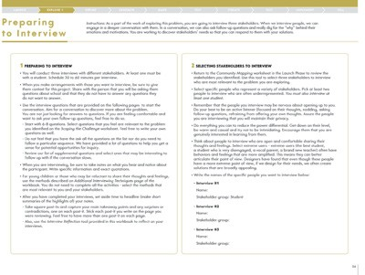
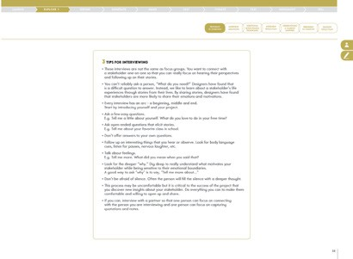
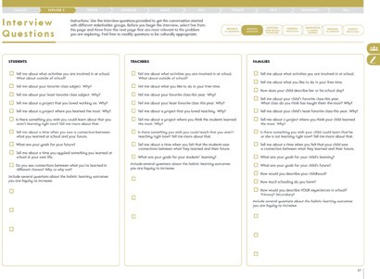
SCHOOLS 2030 HUMAN-CENTERED DESIGN TOOLKIT
#1 Preparing to Interview
WHAT IS THIS TOOL?
30 minutes
The Preparing to Interview handout is a guide for conducting empathy interviews as a part of your design research.
WHAT IS YOUR GOAL?
Use specific techniques for empathy interviewing that will help unlock insights from your stakeholder.
Use this guide to support your fieldwork.
TOOL TIPS:
If design teams are nervous about interviewing stakeholders, have them do practice interviews with each other.
Ask participants to review this resource before conducting interviews.
The most important thing to remember is to ask open-ended questions and follow up with “Tell me more about...”
PAGE 34-35 • HUMAN-CENTERED DESIGN TOOLKIT
#2 Interview Questions
WHAT IS THIS TOOL?
The Interview Questions handout helps you with starter questions for your empathy interviews. You do not need to ask all the questions. Pick 5 that are most relevant to start. You can also modify the questions as needed.
WHAT IS YOUR GOAL?
It is very important when you are conducting empathy interviews to ask open-ended questions that are related to the problem you are solving; do not ask the stakeholder to solve the problem. Use these questions to get started.
30 minutes to prepare, 30 minutes per interview
PAGE 37 • HUMAN-CENTERED DESIGN TOOLKIT
TOOL TIPS:
Remind design teams that they do not have
to interview all three of these stakeholder groups.
Remind design teams that framing questions
as “Tell me more about...” will help them create open-ended questions.
Remind design teams that they do not have to ask every question on this list. They should pick 5 from this list and 3-5 from the supplemental list.
Remind participants to rewrite the questions they chose in the Interview Notes section of their toolkit.
62
TEST
ITERATE
TEST
IMPLEMENT
TELL

Slide 75
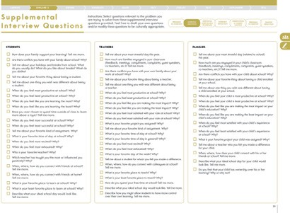
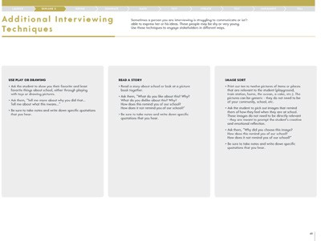
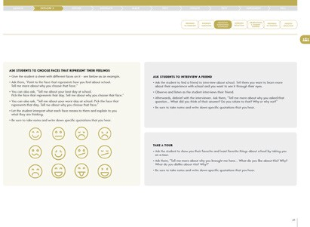
SCHOOLS 2030 HUMAN-CENTERED DESIGN TOOLKIT
EXPLORE PHASE FACILITATION & COACHING
TOOL TIPS:
Remind design teams that they do not have to ask every question on this list. They should pick 3-5 from the supplemental list.
Remind design teams that they do not have to interview all three of these stakeholder groups.
Remind participants to rewrite the questions they chose in the Interview Notes section of their toolkit.
PAGE 39 • HUMAN-CENTERED DESIGN TOOLKIT
#3 Additional Interviewing Techniques
WHAT IS THIS TOOL?
The Additional Interviewing Techniques handout gives you additional tools for engaging stakeholders, particularly young students or those who have a hard time sharing their answers to your questions. You do not need to use every technique. Choose techniques that are most relevant and appropriate for your context.
WHAT IS YOUR GOAL?
Your goal is to gain a deeper understanding of the problem. A variety of techniques can help you engage with different stakeholders.
15 minutes to prepare
TOOL TIPS:
Remind design teams that they do not have to use these techniques if they do not find them helpful.
Remind design teams that these techniques are especially useful with young children and those who might be hesitant to share their thoughts and feelings.
Remind participants that they should only use one or two of these techniques per interview.
Remind participants to rewrite the techniques they chose in the Interview Notes section of their toolkit.
Be sure to remind participants to take notes.
PAGE 40-41 • HUMAN-CENTERED DESIGN TOOLKIT
63
LAUNCH
EXPLORE
DEFINE
GENERATE
MAKE

Slide 76
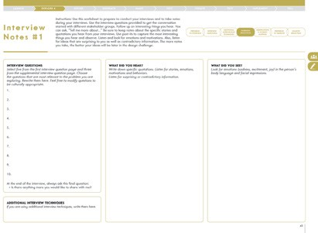
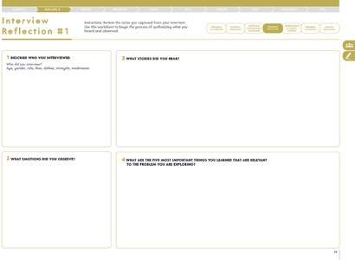
SCHOOLS 2030 HUMAN-CENTERED DESIGN TOOLKIT
TOOL TIPS:
Remind design teams to take note of specific quotations they hear and specific observations they see. They must capture notes in order to reference them later in the design challenge. The more specific the better!
Participants should be listening and looking for emotions and motivations.
Participants should also ask follow-up questions to get
to a deeper understanding of the stakeholders they are interviewing.
PAGE 43 • HUMAN-CENTERED DESIGN TOOLKIT
#4 Interview Reflection
WHAT IS THIS TOOL?
The Interview Reflection handout helps you reflect on what you heard from the people you interviewed.
WHAT IS YOUR GOAL?
It is critical to capture notes and reflections of your empathy interviews and bring them to the next workshop. The notes you gather will inform the next phase of the design challenge.
15-30 minutes per interview
PAGE 45 • HUMAN-CENTERED DESIGN TOOLKIT
TOOL TIPS:
Participants should use this tool to synthesize the notes they took during their interviews in order to identify the most interesting and important things they heard and saw.
This activity is best completed right after the interview, but if participants have not completed it by the time you see them, ask them to take a few minutes to review their notes and then complete this reflection.
64
TEST
ITERATE
TEST
IMPLEMENT
TELL

Slide 77
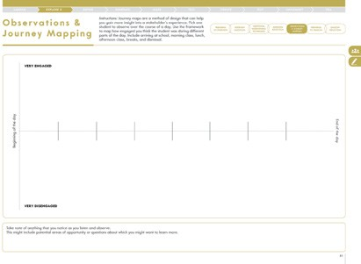
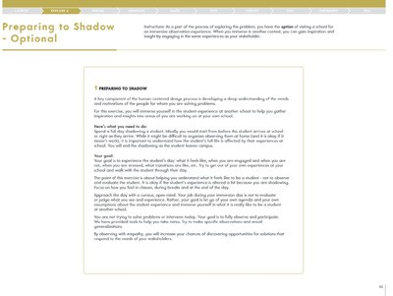
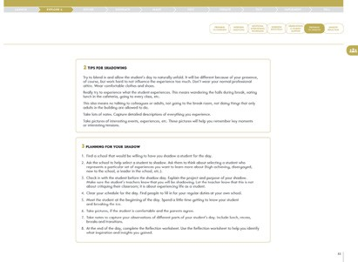
SCHOOLS 2030 HUMAN-CENTERED DESIGN TOOLKIT
EXPLORE PHASE FACILITATION & COACHING
#5 Observations & Journey Mapping
WHAT IS THIS TOOL?
The Observation & Journey Mapping handout helps you capture notes from your observation exercise.
A journey map helps you synthesize what you observed based on time.
WHAT IS YOUR GOAL?
By observing one of your students and completing a journey map, you will get a new perspective
on the student experience in your classroom.
30 minutes to reflect
PAGE 51 • HUMAN-CENTERED DESIGN TOOLKIT
TOOL TIPS:
Remind participants to pick one specific student to observe throughout the day.
Remind participants that they are focused on noticing when that student is engaged and disengaged.
This exercise is designed to help participants identify opportunities to solve problems or meet needs.
#6 Preparing to Shadow -- OPTIONAL
WHAT IS THIS TOOL?
Shadowing a student is an optional activity where you make arrangements to visit another school and shadow a student for a day. The Preparing to Shadow handout helps you prepare for that experience.
WHAT IS YOUR GOAL?
By shadowing a student at another school, you will get new perspectives and inspiration for how to solve your problem back at home.
30 minutes to prepare, all day to shadow
TOOL TIPS:
Remind design teams that shadowing a student at another school is an optional activity.
Remind participants to review the instructions on this sheet before the day of their shadows.
Be sure to remind participants to take notes throughout the shadow day on the Shadow Notes page.
PAGE 52-53 • HUMAN-CENTERED DESIGN TOOLKIT
65
LAUNCH
EXPLORE
DEFINE
GENERATE
MAKE

Slide 78
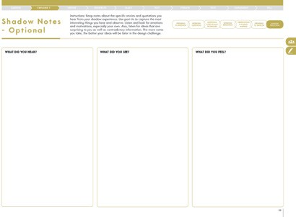
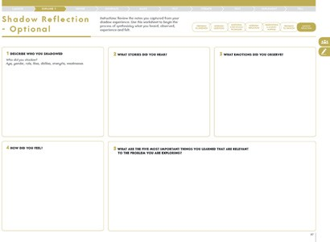
SCHOOLS 2030 HUMAN-CENTERED DESIGN TOOLKIT
TOOL TIPS:
Remind design teams that shadowing a student at another school is an optional activity.
Remind participants to review the instructions on this sheet before the day of their shadows.
Be sure to remind participants to take notes throughout the shadow day on the Shadow Notes page.
PAGE 55 • HUMAN-CENTERED DESIGN TOOLKIT
#7 Shadow Reflection -- OPTIONAL
WHAT IS THIS TOOL?
The Shadow Reflection handout helps you capture the notes and reflections from your shadow experience.
WHAT IS YOUR GOAL?
It is critical to capture notes and reflections of your empathy interviews and bring them to the next workshop. The notes you gather will inform the next phase of the design challenge.
30 minutes to shadow
PAGE 57 • HUMAN-CENTERED DESIGN TOOLKIT
TOOL TIPS:
Participants should use this tool to synthesize the notes they took during their shadow experiences in order to identify the most interesting and important things they heard and saw.
This activity is best completed right after the shadow,
but if participants have not completed it by the time you see them, ask them to take a few minutes to review their notes and then complete this reflection.
66
TEST
ITERATE
TEST
IMPLEMENT
TELL

Slide 79
SCHOOLS 2030 HUMAN-CENTERED DESIGN TOOLKIT
EXPLORE TRANSITION FACILITATION & COACHING
FROM THE EDUCATOR TOOLKIT
• TEAM ALIGNMENT
In order to seek alignment as a team, share each of your summary pages and use the questions below to narrow your team’s focus so that you
can move on to the next phase of the design challenge with a shared perspective. Let each person read their summary responses without interruption or comments from the team. If there are differing views and ideas from team members, ask questions to gain understanding. Try questions like: “Can you share more information about how you came to these ideas?”and“Tell me more about that...” Your team does not have to be aligned on all aspects of your design work, but you must be aligned on the items below in order to move on.
COACHING FOR ALIGNMENT:
To successfully wrap up this phase of the design challenge, the team must answer the alignment questions with specific and clear ideas.
During this alignment for the Exploring the Problem phase you can focus on collecting the views and work of everyone on the team. Picking the twelve most important things the team has learned might require some longer conversations, but it’s also acceptable
to have more than twelve.
Let this alignment be a conversation and debrief as a team. Encourage design teams to focus on stories, not just specific data points. Allow time for the team to share the things they learned to help the rest of the team have a wider understanding of the problem.
COACHING FOR QUALITY:
Good fieldwork for the Explore the Problem phase will be demonstrated with a large volume of notes from the interviews and additional techniques.
List all the stakeholders you interviewed.
•
•
•
•
•
•
Ideally, the team will have already started to notice some interesting or unexpected aspects of the problem that were revealed by actively listening to stakeholders.
This new perspective helps them to see the problem differently.
Ask for specific stories that demonstrate a focus on emotions and motivations, going beyond the obvious surface level information.
What are the twelve most important things your team learned from the Explore phase?
•
•
•
•
•
How does your team’s exploration of the problem connect to improving the holistic learning outcomes for your students?
67
LAUNCH
EXPLORE
DEFINE
GENERATE
MAKE

Slide 80
SCHOOLS 2030 HUMAN-CENTERED DESIGN TOOLKIT
CRITERIA FOR IMPROVING PROCESS WORK:
Use the rubric below to assess how your team is doing in terms of your process work and the mindsets of Human-Centered Design. Circle the description that most represents your team’s progress.
Partial Demonstration
Proficient Demonstration
Sophisticated Demonstration
Get inspired by people - active listening is a source of creative inspiration | The team is not conducting interviews and if you are, you are not carrying what you learned from stakeholders into your design work. | The team is bringing forward some voices from their design research but their depth of understanding is shallow; the team is not speaking to those people who are underrepresented. | The team deeply understands the stakeholders they are designing for and has sought out voices of those who are typically underrepresented.
Put aside biases and assumptions about what you think the problem is - listen to the stakeholder. | The team is struggling to put aside biases and question assumptions. They are not relying on evidence from design research to make decisions. | The team has been successful putting aside biases and questioning assumptions some of the time. | The team has named their biases and assumptions and have worked hard to gather evidence to help inform their decision- making process.
Look carefully to understand potential problems and opportunities | The team is not immersing themselves in the experiences of the stakeholders they are serving; they are relying on their own experiences and/or assumptions. | The team has been successful immersing in the experiences of the stakeholders they are serving some of the time. | The team has deeply immersed themselves in the experiences of the stakeholders they are serving; they have gained profound empathy for those stakeholders.
Stay optimistic that you can solve the problem | The teams is not optimistic about solving the problem in new and novel ways; there is a lack of positive energy on the team. | The team is struggling to stay optimistic about solving the problem in new and novel ways; positive energy on the team comes and goes. | The team is working hard to help each other stay optimistic about solving the problem in new and novel ways; there is a lot of positive energy on the team.
Hold back on solving the problem during this phase | The team already has a solution in mind based on their assumptions about the problem and the stakeholders they are serving. | The team is struggling to hold back on solving the problem and are working to remind each other. | The team is actively holding back on coming up with solutions; when they do have an idea they write it down and put is aside for later.
68
TEST
ITERATE
TEST
IMPLEMENT
TELL

Slide 81
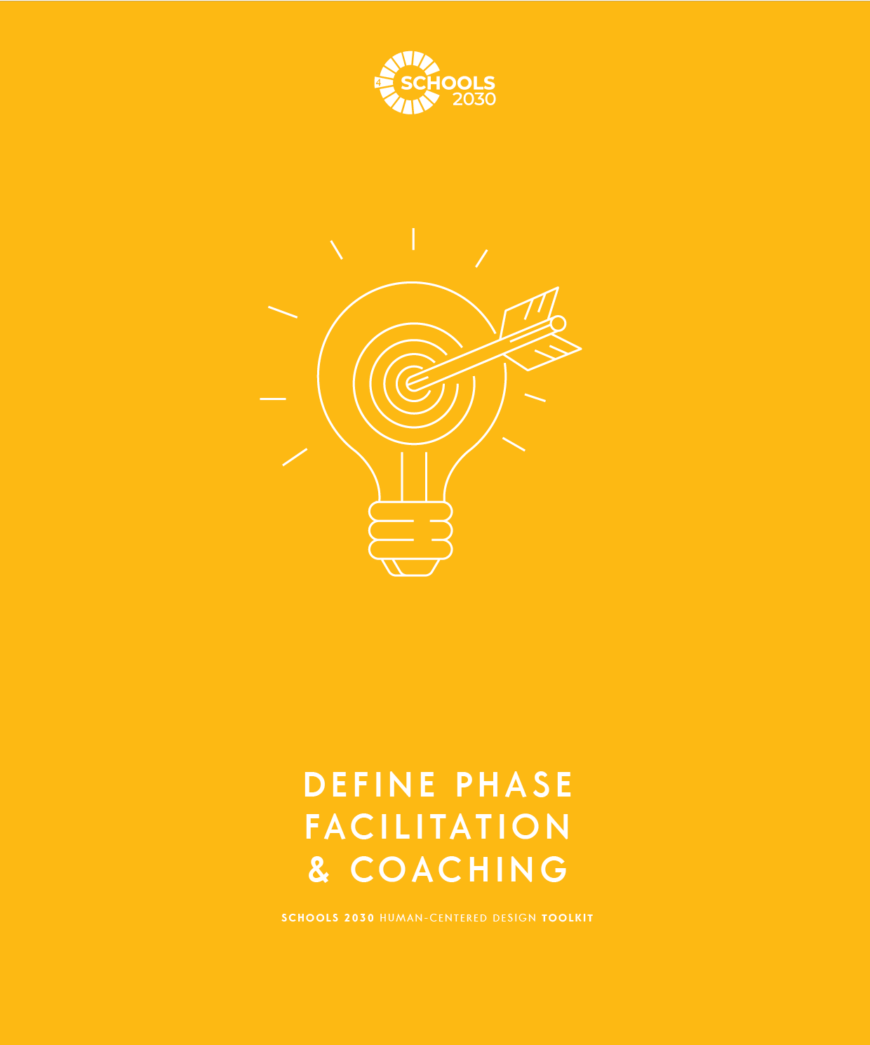
SCHOOLS 2030 HUMAN-CENTERED DESIGN TOOLKIT
69

Slide 82
SCHOOLS 2030 HUMAN-CENTERED DESIGN TOOLKIT
DEFINE PHASE FACILITATION & COACHING
FROM THE EDUCATOR TOOLKIT
• OVERVIEW OF DEFINE THE PROBLEM PHASE
The handouts in the Define the Problem phase
of the challenge are focused on developing
a point of view about the needs of your stakeholder. During this stage of the challenge, designers narrow from lots of information to a statement that is inspiring and specific. This part of the challenge can be done in school-based teams or collaboratively with other schools.
COACHING FOR SUCCESS:
In the Define the Problem phase of the design challenge, the team will use the worksheets to develop a more specific problem to solve. Continually reinforce that they should reference their Explore the Problem fieldwork and focus on the stakeholders’ needs.
Good problems are specific and inspiring. This comes from good analysis and thinking deeply about the problem, moving beyond the obvious ideas.
This phase of the design challenge will include: analyzing your design research activities (interviews, observations and shadows), inferring an interesting insight to build a Point of View statement and writing How Might We questions.
Guide the team to be specific about the stakeholder,
the need, the goal, and holistic learning outcomes.
There is not one perfect point of view or question.
Help the team understand that a great How Might We Question will come from creating many different questions, and picking the one that is best.
COACHING TO AVOID COMMON MISTAKES:
A common mistake during the Define the Problem phase is that the design team tries to the define the problem based on old assumptions, and doesn’t utilize the fieldwork to inform the definition of the problem.
You can guide the team by regularly asking if they can share specific notes, observation, or stories from the
Explore phase that support their guesses,
POV statements, and HMW Questions.
• OBJECTIVES OF DEFINE THE PROBLEM PHASE
The goal of this phase is to identify the needs of your stakeholders based on what you heard and saw about their experiences, motivations and emotions.
At the end of this phase, all team members should be clear on several new Point of View statements that they will use to inform their design work. The team will also generate How Might We questions that they will use to generate solutions.
Avoid How Might We Questions that are too vague or lack a specific stakeholder. Focus on human-centered questions that seem actionable and inspiring for the team.
Draw inspiration from analogies when writing HMWs.
Avoid putting a solution into the How Might We Question. The question should focus on an opportunity that could be solved many different ways.
COACHING FOR MINDSETS:
• MINDSETS OF DEFINE THE PROBLEM PHASE
Seek new perspectives on old problems
Look carefully to understand potential problems and opportunities
Stay optimistic that you can solve the problem
See opportunities in constraints
Get comfortable with navigating contradictory information
Hold back on solving the problem during this phase
Remind the team to focus on seeing the problem from the perspective of the stakeholders, setting aside their own ideas and opinions (for now).
With all the new information from the interview, the problem can seem overwhelmingly complex, but help them to reframe the constraints as an opportunity to be more specific about the problem they are hoping to solve.
Continue to support the team to wait to solve the problem and to be optimistic that working through the phases of the Design Challenge will lead to great ideas that will improve the holistic learning outcomes at the school.
Ask participants to pick one mindset that they are going to focus on during this phase of the process.
70
LAUNCH
EXPLORE
DEFINE
GENERATE
MAKE

Slide 83
SCHOOLS 2030 HUMAN-CENTERED DESIGN TOOLKIT
DEFINE PHASE FACILITATION & COACHING
CREATIVE EXERCISES:
Convergence
Goal:
This exercise is designed to help participants listen, make connections between ideas and anticipate what others are thinking.
Instructions:
The goal of Convergence is to get two people to say the same word at the same time.
Ask for two volunteers. Have them stand in the center of the circle.
2If the two words are not the same, ask for two volunteers who think they can say
a new word that is the same. No previous words can be repeated.
Repeat until two people successfully say the same word at the same time.
Online Adaptation:
Ask for two volunteers from the group. Count to three and have the two people say the words. Ask for two more volunteers. Continue the process until two people say the same word at the same time.
Debrief Questions:
What was it like to jump in to offer an idea? What was hard about it? What was easy?
How did it feel to be working on such an open-ended challenge?
How did it feel to be working on that challenge as a group?
Story Machine
Goal:
This exercise is designed to help participants listen and respond creatively to an open-ended prompt. This exercise is also designed to help participants explore an idea without one single correct answer.
Instructions:
The goal of Story Machine is to create a new story from a series of prompts..
Have everyone divide into three groups: people, places and things. Have everyone write one thing from their category down on a piece of paper and stack them.
Have one person draw one piece of paper from each category. Ask for four volunteers to write a story on the spot based on the three pieces of paper. They will write the story one word at a time.
When the group feels that they have created a complete story, everyone should start clapping.
Online Adaptation:
Divide the group into three based on their first initials. Assign each category. Have people write one word for their category on a piece of paper and hold it up to the camera. Ask for four volunteers. Have the volunteers pick a person, place and thing. Have everyone else put down their words. Have the volunteers create a story. When the group feels that they have created a complete story, everyone should start clapping.
Debrief Questions:
What was it like to make up a story in the moment?
What was difficult about that? What was easy?
LEARN MORE ABOUT THIS PHASE:
To learn more about this phase, check our electronic appendix of articles we have curated.
Three Ways To Reframe A Problem To Find An Innovative Solution
To Make Sense of Messy Research, Get Visual
The Secret Phrase Top Innovators Use
How Reframing A Problem Unlocks Innovation
71
LAUNCH
EXPLORE
DEFINE
GENERATE
MAKE

Slide 84
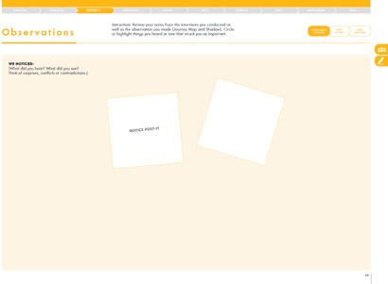
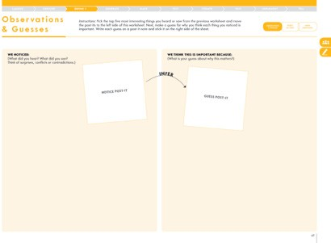
SCHOOLS 2030 HUMAN-CENTERED DESIGN TOOLKIT
#1 Observations & Guesses
WHAT IS THIS TOOL?
Observations & Guesses is a worksheet designed to help you highlight compelling observations (look for surprises, tensions and contradictions) and infer these observations into guesses about what they mean.
WHAT IS YOUR GOAL?
This tool can help you make meaning of the qualitative data you gathered through your design research activities.
45-60 minutes
PAGE 65 • HUMAN-CENTERED DESIGN TOOLKIT
TOOL TIPS:
Ask participants to first take specific quotations and observations from the different activities from
the Explore phase and put each one on a post-it on this sheet.
They do not need to write a lot -- just one or two sentences.
Ask participants to note who the observation is about.
Participants should try to get at least five interesting observations from across all of their experiences.
TOOL TIPS:
Participants will create one inference per observation.
Inferring is a process of informed guessing.
If that is uncomfortable for participants, ask them to work with a partner to create their guesses.
Through empathetic listening and observations and then inference, the human-centered design process helps participants to identify problems they might not have uncovered otherwise.
PAGE 67 • HUMAN-CENTERED DESIGN TOOLKIT
72
TEST
ITERATE
TEST
IMPLEMENT
TELL

Slide 85
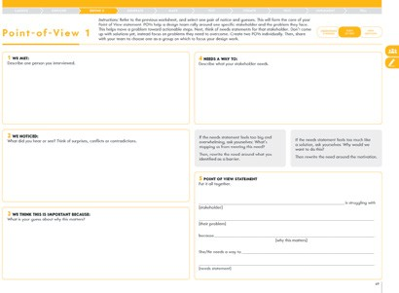
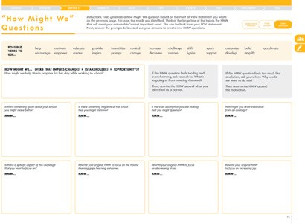
SCHOOLS 2030 HUMAN-CENTERED DESIGN TOOLKIT
DEFINE PHASE FACILITATION & COACHING
#2 Point of View
WHAT IS THIS TOOL?
30-45 minutes
Point of View is a worksheet designed to help you take your observations and guesses and turn them into
a statement that preserves the emotions of the stakeholder for whom you want to design.
WHAT IS YOUR GOAL?
Your POV statement will help your team rally around
a real person’s story and their needs in regard to your design challenge.
PAGE 69 • HUMAN-CENTERED DESIGN TOOLKIT
TOOL TIPS:
Participants will use the observations and guesses from the previous page to start creating their POV statements.
Participants should describe the student they are designing for to give them inspiration about who the student is and what she or he is interested in.
The “Needs a way to” statements should not be solutions. They should be generative statements with lots of possible solutions.
If participants are struggling to avoid jumping to a solution, they should ask themselves, “Why would we want to do this?” That will help them develop a broader statement.
#3 How Might We Questions
WHAT IS THIS TOOL?
30-45 minutes
How Might We Questions are designed to help your team turn your POV statement into How Might
We questions that will drive your brainstorming process.
WHAT IS YOUR GOAL?
HMW questions help you to rally your team around a question that captures the needs and emotions of your user. HMW questions also expand the problem in a way that creates a generative atmosphere for new ideas.
PAGE 73 • HUMAN-CENTERED DESIGN TOOLKIT
TOOL TIPS:
HMW questions are a way to take a needs statement and turn it into an actionable, generative question for brainstorming.
Encourage participants to use the prompts to create multiple HMW questions.
Encourage participants to use the word bank to generate new HMW questions.
73
LAUNCH
EXPLORE
DEFINE
GENERATE
MAKE

Slide 86
SCHOOLS 2030 HUMAN-CENTERED DESIGN TOOLKIT
FROM THE EDUCATOR TOOLKIT
COACHING FOR ALIGNMENT:
To successfully wrap up this phase of the design
challenge, the team must answer the alignment questions with specific and clear ideas.
• TEAM ALIGNMENT
In order to seek alignment as a team, share each of your summary pages and use the questions below to narrow your team’s focus so that you can move on to the next phase of the design challenge with a shared perspective.
Let each person read their summary responses without interruption or comments from the team. If there are differing views and ideas from team members, ask questions to gain understanding.
Try questions like: “Can you share more information about how you came to these ideas?”and
“Tell me more about that...”
Your team does not have to be aligned on all aspects of your design work, but you must be aligned on the items below in order to move on.
Ideally, a few of the Point of View Statements and How Might We Questions will stand out among the many ver- sions that the design team will create.
If design team have conflict during the alignment for the Point of View Statement or the How Might We Question, have the team work together to write a new one that is more agreed upon by the group. As the facilitator, guide them to respond to the fieldwork and not stray into what they “think” the problem is.
If the team is divided about what stakeholder they want to design for, then lead a conversation for alignment. Some options might be about who do they want to design for first or who would be most impacted by a successful solution?
What is the POV statement your team will move forward?
[stakeholder]
COACHING FOR QUALITY:
A high-quality How Might We Question has a specific stakeholder, a strong verb that implies the change you hope to achieve, and an opportunity you hope to achieve.
A high-quality How Might We Question should also feel actionable and inspiring. When you read the question out loud to the team, there will be a flow of ideas in response. If the question does not inspire a few ideas quickly then it might need some more iteration to refocus the stakeholder, the opportunity, and the verb to achieve the change you want. Return to the worksheets to guide the work.
is struggling with
[their problem]
because
.
[why this matters]
She/He needs a way to
.
[needs statement]
What are the three HMWs that are connected to the POV that your team will move forward?
Avoid How Might We Questions that are too narrow
or have only a few ways to solve it. If you can respond to the question with “Let’s just make/build/fund that idea!” then it is not a high-quality question because it’s already
a solution.
For example, a weak question would be “How might
we build a new science building to increase the critical thinking skills of students?” You could respond, “Let’s build that building!” A better example would be “How might we reimagine our classroom spaces to match the values of the school mission?” There are many possible solutions to this question.
How does your team’s POV statement and HMW questions connect to improving the holistic learning outcomes for your students?
74
TEST
ITERATE
TEST
IMPLEMENT
TELL

Slide 87
SCHOOLS 2030 HUMAN-CENTERED DESIGN TOOLKIT
DEFINE PHASE FACILITATION & COACHING
CRITERIA FOR IMPROVING PROCESS WORK:
Use the rubric below to assess how your team is doing in terms of your process work and the mindsets of Human-Centered Design. Circle the description that most represents your team’s progress.
Partial Demonstration
Proficient Demonstration
Sophisticated Demonstration
Seek new perspectives on old problems | The team is not pushing to redefine problems and develop new insights. | The team is working to redefine the problem and develop insights, but what is created does not offer new insights. | The team has pushed hard to redefine the problem and develop meaningful insights that will drive an innovative approach to solving this problem.
Look carefully to understand potential problems and opportunities | The team is struggling to put aside biases and question assumptions. They are not relying on evidence from design research to make decisions. | The team has been successful putting aside biases and questioning assumptions some of the time. | The team has named their biases and assumptions and have worked hard to gather evidence to help inform their decision-making process.
Stay optimistic that you can solve the problem | The teams is not optimistic about solving the problem in new and novel ways; there is a lack of positive energy on the team. | The team is struggling to stay optimistic about solving the problem in new and novel ways; positive energy on the team comes and goes. | The team is working hard to help each other stay optimistic about solving the problem in new and novel ways; there is a lot of positive energy on the team.
See opportunities in constraints | The team has not been able to see beyond the constraints of the situation. | The team is struggling to find opportunities in the constraints of the situation. | The team is working hard to help each other find opportunities in the constraints of the situation.
Get comfortable with navigating contradictory information | The team has struggled to make sense of contradictory information. | The team is struggling to make sense of contradictory information and are working to remind each other. | The team is actively working to make sense of contradictory information.
Hold back on solving the problem during this phase | The team already has a solution in mind based on their assumptions about the problem and the stakeholders they are serving. | The team is struggling to hold back on solving the problem and are working to remind each other. | The team is actively holding back on coming up with solutions; when they do have an idea they write it down and put is aside for later.
75
LAUNCH
EXPLORE
DEFINE
GENERATE
MAKE

Slide 88
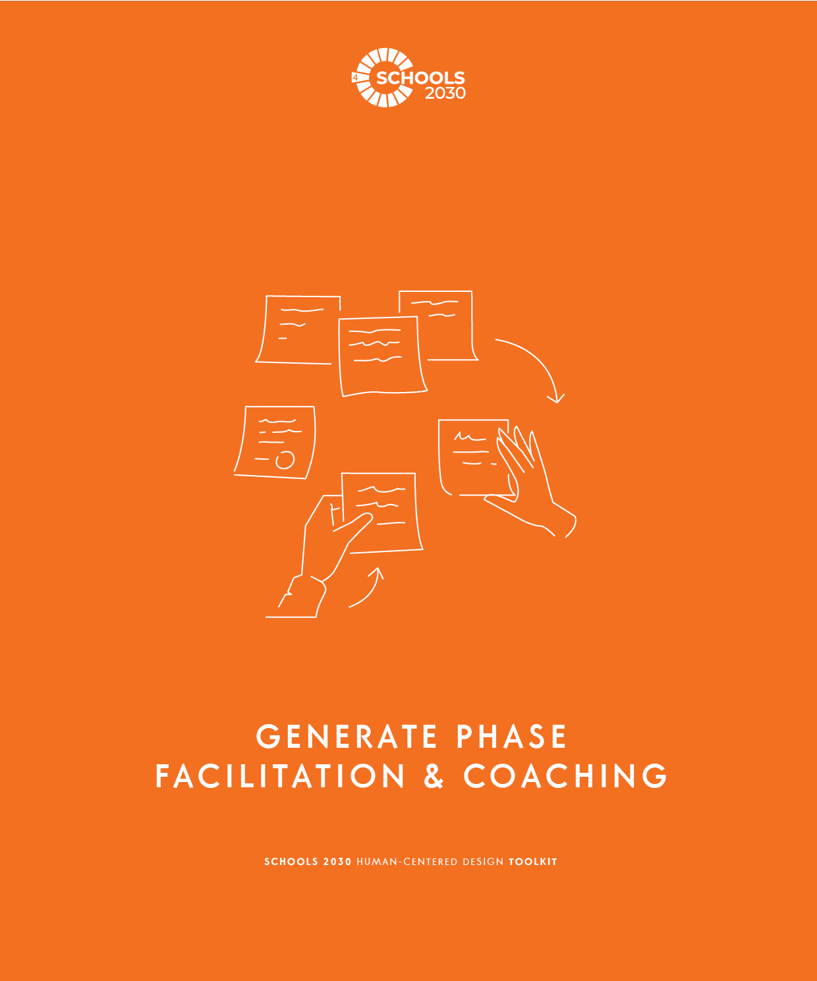
SCHOOLS 2030 HUMAN-CENTERED DESIGN TOOLKIT
76

Slide 89
SCHOOLS 2030 HUMAN-CENTERED DESIGN TOOLKIT
GENERATE PHASE FACILITATION & COACHING
FROM THE EDUCATOR TOOLKIT
COACHING FOR SUCCESS:
• OVERVIEW OF GENERATE SOLUTIONS PHASE
The handout in the Generate Solutions phase of the process is focused on generating as many solutions
to a problem as possible. Once many solutions have been generated, members of your team will select one to four to move forward to prototyping.
In the Generate Solutions phase of the design challenge the team will begin imagining possible solutions to their specific design challenge.
Now is the time to share ideas about what to do and what to make. As this happens, it is important to focus on creating a very large volume of ideas, and avoid being overly critical of the quality.
Let the team have ideas that are free from the normal constraints of money, time, resources, schedule, rules.
By allowing this freedom of creative ideas the team
just might think of something that will have an incredibly positive impact on the holistic learning outcomes
at the school.
This is a collaborative process and should be completed in teams. These teams can be school-based or from other schools.
You will know if the brainstorm is successful if ideas are flowing easily, people are laughing, and the team is collaboratively building upon each other’s ideas.
• OBJECTIVES OF GENERATE SOLUTIONS PHASE
The goal of this phase is to use the POV statements
and HMW questions to generate many solutions.
By generating lots of solutions, you will get to
innovative solutions. From there, the team will use criteria to select ideas that have clustered into themes.
COACHING TO AVOID COMMON MISTAKES:
It is a common mistake that during the Generate Ideas phase teams begin to judge ideas too quickly, which leads to fewer ideas and frustration among the team.
Avoid letting one team member have too much control over the development of the ideas. Everyone should have a chance to contribute without judgment.
At the end of this phase, all team members should be clear on 1-4 ideas that they are interested in prototyping.
To avoid judgment, don’t allow team members to comment on ideas or add more information like “We did that once” or “That would never work.” Instead ask people to comment with “Yes, and...” Everyone should work on building on the ideas of others.
• MINDSETS OF GENERATE SOLUTIONS PHASE
Many ideas lead to good ideas
Defer judgment and criticism of ideas
COACHING FOR MINDSETS:
This phase of the design challenge is about having many ideas. That means that the team should stay open to everything, no matter how outrageous or uncommon
the idea might be.
Idea generation is not the time for evaluating ideas
Brainstorming is a collaborative team activity
This is also a collaborative moment for the team to listen and support each other. It’s not about having perfect ideas, or finding the right solution. This phase is about embracing a creative imagining of new solutions that might solve the problem.
Ask participants to pick one mindset that they are going to focus on during this phase of the process.
Allow yourself to think of wild ideas
See opportunities in constraints
This phase is the time to solve the problem
LAUNCH
EXPLORE
DEFINE
GENERATE
MAKE

Slide 90
SCHOOLS 2030 HUMAN-CENTERED DESIGN TOOLKIT
GENERATE PHASE FACILITATION & COACHING
CREATIVE EXERCISES:
Yes And!
Goal:
This exercise is designed to help participants practice building on the ideas of others. This exercise is also designed to help participants experience the difference in energy and effectiveness between evaluating and rejecting ideas and affirming them.
Instructions:
Ask the group if there is a person who has a party they need to plan in the near future.
Ask participants to generate ideas for the party. Ask them to start each of their contributions with “No, but...”
Ask the group how far their brainstorm got them? Is there a plan? What was the energy like during this brainstorm?
Now, ask participants to start again but every time people offer a contribution, they should say, “Yes, and!”
Now, ask the group what this brainstorm generated? Why was this different?
Online Adaptation:
Have participants contribute based on an order of participants that you put in the chat box.
Debrief Questions:
How far did we get in the first round? Why?
How was the energy different during the second round? Why?
Rock, Paper, Scissors Competition
Goal:
This exercise is designed to help participants get energized!
Instructions:
Everyone is going to compete in a Rock, Paper, Scissors competition.
Have people pair up and after the count of three, they will choose either the rock,
paper or scissors symbol with their hands. Rock beats scissors. Paper beats rock. Scissors beats paper.
If the person wins the competition, they should find another competitor.
If they lose the competition they should cheer on the person who beat them.
Continue until there is a single winner!
Online Adaptation:
Have everyone have their gallery view on Zoom. Everyone will compete with the person to their right. The facilitator
will call out 1, 2, 3. If they lose to the person, they should turn off their camera and start cheering for others. Use the Mute
All button to continue to call out. Continue until one person wins. Award a trophy virtual background to the winner.
LEARN MORE ABOUT THIS PHASE:
To learn more about this phase, check our electronic appendix of articles we have curated.
Design Thinking — brainstorming through the ‘Ideation’ phase
Ideate: Beyond Basic Brainstorms
IDEO Brainstorming
LAUNCH
EXPLORE
DEFINE
GENERATE
MAKE

Slide 91
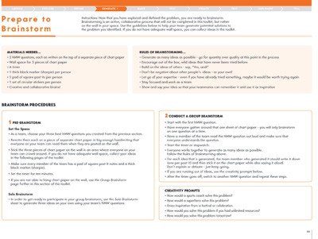
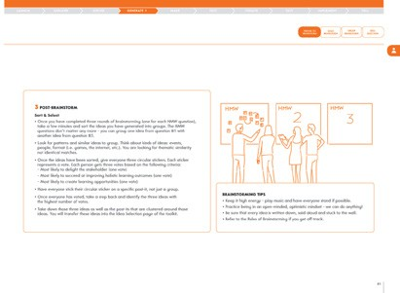
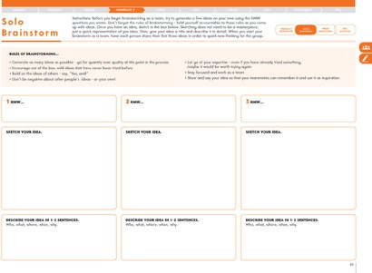
SCHOOLS 2030 HUMAN-CENTERED DESIGN TOOLKIT
#1 Prepare to Brainstorm
WHAT IS THIS TOOL?
15 minutes to prepare
Prepare to Brainstorm is a worksheet designed to help your team prepare to run a collaborative brainstorm.
WHAT IS YOUR GOAL?
Brainstorming as a team helps generate lots of solutions from different perspectives. It is helpful to prepare for your brainstorm to create the best conditions for collaborative, generative work.
TOOL TIPS:
Remind design teams to review the tool, including the Rules of Brainstorming, before they begin to brainstorm as a group.
Design teams will ideally brainstorm together as a group in order to generate as many ideas as possible.
All ideas need to be written down on post-it notes in order to sort them into categories later.
Group brainstorms should be high-energy, generative activities. If a design team is not generating a lot of ideas, remind them to use the creativity prompts to spark new ideas.
PAGE 80-81 • HUMAN-CENTERED DESIGN TOOLKIT
#2 Solo Brainstorm
WHAT IS THIS TOOL?
15 minutes
Solo Brainstorming is a worksheet designed to help you generate ideas on your own before you generate them as a group.
WHAT IS YOUR GOAL?
By first generating ideas on your own, this will help you share and build ideas as a team.
TOOL TIPS:
Have participants generate several ideas independently before they brainstorm as a group. This allows everyone on the team to have several ideas to contribute at the beginning of the group brainstorm.
PAGE 83 • HUMAN-CENTERED DESIGN TOOLKIT
Encourage participants to sketch their ideas as well
as write descriptions. Sketching can help them to think differently about the idea.
TEST
ITERATE
TEST
IMPLEMENT
TELL

Slide 92
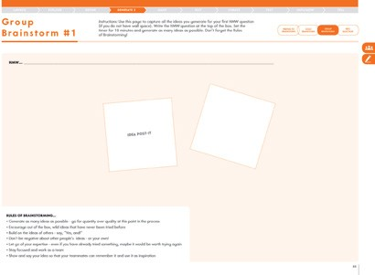
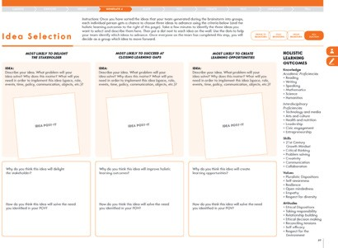
SCHOOLS 2030 HUMAN-CENTERED DESIGN TOOLKIT
GENERATE PHASE FACILITATION & COACHING
#4 Idea Selection 30 minutes
WHAT IS THIS TOOL?
Idea Selection is a worksheet designed to help you select the ideas you want to advance using specific criteria.
WHAT IS YOUR GOAL?
As a team you will need to identify one to four ideas you are planning to continue to develop through prototyping. This activity helps you reflect on which ideas are most likely to address the problem you are exploring.
TOOL TIPS:
PAGE 85 • HUMAN-CENTERED DESIGN TOOLKIT
Encourage design teams to generate as many ideas as possible. Now is the time to generate ideas,
not evaluate ideas.
Encourage design teams to say “Yes and!” after every idea generated.
Ensure design teams are capturing all the ideas they are creating.
Brainstorms should be quick and high-energy. Participants should set a timer for ten minutes.
If they are losing steam, remind them to use their creativity prompts.
If design teams do not have wall space to brainstorm, they can capture their ideas on this tool.
#3 Group Brainstorm
WHAT IS THIS TOOL?
Group Brainstorm are worksheets designed to help your team capture ideas generated during your brainstorm.
WHAT IS YOUR GOAL?
Brainstorming as a team helps generate lots of solutions from different perspectives. It also helps you build upon the ideas of others to get to more innovative solutions.
45-60 minutes to brainstorm
TOOL TIPS:
PAGE 89 • HUMAN-CENTERED DESIGN TOOLKIT
Ensure all members of the design team are able to select ideas that they believe meet the criteria.
For now, participants should only pick one idea at a time.
Remind participants to review the holistic learning outcomes when selecting ideas.
Encourage participants to think and discuss why they believe these ideas are going to improve holistic learning outcomes for students.
LAUNCH
EXPLORE
DEFINE
GENERATE
MAKE

Slide 93
SCHOOLS 2030 HUMAN-CENTERED DESIGN TOOLKIT
GENERATE PHASE FACILITATION & COACHING
FROM THE EDUCATOR TOOLKIT
• TEAM ALIGNMENT
In order to seek alignment as a team, share each
of your summary pages and use the questions below to narrow your team’s focus so that you can move on to the next phase of the design challenge with a shared perspective.
Let each person read their summary responses without interruption or comments from the team. If there are differing views and ideas from team members, ask questions to gain understanding.
Try questions like: “Can you share more information about how you came to these ideas?”and
“Tell me more about that...”
Your team does not have to be aligned on
all aspects of your design work, but you must be aligned on the items below in order to move on.
COACHING FOR ALIGNMENT:
To successfully wrap up this phase of the design chal- lenge, the team must answer the alignment questions with specific and clear ideas.
The team will want to pick one idea to move forward into the next phase of the design challenge. If the design team is struggling to find alignment, then first consider some criteria that you could use to evaluate the ideas more objectively.
For example, what idea is going to be the easiest to create and test? What will clearly have an impact on the holistic learning outcomes? You can also ask an external stakeholder or school leader to join you and give input on the ideas.
As a team, select one idea to advance. Write it below.
COACHING FOR QUALITY:
A high-quality idea should excite the team with optimism and hope for lasting impact. If the idea isn’t inspiring for the team to take action, then ask what is missing or what might be adjusted to make the idea robust.
It’s also important to consider an idea that the team
is interested in working on for many weeks. In the next
phase, the team will build prototypes to test the ideas,
so they should feel good about engaging with this idea for a long time.
Another sign of a high-quality idea is that the team is excited about the positive impact on one of the holistic learning outcomes if the idea is successful.
How does your team’s idea relate to improving the holistic learning outcomes for your students?
TEST
ITERATE
TEST
IMPLEMENT
TELL

Slide 94
SCHOOLS 2030 HUMAN-CENTERED DESIGN TOOLKIT
GENERATE PHASE FACILITATION & COACHING
CRITERIA FOR IMPROVING PROCESS WORK:
Use the rubric below to assess how your team is doing in terms of your process work and the mindsets of Human-Centered Design. Circle the description that most represents your team’s progress.
Partial Demonstration
Proficient Demonstration
Sophisticated Demonstration
Many ideas lead to good ideas | The team is not generating a large volume of ideas. | The team is generating some ideas but not a large volume. | The team has generated a large number of ideas.
Defer judgment and criticism of ideas | The team is struggling to defer judgment when generating ideas. | The team is able to defer judgment some of the time but not all of the time. | The team has successfully deferred judgment, both as a group and internally.
Idea generation is not the time for evaluating ideas | The team is struggling to avoid evaluating ideas as they are being generated. | The team is able to avoid evaluating ideas some of the time but not all of the time. | The team has successfully avoided evaluating ideas, both as a group and internally.
Brainstorming is a collaborative team activity | The teams is struggling to work as a team to generate ideas; not all members of the team are able to contribute. | The team is working collaboratively some of the time, but not all members are able to contribute. | The team is working collaboratively as a team and all team members are actively contributing.
Allow yourself to think of wild ideas | The team is struggling to generate innovative, novel ideas. | The team is generating some innovative, novel ideas but not many. | The team has successfully generated a lot of innovative, novel ideas.
See opportunities in constraints | The team is struggling to see opportunities in constraints and are focusing on why an idea won’t work. | The team is able to let go of constraints some of the time but not always. | The team has successfully found opportunities in constraints.
This phase is the time to solve the problem | The team is struggling to generate solutions to the problem they identified. | The team is generating some ideas but not a large volume. | The team has generated a large volume of innovative, novel ideas.
LAUNCH
EXPLORE
DEFINE
GENERATE
MAKE

Slide 95
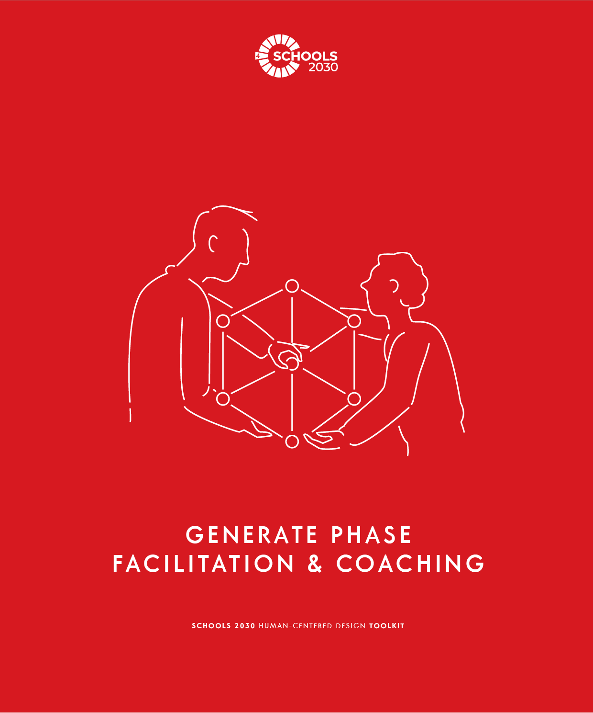
SCHOOLS 2030 HUMAN-CENTERED DESIGN TOOLKIT
83

Slide 96
SCHOOLS 2030 HUMAN-CENTERED DESIGN TOOLKIT
MAKE PHASE FACILITATION & COACHING
FROM THE EDUCATOR TOOLKIT
• OVERVIEW OF MAKE YOUR PROTOTYPE PHASE
The worksheets in the Make Your Prototype phase are designed to help your team construct representations of your solutions.
These representations are intended to elicit feedback, answer specific questions about a concept and test assumptions embedded in the ideas. This can be done in site-based teams or with other schools.
COACHING FOR SUCCESS:
During the Make Your Prototype phase of the design challenge the design team will work collaboratively to create a prototype that will respond to the needs of the stakeholders.
A great prototype will help the team gain a deeper understanding of the stakeholders and the problem. The team is making something to learn more and to improve the idea.
This phase of the design challenge will include: combining ideas into larger concepts, expanding your ideas with specific elements, surfacing the assumptions you are making with your solution, sketching out additional ideas and designing a prototype designed to test those assumptions.
Remember to coach design teams that a great prototype creates an experience that tests a stakeholder’s reaction to the solution.
• OBJECTIVES OF MAKE YOUR PROTOTYPE PHASE
The goal of this phase is to get your design team aligned around what assumptions you are making about your solution so that you can design low-resolution prototypes (low time investment, low cost, small scale).
COACHING TO AVOID COMMON MISTAKES:
A common mistake in the Make Your Prototype phase is that teams attempt to make something that is more sophisticated, expensive, or time-consuming than what is really needed. Remember a prototype does not need to be extravagant to test an assumption about the idea.
At the end of this phase, all team members should be clear on how they are going to run
a prototype to test an assumption embedded in the team’s solution.
Avoid ideas that are too time consuming to produce.
If the design team keeps delaying the prototype because they are not ready, then consider a smaller-scale or lower resolution option that might allow the team to learn something similar.
COACHING FOR MINDSETS:
Hopefully, the team is feeling optimistic and energized
by this phase of the design challenge. Allow the team to embrace their creative skills to imagine the prototypes.
• MINDSETS OF MAKE YOUR PROTOTYPE PHASE
Stay optimistic that you can solve the problem
Prototype early and often in order to learn about your idea
Start small to make big change
Teams often get attached to their ideas and want them to succeed at all cost. Help the team to remember prototyping is about learning, and you don’t have to
do something big or expensive to learn about how to improve the idea.
Show don’t tell
Embrace the attitude of making and showing people the ideas, and not just talking about it. Taking action is better than waiting until it’s perfect. Help the team feel comfortable making something quickly and share it with stakeholders.
Ask participants to pick one mindset that they are going to focus on during this phase of the process.
Many cycles of prototyping are necessary to develop an idea
LAUNCH
EXPLORE
DEFINE
GENERATE
MAKE

Slide 97
SCHOOLS 2030 HUMAN-CENTERED DESIGN TOOLKIT
MAKE PHASE FACILITATION & COACHING
CREATIVE EXERCISES:
How Would You Prototype That?
Goal:
This exercise is designed to help participants practice thinking about how to take an experience
that is difficult to try beforehand, surface assumptions that need to be tested and then test those assumptions.
Instructions:
Show participants several images of scenarios that would benefit from being prototyped (astronaut on the moon, starting a restaurant, One Laptop per Child, etc.).
Ask participants to brainstorm: “How would you prototype that?
What would you need to learn and how could you test it in a low cost, low investment way?”
Facilitate a conversation about each scenario.
Online Adaptation:
This activity translates well to online. Share your screen to show the images. Ask participants to share their ideas in the chat.
Debrief Questions:
What did you learn about how you might prototype an experience?
Why is prototyping important?
LEARN MORE ABOUT THIS PHASE:
To learn more about this phase, check our electronic appendix of articles we have curated.
Design Thinking 2: Rapid Prototyping (video)
Design Thinking 3: Composting Prototypes (video)
The Art of Thinking Through Making
6 Invaluable Lessons for Startups From Stanford’s Famed Design School
LAUNCH
EXPLORE
DEFINE
GENERATE
MAKE

Slide 98
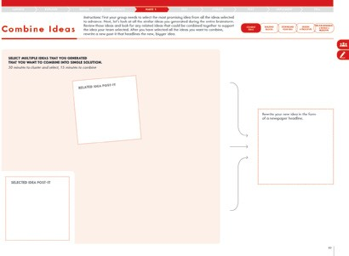
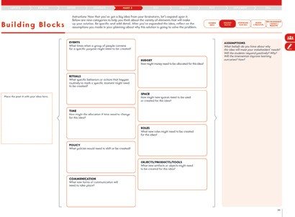
SCHOOLS 2030 HUMAN-CENTERED DESIGN TOOLKIT
#1 Combine Ideas
WHAT IS THIS TOOL?
Combine Ideas is a worksheet designed to help identify ideas you’ve generated in your brainstorm in order to synthesize those ideas into a single concept.
WHAT IS YOUR GOAL?
This tool helps you cluster and combine ideas into a broader concept.
30 minutes to cluster and select, 15 minutes to combine
PAGE 97 • HUMAN-CENTERED DESIGN TOOLKIT
TOOL TIPS:
Once design teams have selected an idea they want to advance, have them return to the rest of the ideas they generated to see if there were any related ideas they want to include.
These related ideas will help them to make their idea more robust.
It is helpful to then rename the idea in the form of a newspaper headline so that the team can have clarity about their idea.
#2 Building Blocks
WHAT IS THIS TOOL?
30-45 minutes
Building Blocks is a worksheet designed to help your team identify all the elements of your idea that need to be developed.
WHAT IS YOUR GOAL?
Your concept is more complex than a single post-it. Use this tool to help your develop your concept more fully by adding specific details.
PAGE 99 • HUMAN-CENTERED DESIGN TOOLKIT
TOOL TIPS:
Ask the design teams to use this tool to expand upon the idea they created. Now is the time to get more specific about their idea.
Design teams are not committing to this idea yet, so encourage teams to dream about all that is possible without thinking about feasibility.
Design teams do not need to use every box on this tool.
TEST
ITERATE
TEST
IMPLEMENT
TELL

Slide 99
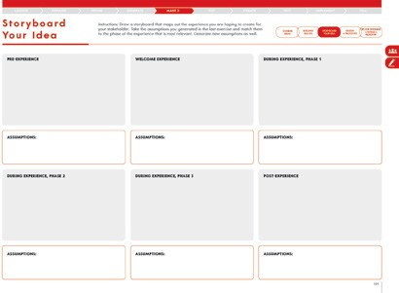
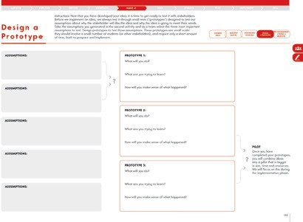
SCHOOLS 2030 HUMAN-CENTERED DESIGN TOOLKIT
MAKE PHASE FACILITATION & COACHING
#3 Storyboard Your Idea
WHAT IS THIS TOOL?
30-45 minutes
Storyboard Your Idea is a handout worksheet to help your team think through your idea in terms of a timeline. What happens at the beginning, the middle and then end?
WHAT IS YOUR GOAL?
By thinking through your idea in terms of a timeline, you will be able to further reflect on the assumptions you are making and generate new assumptions as well.
PAGE 101 • HUMAN-CENTERED DESIGN TOOLKIT
TOOL TIPS:
Ask the design teams to use this tool to expand upon the idea they create using a storyboard of the experience. Now is the time to get more specific about their idea.
Design teams are not committing to this idea yet, so encourage teams to dream about all that is possible without thinking about feasibility.
Design teams do not need to use every box on this tool.
#4 Design a Prototype
WHAT IS THIS TOOL?
30-45 minutes
Design a Prototype is a worksheet designed to help your team design low-resolution prototypes to test the assumptions you are making about why your concept is going to solve your stakeholder’s problem or meet their need.
WHAT IS YOUR GOAL?
As you brainstorm, the ideas you generate are full of assumptions about why those ideas will solve your stakeholder’s problem or meet their need.
Your prototype needs to test those assumptions early in order to get authentic, relevant stakeholder feedback.
PAGE 103 • HUMAN-CENTERED DESIGN TOOLKIT
TOOL TIPS:
Design teams will be designing prototypes based on the assumptions they are making in their idea.
Prototypes should be small experiments that are specifically designed to test assumptions.
Push teams to connect what they are going to do with what ideas they are trying to test.
LAUNCH
EXPLORE
DEFINE
GENERATE
MAKE

Slide 100
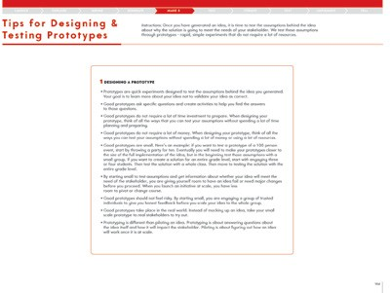
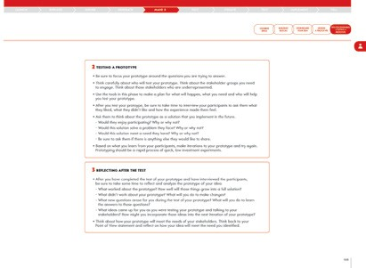
SCHOOLS 2030 HUMAN-CENTERED DESIGN TOOLKIT
#5 Tips for Designing & Testing a Prototype
WHAT IS THIS TOOL?
Tips for Designing & Testing a Prototype is a worksheet designed to help your team prepare to design and test the assumptions you are making about why your idea will meet the needs of your stakeholder.
WHAT IS YOUR GOAL?
As you brainstorm, the ideas you generate are full of assumptions about why those ideas will solve your
stakeholder’s problem or fill their need. Designing and testing a low investment, low risk prototype will help you test those assumptions and make changes to your idea before you implement it at scale.
15 minutes
TOOL TIPS:
Remind design teams to review the tool.
Members of the design teams will test prototypes individually.
Encourage participants to make iterations to their prototypes and test them again.
Remind participants to take notes about what they learned. They should also take time after the prototype to reflect and make sense of what they learned before they come back together as a team.
PAGE 104-105 • HUMAN-CENTERED DESIGN TOOLKIT
TEST
ITERATE
TEST
IMPLEMENT
TELL

Slide 101
SCHOOLS 2030 HUMAN-CENTERED DESIGN TOOLKIT
MAKE TRANSITION FACILITATION & COACHING
FROM THE EDUCATOR TOOLKIT
• TEAM ALIGNMENT
In order to seek alignment as a team, share each
of your summary pages and use the questions below to narrow your team’s focus so that you can move on to the next phase of the design challenge with
a shared perspective.
Let each person read their summary responses without interruption or comments from the team. If there are differing views and ideas from team members, ask questions to gain understanding.
Try questions like: “Can you share more information about how you came to these ideas?”and “Tell me more about that...”
Your team does not have to be aligned on all aspects of your design work, but you must be aligned on the items below in order to move on.
COACHING FOR ALIGNMENT:
To successfully wrap up this phase of the design challenge, the team must answer the alignment questions with specific and clear ideas.
There can be many things that the team will want to learn about the idea and there will be many assumptions that are possible to test. It can be helpful to determine the foundational elements that will give the design team the most information about if their solution will meet their stakeholders’ needs.
Encourage design teams to narrow their focus to maxi- mize what they are able to learn.
What are the two assumptions that your team wants to test through prototyping?
COACHING FOR QUALITY:
A high-quality prototype is created to test assumptions about the idea, and elicit useful feedback about ways to improve. Help the team pick two assumptions that can be clearly tested by documenting experiences and following up with questions for the stakeholders.
It’s important to know how you are going to understand and assess the feedback you get about the prototype.
If you know what you are trying to test with the prototype then the team should also be very clear about how they will make sense of that learning.
Describe the prototype your team will develop:
Remind the team that the assumptions they are testing in their prototypes should help them get better understanding about how they will improve the holistic learning outcomes. Determining if students “like” something might not be enough to prove
this is a valuable idea.
What will you do?
What are you trying to learn?
How will you make sense of what happened?
How do think your team’s prototype will lead you to a solution that will improve the holistic learning outcomes for your students?
LAUNCH
EXPLORE
DEFINE
GENERATE
MAKE

Slide 102
SCHOOLS 2030 HUMAN-CENTERED DESIGN TOOLKIT
MAKE TRANSITION FACILITATION & COACHING
CRITERIA FOR IMPROVING PROCESS WORK:
Use the rubric below to assess how your team is doing in terms of your process work and the mindsets of Human-Centered Design. Circle the description that most represents your team’s progress.
Partial Demonstration
Proficient Demonstration
Sophisticated Demonstration
Stay optimistic that you can solve the problem | The team is not able to stay optimistic about solving the problem. | The team is able to stay somewhat optimistic about solving the problem. | The team is able to stay very optimistic about solving the problem.
Prototype early and often in order to learn about your idea | The team is struggling to create and try prototypes of their idea. | The team is struggling to create and try prototypes of their idea but are wiling to try at least once. | The team is excited to create and try several prototypes of their idea.
Start small to make big change | The team is struggling to develop prototypes that are small in scale and investment. | The team is struggling to develop prototypes that are small in scale and investment but are working on iterating in their prototypes. | The team has developed prototypes that are small in scale and investment.
Show don’t tell | The teams is struggling to create a prototype that is experiential and does not rely on telling the stakeholder about the idea. | The teams is struggling to create a prototype that is experiential and does not rely on telling the stakeholder about the idea but they are making progress. | The teams has created a prototype that is experiential and does not rely on telling the stakeholder about the idea.
Many cycles of prototyping are necessary to develop an idea | The team is struggling to embrace the idea of multiple rounds of prototyping. | The team is struggling to embrace the idea of multiple rounds of prototyping but they are making progress. | The team is embracing the idea of multiple rounds of prototyping.
TEST
ITERATE
TEST
IMPLEMENT
TELL

Slide 103
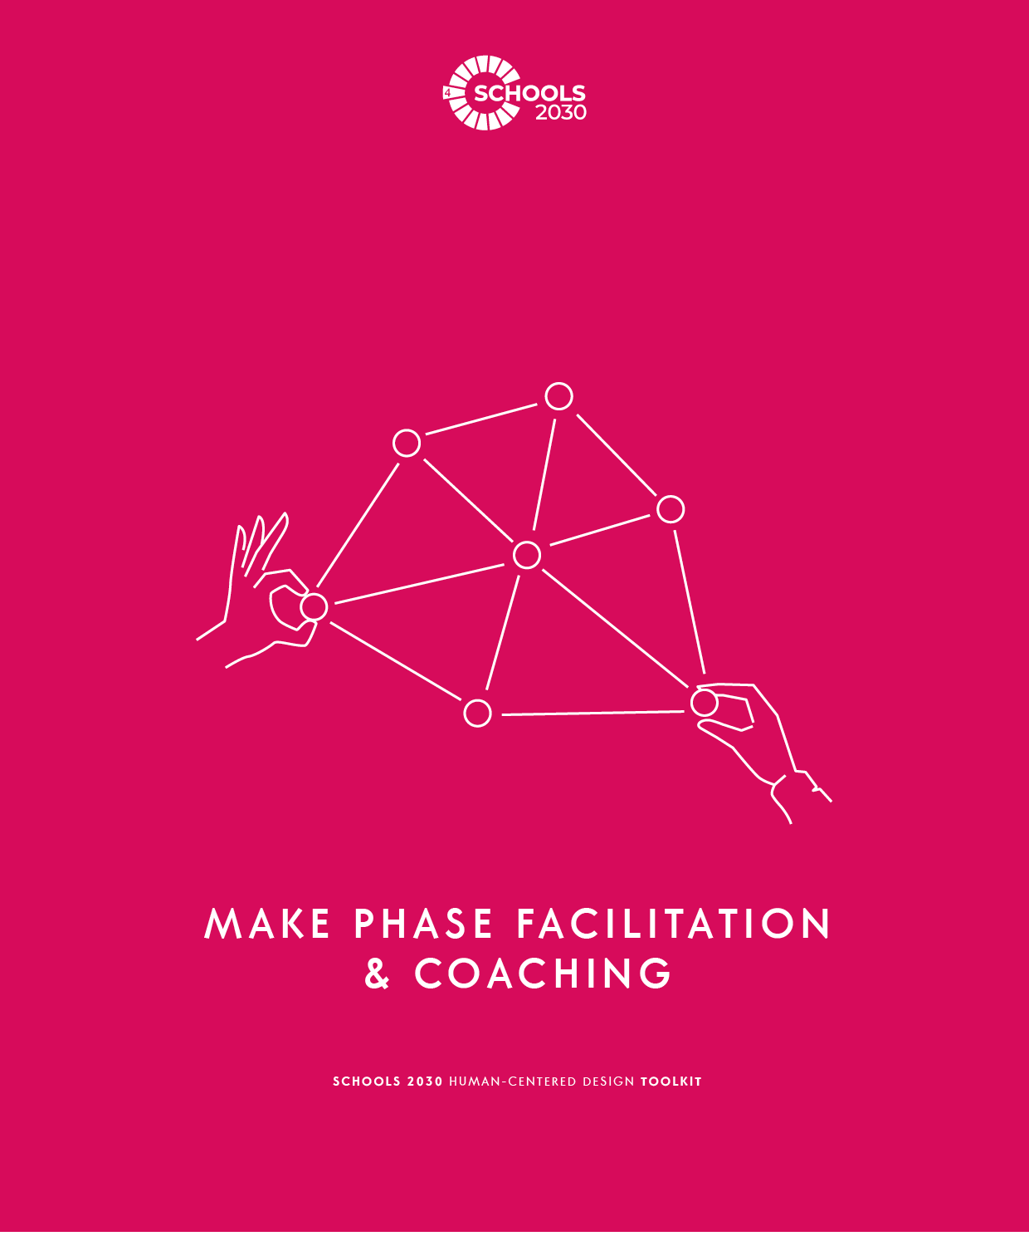
SCHOOLS 2030 HUMAN-CENTERED DESIGN TOOLKIT
91

Slide 104
SCHOOLS 2030 HUMAN-CENTERED DESIGN TOOLKIT
TEST PHASE FACILITATION & COACHING
FROM THE EDUCATOR TOOLKIT
• OVERVIEW OF TEST YOUR PROTOTYPE PHASE
The worksheets in the Test Your Prototype phase are designed to help you construct tangible tests
of your solutions. These tests are intended to elicit feedback, answer specific questions about a concept and test assumptions embedded in the ideas. The work of these workshops can be done collaboratively with school-based teams or other schools. Prototyping will be conducted by individual educators.
COACHING FOR SUCCESS:
Feedback is a gift. Design teams might be wanting to hear only praise for their prototypes but that will not help them improve the idea. Encourage design teams to seek critical and thoughtful responses that will help the team make the idea even stronger.
The team will want to test the prototype with a variety of stakeholders. Consider some typically underrepresented stakeholders that might not usually have a voice in how ideas get developed and implemented. This range of feedback will be very helpful to the team.
This phase of the design challenge will include: preparing you to run your prototype and reflect on what you learned, evaluating your idea based on the stakeholder’s needs and determining the best next steps.
• OBJECTIVES OF TEST YOUR PROTOTYPE PHASE
The goal of this phase is to run your low-resolution prototype with stakeholders to get authentic feedback.
At the end of this phase, you should be clear about whether the solution you brainstormed has the potential to meet the needs you identified in your POV statement. You should also have a clear sense of how you want to iterate your next prototype.
COACHING TO AVOID COMMON MISTAKES:
A common mistake in the Test Your Prototype phase is that the team will want to validate the idea rather than seek deeper understanding about how to solve the problem for the stakeholders. If all of the feedback is,
”I love it!” or “This is a great idea!” then they don’t have good feedback to improve their idea. This often means that people are being too nice to be helpful.
Encourage teams to avoid asking leading questions about their prototype. Remind design teams of the lessons from the Explore Your Idea phase that helped them ask good open-ended questions.
• MINDSETS OF TEST YOUR PROTOTYPE PHASE
Stay optimistic that you can solve the problem
Test early and often in order to learn about your idea
Start small to make big change
COACHING FOR MINDSETS:
Critical feedback can be difficult to hear sometimes, so encourage the design team to stay optimistic that feedback is a valuable tool for improving their work.
Remind design teams to test their prototypes often, and incorporate the feedback as quickly as they can so they aren’t getting the same feedback repeatedly.
Show don’t tell
The design challenge is an iterative process so the team will have a chance to test again. Encourage design teams to not put all their ideas into this first round.
Many cycles of prototyping are necessary to develop an idea
Feedback is a gift to improve your ideas
Ask participants to pick one mindset that they are going to focus on during this phase of the process.
92
TEST
ITERATE
TEST
IMPLEMENT
TELL

Slide 105
SCHOOLS 2030 HUMAN-CENTERED DESIGN TOOLKIT
TEST PHASE FACILITATION & COACHING
CREATIVE EXERCISES:
The Spaghetti Marshmallow Challenge
Goal:
This exercise is designed to help participants experience the need for testing their ideas early instead of spending all of their time discussing and planning.
Instructions:
Challenge: To build the tallest tower possible in 18 minutes that will support the marshmallow.
Each team gets the same set of supplies…
  20 sticks of dry spaghetti
  one yard of string
  one yard of tape
  one marshmallow
Explain the challenge: Build the tallest tower possible that will support a marshmallow in 18 minutes.
Put the group into teams of four. Distribute the supplies. Set a timer for 18 minutes.
Start the timer and give time updates every 6 minutes.
When the time goes off, measure each structure to find the tallest tower.
Watch Tom Wujec’s TED Talk: https://www.ted.com/talks/tom_wujec_build_a_tower_build_a_team.
Online Adaptation:
Watch Tom Wujec’s TED Talk: https://www.ted.com/talks/tom_wujec_build_a_tower_build_a_team. Put participants
in pairs into breakout rooms. Debrief what the team learned about the need to test ideas early and often.
Debrief Questions:
What did you learn about the need to test ideas early and often?
What did you learn about working as a team?
LEARN MORE ABOUT THIS PHASE:
To learn more about this phase, check our electronic appendix of articles we have curated.
8 Ways to Fail Your Way to Success
Failure to Learn
Feedback Is Not a Fad
93
LAUNCH
EXPLORE
DEFINE
GENERATE
MAKE

Slide 106
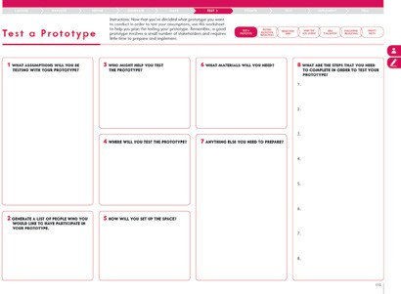
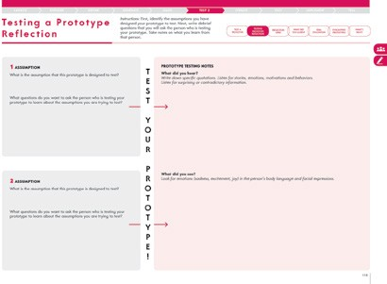
SCHOOLS 2030 HUMAN-CENTERED DESIGN TOOLKIT
#1 Test a Prototype
WHAT IS THIS TOOL?
The Test a Prototype worksheet is designed to help you plan the logistics of testing your prototypes.
WHAT IS YOUR GOAL?
Testing prototypes requires a little bit of planning. This tool helps you think through those logistics.
30 minutes to prepare, 1-2 hours to run a prototype
PAGE 113 • HUMAN-CENTERED DESIGN TOOLKIT
TOOL TIPS:
Ask participants to use this tool to plan their prototypes and work out all the logistics necessary in advance.
Remind participants that prototypes should not take a lot of time or money to plan or implement.
An excellent prototype is only as big as is required to test the assumptions of their concept.
#2 Testing Prototype Reflection
WHAT IS THIS TOOL?
Testing Prototype Reflection is a worksheet designed to help you to prepare to test your prototype and then reflect on what you learned from testing your prototype.
WHAT IS YOUR GOAL?
Use this tool to help you get ready to test your prototype and then capture what you learned from testing.
30-45 minutes per prototype
PAGE 115 • HUMAN-CENTERED DESIGN TOOLKIT
TOOL TIPS:
This tool asks participants to again reiterate which assumptions their prototype is designed to test and how the prototype will test those assumptions.
This is also a tool to help participants reflect on what they learned. Remind them to capture notes about what they learned from testing their assumptions. These reflections should be directly connected to the assumptions they were trying to test with their prototypes.
94
TEST
ITERATE
TEST
IMPLEMENT
TELL

Slide 107
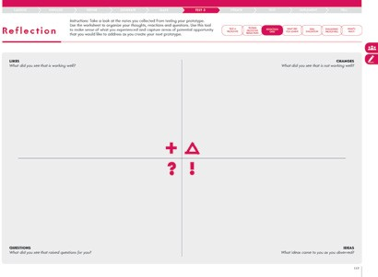
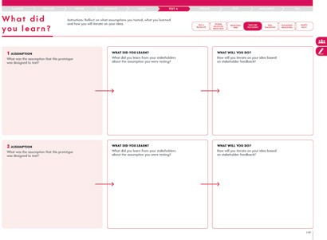
SCHOOLS 2030 HUMAN-CENTERED DESIGN TOOLKIT
TEST PHASE FACILITATION & COACHING
#3 Reflection Grid
WHAT IS THIS TOOL?
The Reflection Grid is a worksheet designed to help you make sense of what you learned from testing your prototype.
WHAT IS YOUR GOAL?
The primary goal of testing a prototype is to reflect and learn about your idea and whether it meets the needs of the stakeholder or not. Use this tool to capture what you learned from testing.
30-45 minutes per prototype
PAGE 117 • HUMAN-CENTERED DESIGN TOOLKIT
TOOL TIPS:
Remind design teams to complete the reflection tool directly after they complete their prototype.
If they didn’t, give them a few minutes to complete the reflection tool before they reconnect with their team.
This tool is designed to encourage participants to not only think about what went well and what didn’t but also to record what new ideas and questions came up during the prototype.
#4 What Did You Learn?
WHAT IS THIS TOOL?
30-45 minutes
The What Did You Learn? worksheet asks you to reflect on what assumptions you are making about why your idea will solve your stakeholder’s problem. This tool also asks you to continue to iterate based on what you learn from your testing.
WHAT IS YOUR GOAL?
When you have completed this tool, you will have clarity on how you are going to test the assumptions embedded in your solution.
PAGE 119 • HUMAN-CENTERED DESIGN TOOLKIT
TOOL TIPS:
This tool asks participants to reflect on the assumptions their prototype was designed to test, what they learned and what they will do next.
95
LAUNCH
EXPLORE
DEFINE
GENERATE
MAKE

Slide 108
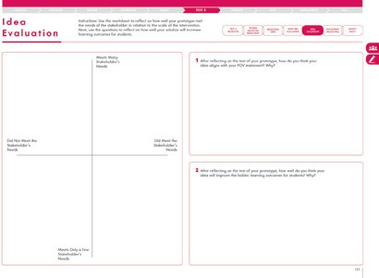

SCHOOLS 2030 HUMAN-CENTERED DESIGN TOOLKIT
#5 Idea Evaluation 30-45 minutes
WHAT IS THIS TOOL?
Idea Evaluation is a worksheet designed to help you to evaluate your prototype based on your stakeholder testing.
WHAT IS YOUR GOAL?
As you continue to work through the design challenge, it is important to continue to revisit your original stakeholder’s POV and ask how well your solution will improve the holistic learning outcomes for students.
PAGE 121 • HUMAN-CENTERED DESIGN TOOLKIT
TOOL TIPS:
This tool asks participants to reflect on their solution
and how it connects to the Point of View statement they wrote as well as the holistic learning outcomes.
Encourage participants to evaluate their solution, even if they are unsure. They can use the grid to help them develop their opinion.
#6 Evaluating Prototypes to Get to Next Steps
WHAT IS THIS TOOL?
Evaluating Prototypes to Get to Next Steps is a worksheet designed to help your team identify what your best next steps are in terms of iterating on your concept.
WHAT IS YOUR GOAL?
When you have completed this tool, you will have good insight into what the best next steps are for the next iteration of your idea.
30-45 minutes
TOOL TIPS:
PAGE 123 • HUMAN-CENTERED DESIGN TOOLKIT
This tool asks participants to reflect on their solution and how it improves learning outcomes. It also asks participants to evaluate the scale of their prototype.
Encourage participants to evaluate their solution, even if they are unsure. They can use the grid to help them develop their opinion.
Once they have evaluated their prototype, the grid will point them in the right direction for next steps.
Every design team will be testing another prototype, but some teams might want to return to several of the steps in the design process before they prototype again.
96
TEST
ITERATE
TEST
IMPLEMENT
TELL

Slide 109

SCHOOLS 2030 HUMAN-CENTERED DESIGN TOOLKIT
TEST PHASE FACILITATION & COACHING
#7 What’s Next? 30-45 minutes
WHAT IS THIS TOOL?
The What’s Next? worksheet asks you to reflect on where you are in your design challenge and what your next steps should be.
WHAT IS YOUR GOAL?
Human-centered design is not a linear process. You may find that you need to return to the Explore the Problem phase of the process after you test an initial prototype.
You may also choose to continue to develop your concept through prototyping.
PAGE 125 • HUMAN-CENTERED DESIGN TOOLKIT
TOOL TIPS:
This tool asks participants to reflect on their solution and how confident they are about it.
Encourage participants to evaluate their solution, even if they are unsure. They can use the scale to help them develop their opinion.
Once they have evaluated their prototype, ask them to reflect on next steps.
Every design team will be testing another prototype, but some teams might want to return to several of the steps in the design process before they prototype again.
97
LAUNCH
EXPLORE
DEFINE
GENERATE
MAKE

Slide 110
SCHOOLS 2030 HUMAN-CENTERED DESIGN TOOLKIT
TEST PHASE FACILITATION & COACHING
FROM THE EDUCATOR TOOLKIT
• TEAM ALIGNMENT
In order to seek alignment as a team, share each
of your summary pages and use the questions below to narrow your team’s focus so that you can move on to the next phase of the design challenge with a shared perspective. Let each person read their summary responses without interruption or comments from the team. If there are differing views and ideas from team members, ask questions to gain understanding. Try questions like: “Can you share more information about how you came to these ideas?”and “Tell me more about that...” Your team does not have to be aligned on all aspects of your design work, but you must be aligned on the items below in order to move on.
COACHING FOR ALIGNMENT:
To successfully wrap up this phase of the design challenge, your team must answer the alignment questions with specific and clear ideas.
The design team will want to identify three things that they learned from prototyping. If the design team is struggling to find alignment then first consider some criteria that you could use to evaluate the ideas more objectively.
For example, what was most important about what they learned in terms of testing their assumptions? They can also ask an external stakeholder or school leader to join them and give input on the ideas.
As a team, determine what the three most important things are that you learned from testing your prototypes.
COACHING FOR QUALITY:
A high-quality test of a prototype should help design teams answer very specific questions about their idea and the assumptions they are making about that idea.
Another sign of a high-quality test is that the design team is excited about the potential impact of their concept on improving the holistic learning outcomes.
What does your team need to do next to be the most prepared for designing new prototypes?
How does your next step guide your team’s work toward developing a solution that will improve the holistic learning outcomes for your students?
98
TEST
ITERATE
TEST
IMPLEMENT
TELL

Slide 111
SCHOOLS 2030 HUMAN-CENTERED DESIGN TOOLKIT
TEST PHASE FACILITATION & COACHING
CRITERIA FOR IMPROVING PROCESS WORK:
Use the rubric below to assess how your team is doing in terms of your process work and the mindsets of Human-Centered Design. Circle the description that most represents your team’s progress.
Partial Demonstration
Proficient Demonstration
Sophisticated Demonstration
Stay optimistic that you can solve the problem | The team is not able to stay optimistic about solving the problem. | The team is able to stay somewhat optimistic about solving the problem. | The team is able to stay very optimistic about solving the problem.
Test early and often in order to learn about your idea | The team is struggling to create and try tests of their idea. | The team is struggling to create and try tests of their idea but are wiling to try at least once. | The team is excited to create and try several tests of their idea.
Start small to make big change | The team is struggling to develop tests that are small in scale and investment. | The team is struggling to develop tests that are small in scale and investment but are working on iterating in their tests. | The team has developed tests that are small in scale and investment.
Show don’t tell | The teams is struggling to create a test that is experiential and does not rely on telling the stakeholder about the idea. | The teams is struggling to create a test that is experiential and does not rely on telling the stakeholder about the idea but they are making progress. | The teams has created a test that is experiential and does not rely on telling the stakeholder about the idea.
Many cycles of prototyping are necessary to develop an idea | The team is struggling to embrace the idea of multiple rounds of prototyping. | The team is struggling to embrace the idea of multiple rounds of prototyping but they are making progress. | The team is embracing the idea of multiple rounds of prototyping.
Feedback is a gift to improve your ideas | The team is struggling to seek and/or receive feedback from stakeholders. | The team is struggling to seek and/or receive feedback from stakeholders, but they are making progress. | The team is embracing the process of seeking and receiving feedback from stakeholders.
99
LAUNCH
EXPLORE
DEFINE
GENERATE
MAKE

Slide 112

SCHOOLS 2030 HUMAN-CENTERED DESIGN TOOLKIT
100

Slide 113
SCHOOLS 2030 HUMAN-CENTERED DESIGN TOOLKIT
ITERATE PHASE FACILITATION & COACHING
FROM THE EDUCATOR TOOLKIT
• OVERVIEW OF ITERATE PHASE
The worksheets in the Iterate phase will help you advance your solution through another round of low-resolution prototypes. This can be done in school-based teams or with other schools.
This phase of the design challenge will include: combining ideas from your reflection about your first round of prototypes into larger concepts, expanding your ideas with specific elements, identifying the assumptions you are making
with your solution and making a prototype to test those assumptions.
COACHING FOR SUCCESS:
The worksheets in the Iterate phase are designed to help the design team align around a next iteration of their idea in terms of improving the holistic learning outcomes for students.
This is an opportunity for design teams to make changes based on feedback and test another prototype to continue to develop their idea.
• OBJECTIVES OF ITERATE PHASE
The goal of this phase is to help you advance your idea by incorporating feedback from the first round
of testing while also testing new assumptions you are making about your solution. From there, you will design low-resolution prototypes (low time investment, low cost, small scale).
COACHING TO AVOID COMMON MISTAKES:
It is a common mistake during the Iterate phase
to not use feedback from the first test when designing the next iteration. Encourage teams to reflect on what they learned and incorporate that feedback into their next iteration.
At the end of this phase, all team members should be clear on how they are going to run a
new iteration of a prototype to test an assumption embedded in the team’s solution.
• MINDSETS OF ITERATE PHASE
Stay optimistic that you can solve the problem
COACHING FOR MINDSETS:
The Iterate phase of the design challenge
is a collaborative moment for the team to listen and support each other to improve and evolve their idea to be the strongest it can be.
Encourage design teams to work together to reflect on what they learned and incorporate that into their next iteration.
Test early and often in order to learn about your idea
Start small to make big changes
Show don’t tell
Many cycles of prototyping are necessary to develop an idea
Ask participants to pick one mindset that they are going to focus on during this phase of the process.
Feedback is a gift to improve your ideas
101
TEST
ITERATE
TEST
IMPLEMENT
TELL

Slide 114
SCHOOLS 2030 HUMAN-CENTERED DESIGN TOOLKIT
CREATIVE EXERCISES:
Protobot.org
Goal:
This exercise is designed to help participants practice creatively solving problems based
on specific scenarios. This exercise is also designed for participants to practice sketching.
Instructions:
Use the design challenge generator, Protobot.org, to generate a design prompt.
Ask participants to sketch an idea for the design prompt.
Ask participants to share their sketches with their group.
Now, ask participants to reflect on what assumptions they made about the solution they created and share.
Online Adaptation:
This activity translates well to online. Share your screen to show the Protobot.org.
When the participants have completed their sketches, ask them to share in their computer camera.
Debrief Questions:
What was it like to sketch a solution to the scenario?
What did you learn about questioning the assumptions you make when generating ideas?
LEARN MORE ABOUT THIS PHASE:
To learn more about this phase, check our electronic appendix of articles we have curated.
Design iteration brings powerful results. So, do it again designer!
102
LAUNCH
EXPLORE
DEFINE
GENERATE
MAKE

Slide 115


SCHOOLS 2030 HUMAN-CENTERED DESIGN TOOLKIT
ITERATE PHASE FACILITATION & COACHING
#1 Combine Reflections & Ideas 30-45 minutes
WHAT IS THIS TOOL?
Combine Reflections & Ideas is a worksheet designed to help you combine ideas from your first round of testing in order to advance your solution.
WHAT IS YOUR GOAL?
This tool helps you group and combine new ideas into a broader concept.
PAGE 133 • HUMAN-CENTERED DESIGN TOOLKIT
TOOL TIPS:
Unlike the last time participants completed this tool, this time they will be drawing from feedback and ideas that came out of their prototypes.
These related ideas will help them to make their idea more robust.
It is helpful to then rename the idea in the form of a newspaper headline so that the team can have clarity about their idea.
#2 Building to Iterate 30-45 minutes
WHAT IS THIS TOOL?
The Building to Iterate worksheet helps your team identify all the elements of your concept that need to be developed as well as the assumptions embedded in that concept.
WHAT IS YOUR GOAL?
Your concept is more complex than a single post-it.
Use this tool to help your develop your concept more fully.
PAGE 135 • HUMAN-CENTERED DESIGN TOOLKIT
TOOL TIPS:
Ask the design teams to use this tool to expand upon the idea they created. Now is the time to get more specific about their idea.
Design teams are not committing to this idea yet, so encourage teams to dream about all that is possible without thinking about feasibility.
Design teams do not need to use every box on this tool.
103
TEST
ITERATE
TEST
IMPLEMENT
TELL

Slide 116


SCHOOLS 2030 HUMAN-CENTERED DESIGN TOOLKIT
#3 Storyboard Your Iteration 30-45 minutes
WHAT IS THIS TOOL?
Storyboard Your Iteration is a worksheet designed to help your team think through your idea in terms of a timeline. What happens at the beginning,
the middle and then end?
WHAT IS YOUR GOAL?
By thinking through your idea in terms of a timeline, you will be able to further reflect on the assumptions you are making and generate new assumptions as well.
PAGE 137 • HUMAN-CENTERED DESIGN TOOLKIT
TOOL TIPS:
Ask the design teams to use this tool to expand upon the idea they create using a storyboard of the experience. Now is the time to get more specific about their idea.
Design teams are not committing to this idea yet, so encourage teams to dream about all that is possible without thinking about feasibility.
Design teams do not need to use every box on this tool.
#4 Design Another Prototype 30-45 minutes
WHAT IS THIS TOOL?
The Design Another Prototype worksheet helps your team design low-resolution prototypes to test
the assumptions you are making about why your concept is going to solve your stakeholder’s problem or meet their need.
WHAT IS YOUR GOAL?
As you continue to prototype, the ideas you generate are full of assumptions about why those ideas will solve your stakeholder’s problem or fill their need. Your prototype needs to test those assumptions early in order to get authentic, relevant stakeholder feedback.
PAGE 139 • HUMAN-CENTERED DESIGN TOOLKIT
TOOL TIPS:
Design teams will be designing prototypes based on the assumptions they are making in their idea.
Prototypes should be small experiments that are specifically designed to test assumptions.
Push teams to connect what they are going to do with what ideas they are trying to test.
104
LAUNCH
EXPLORE
DEFINE
GENERATE
MAKE

Slide 117
SCHOOLS 2030 HUMAN-CENTERED DESIGN TOOLKIT
ITERATE PHASE FACILITATION & COACHING
FROM THE EDUCATOR TOOLKIT
• TEAM ALIGNMENT
In order to seek alignment as a team, share each of your summary pages and use the questions below to narrow your team’s focus so that you can move on to the next phase of the design challenge with a shared perspective.
Let each person read their summary responses without interruption or comments from the team. If there are differing views and ideas from team members, ask questions to gain understanding. Try questions like: “Can you share more information about how you came to these ideas?”and “Tell me more about that...”
Your team does not have to be aligned on
all aspects of your design work, but you must be aligned on the items below in order to move on.
COACHING FOR ALIGNMENT:
To successfully wrap up this phase of the design challenge, the team must answer the alignment questions with specific and clear ideas.
There can be many things that the team will want to learn about the idea and there will be many
assumptions that are possible to test. It can be helpful to determine the foundational elements that will give the design team the most information about if their solution will meet their stakeholders’ needs.
Encourage design teams to narrow their focus to maximize what they are able to learn.
What are the two assumptions that your team wants to test through prototyping?
COACHING FOR QUALITY:
A high-quality prototype is created to test assumptions about the idea, and elicit useful feedback about ways to improve. Help the team to pick two assumptions that can be clearly tested by documenting experiences and following up with questions for the stakeholders.
It’s important for design teams to know how they are going to understand and assess the feedback they get about the prototype. If they know what they are trying to test with the prototype then the team should also be very clear about how they will make sense of that learning.
Remind the team that the assumptions they are testing in their prototypes should help them get better
understanding about how they will improve the holistic learning outcomes. Determining if students “like” something might not be enough to prove this
is a valuable idea.
Describe the prototype your team will develop:
What will you do?
What are you trying to learn?
How will you make sense of what happened?
How do think your team’s prototype will lead you to a solution that will improve the holistic learning outcomes for your students?
105
TEST
ITERATE
TEST
IMPLEMENT
TELL

Slide 118
SCHOOLS 2030 HUMAN-CENTERED DESIGN TOOLKIT
ITERATE PHASE FACILITATION & COACHING
CRITERIA FOR IMPROVING PROCESS WORK:
Use the rubric below to assess how your team is doing in terms of your process work and the mindsets of Human-Centered Design. Circle the description that most represents your team’s progress.
Partial Demonstration
Proficient Demonstration
Sophisticated Demonstration
Stay optimistic that you can solve the problem | The team is not able to stay optimistic about solving the problem. | The team is able to stay somewhat optimistic about solving the problem. | The team is able to stay very optimistic about solving the problem.
Test early and often in order to learn about your idea | The team is struggling to create and try tests of their idea. | The team is struggling to create and try tests of their idea but are wiling to try at least once. | The team is excited to create and try several tests of their idea.
Start small to make big change | The team is struggling to develop tests that are small in scale and investment. | The team is struggling to develop tests that are small in scale and investment but are working on iterating in their tests. | The team has developed tests that are small in scale and investment.
Show don’t tell | The teams is struggling to create a test that is experiential and does not rely on telling the stakeholder about the idea. | The teams is struggling to create a test that is experiential and does not rely on telling the stakeholder about the idea but they are making progress. | The teams has created a test that is experiential and does not rely on telling the stakeholder about the idea.
Many cycles of prototyping are necessary to develop an idea | The team is struggling to embrace the idea of multiple rounds of prototyping. | The team is struggling to embrace the idea of multiple rounds of prototyping but they are making progress. | The team is embracing the idea of multiple rounds of prototyping.
Feedback is a gift to improve your ideas | The team is struggling to seek and/or receive feedback from stakeholders. | The team is struggling to seek and/or receive feedback from stakeholders, but they are making progress. | The team is embracing the process of seeking and receiving feedback from stakeholders.
106
LAUNCH
EXPLORE
DEFINE
GENERATE
MAKE

Slide 119

SCHOOLS 2030 HUMAN-CENTERED DESIGN TOOLKIT
107

Slide 120
SCHOOLS 2030 HUMAN-CENTERED DESIGN TOOLKIT
TEST PHASE FACILITATION & COACHING
FROM THE EDUCATOR TOOLKIT
COACHING FOR SUCCESS:
Feedback is a gift. Design teams might be wanting to hear only praise for their prototypes but that will not help them improve the idea. Encourage design teams to seek critical and thoughtful responses that will help the team make the idea even stronger.
• OVERVIEW OF TEST ANOTHER PROTOTYPE PHASE
The worksheets in the Test Another Prototype phase are designed to help you construct tests of your solutions. These tests are intended to elicit feedback, answer specific questions about
a concept and test assumptions embedded in the ideas. The work of these workshops can be done collaboratively with school-based teams or other schools. Prototyping will be conducted by individual educators.
This phase of the design process will include: preparing you to run your prototype and reflect on what you learned, and evaluating your idea based on the stakeholder’s needs.
The team will want to test the prototype with a variety of stakeholders. Consider some typically underrepresented stakeholders that might not usually have a voice in how ideas get developed and implemented. This range of feedback will be very helpful to the team.
COACHING TO AVOID COMMON MISTAKES:
• OBJECTIVES OF TEST ANOTHER PROTOTYPE PHASE
The goal of this phase is to run your low-resolution prototype with stakeholders to get authentic feedback.
A common mistake in the Test Your Prototype phase is that the team will want to validate the idea rather than seek deeper understanding about how to solve the problem for the stakeholders. If all of the feedback is,
”I love it!” or “This is a great idea!” then they don’t have good feedback to improve their idea. This often means that people are being too nice to be helpful.
Encourage teams to avoid asking leading questions about their prototype. Remind design teams of the lessons from the Explore Your Idea phase that helped them ask good open-ended questions.
At the end of this phase, you should be clear about whether the solution you are developing has the potential to meet the needs you identified in your POV statement and close the learning gaps identified.
• MINDSETS OF TEST ANOTHER PROTOTYPE PHASE
Stay optimistic that you can solve the problem
Prototype early and often in order to learn about your idea
Start small to make big change
COACHING FOR MINDSETS:
Critical feedback can be difficult to hear sometimes, so encourage the design team to stay optimistic that feedback is a valuable tool for improving their work.
Ask participants to pick one mindset that they are going to focus on during this phase of the process.
Show don’t tell
Many cycles of prototyping are necessary to develop an idea
Feedback is a gift to improve your ideas
108
TEST
ITERATE
TEST
IMPLEMENT
TELL

Slide 121
SCHOOLS 2030 HUMAN-CENTERED DESIGN TOOLKIT
TEST PHASE FACILITATION & COACHING
CREATIVE EXERCISES:
Fail Test
Goal:
This exercise is designed to help participants practice what it is like to try something and fail. This exercise is also designed to help participants experience the emotional difference it makes when you celebrate failure.
Instructions:
Put participants in pairs. Have them stand facing each other.
Ask participants to count to three by switching off. The first person says “1,” the second person says “2,” the first person says “3,” the second person says “1.” Keep counting. Speed up! Did you fail? What was that like?
For the next round, have participants insert a clap for:
  Whenever you fail, say ta-dah! Insert a snap for
  Whenever you fail, say ta-dah! Insert a tap on the head for
  What did you learn from this activity? What changed when you started celebrating failure?
For the next round, have participants insert a snap for:
Whenever you fail, say ta-dah! Insert a tap on the head for
What did you learn from this activity? What changed when you started celebrating failure?
For the next round, have participants insert a stomp for 3.
Online Adaptation:
Have all the participants turn on their cameras. Create partner pairs and put the list in the chat. Count to three using hand signals by switching off. Keep counting. Speed up! Did you fail?
What was that like? Insert a clap for:
Whenever you fail, say ta-dah! Insert a snap for
Whenever you fail, say ta-dah! Insert a tap on the head for
What did you learn from this activity? What changed when you started celebrating failure?
Debrief Questions:
  What did you learn from this activity?
  What changed when you started celebrating failure?
LEARN MORE ABOUT THIS PHASE:
To learn more about this phase, check our electronic appendix of articles we have curated.
Design iteration brings powerful results. So, do it again designer!
109
LAUNCH
EXPLORE
DEFINE
GENERATE
MAKE

Slide 122


SCHOOLS 2030 HUMAN-CENTERED DESIGN TOOLKIT
#1 Test a Prototype
WHAT IS THIS TOOL?
The Test a Prototype worksheet is designed to help you plan the logistics of testing your prototypes.
WHAT IS YOUR GOAL?
Testing prototypes requires a little bit of planning. This tool helps you think through those logistics.
30 minutes to prepare, 1-2 hours to run a prototype
PAGE 147 • HUMAN-CENTERED DESIGN TOOLKIT
TOOL TIPS:
Ask participants to use this tool to plan their prototypes and work out all the logistics necessary in advance.
Remind participants that prototypes should not take a lot of time or money to plan or implement.
An excellent prototype is only as big as is required to test the assumptions of their concept.
#2 Testing Prototype Reflection
WHAT IS THIS TOOL?
Testing Prototype Reflection is a worksheet designed to help you to prepare to test your prototype and then reflect on what you learned from testing your prototype.
WHAT IS YOUR GOAL?
Use this tool to help you get ready to test your prototype and then capture what you learned from testing.
30-45 minutes per prototype
PAGE 149 • HUMAN-CENTERED DESIGN TOOLKIT
TOOL TIPS:
This tool asks participants to again reiterate which assumptions their prototype is designed to test and how the prototype will test those assumptions.
This is also a tool to help participants reflect on what they learned. Remind them to capture notes about what they learned from testing their assumptions. These reflections should be directly connected to the assumptions they were trying to test with their prototypes.
110
TEST
ITERATE
TEST
IMPLEMENT
TELL

Slide 123


SCHOOLS 2030 HUMAN-CENTERED DESIGN TOOLKIT
TEST PHASE FACILITATION & COACHING
#3 Reflection Grid 30-45 minutes per prototype
WHAT IS THIS TOOL?
The Reflection Grid is a worksheet designed to help you make sense of what you learned from testing your prototype.
WHAT IS YOUR GOAL?
The primary goal of testing a prototype is to reflect and learn about your idea and whether it meets the needs of the stakeholder or not. Use this tool to capture what you learned from testing.
PAGE 151 • HUMAN-CENTERED DESIGN TOOLKIT
TOOL TIPS:
Remind design teams to complete the reflection tool directly after they complete their prototype.
If they didn’t, give them a few minutes to complete the reflection tool before they reconnect with their team.
This tool is designed to encourage participants to not only think about what went well and what didn’t but also to record what new ideas and questions came up during the prototype.
#4 What Did You Learn? 30-45 minutes
WHAT IS THIS TOOL?
The What Did You Learn? worksheet asks you to reflect on what assumptions you are making about why your idea will solve your stakeholder’s problem. This tool also asks you to continue to iterate based on what you learn from your testing.
WHAT IS YOUR GOAL?
When you have completed this tool, you will have clarity on how you are going to test the assumptions embedded in your solution.
PAGE 153 • HUMAN-CENTERED DESIGN TOOLKIT
TOOL TIPS:
This tool asks participants to reflect on the assumptions their prototype was designed to test, what they learned, and what they will do next.
111
LAUNCH
EXPLORE
DEFINE
GENERATE
MAKE

Slide 124

SCHOOLS 2030 HUMAN-CENTERED DESIGN TOOLKIT
#5 Idea Evaluation 30-45 minutes per prototype
WHAT IS THIS TOOL?
Idea Evaluation is a worksheet designed to help you to evaluate your prototype based on your stakeholder testing.
WHAT IS YOUR GOAL?
As you continue to work through the design challenge, it is important to continue to revisit your original stakeholder’s POV and how well your solution will close the learning gaps identified.
PAGE 155 • HUMAN-CENTERED DESIGN TOOLKIT
TOOL TIPS:
This tool asks participants to reflect on their solution
and how it connects to the Point of View statement they wrote as well as the holistic learning outcomes.
Encourage participants to evaluate their solution, even if they are unsure. They can use the grid to help them develop their opinion.
This tool also asks participants to make a connection between what they learned and what they are going to share in their pitches.
124
TEST
ITERATE
TEST
IMPLEMENT
TELL

Slide 125
SCHOOLS 2030 HUMAN-CENTERED DESIGN TOOLKIT
TEST TRANSITION FACILITATION & COACHING
FROM THE EDUCATOR TOOLKIT
• TEAM ALIGNMENT
In order to seek alignment as a team, share each of your summary pages and use the questions below to narrow your team’s focus so that you can move on to the next phase of the design challenge with a shared perspective.
Let each person read their summary responses without interruption or comments from the team. If there are differing views and ideas from team members, ask questions to gain understanding.
Try questions like: “Can you share more information about how you came to these ideas?”and “Tell me more about that...”
Your team does not have to be aligned on all aspects of your design work, but you must be aligned on the items below in order to move on.
COACHING FOR ALIGNMENT:
To successfully wrap up this phase of the design chal- lenge, your design teams must answer the alignment questions with specific and clear ideas.
The design team will want to identify three things that they learned from prototyping. If the design team is struggling to find alignment then first consider some criteria that you could use to evaluate the ideas more objectively.
For example, what was most important about what they learned in terms of testing their assumptions? They can also ask an external stakeholder or school leader to join you and give input on the ideas.
As a team, determine the three most important things that you learned from testing your prototypes.
COACHING FOR QUALITY:
A high-quality test of a prototype should help design teams answer very specific questions about their idea and the assumptions they are making about that idea.
Another sign of a high-quality test is that the design team is excited about the potential impact of their concept on improving the holistic learning outcomes.
How will you incorporate what you learned from all the prototypes into your next iteration?
How does your next iteration guide your team’s work toward developing a solution that will improve the holistic learning outcomes for your students?
125
TEST
ITERATE
TEST
IMPLEMENT
TELL

Slide 126
SCHOOLS 2030 HUMAN-CENTERED DESIGN TOOLKIT
CRITERIA FOR IMPROVING PROCESS WORK:
Use the rubric below to assess how your team is doing in terms of your process work and the mindsets of Human-Centered Design. Circle the description that most represents your team’s progress.
Partial Demonstration
Proficient Demonstration
Sophisticated Demonstration
Stay optimistic that you can solve the problem | The team is not able to stay optimistic about solving the problem. | The team is able to stay somewhat optimistic about solving the problem. | The team is able to stay very optimistic about solving the problem.
Test early and often in order to learn about your idea | The team is struggling to create and try tests of their idea. | The team is struggling to create and try tests of their idea but are wiling to try at least once. | The team is excited to create and try several tests of their idea.
Start small to make big change | The team is struggling to develop tests that are small in scale and investment. | The team is struggling to develop tests that are small in scale and investment but are working on iterating in their tests. | The team has developed tests that are small in scale and investment.
Show don’t tell | The teams is struggling to create a test that is experiential and does not rely on telling the stakeholder about the idea. | The teams is struggling to create a test that is experiential and does not rely on telling the stakeholder about the idea but they are making progress. | The teams has created a test that is experiential and does not rely on telling the stakeholder about the idea.
Many cycles of prototyping are necessary to develop an idea | The team is struggling to embrace the idea of multiple rounds of prototyping. | The team is struggling to embrace the idea of multiple rounds of prototyping but they are making progress. | The team is embracing the idea of multiple rounds of prototyping.
Feedback is a gift to improve your ideas | The team is struggling to seek and/or receive feedback from stakeholders. | The team is struggling to seek and/or receive feedback from stakeholders, but they are making progress. | The team is embracing the process of seeking and receiving feedback from stakeholders.
126
TEST
ITERATE
TEST
IMPLEMENT
TELL

Slide 127

SCHOOLS 2030 HUMAN-CENTERED DESIGN TOOLKIT
115

Slide 128
SCHOOLS 2030 HUMAN-CENTERED DESIGN TOOLKIT
IMPLEMENT PHASE FACILITATION & COACHING
FROM THE EDUCATOR TOOLKIT
• OVERVIEW OF PREPARE TO IMPLEMENT PHASE
The worksheets in the Prepare to Implement phase are designed to help your team begin to think about how you might work to implement your solution if you were to receive funding. At this phase of the design challenge, you are moving from an idea you are developing to a concept you are working to implement. A concept is a robust idea that has been developed through multiple rounds of prototyping.
The work of this workshop can be done collaboratively with school-based teams only.
This phase of the design process will include: refining your idea and project planning.
COACHING FOR SUCCESS:
The worksheets in the Prepare to Implement phase of
the design challenge ask design teams to begin imagining what they would need to do in order to make this idea
a real solution that is implemented at scale.
Now is the time to start to think strategically about how
to put this idea in place. As this happens it is important
to transition from thinking only about what is desirable
to begin to think about what is also feasible and viable.
Push design teams to begin to get specific about what they would need, including funding.
COACHING TO AVOID COMMON MISTAKES:
• OBJECTIVES OF PREPARE TO IMPLEMENT PHASE
The goal of this phase is to get your design team aligned around what the next steps are that would
be required to implement your concept. Also consider your long-term goals for improving the holistic learning outcomes for students.
It is a common mistake that during the Prepare to Implement phase that teams are hesitant to think strategically about their idea. Push them to think concretely about the solution as if it really were going to happen.
Avoid letting one team member have too much control over the development of the strategy for implementation. Everyone should have a chance to contribute without judgment.
At the end of this phase, all team members should be clear on what needs to happen next.
COACHING FOR MINDSETS:
The Prepare to Implement phase of the design challenge is about thinking strategically. That means that the team needs to work together to identify what needs to happen.
• MINDSETS OF PREPARE TO IMPLEMENT PHASE
Stay optimistic that you can solve the problem
Work together to understand the context
This is also a collaborative moment for the team to listen and support each other to stay optimistic and develop strong strategies for how to implement your solution.
Ask participants to pick one mindset that they are going to focus on during this phase of the process.
Look closely to understand potential problems and opportunities
116
TEST
ITERATE
TEST
IMPLEMENT
TELL

Slide 129
SCHOOLS 2030 HUMAN-CENTERED DESIGN TOOLKIT
IMPLEMENT PHASE FACILITATION & COACHING
CREATIVE EXERCISES:
How to Draw Toast
Goal:
This exercise is designed to help participants think through a process or procedure in all of its component parts.
Instructions:
Ask everyone to get a piece of paper and a pen.
Explain the challenge: Everyone will have 3 minutes to draw the process of making toast (or something else culturally-relevant, like making breakfast).
Set a timer for three minutes. Give a warning once every minute.
At the end of the three minutes, ask everyone to show their drawings.
Watch Tom Wujec’s TED Talk: https://www.drawtoast.com/.
Online Adaptation:
Follow the instructions above. Use a polling tool to capture reflections.
Debrief Questions:
What did you learn about breaking an idea into its component parts?
How does this help you think strategically about implementing the idea?
LEARN MORE ABOUT THIS PHASE:
To learn more about this phase, check our electronic appendix of articles we have curated.
Getting to the Heart of Equity: A Human Centered Design Case Study
117
LAUNCH
EXPLORE
DEFINE
GENERATE
MAKE

Slide 130


SCHOOLS 2030 HUMAN-CENTERED DESIGN TOOLKIT
#1 Refine Your Idea 45-60 minutes
WHAT IS THIS TOOL?
Refine Your Idea is a worksheet designed to help you begin to think about your prototype as a concept you are implementing.
WHAT IS YOUR GOAL?
Prototyping an idea is radically different than implementing a concept. Transitioning to implementation can be difficult for teams. Use this framework to help your team make the transition.
PAGE 163 • HUMAN-CENTERED DESIGN TOOLKIT
TOOL TIPS:
Ask the design teams to use this tool to expand upon
the idea they created. Now is the time to get even more specific about their idea.
Encourage design teams to think about the objectives of their solution. What is this solution trying to accomplish?
Encourage design teams to think about how they will know if their solution has been successful.
#2 Project Planning
WHAT IS THIS TOOL?
45-60 minutes
The Project Planning worksheet is designed to help your team transition from an exploratory design mode to implementation mode and map out the next steps required to implement your solution.
WHAT IS YOUR GOAL?
We know that transitioning from open-ended design work to implementing an idea requires a significant shift in how the team is working. Use this framework to support that shift. When you have completed these tools, your team should be aligned around the next steps needed.
PAGE 165 • HUMAN-CENTERED DESIGN TOOLKIT
TOOL TIPS:
Ask the design teams to use this tool to get really specific about what strategies and decisions will be needed in order to implement their solution.
Design teams do not need to use every box on this tool.
118
TEST
ITERATE
TEST
IMPLEMENT
TELL

Slide 131

SCHOOLS 2030 HUMAN-CENTERED DESIGN TOOLKIT
IMPLEMENT PHASE FACILITATION & COACHING
#3 Project Planning Timeline
WHAT IS THIS TOOL?
45-60 minutes
The Project Planning Timeline worksheet is designed to map out the next steps required to implement your solution based on a timeline.
WHAT IS YOUR GOAL?
Use this tool to break down the implementation
of your concept into specific parts with deadlines. When you have completed these tools, your team should be aligned around the next steps needed.
PAGE 167 • HUMAN-CENTERED DESIGN TOOLKIT
TOOL TIPS:
Ask the design teams to use this tool to get really specific about the timeline and activities that will be needed in order to implement their solution.
Design teams do not need to use every box on this tool.
119
LAUNCH
EXPLORE
DEFINE
GENERATE
MAKE

Slide 132
SCHOOLS 2030 HUMAN-CENTERED DESIGN TOOLKIT
IMPLEMENT PHASE FACILITATION & COACHING
FROM THE EDUCATOR TOOLKIT
COACHING FOR ALIGNMENT:
To successfully wrap up this phase of the design challenge, your team must answer the alignment questions with specific and clear ideas.
• TEAM ALIGNMENT
In order to seek alignment as a team, share each of your summary pages and use the questions below to narrow your team’s focus so that you
can move on to the next phase of the design challenge with a shared perspective.
Let each person read their summary responses without interruption or comments from the team. If there are differing views and ideas from team members, ask questions to gain understanding. Try questions like: “Can you share more information about how you came to these ideas?”and “Tell me more about that...”
Your team does not have to be aligned on all aspects of your design work, but you must be aligned on the items below in order to move on.
The design team will want to pick one idea to move forward into the next phase of the design challenge.
If the design team is struggling to find alignment then
first consider some criteria that you could use to evaluate the ideas more objectively.
For example, what will clearly have an impact on the holistic learning outcomes? They can also ask an external stakeholder or school leader to give input on the ideas.
As a team, determine what concept you plan to pitch to the Schools2030 initiative leadership and implement on your campus:
COACHING FOR QUALITY:
A high-quality concept should excite your team with optimism and hope for lasting impact.
If the idea isn’t inspiring for your team to take action, then ask what is missing or what might be adjusted to make the idea more robust.
It’s also important to consider a concept that the design team is interested in committing to implementing. In the next phase, the team will create pitches to get funding, so they should feel good about engaging with this idea for a long time.
Another sign of a high-quality concept is that the team is excited about the positive impact for the holistic learning outcomes if the idea is successful.
How does your team’s concept lead to improving the holistic learning outcomes for your students?
120
TEST
ITERATE
TEST
IMPLEMENT
TELL

Slide 133
SCHOOLS 2030 HUMAN-CENTERED DESIGN TOOLKIT
IMPLEMENT PHASE FACILITATION & COACHING
CRITERIA FOR IMPROVING PROCESS WORK:
Use the rubric below to assess how your team is doing in terms of your process work and the mindsets of Human-Centered Design. Circle the description that most represents your team’s progress.
Partial Demonstration
Proficient Demonstration
Sophisticated Demonstration
Stay optimistic that you can solve the problem | The team is not able to stay optimistic about solving the problem. | The team is able to stay somewhat optimistic about solving the problem. | The team is able to stay very optimistic about solving the problem.
Work together to understand the context | The team is struggling to work together to understand how their solution might fit into the context. | The team is struggling to work together to understand how their solution might fit into the context but are working to advance the process. | The team feels confident that they understand how their solution will fit into the context and are ready to move forward.
Look closely to understand potential problems and opportunities | The team is not leveraging the insights they have developed about their stakeholders through the design process; they are relying on their own experiences and/or assumptions. | The team is leveraging the insights they have developed about their stakeholders through the design process some of the time. | The team is successfully leveraging the insights they have developed about their stakeholders through the design process.
121
LAUNCH
EXPLORE
DEFINE
GENERATE
MAKE

Slide 134

SCHOOLS 2030 HUMAN-CENTERED DESIGN TOOLKIT
122

Slide 135
SCHOOLS 2030 HUMAN-CENTERED DESIGN TOOLKIT
TELL PHASE FACILITATION & COACHING
FROM THE EDUCATOR TOOLKIT
COACHING FOR SUCCESS:
The worksheets in the Tell Your Community phase of the design challenge ask the design teams to prepare to pitch their concept to the broader community in order to get funding and support for implementing the concept.
• OVERVIEW OF TELL YOUR COMMUNITY PHASE
The handouts in the Tell Your Community phase are designed to help you synthesize what you learned from your design work and prepare to share your insights
and ideas in a human-centered way. The work of this phase can be done collaboratively with school-based teams orother schools.
This phase of the design process will include: developing a stakeholder-centered story to tell
and a pitch to share.
Coach design teams to develop and practice telling the stories of their design work. They should pitch the potential impact of their concepts through sharing what they learned from the stakeholders they connected with throughout the process.
Encourage design teams to use the narrative arc of a story to help their audiences build empathy with the stakeholders who will be impacted by the concept.
• OBJECTIVES OF TELL YOUR COMMUNITY PHASE
The goal of this phase is to help you develop two approaches to communicating what you learned about your solution and why it has the potential to meet the stakeholder’s needs and close the learning gaps identified. The storytelling approach is focused on sharing a stakeholder-specific way of communicating about your idea. Your pitch an approach to communicating your idea that is focused on why your idea will have the greatest impact on holistic learning outcomes for students.
COACHING TO AVOID COMMON MISTAKES:
It is a common mistake that during the Tell Your Community phase that teams get focused on their ideas and do not communicate the potential impact of their concept.
Design teams also make the mistake of over-communicating and sharing too much detail. A good story and a good pitch should be short and powerful.
At the end of this phase, you should be clear on how you plan to communicate about your solution and its potential.
COACHING FOR MINDSETS:
The Tell Your Community phase of the design challenge is about sharing what inspired you about the stakeholders you met.
This is also a collaborative moment for the team to listen and support each other to improve the pitch to be the strongest it can be. Encourage teams to work together
to draft, edit and deliver their stories and pitches in an iterative, collaborative way.
• MINDSETS OF TELL YOUR COMMUNITY PHASE
Get inspired by people
Many cycles of testing are necessary to develop an idea
Feedback is a gift to improve your ideas
Ask participants to pick one mindset that they are going to focus on during this phase of the process.
123
TEST
ITERATE
TEST
IMPLEMENT
TELL

Slide 136
SCHOOLS 2030 HUMAN-CENTERED DESIGN TOOLKIT
TELL PHASE FACILITATION & COACHING
CREATIVE EXERCISES:
Word at a Time Proverb
Goal:
This exercise is designed to help participants practice creatively crafting a story. This exercise is also designed to help participants navigate an open-ended challenge without one single correct answer.
Instructions:
Everyone will work together to create wise statements about life (proverbs) one word at a time. Get the group into a circle.
Start the proverb with one word.
The next person in the circle should add one word.
When the group feels that they have created a proverb, everyone should start snapping their fingers.
Online Adaptation:
Put the participants in order in a list in the chat. That list will guide who contributes next to the proverb.
Debrief Questions:
What did you learn from this activity?
What was it like to have to respond to the words that were shared before you?
What was it like to have to build on the ideas of others?
Story, Story, Die
Goal:
This exercise is designed to help participants practice creatively crafting a story. This exercise is also designed to help participants navigate an open-ended challenge without one single correct answer.
Instructions:
Everyone will work together to create a story. Get the group into a circle.
Ask the group to generate a location, a character and a problem (e.g. the park, a squirrel, needs to protect the nuts he has gathered from an alligator).
As the facilitator, start the story with “Once upon a time...” and set the stage with the location, character and problem.
Then, choose a participant in the circle to pick up the story. The participant will continue creating a story until you ring a bell. Vary the times that each participant has to talk (make some longer and some shorter).
When you ring the bell, the storyteller passes the story to a new person who hasn’t shared yet. If the storyteller isn’t able to generate a story, as the facilitator call them out (they have “died”) and pass the story to a new person.
When several people have helped write the story, interject and say, “Until one day...” and ask the next storyteller to complete the story?
Online Adaptation:
Have each storyteller call on the next storyteller to pass the story.
Debrief Questions:
What did you learn from this activity?
What was it like to have to respond to the story that was shared before you?
What was it like to have to build on the ideas of others?
LEARN MORE ABOUT THIS PHASE:
To learn more about this phase, check our electronic appendix of articles we have curated.
Use Design Thinking to Build Commitment to a New Idea
124
LAUNCH
EXPLORE
DEFINE
GENERATE
MAKE

Slide 137


SCHOOLS 2030 HUMAN-CENTERED DESIGN TOOLKIT
#1 Storytelling 30-45 minutes
WHAT IS THIS TOOL?
Human-centered design is an approach to creative problem-solving that puts the needs and emotions of the stakeholder at the center of the process. Because we are focused on the needs and emotions of the stakeholder, we like to structure our process of pitching idea as a story with a main character, a narrative and a story arc -- a beginning, middle and end. Storytelling is a worksheet designed to help you create a human-centered story about your design project.
WHAT IS YOUR GOAL?
By using character-driven storytelling as the framework for synthesizing your learning and pitching a new concept, we find that we create more compelling and engaging pitches.
PAGE 175 • HUMAN-CENTERED DESIGN TOOLKIT
TOOL TIPS:
Ask the design teams to use this tool to create a story of their design work. They will use this story to share their work at the Pitch Night.
A story is different from a pitch because it focuses on the experiences and emotions of the stakeholder your solution is designed to serve.
Encourage the design teams to focus their storytelling on the stakeholder who inspired their design work.
Encourage the design teams to connect what they learned from their design work to their reasoning for why this solution is going to improve holistic learning outcomes.
#2 Pitching 30-45 minutes
WHAT IS THIS TOOL?
Pitching is a worksheet designed to help you communicate why your solution will have an impact for the stakeholders and the students’ holistic learning outcomes.
WHAT IS YOUR GOAL?
When you have completed this tool, you will be ready
to pitch your idea to your community as well as potential funders.
TOOL TIPS:
PAGE 177 • HUMAN-CENTERED DESIGN TOOLKIT
Ask the design teams to use this tool to create a pitch of their design work. They will use this story to share their work at the Pitch Night.
A pitch is different from a story because it focuses on the strategy behind your solution and why it will make an impact.
Encourage the design teams to focus their pitch on the reason why they believe this solution will increase holistic learning outcomes for students.
125
TEST
ITERATE
TEST
IMPLEMENT
TELL

Slide 138
SCHOOLS 2030 HUMAN-CENTERED DESIGN TOOLKIT
TELL TRANSITION FACILITATION & COACHING
FROM THE EDUCATOR TOOLKIT
• TEAM ALIGNMENT
In order to seek alignment as a team, share each of your summary pages and use the questions below to narrow your team’s focus so that you can move on to the next phase of the design challenge with a shared perspective.
Let each person read their summary responses without interruption or comments from the team. If there are differing views and ideas from team members, ask questions to gain
understanding. Try questions like: “Can you share more information about how you came to these ideas?”and “Tell me more about that...”
Your team does not have to be aligned on all aspects of your design work, but you must be aligned on the items below in order to move on.
COACHING FOR ALIGNMENT:
To successfully wrap up this phase of the design chal- lenge, your team must answer the alignment questions with specific and clear ideas.
At the end of this design phase, design teams will need
to have a story of their design work and a pitch of their concept ready to present at the Regional Pitch Night.
If design teams are struggling to find alignment then first consider some criteria that they could use to evaluate the ideas more objectively.
For example, how might they clearly communicate why they believe their concept will have an impact on the holistic learning outcomes? They can also ask an external stakeholder or school leader to give input on the ideas.
What is the best pitch outline your team wants to use to present to the Schools2030 initiative?
COACHING FOR QUALITY:
A high-quality pitch should excite your community and potential funders with optimism and hope for lasting impact.
If the idea isn’t inspiring for the design teams to take action, then ask what is missing or what might be adjust- ed to make the idea robust.
Another sign of a high-quality idea is that the team is excited about the positive impact related to the holistic learning outcomes and they are able to communicate that clearly to the community.
How does your team’s pitch communicate why you believe your concept will improve the holistic learning outcomes for your students?
126
LAUNCH
EXPLORE
DEFINE
GENERATE
MAKE

Slide 139
SCHOOLS 2030 HUMAN-CENTERED DESIGN TOOLKIT
TELL TRANSITION FACILITATION & COACHING
CRITERIA FOR IMPROVING PROCESS WORK:
Use the rubric below to assess how your team is doing in terms of your process work and the mindsets of Human-Centered Design. Circle the description that most represents your team’s progress.
Partial Demonstration
Proficient Demonstration
Sophisticated Demonstration
Get inspired by people | The team is struggling to tell the story of the stakeholders they met and how their solution might improve the stakeholders’ lives. | The team is struggling to tell the story of the stakeholders they met and how their solution might improve the stakeholders’ lives but they are making progress. | The team has successfully told the story of the stakeholders they met and how their solution might improve the stakeholders’ lives.
Many cycles of prototyping are necessary to develop an idea | The team is struggling to embrace the idea of multiple rounds of iteration | The team is struggling to embrace the idea of multiple rounds of iteration but they are making progress. | The team is embracing the idea of multiple rounds of iteration.
Feedback is a gift to improve your ideas | The team is struggling to seek and/or receive feedback about their pitch. | The team is struggling to seek and/or receive feedback about their pitch but they are making progress. | The team is embracing the process of seeking and receiving feedback about their pitch.
127
TEST
ITERATE
TEST
IMPLEMENT
TELL

Slide 140
SCHOOLS 2030 HUMAN-CENTERED DESIGN TOOLKIT
FACILITATOR’S GUIDE
5
COMPLETING THE
DESIGN CHALLENGE
SCHOOLS 2030 HUMAN-CENTERED DESIGN TOOLKIT
Selecting the Idea to Pitch
Once your design teams have completed their design challenges, they will have prepared a story
of their design work (who they met, what they did, what they learned, etc.) as well as a pitch
for why their idea solves a challenge that will lead to increasing holistic learning outcomes for students. Work with School Leaders and their teams to hone their stories and pitches.
Now is a good time for School Leaders to assess the feasibility and viability of their ideas and help them to shape their ideas into something that is possible to implement.
Regional Pitch Night & Celebration
Work with your School Leaders to explore the possibility of a regional pitch night and celebration where design teams from different schools across the region come together to share their ideas
and celebrate the completion of their design challenge. During this event, the Schools2030 leadership may decide to select one idea or multiple ideas to fund in all regional schools.
Do your part to provide space for hosting the celebration and for gathering the community (families, business leaders, professors, etc.) together to hear the design teams’ pitches.
Transitioning from the Design Challenge to Implementation
Once your design teams have presented their pitches, received feedback, and heard whether
or not they received funding, help the School Leaders and their design teams transition from an
exploratory design mode to a strategic implementation mode. Now is the time for School Leaders
to influence the process, share their knowledge and collaborate to help with what is needed in order
to implement the solution. Also, guide the School Leaders to play a role in helping design team(s) assess the success of the ideas they are implementing over the long term.
140

Slide 141
SCHOOLS 2030 HUMAN-CENTERED DESIGN TOOLKIT
6
IMPLEMENTATION CHECKLIST
& PLANNING TOOLS
SCHOOLS 2030 HUMAN-CENTERED DESIGN TOOLKIT
• SCHOOLS2030 IMPLEMENTATION CHECKLIST
Delegate roles & responsibilities to program staff
Choose a regional model & schedule workshops/meetings
Select schools for cohorts
Work with School Leaders on logistics
Launch design challenges
Plan and implement workshops/meetings
Check in with design teams on progress
Plan and implement Regional Pitch Night
• WORKING WITH SCHOOL LEADERS
Orient School Leader to design challenge and model
Coach School Leader to select design team(s)
Work with School Leader to schedule all workshops/meetings, including the Kick-Off and the Regional Pitch Night
Check in with School Leader on progress
Work with School Leader to plan Regional Pitch Night
141

Slide 142
SCHOOLS 2030 HUMAN-CENTERED DESIGN TOOLKIT
• SCHOOLS2030 PLANNING: MODEL SELECTION
Choose a regional model
Model 1: Regional Workshops Model 2: School-Based Workshops Model 3: Twenty Short Meetings
Model 4: Solo or Partnered Work with Check-Ins
• SCHOOLS2030 PLANNING: SCHEDULE BENCHMARKS
Schedule Benchmarks
Complete Launch & Explore by
Complete Define, Generate & Make by
Complete Test & Iterate by
Complete Test Another, Implement & Tell by
Complete Regional Pitch Night by
142

Slide 143
SCHOOLS 2030 HUMAN-CENTERED DESIGN TOOLKIT
FACILITATOR’S GUIDE
• SCHOOLS2030 PLANNING: COHORTS
Cohort 1 Schools & School Leaders
Cohort Lead:
Cohort 2 Schools & School Leaders
Cohort Lead:
143

Slide 144
SCHOOLS 2030 HUMAN-CENTERED DESIGN TOOLKIT
FACILITATOR’S GUIDE
Cohort 3 Schools & School Leaders
Cohort Lead:
Cohort 4 Schools & School Leaders
Cohort Lead:
144

Slide 145



Developed by

