Slide 1
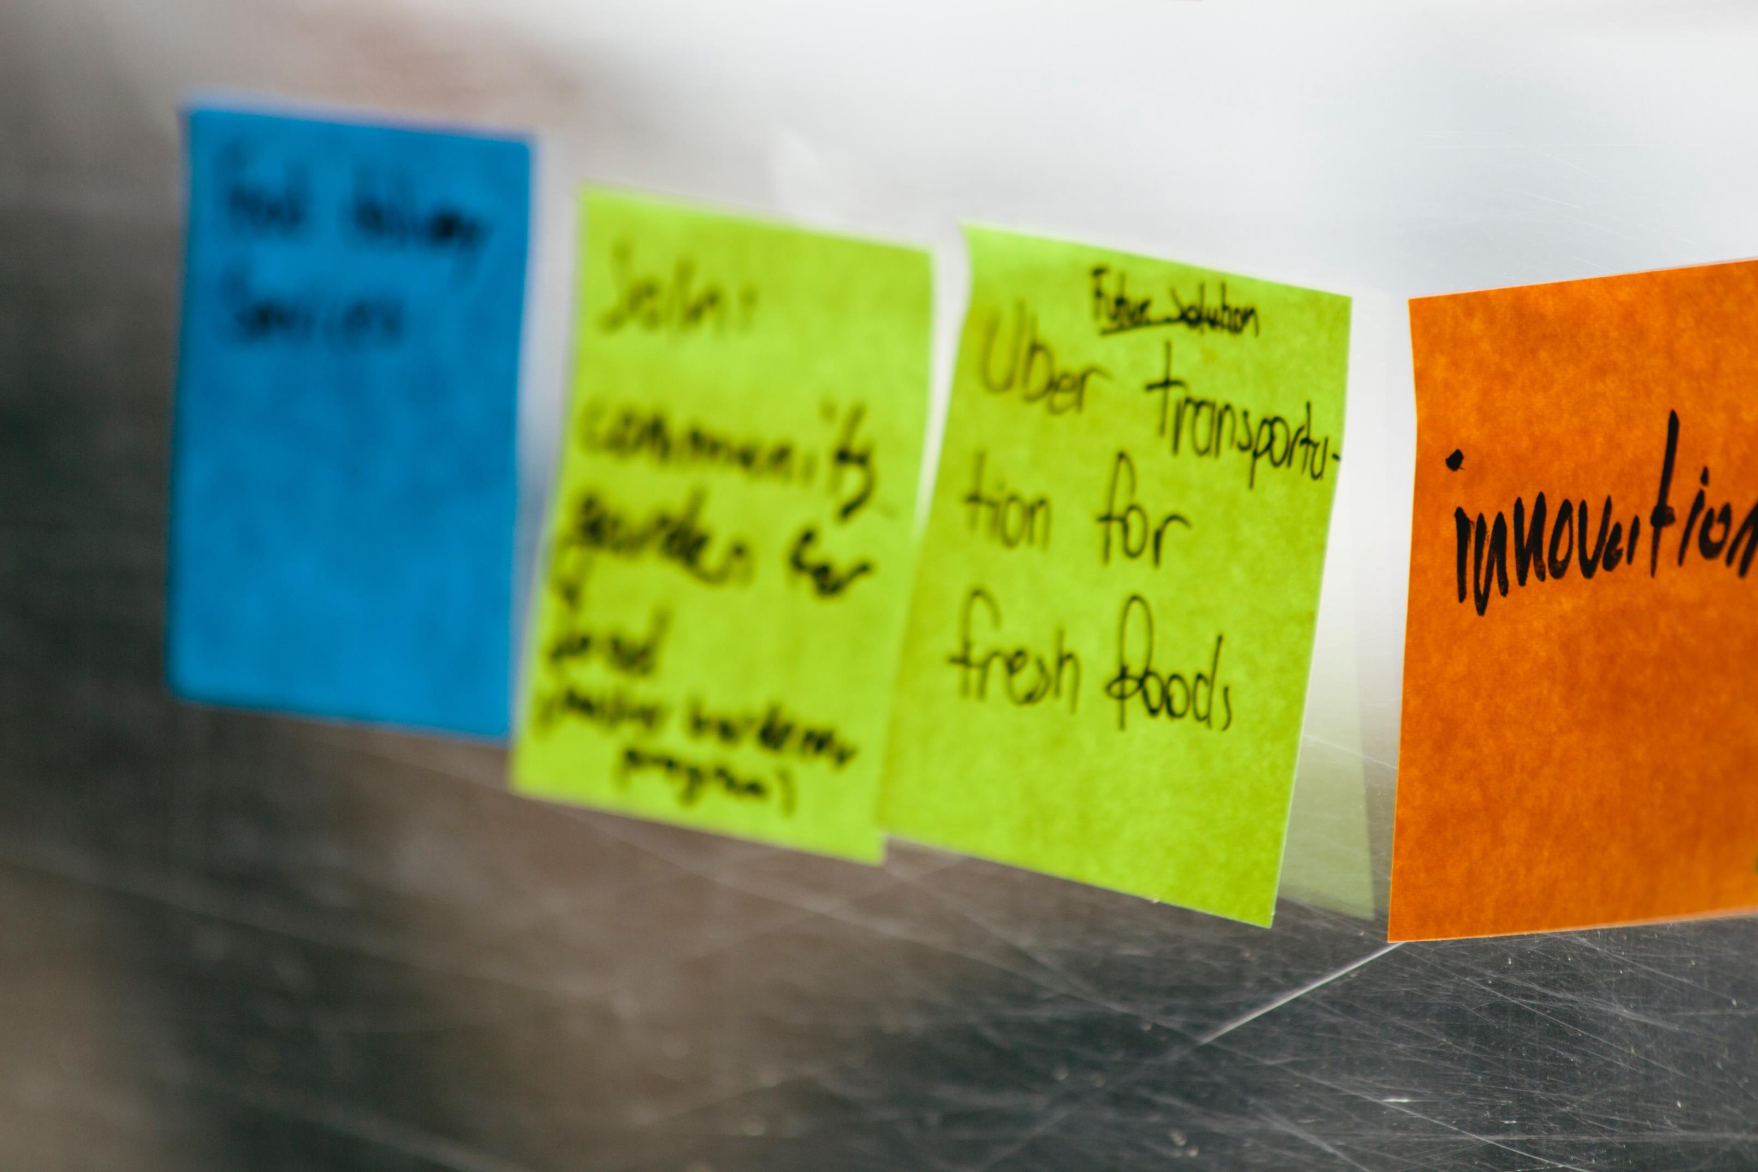
Design Thinking
A methodology for creative problem-solving
Presented by
Katie Krummeck

Slide 2

Design Thinking for Global Education:
At Home Edition
Presented by
Katie Krummeck & Gray Garmon

Slide 3

Today
1 Welcome
2 Introduction to Human-Centered Design
3 Introduction to Collaboration Tools
4 Debrief

Slide 4
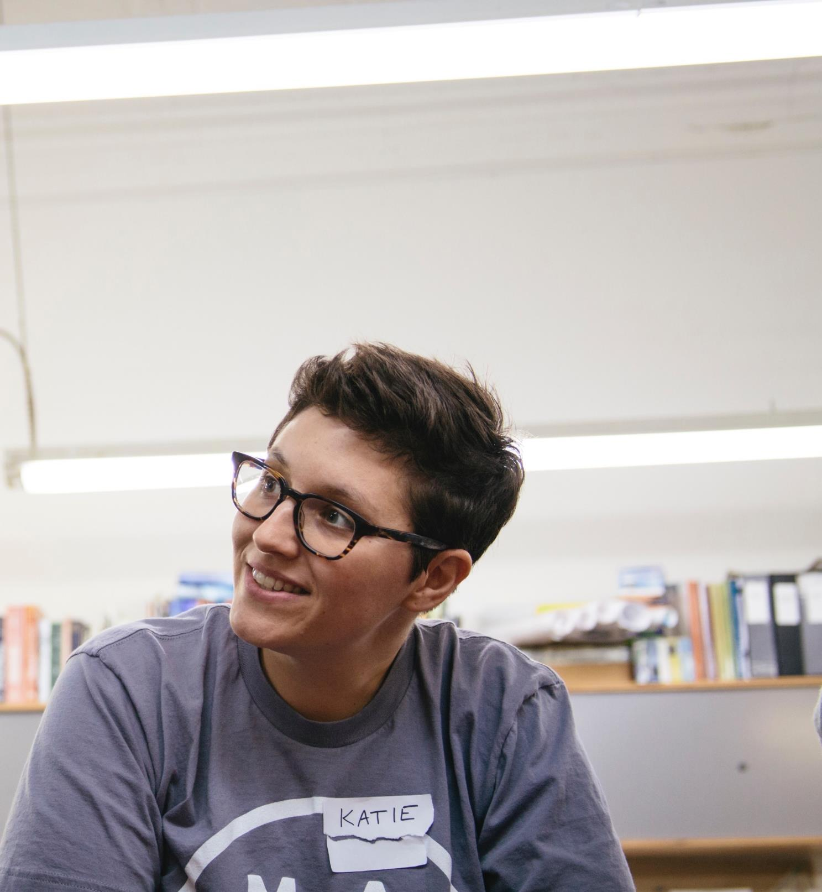
Hi,
I’m Katie.

Slide 5
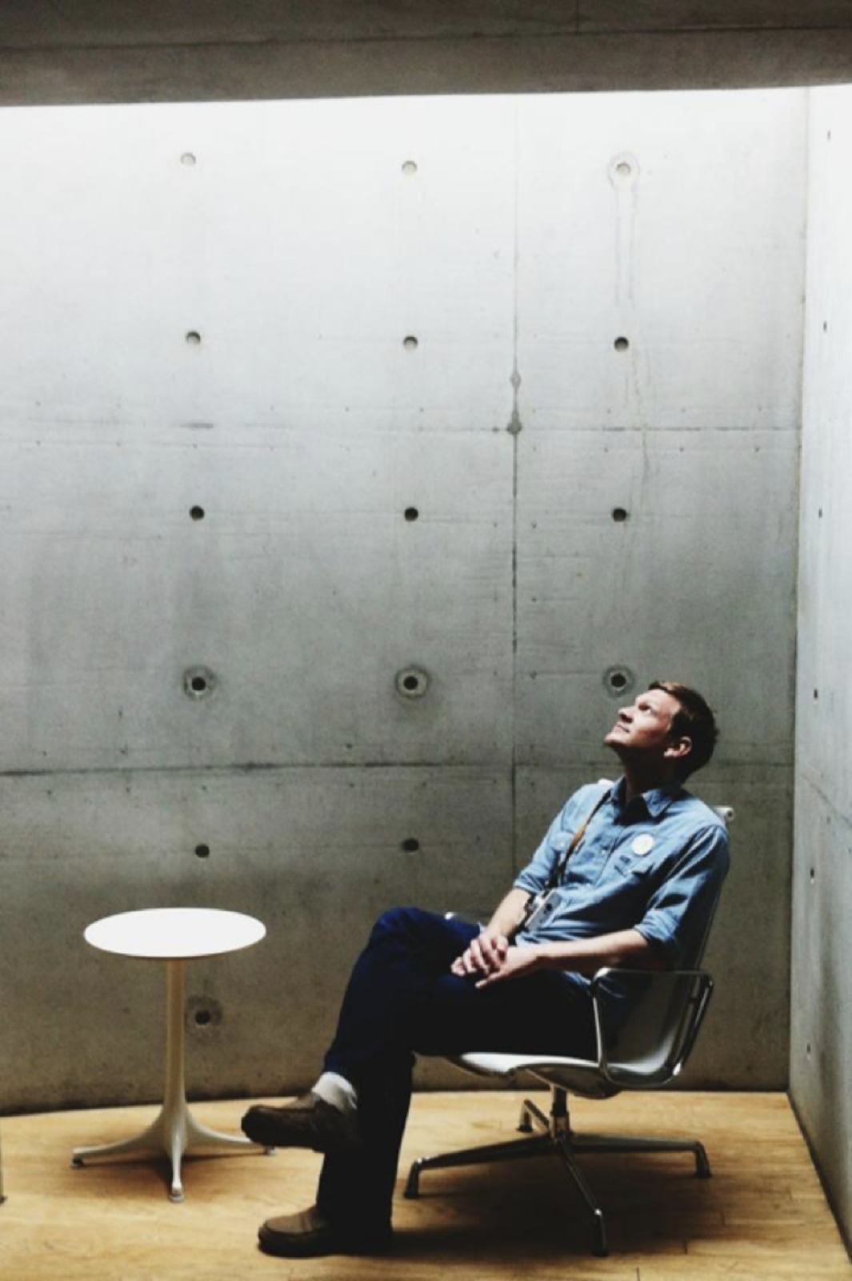
Hi,
I’m Gray.

Slide 6
hello,
my name is…

Slide 7

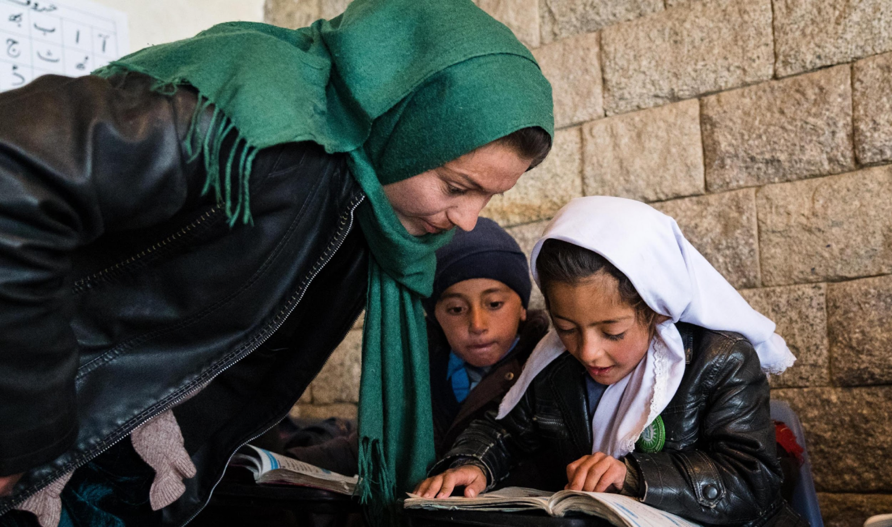

Program Goals

Slide 8
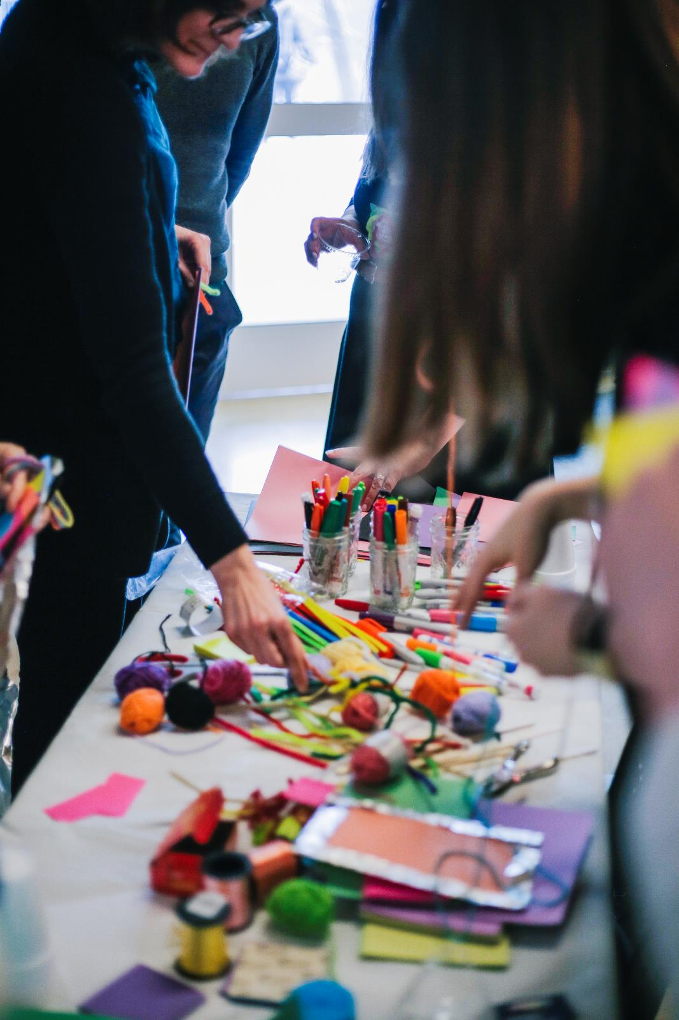
Using human-centered design, we hope to inspire and empower educators to identify problems and solve them in meaningful ways.

Slide 9
Create a design-based innovation process for schools participating in the Schools2030 initiative
Empower school leaders and educators to launch this innovation process on their campuses
Design tools to support this work and provide coaching materials to equip AKF staff to work with design teams

Slide 10
Implement a training and support system to ensure that design teams create high-quality solutions that will make positive change on their campuses by increasing the holistic learning outcomes identified by Schools2030
Support teams to ensure they create fundable and implementable solutions
Create a system and set of tools that is highly adaptable to a variety of contexts and constraints

Slide 11
Innovation Process

Slide 12
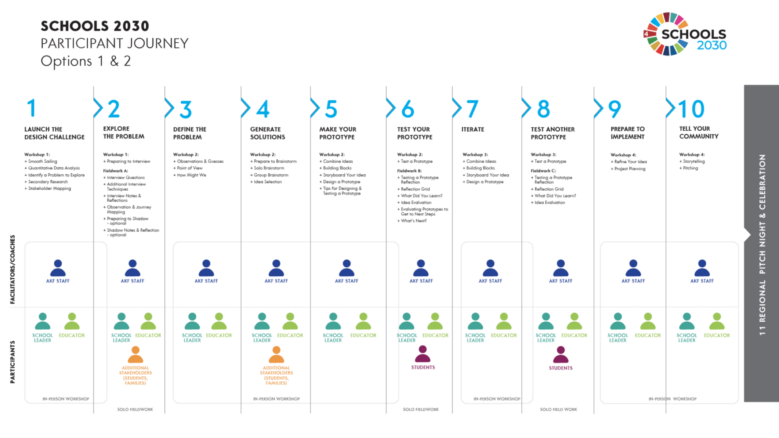

Slide 13
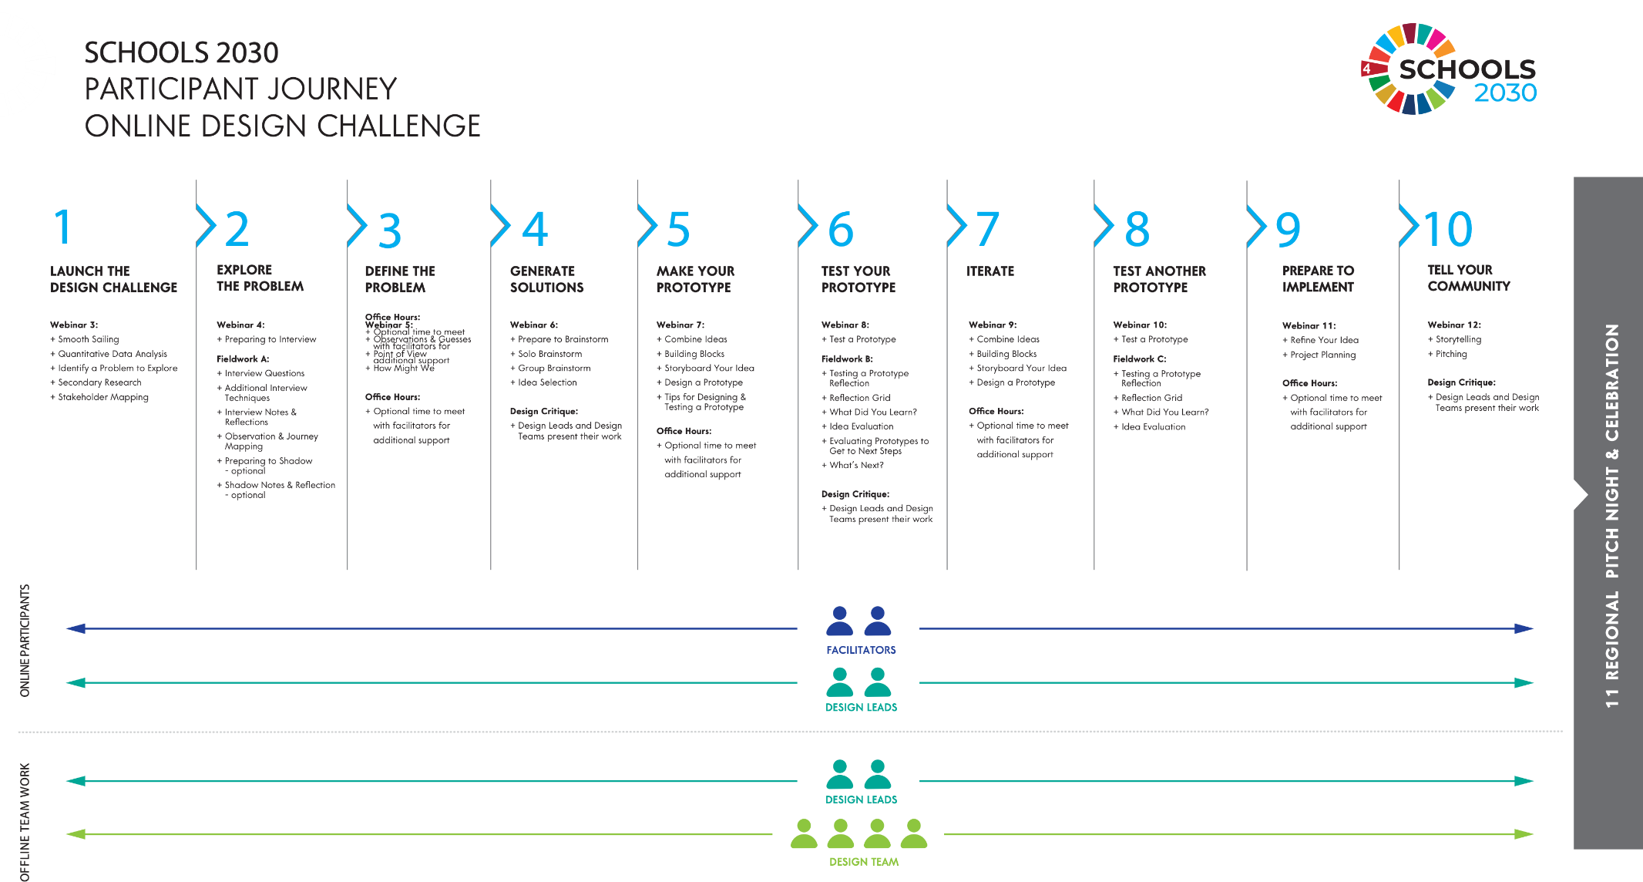

Slide 14


Slide 15
Introduction to Workshop Process

Slide 16

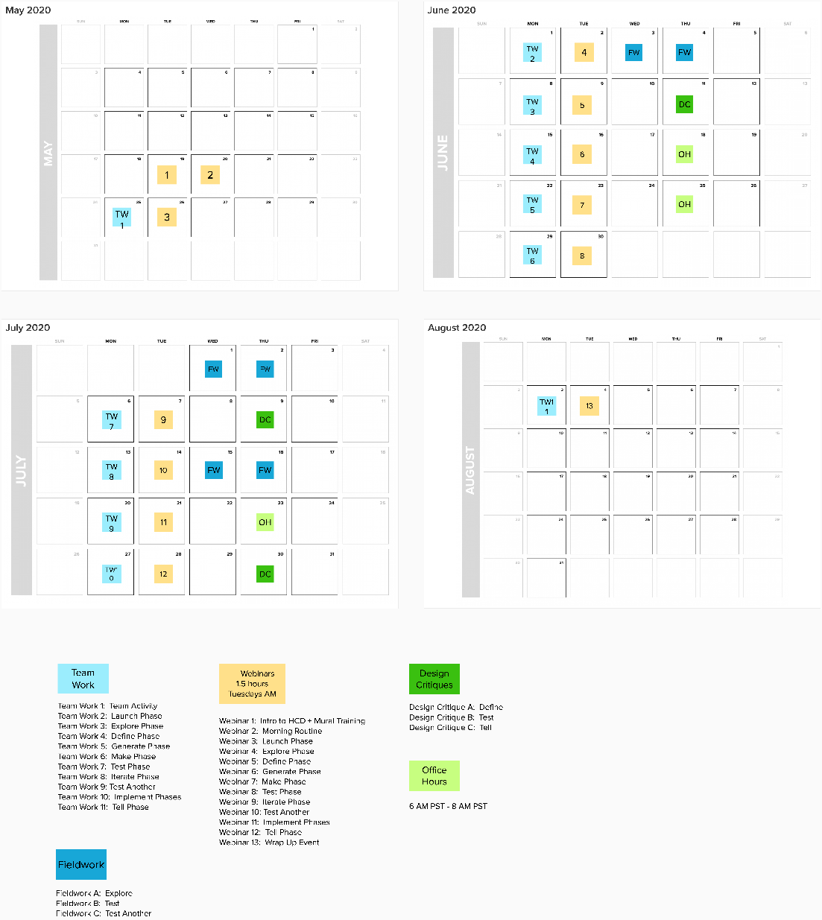
Workshop Dates

Slide 17
Workshop Dates
Webinar 7: Make Phase
  Tuesday, June 23rd 7:00 AM CET
  Alternative time: Tuesday, June 23rd 12 PM Brazil time/4 PM Portugal time
Webinar 8: Test Phase
  Tuesday, June 30th 7:00 AM CET
  Alternative time: Tuesday, June 30th 12 PM Brazil time/4 PM Portugal time
Webinar 9: Iterate Phase
  Tuesday, July 7th 7:00 AM CET
  Alternative time: Tuesday, July 7th 12 PM Brazil time/4 PM Portugal time
Webinar 10: Test Another
  Tuesday, July 14th 7:00 AM CET
  Alternative time: Tuesday, July 14th 12 PM Brazil time/4 PM Portugal time
Webinar 11: Implement Phases
  Tuesday, July 21st 7:00 AM CET
  Alternative time: Tuesday, July 21st 12 PM Brazil time/4 PM Portugal time
Webinar 12: Tell Phase
  Tuesday, July 28th 7:00 AM CET
  Alternative time: Tuesday, July 28th 12 PM Brazil time/4 PM Portugal time
Webinar 13: Wrap Up Event
  Tuesday, August 4th 3:00 PM CET
Webinar 1: Introduction to Human-Centered Design + MURAL
  Tuesday, May 19th 7:00 AM CET
  Alternative time: Tuesday, May 19th, 12 PM Brazil time/4 PM Portugal time
Webinar 2: Morning Routine and Getting to Know Your Team
  Wednesday, May 20th 7:00 AM CET
  Alternative time: Wednesday, May 20th, 12 PM Brazil time/4 PM Portugal time
Webinar 3: Launch Phase
  Tuesday, May 26th 7:00 AM CET
  Alternative time: Tuesday, May 26th, 12 PM Brazil time/4 PM Portugal time
Webinar 4: Explore Phase
  Tuesday, June 2nd 7:00 AM CET
  Alternative time: Tuesday, June 2nd 12 PM Brazil time/4 PM Portugal time
Webinar 5: Define Phase
  Tuesday, June 9th 7:00 AM CET
  Alternative time: Tuesday, June 9th 12 PM Brazil time/4 PM Portugal time
Webinar 6: Generate Phase
  Tuesday, June 16th 7:00 AM CET
  Alternative time: Tuesday, June 16th 12 PM Brazil time/4 PM Portugal time

Slide 18
Workshop Norms
Stay open-minded and take a posture of learning — especially when it comes to technology!
Step up and step back in order to be a great teammate
Participate fully in every activity. We believe you learn best by doing!
Please keep your focus on our time together — try not to multitask!
Aim for understanding. This is a safe place to ask questions

Slide 19

Just so you know…
We will share with you…
  Slide decks and resources
  Digital copies of the Educator Toolkit and Facilitators Guides
  All digital tools and frameworks

Slide 20
Social Media
@agakhanfoundation
@akdn
@akf_global
#Schools2030

Slide 21
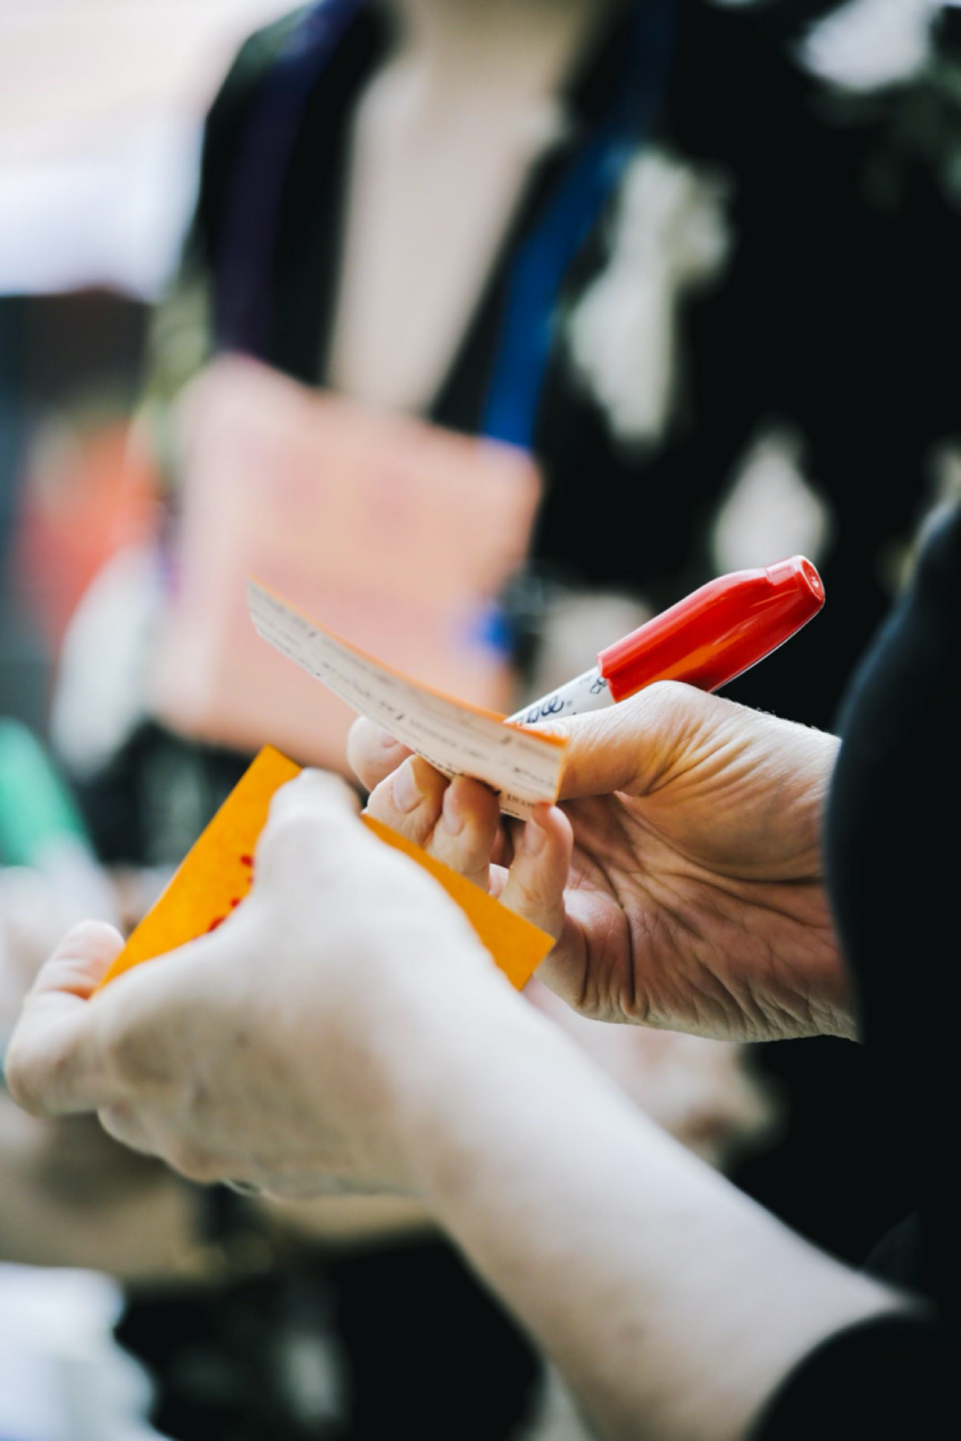
Are we missing anything you need to make this a successful learning environment?

Slide 22

Introduction to Human-Centered Design

Slide 23
"Coming out of the worst economic downturn in our professional lifetimes -- and facing a new normal that is distinctly different -- …CEOs identify creativity as the number one leadership competency of the successful enterprise of the future.”
Frank Kern, IBM
2010 Global CEO Survey

Slide 24
creativity
innovation
out-of-the-box ideas
flexible thinking
reimagination
reinvention
disruption
…

Slide 25
Everybody’s talking about innovation.
But how do we get there?

Slide 26
and…

Slide 27
K12 education needs to shift to meet the needs of the 21st century.
But how are we supposed to know how to do that?

Slide 28
Design.

Slide 29
Design is ___________________________.

Slide 30
Design is
a process for making things right.
Ralph Caplan

Slide 31
Design is
a positive response to dissatisfaction.
Michael DiTullo

Slide 32
Design is
a series of decisions which leads to an (improved) experience.

Slide 33
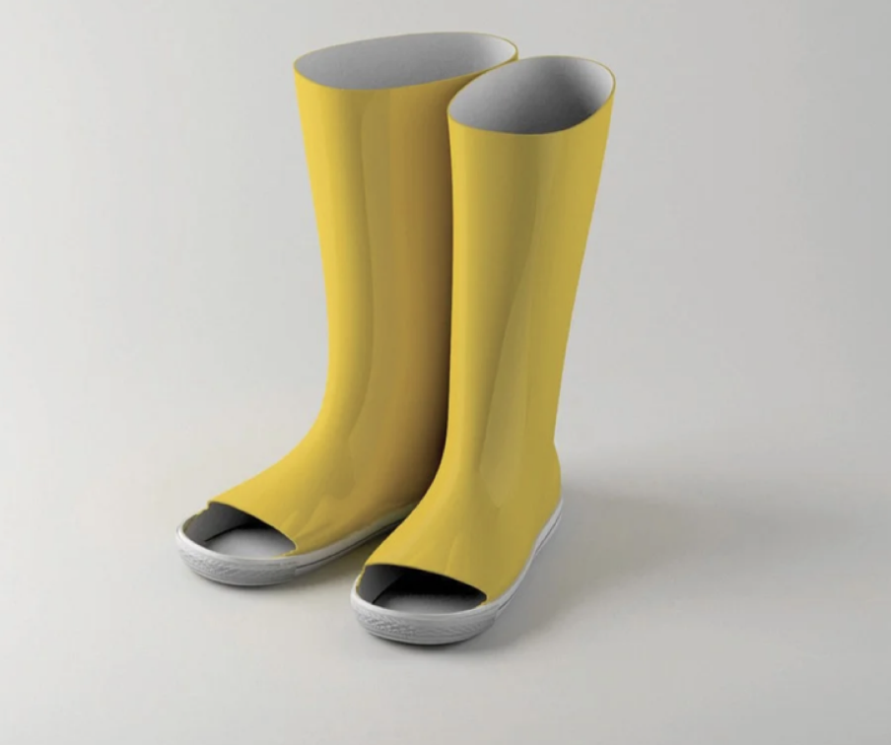
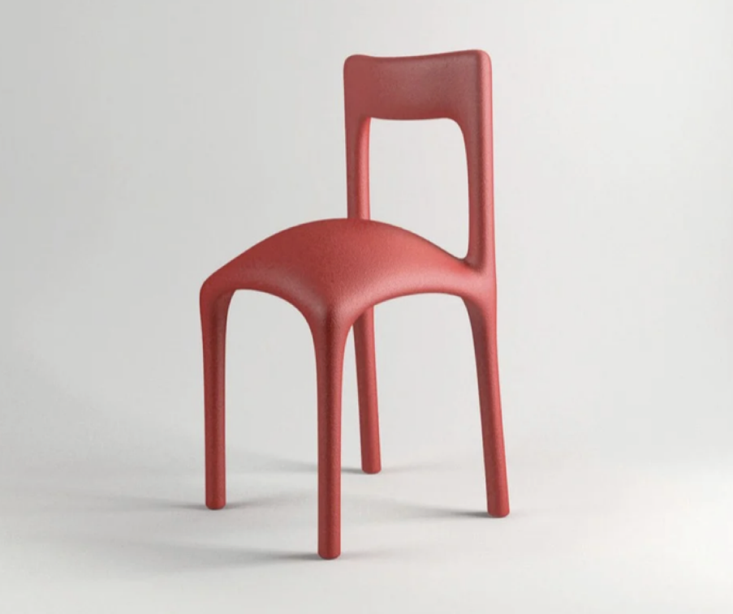
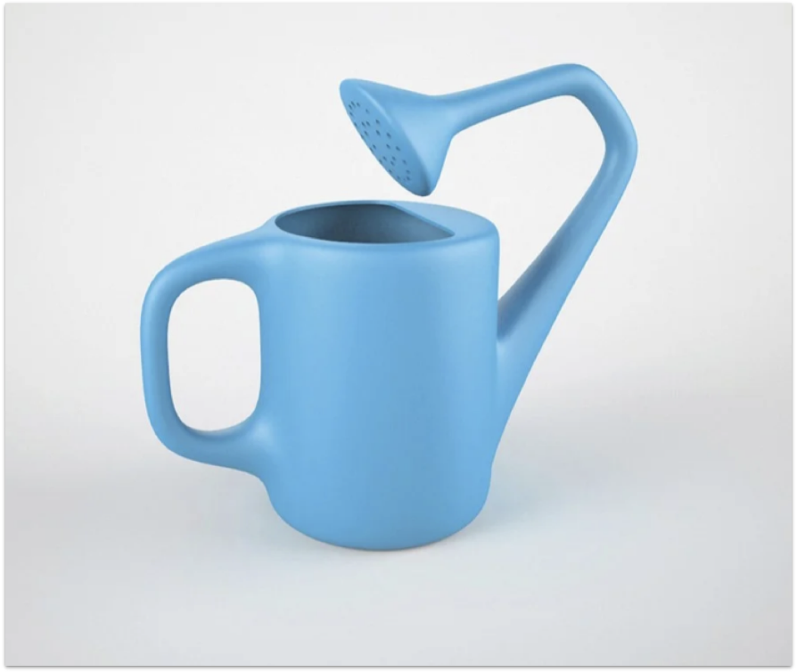
“15 Hilariously Bad Designs for Everyday Objects”
by Kyle Vanhemert
Wired.com
Notes:
This is a joke. Why is it a joke?
Ask audience.
Are these objects functional?
This is a result of bad decisions... Does it fulfill the need?
How can we can create good design that leads to positive experiences?

Slide 34
Design is
a process for making things right.
Ralph Caplan

Slide 35
Human-Centered Design
Design Thinking
Design

Slide 36
Design Thinking is a problem-solving methodology for creating thoughtful experiences for people.

Slide 37
If we believe that anyone who creates experiences for other people is a designer...

Slide 38
Then educators are designers already.

Slide 39
Educators can practice the methods of professional designers to amplify their human-centered work.

Slide 40
Design Thinking leverages the methods and tools of design to help non-designers creatively solve messy, human-centered problems.

Slide 41
We have seen first-hand the power of these tools to accelerate positive change in school contexts.

Slide 42
Educators we have worked with have redesigned:
Curricula
Lunch & Recess
The Schedule
The Calendar
Relationship-Building
Professional Development
Substitute Teaching

Slide 43
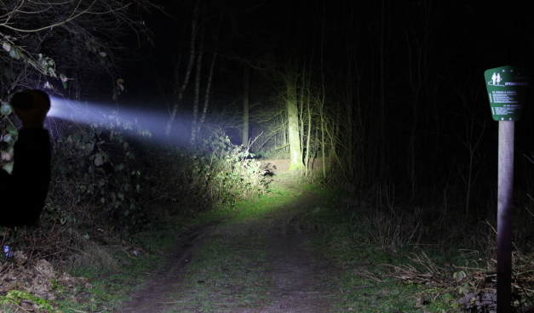

Slide 44









Large corporations and organizations are using design thinking to drive innovation.

Slide 45
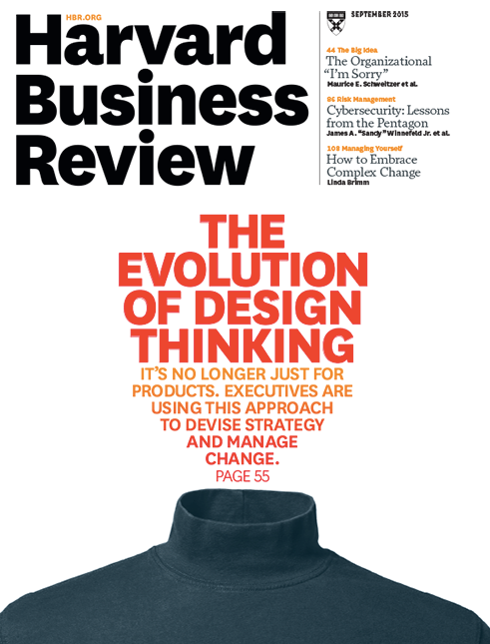

Slide 46

Innovation is not an event.

Slide 47

Innovation is a [design] process.

Slide 48
But it’s hard.
Innovation is not an easy feat.

Slide 50
Schools, in particular, are resistant and resilient to change.
Why?

Slide 52


Slide 53
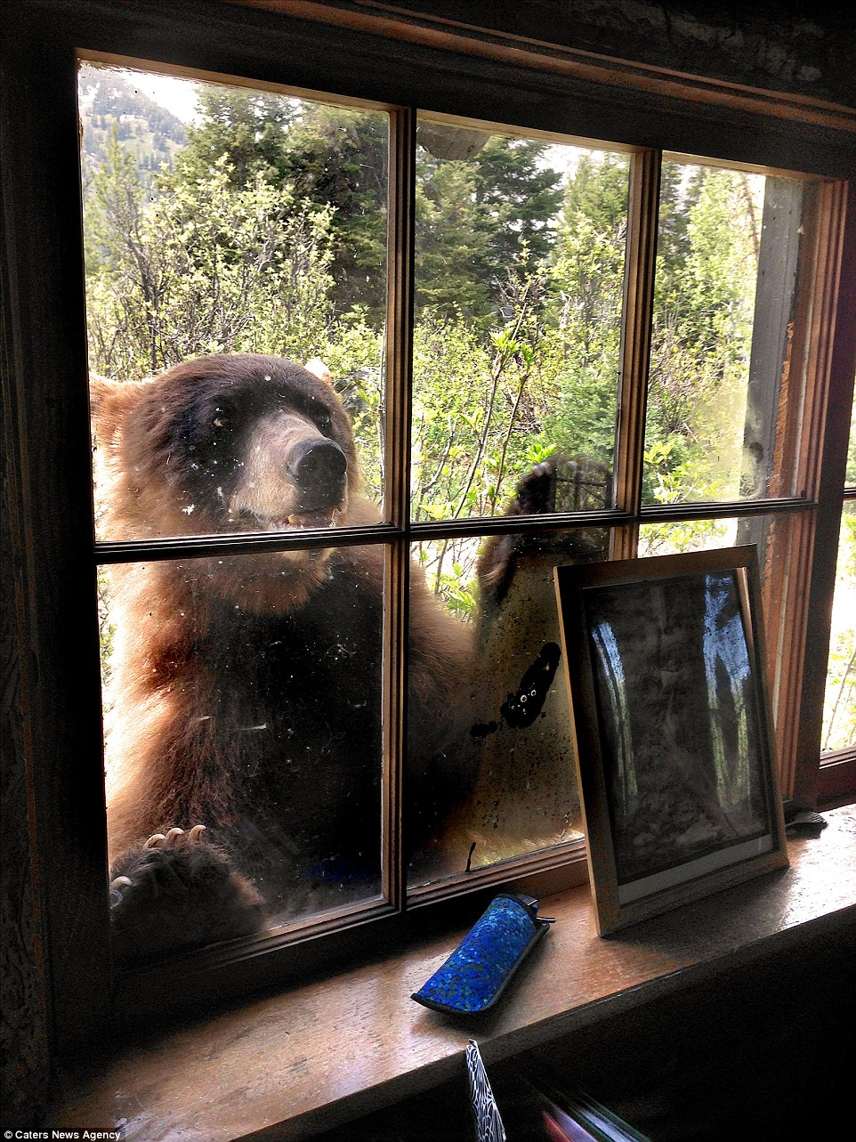

Slide 54
What are [some of] the barriers to innovation?

Slide 55
Path dependence
“This is how it has always been done.”

Slide 56
Our baggage
“This is how it was for me.”

Slide 57
Risk aversion
“You are not experimenting on my kid.”

Slide 58
Systemic challenges
“You must comply.”

Slide 59
“Every system is perfectly designed to get the results it gets.”
W. Edwards Deming

Slide 60
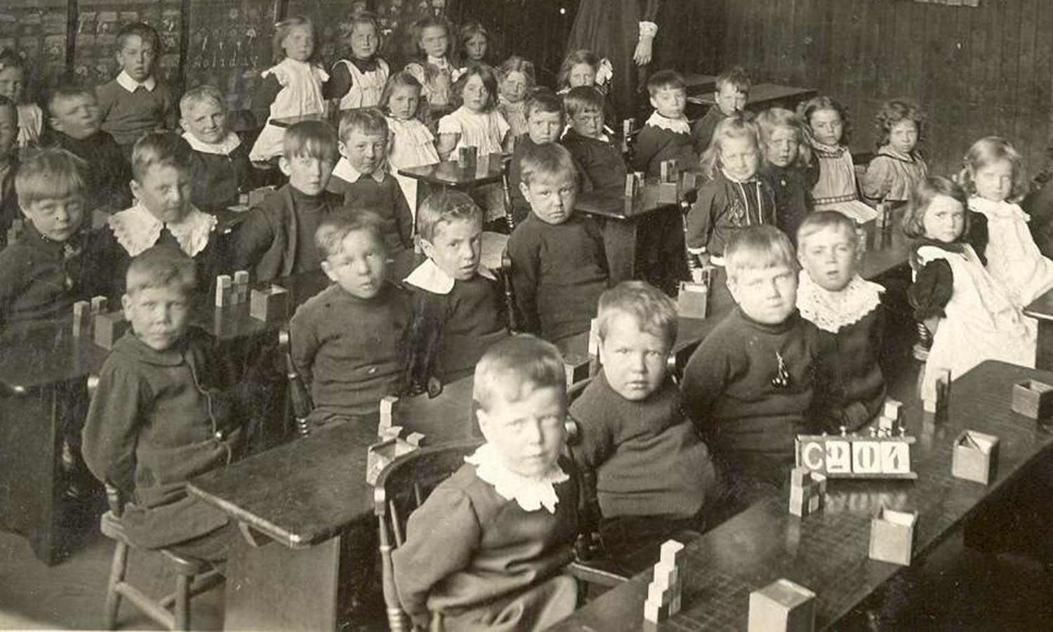

Slide 61
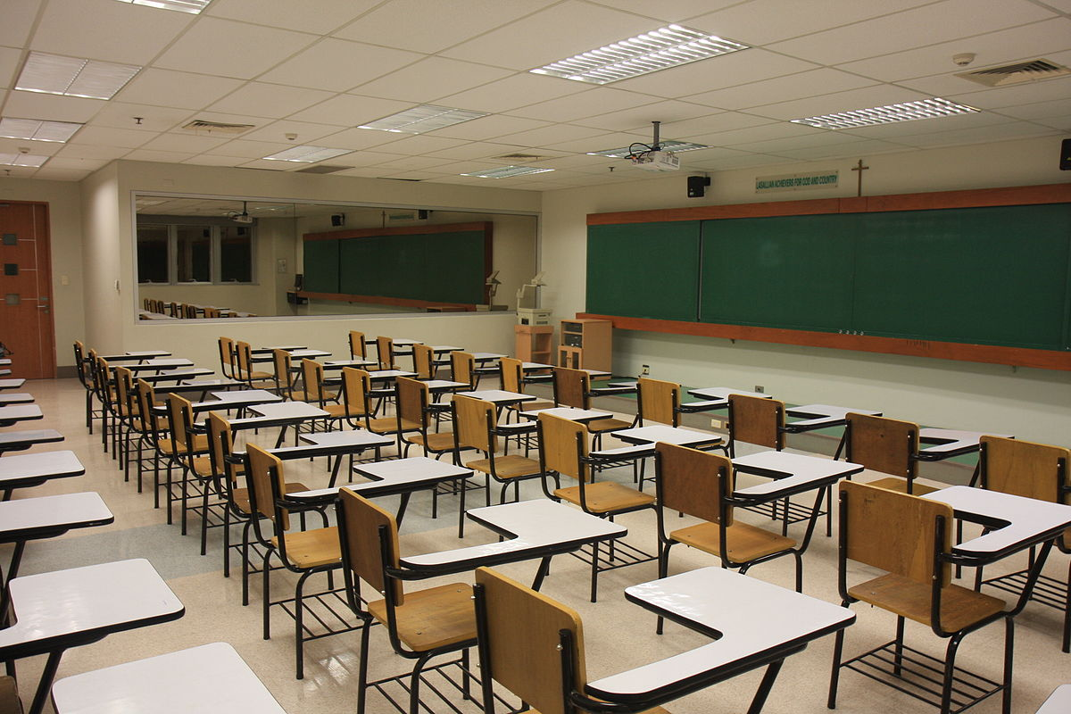

Slide 62
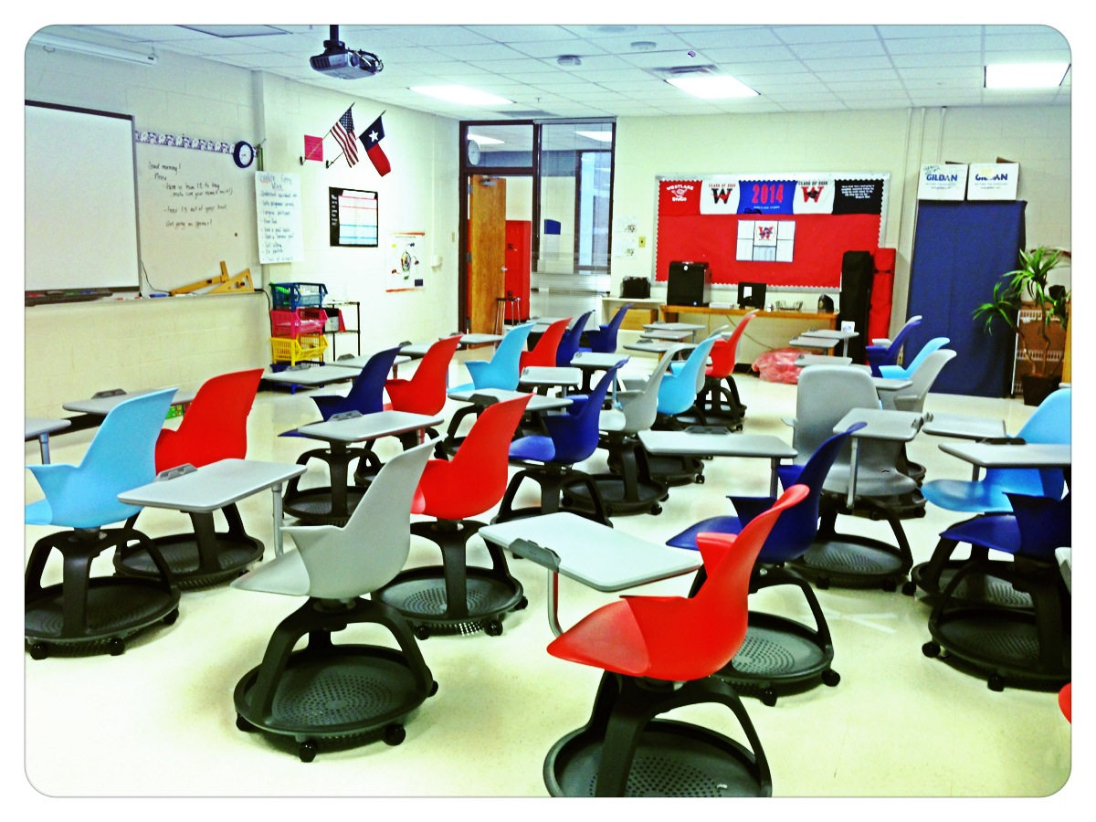

Slide 63

I
How do we let go of our assumptions, feel comfortable taking risks and get energized to tackle systemic challenges?

Slide 64
I
Design.

Slide 65
“It doesn’t occur to most people that everything is design — that every building and everything they touch in the world is designed.”
Bill Moggridge
Designer of the first laptop

Slide 66
Products
Spaces/Buildings
Events
Processes
Tools
Curricula
Systems
Software
…

Slide 67
and in schools…
Lessons
Classrooms
Bulletin Boards
Policies
Rules
Lunch
Budgets
…

Slide 68
“The alternative to good design is always bad design. There is no such thing as no design.”
Adam Judge

Slide 69
We do not design nouns.
We design verbs.

Slide 70
in health care…

Slide 71
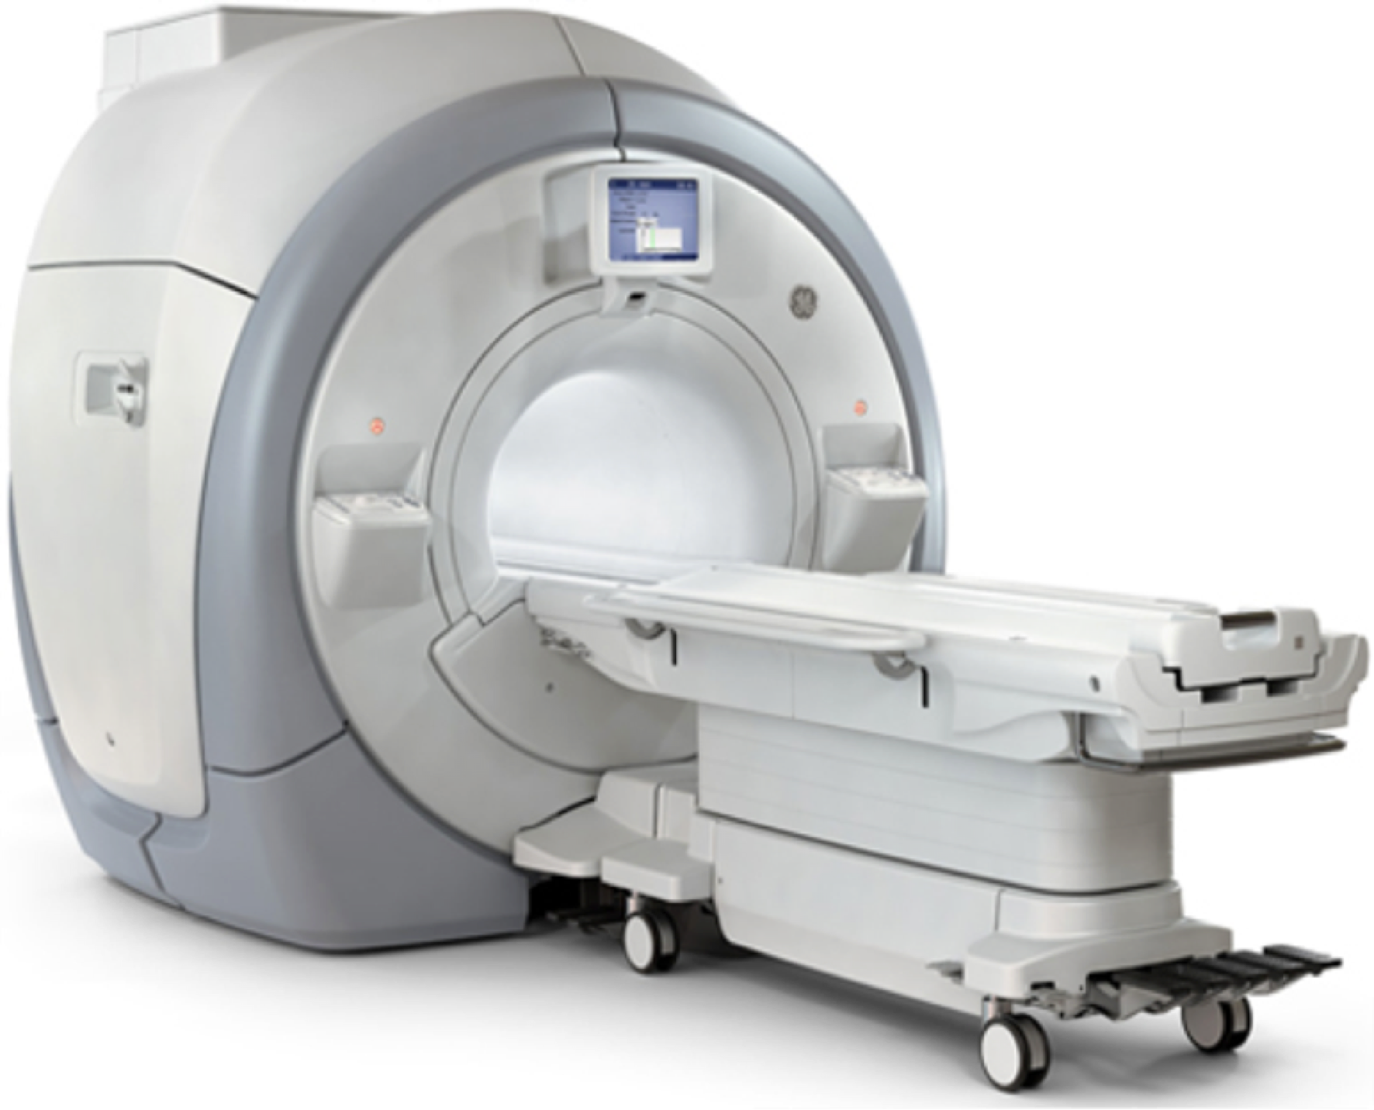

Slide 72

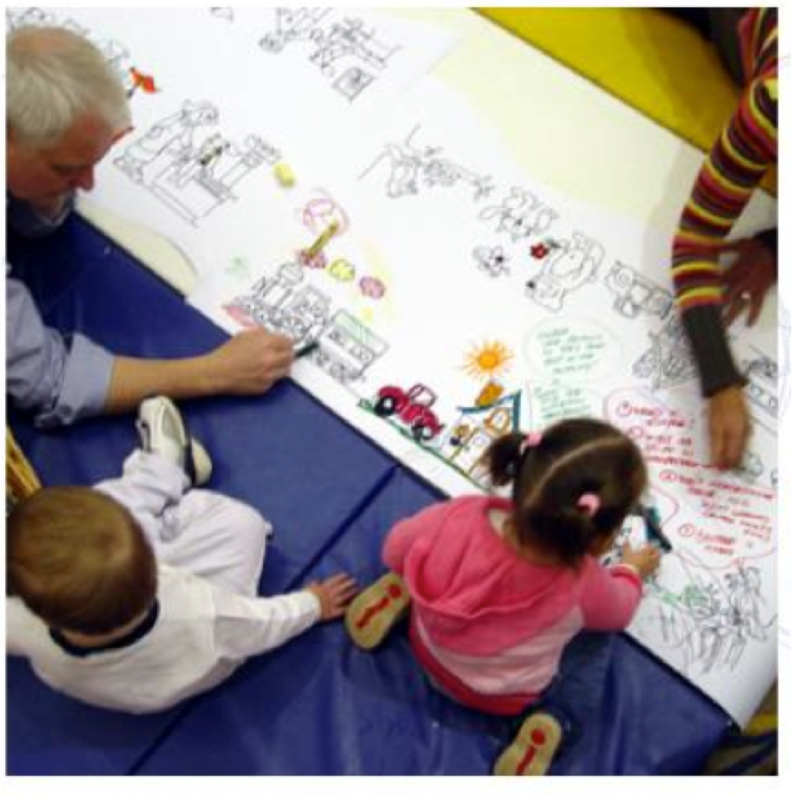

Slide 73
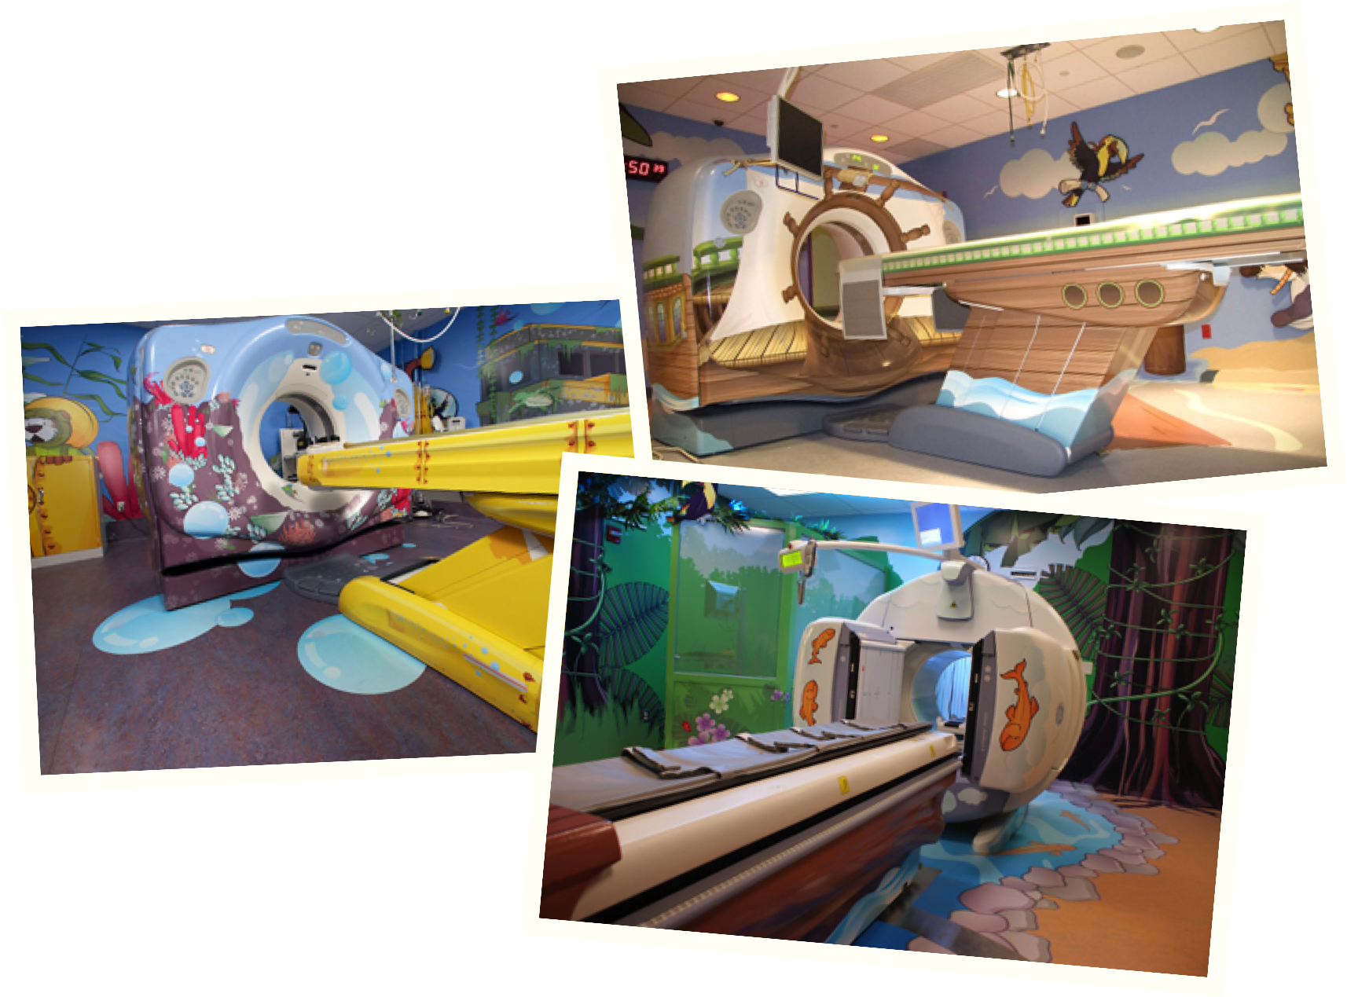

Slide 74
technical
feasibility
business
viability
human
desirability
Human-Centered Design starts here (but requires all three elements to be a successful).

Slide 75
in government…

Slide 76
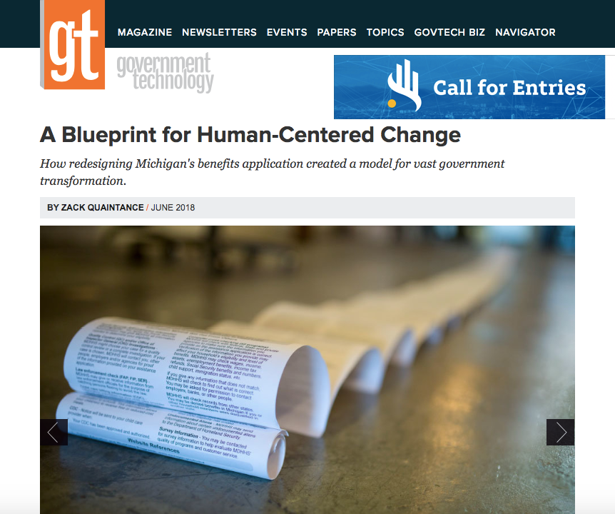

Slide 77
in schools…

Slide 78
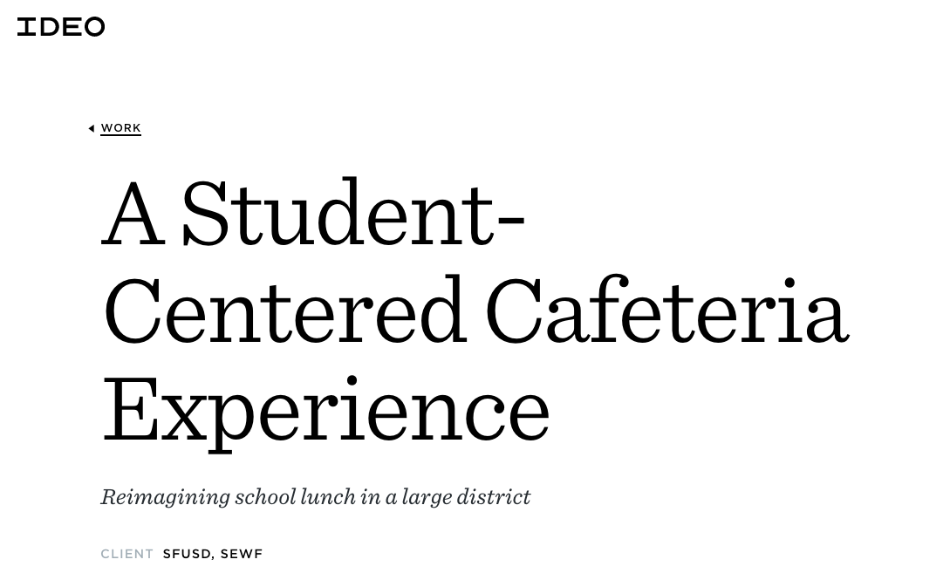

Slide 79
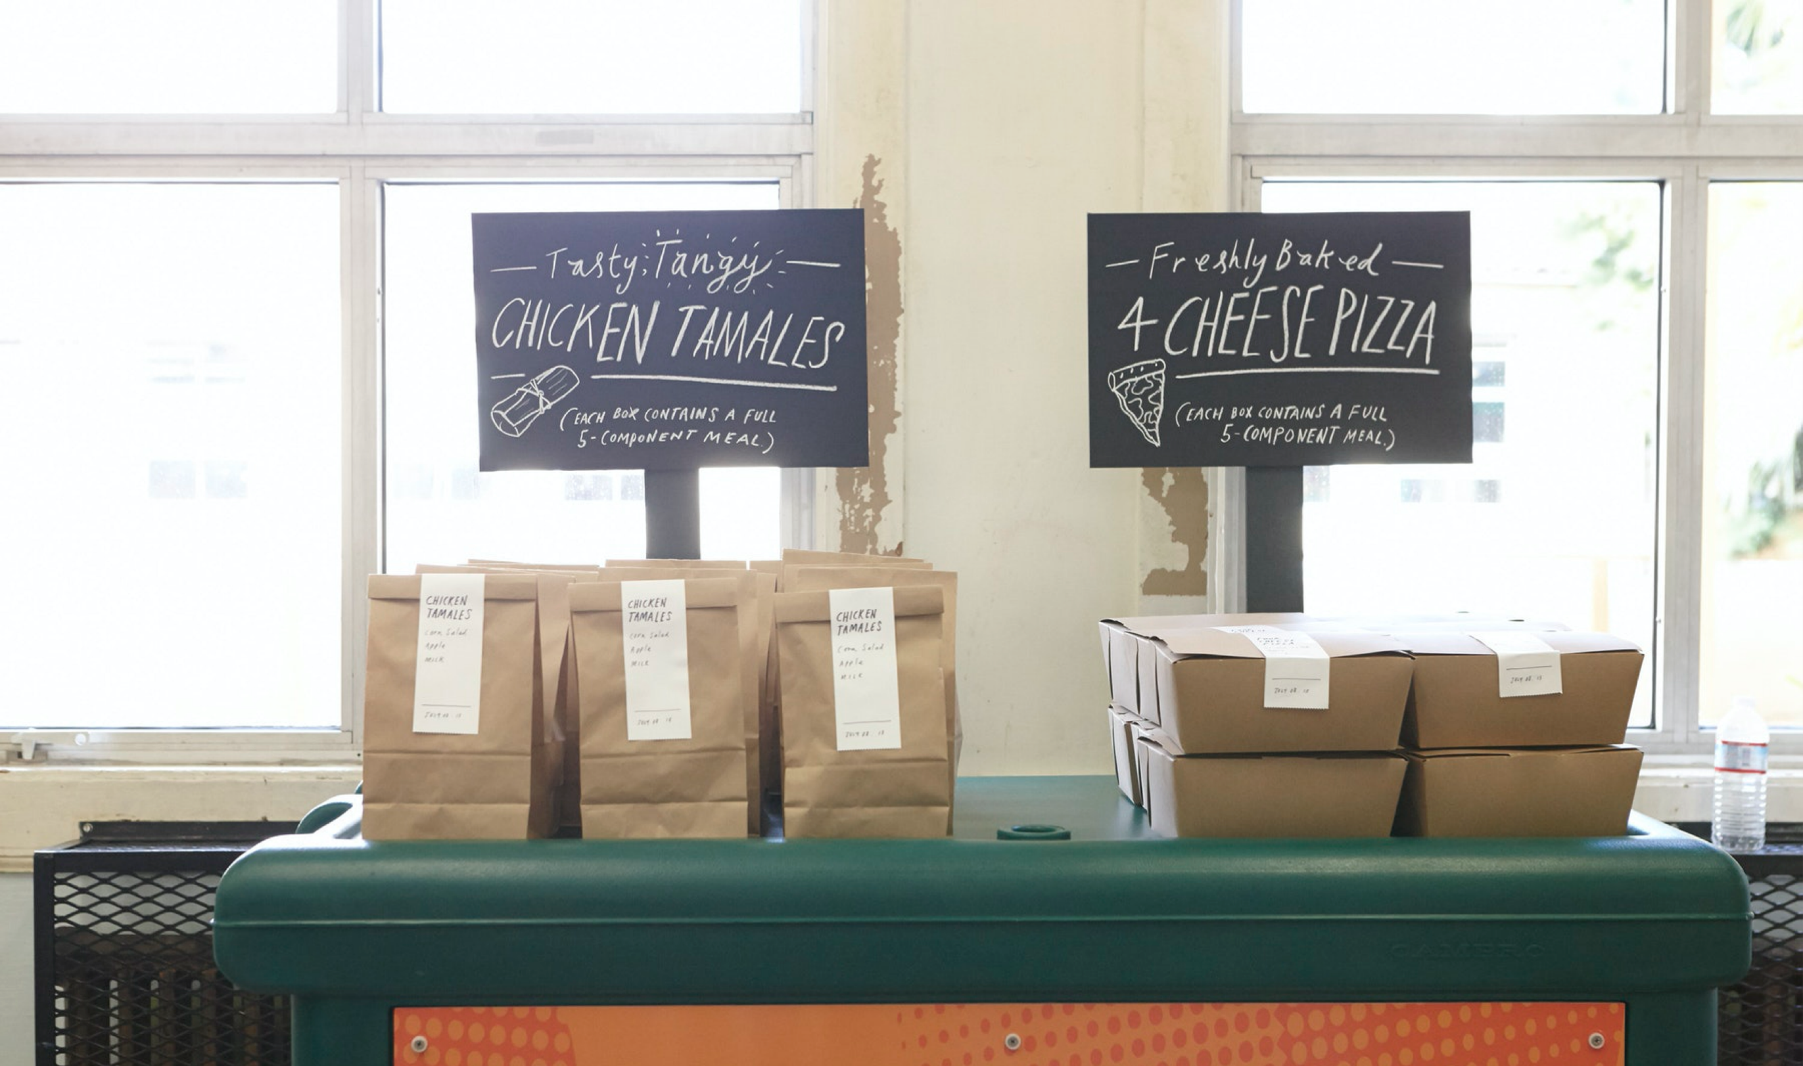

Slide 80
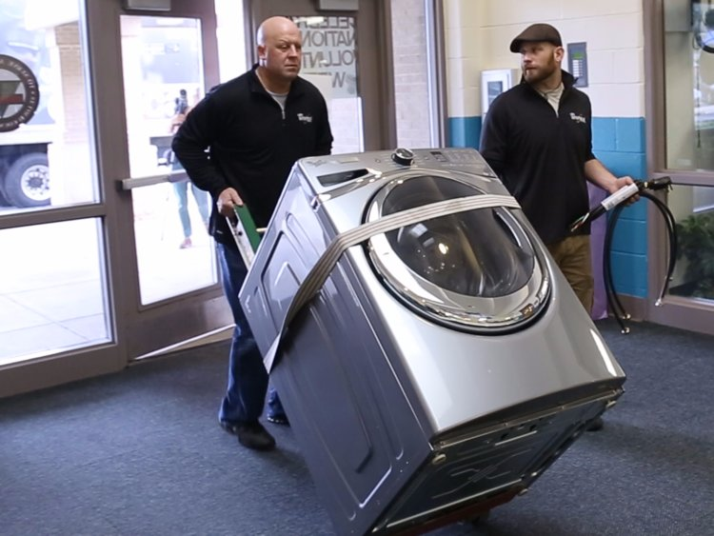

Slide 81
Empathize
Ideate
Define
Prototype
Test

Slide 82
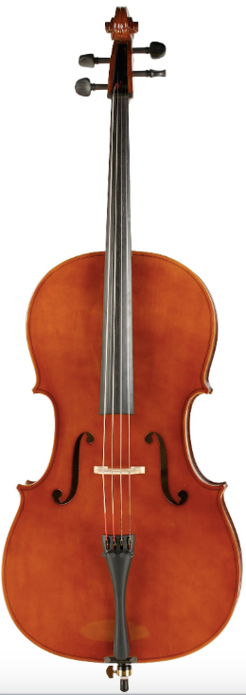
Learning the design process is a process.

Slide 83

Break

Slide 84
Design Challenge
(rapid fire)

Slide 85
Introduction to Collaboration Tools

Slide 86

Teams will be sent to a breakout room to work with each other.
If your team has a question, one person can leave the breakout room to get guidance and then return to the group.
You will move between breakout rooms and the whole group.
You will get time warnings in the breakout rooms.

Slide 87

MURAL Basics
  We will be using MURAL in our work together.
  We will get oriented to how to use MURAL together.
      Navigation
      Writing on post-its
      Adding post-its
  We will share a link to the MURAL board we are using in the Zoom chat box. Right click on the URL in the chat box to open the link.

Slide 88
Have a blank sheet of paper and a Sharpie marker on hand
      Printer paper and/or colored paper
      Markers
      String and/or rubber bands
      Tape
      Scissors
      Tin foil
      Pipe cleaners
      Paper clips and/or binder clips
      Anything made of cardboard (boxes, toilet paper rolls, etc.)
· There is no set amount -- just gather whatever you have around the house.

Slide 89


Slide 90


Slide 91

Redesign your partner’s morning routine

Slide 92
Redesign your partner’s morning routine
… in the time of COVID-19

Slide 93
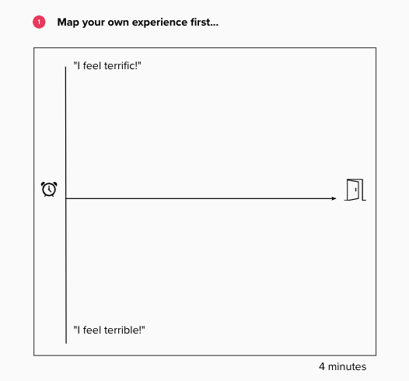

Slide 94
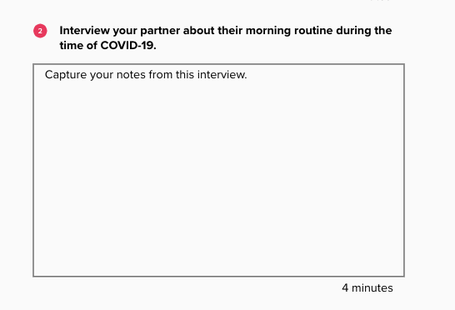

Slide 95
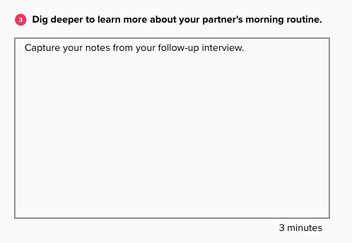

Slide 96
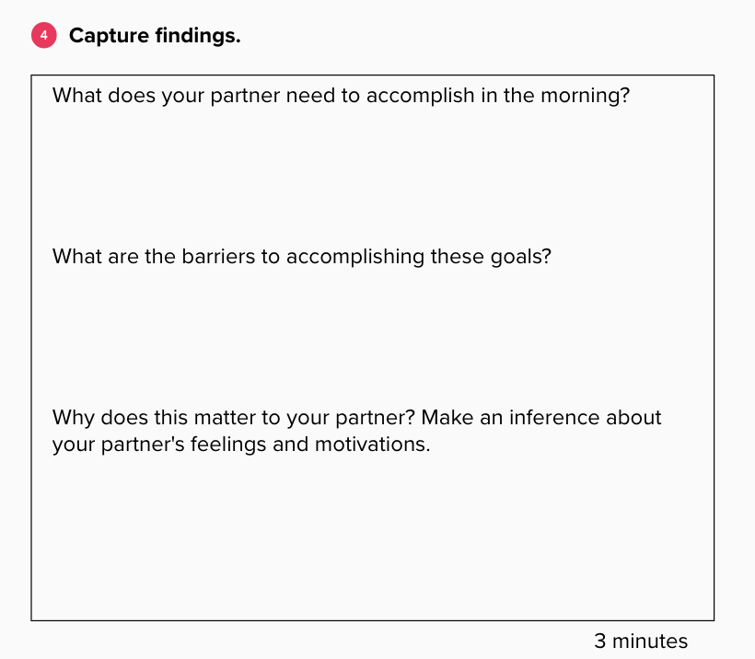

Slide 97
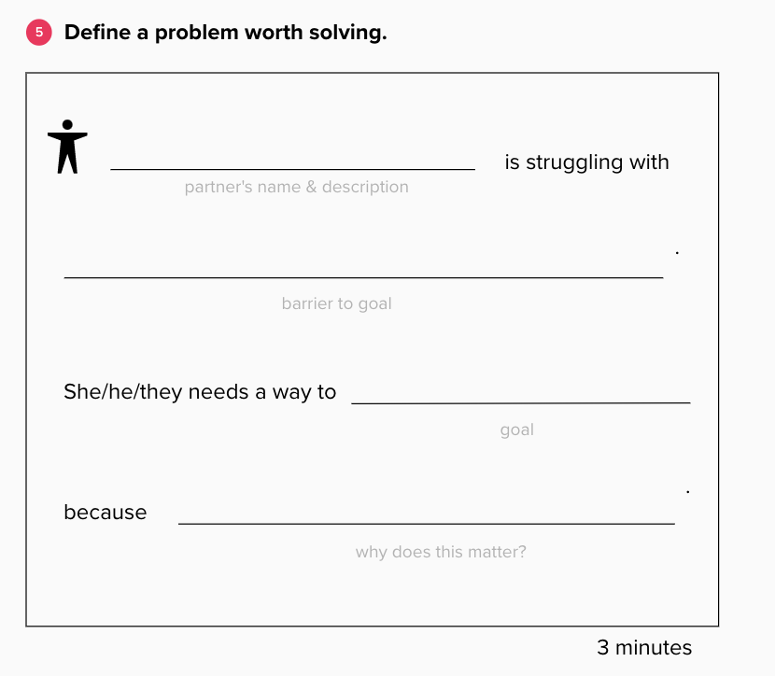

Slide 98
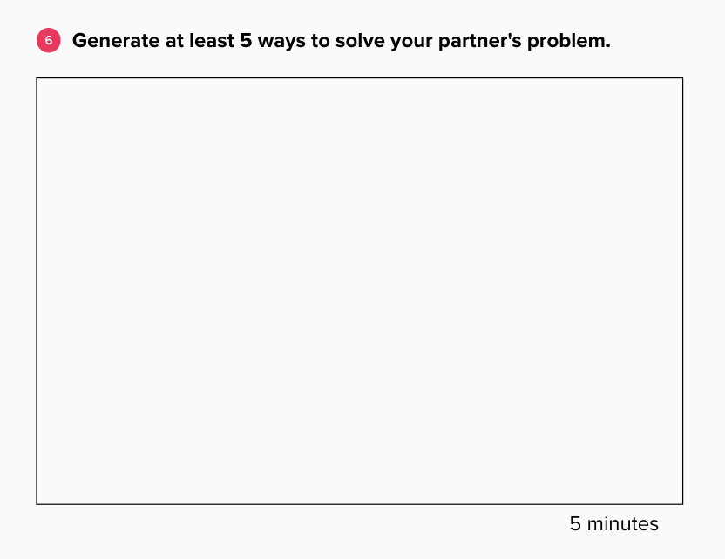

Slide 99
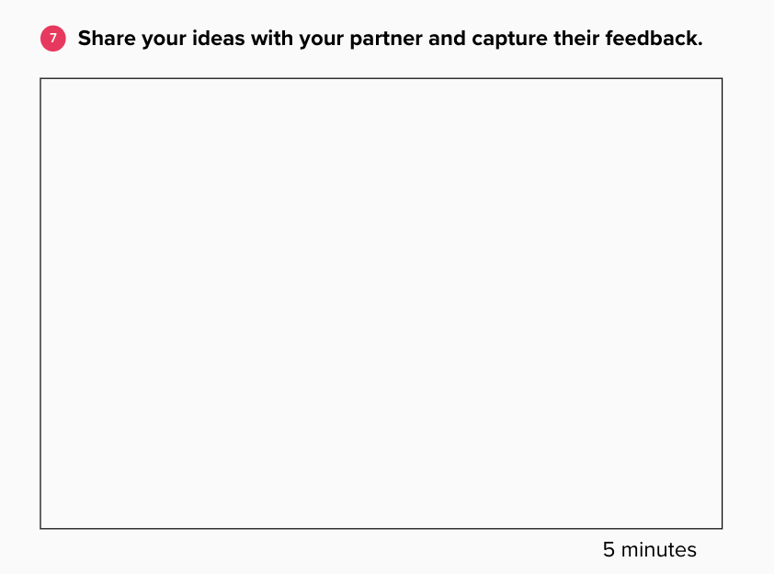

Slide 100
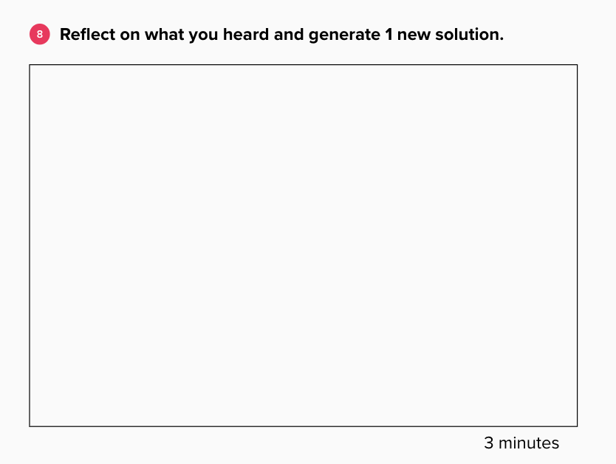

Slide 101
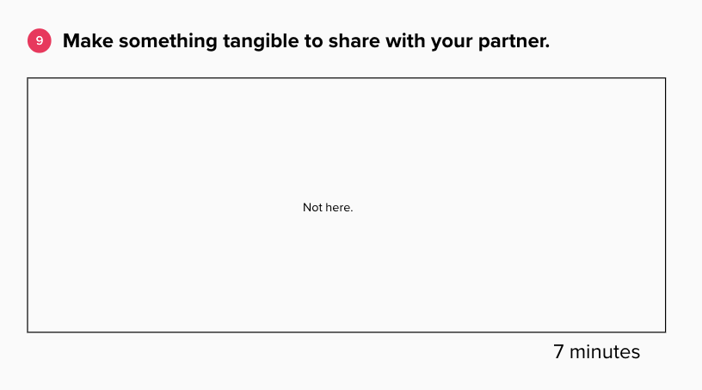

Slide 102
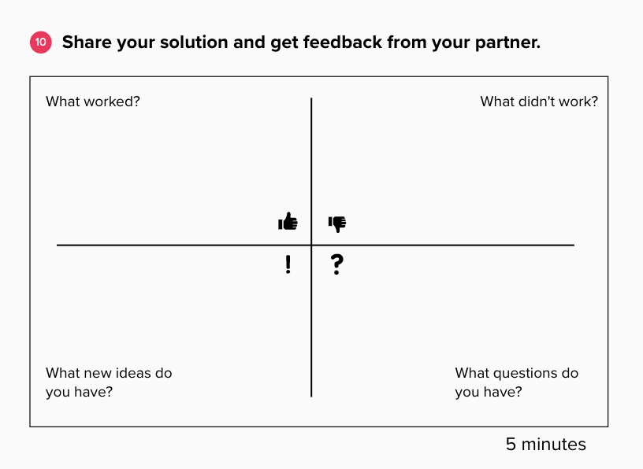

Slide 103
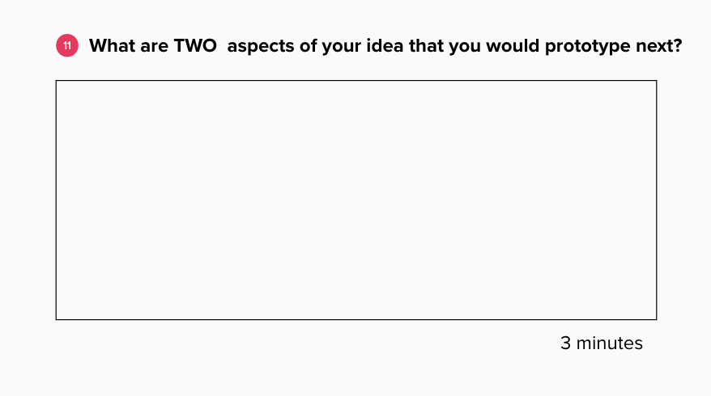

Slide 104
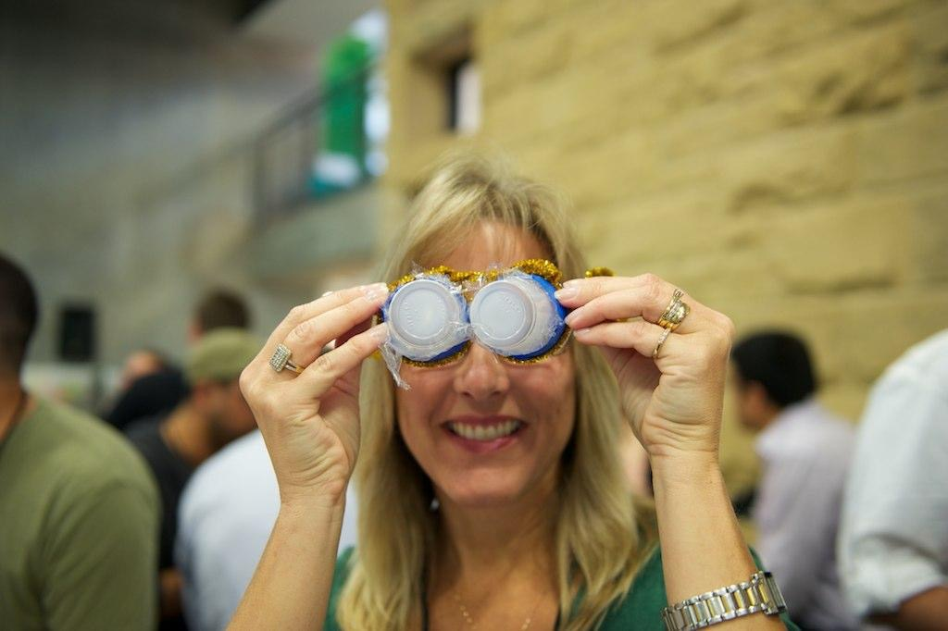
Debrief

Slide 105

Reflect

Slide 106
For next time…

Slide 107
Have a blank sheet of paper and a Sharpie marker on hand
      Printer paper and/or colored paper
      Markers
      String and/or rubber bands
      Tape
      Scissors
      Tin foil
      Pipe cleaners
      Paper clips and/or binder clips
      Anything made of cardboard (boxes, toilet paper rolls, etc.)
· There is no set amount -- just gather whatever you have around the house.

Slide 108
Coming soon…
Slide deck
MURAL links

Slide 109
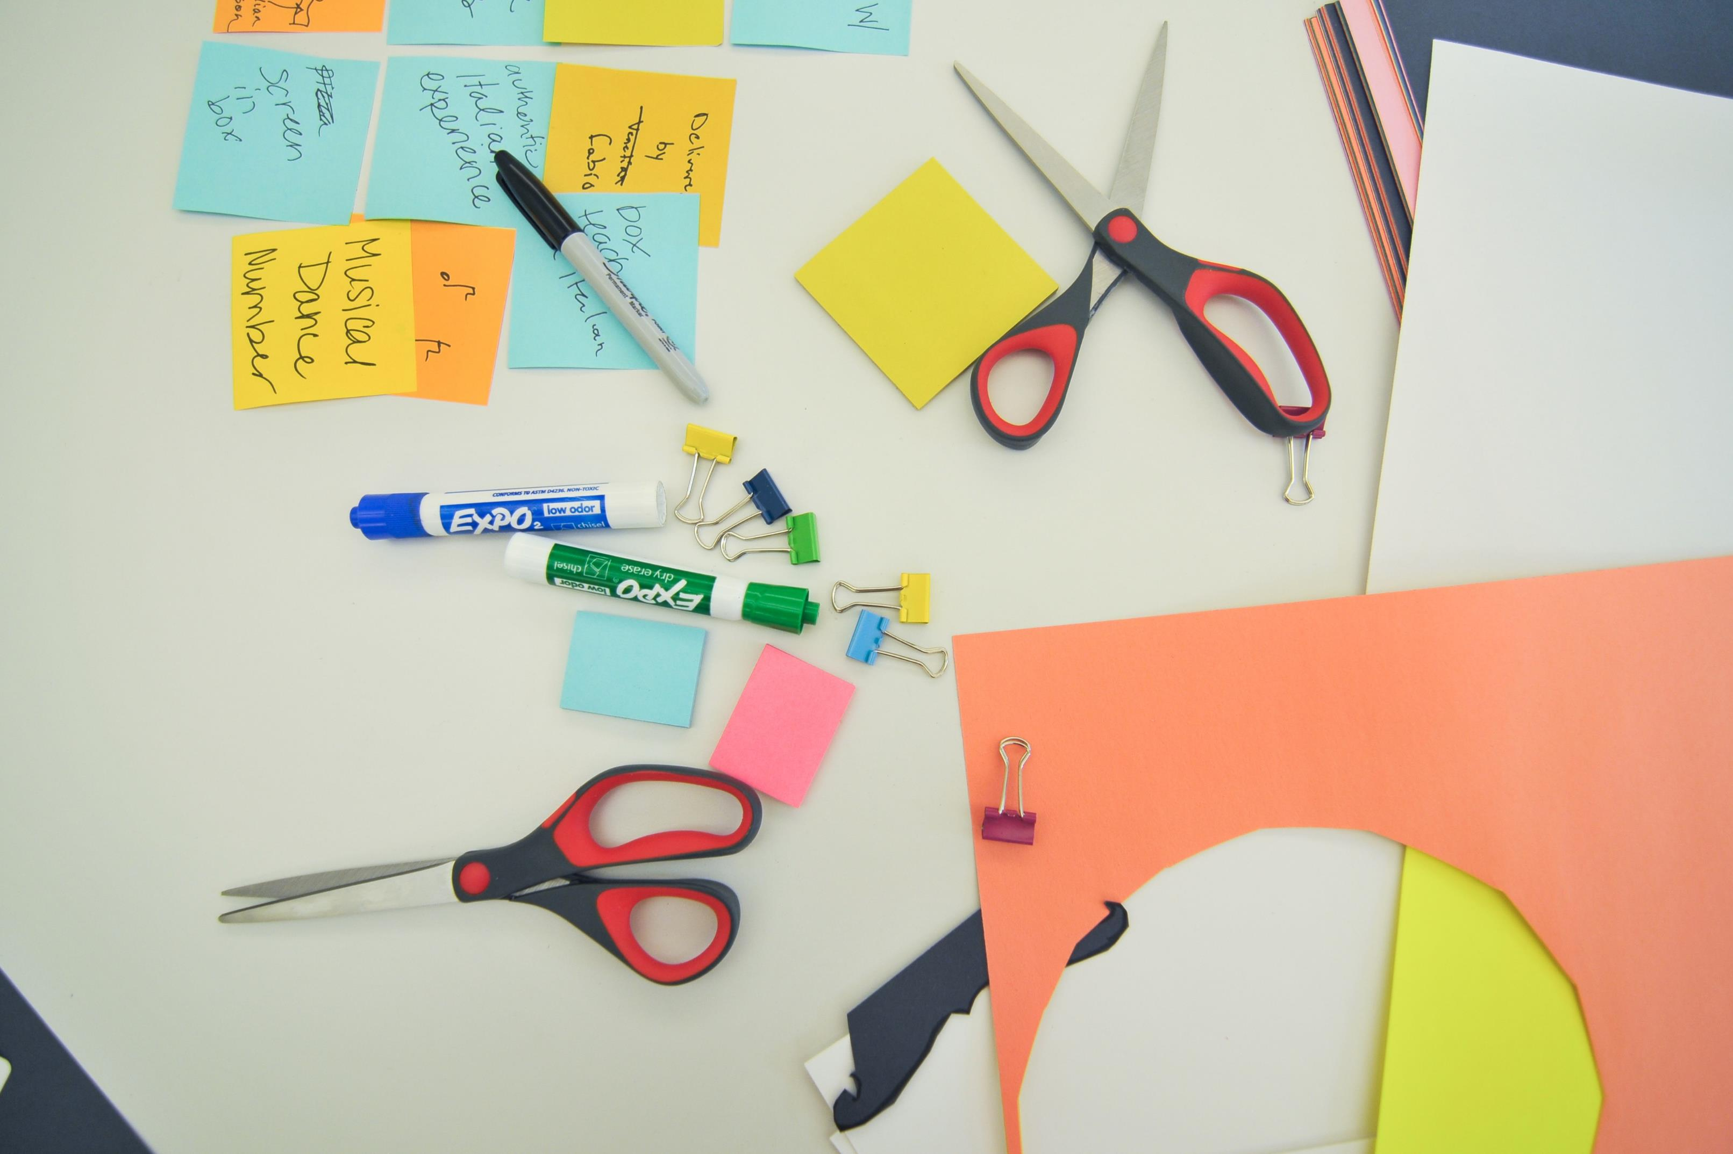
Thank You!

